Slide 1


Slide 2


7S
7A
7I
Welcome to Saint Benedict CVA
New Year 7
7N
7T
7B
7E
7D
7C
7O
Notes:
Welcome
Learning
Inclusion
Rosary
Diversity
Belonging
Giving
Relationships
Kingdom
Youth
Hope
Peace
Joy
Love

Slide 3
7S
7A
7I
7N
7T
7B
7E
7D
7C
7O
Notes:
Welcome
Learning
Inclusion
Rosary
Diversity
Belonging
Giving
Relationships
Kingdom
Youth
Hope
Peace
Joy
Love

Slide 4
7S
7A
Mr Robinson Miss Ellis
7I
7N
7T
Head of Year/PE Teacher
7B
7E
7D
Pastoral Support Assistant PSA
7C
7O

Slide 5

7S
7A
7I
7N
7T
7B
7E
7D
7C
7O

Slide 6
7S
A typical day...
7A
7I
7N
Timetable: Week A/Week B
Form Time: 08:40- 09:00
Period 1: 09:00-10:00
Period 2: 10:00-11:00
Morning Break: 11:00-11:20
Period 3: 11:20-12:20
Period 4: 12:20-13:20
Lunch: 13:20-14:00
Period 5: 14:00-15:00
7T
Timetable: Week A/Week B
25 lessons a week
2 week timetable
5 tutor/form times
Celebration of the word
7B
7E
7D
7C
7O

Slide 7
7S
Tutor time
7A
7I
7N
10 Forms
All have an individual form tutor
Form tutor is first point of contact for pupils
Build a sense of belonging as a form
7T
7B
7E
7D
7C
7O
Notes:
Welcome
Learning
Inclusion
Rosary
Diversity
Belonging
Giving
Relationships
Kingdom
Youth
Hope
Peace
Joy
Love

Slide 8
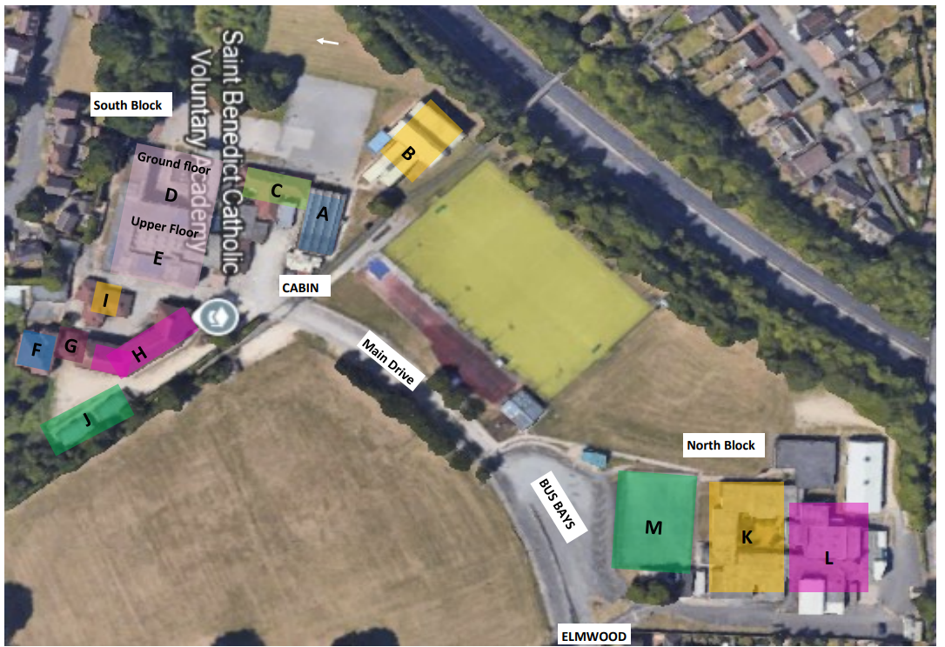
7S
Saint Benedict Site Map
7A
7I
7N
7T
7B
7E
7D
7C
7O
Notes:
Welcome
Learning
Inclusion
Rosary
Diversity
Belonging
Giving
Relationships
Kingdom
Youth
Hope
Peace
Joy
Love

Slide 9
7S
Transport to and from school
7A
7I
7N
7T
School Bus
Parents/Guardians drop off
Walk
Bike
Public Bus
Taxi
7B
7E
7D
7C
7O
Notes:
Welcome
Learning
Inclusion
Rosary
Diversity
Belonging
Giving
Relationships
Kingdom
Youth
Hope
Peace
Joy
Love

Slide 10
7S
Uniform
7A
7I
7N
Blue Blazer
White shirt
Grey jumper (optional)
Yellow Tie
Grey trousers
Black shoes (No trainers)
7T
7B
7E
7D
7C
7O
Notes:
Welcome
Learning
Inclusion
Rosary
Diversity
Belonging
Giving
Relationships
Kingdom
Youth
Hope
Peace
Joy
Love

Slide 11
7S
Beyond the classroom provision
7A
7I
7N
Every Tuesday, Wednesday, and Thursday 3-4:15pm
Sports clubs.
Drama.
Music.
Cooking.
Debate club.
Chaplin.
Library and games.
Many more.
7T
7B
7E
7D
7C
7O
Notes:
Welcome
Learning
Inclusion
Rosary
Diversity
Belonging
Giving
Relationships
Kingdom
Youth
Hope
Peace
Joy
Love

Slide 12
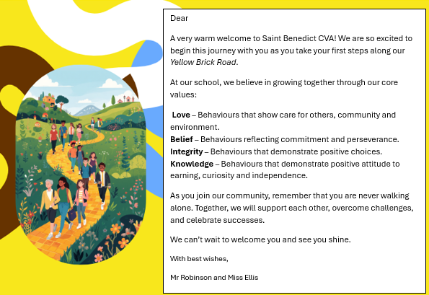
7S
School expectations
7A
7I
7N
7T
7B
7E
7D
7C
7O
Notes:
Welcome
Learning
Inclusion
Rosary
Diversity
Belonging
Giving
Relationships
Kingdom
Youth
Hope
Peace
Joy
Love

Slide 13
7S
Set Your Bar High
1. BE THERE, BE READY​​
2. BE ENGAGED, BECURIOUS​​
3. BE POLITE, BE KIND​​
4. BE RESILIENT, BE BRAVE​
​
7A
96%
7I
7N
#EverydayMatters
7T
7B
7E
7D
7C
7O

Slide 14
7S
7A
In our classrooms​ | In our interactions​ | In our recognitions​
Be Ready = Knowledge​ Be Respectful = Love​ Be Responsible = Integrity​ Be Resilient = Belief ​ ​ Consistent Language ​ Are we ready to learn?​ Are we being respectful?​ Are we acting with integrity?​ Let us learn together ​ ​ Reminder: “Remember, here we act with integrity.”​ Redirection: “Right now, I need you show respect and focus on your work.”​ Choice: “You can choose to reset and show belief in your learning.”​ Reflection: “Which of our values was missing in that moment?”​ Positivity reinforcement & Education before use of C system​ | Consistent language –before every choice ask:​ ​ Is it loving?​ Does is show belief?​ Does it build knowledge?​ Does it show integrity?​ ​ Engage students to reflect on behaviour and bring back to our shared values.​ ​ =Identify, belonging, collective responsibility.​ ​ | FIRE Points (reward system)​ ​ Love​ Belief ​ Knowledge​ Integrity​ ​ “Who set the world on fire this week?”​ -Celebration assemblies ​ -Achievement certificates, rewards & Awards​ ​ Consistent language through verbal praise​ “That showed real integrity.”​ ​ ​ #SetTheWorldOnFire
7I
7N
7T
7B
7E
7D
7C
7O
Notes:
Welcome
Learning
Inclusion
Rosary
Diversity
Belonging
Giving
Relationships
Kingdom
Youth
Hope
Peace
Joy
Love

Slide 15
7S
Break and Lunchtime at Saint Benedict.
7A
7I
7N
7T
Bring your own food.
Buy food from the dinning hall.
The choice is yours you can change your mind every day school dinners one day packed lunch the next.
We are a cashless school.
7B
7E
7D
7C
7O
Notes:
Welcome
Learning
Inclusion
Rosary
Diversity
Belonging
Giving
Relationships
Kingdom
Youth
Hope
Peace
Joy
Love

Slide 16
7S
Homework
7A
7I
All homework is set on Arbor
You will have homework to complete in all subjects about 1 to 1.5 hours a day.
There is a study club if you need support which runs Tuesday, Wednesday, and Thursday after school
Homework is compulsory so you must ensure it is completed to the best of your ability and submitted on time.
7N
7T
7B
7E
7D
7C
7O
Notes:
Welcome
Learning
Inclusion
Rosary
Diversity
Belonging
Giving
Relationships
Kingdom
Youth
Hope
Peace
Joy
Love

Slide 17
7S
Transition Days
7A
7I
7N
^{7th 8th 9th July}
7T
7B
7E
7D
7C
7O

Slide 18
7S
7A
Any questions?
7I
7N
7T
7B
7E
7D
7C
7O
Notes:
Welcome
Learning
Inclusion
Rosary
Diversity
Belonging
Giving
Relationships
Kingdom
Youth
Hope
Peace
Joy
Love

