Slide 1
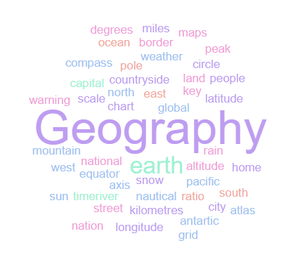
Geography Homework Booklet
Year 7 : The UK
Name:
Class:
Teacher:
Homework Expectations:
You must keep this booklet neat and presentable
All homework must be completed for the date set
High effort is expected in all tasks
You will boost all work in red pen

Slide 2
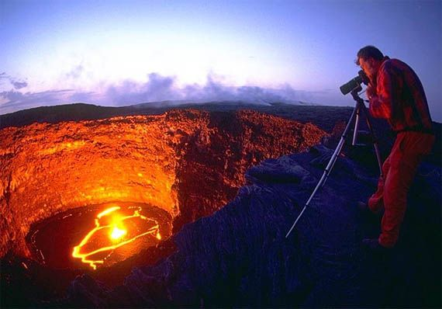
Year 7 Weekly Homework 1.1 What is Geography ? Task : Read the article and answer the questions on the next page
Geography is the study of the earth. The word ‘geography’ comes from the latin ‘geo’ which means earth and the word ‘graphia’ which means to describe or write.
Geography helps us to makes sense of the incredible world upon which we live. There are generally three broad types of geography. One type of geography is physical geography, which involves studying what our planet is like and investigating the natural processes that shape our earth. Physical geography includes studying: rivers, oceans, ice, weather, natural environments and coasts
A second type of geography is human geography. Human geographers study how and where people live and how human processes shape our planet. Human geography includes studying: settlement, development, tourism, industry and globalisation.
The final type of geography is environmental geography. Lots of geographers are environmental geographers because this involves human and physical geography,
It looks at how humans and the environmental interact and can involve studying climate change and resources.
So what makes a good geographer?
A good geographer investigates and understands how the three different types of geography shape the world in which we live. They also develop an excellent knowledge of where places are in the world and they are linked. Superb geographers ask great questions and use a wide range of geographical skills to investigate places.
It has never been more important to study geography. The famous actor and travel writer Michael Palin believes that ‘geographers hold the key to the world’s problems and that so many of world’s current issues – at a global and local scale – boil down to geography. Geographers of the future will help us to understand global warming as it affects countries and regions, food and energy security, the spread of disease and the economic change on places and communities’.
So where can studying geography take me?
People who study geography, especially if they study a geography degree at university, are highly employable. Geographers have a really impressive range of skills, knowledge and understanding which opens up a world of opportunities. Geographers can be employed as: volcanologists (experts who study volcanoes), seismologists (experts who study earthquakes), weather forecasters, oceanographers (experts who study oceans), marine biologists (scientists who study plants and animals in oceans),, city planners and in charities working to help deliver aid to some of the world’s poorest people.

Slide 3
What is Geography ? ______________________________________________________________________________
What word in Latin does Geography come from ? _______________________________________________________
What does ‘Physical’ geography involves studying ? ______________________________________________________
Give 3 examples of Physical Geography 1. _____________________________________________
                2. _____________________________________________
                3. _____________________________________________
What does ‘Human’ geography involve studying ?
Give 3 examples of human geography 1. _____________________________________________
                2. _____________________________________________
                3. _____________________________________________
Why are lots of Geographers environmental geographers ? _______________________________________________
What makes a ‘superb’ geographer ? ________________________________________________________________
Give 2 examples of job opportunities for Physical geographers 1. _______________________________________
                2. _______________________________________
Give 2 examples of job opportunities for human geography 1. _______________________________________
2. ______________________________________

Slide 4
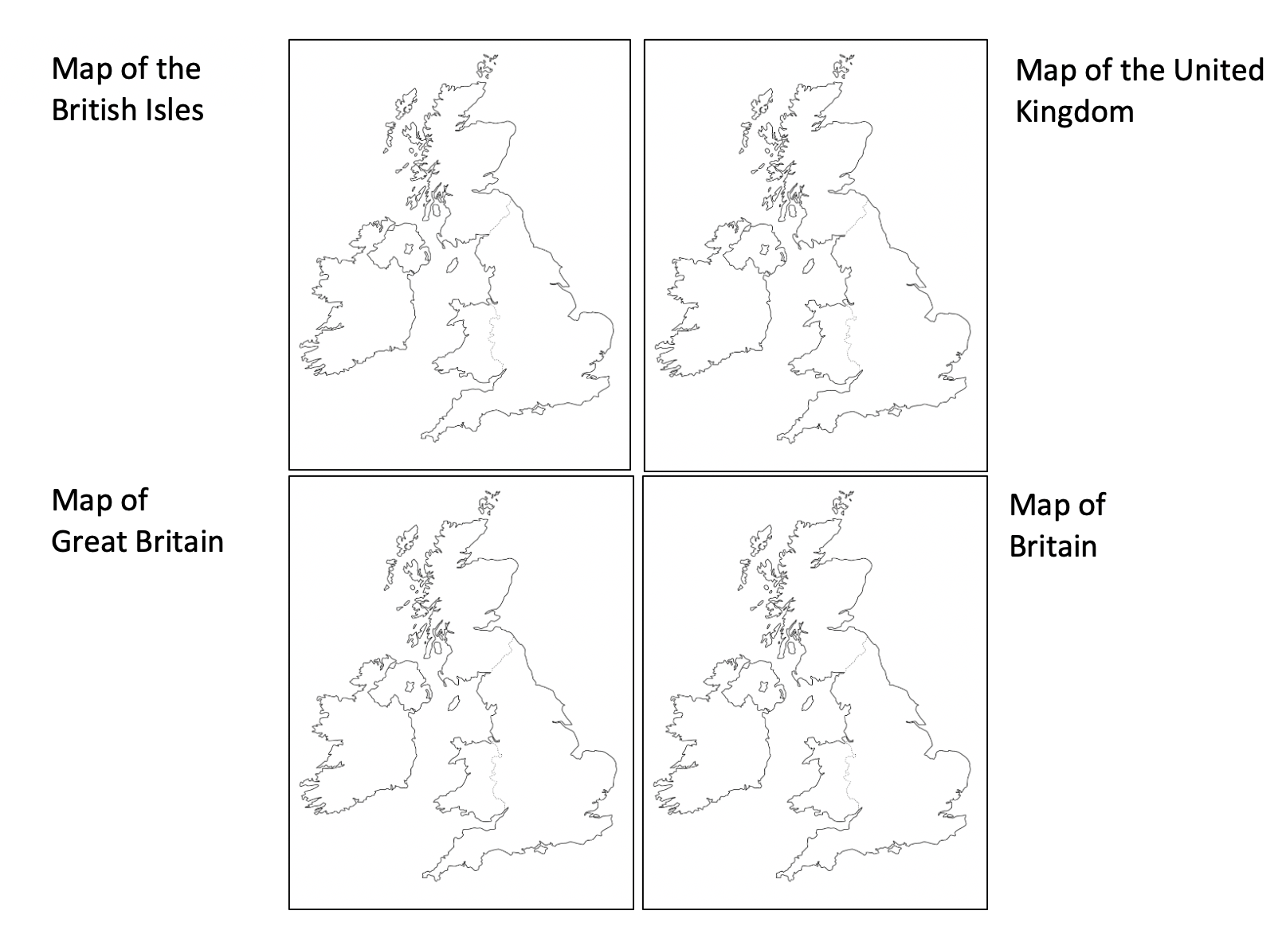
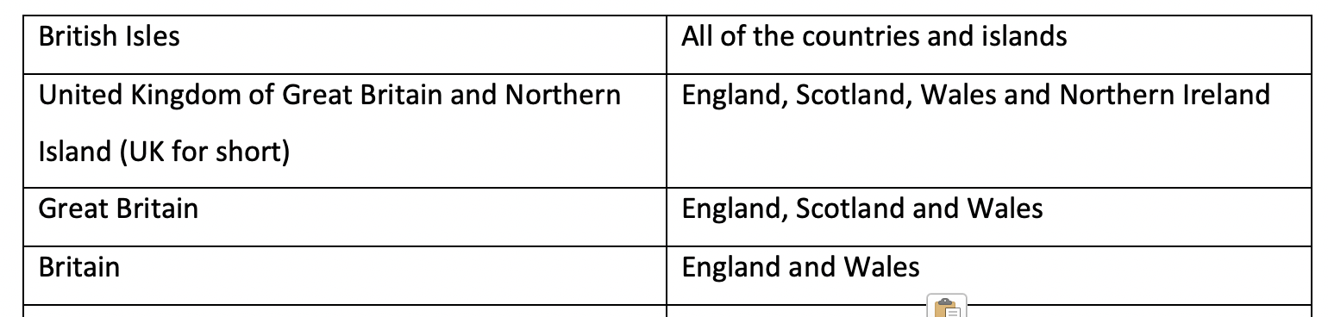
Year 7 Weekly Homework 1.2 What is the UK ? KB Page 14
Task 1.
The 4 countries that make up the UK are
________________________
________________________
________________________
________________________
b) The capital city of Scotland is _________________.
c) The capital city of Wales is ______________________.
d) The sea off the east coast is __________ __________.
e) The ocean to the west is __________________ Ocean.
Task 2.
Read P14 in your KB. It describes the difference between the British Isles, the United Kingdom, Great Britain and Britain.
Use that knowledge and the information below to shade in the correct parts of the maps on the right.

Slide 5
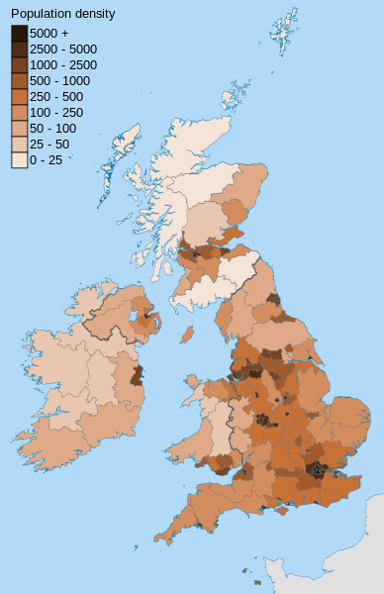
Year 7 Weekly Homework 1.3 Population Distribution in the UK ? KB Page 15
1. Fill in the key terms and definitions for the following:
2. Draw an image/ icon for the following key terms:
3. Use compass points to describe the population distribution in the UK ( 3 )
Key Term | Definition
 | A small amount of people in a given area.
Densely Populated
Population Distribution
 | The number of people living in a given area, usually within 1km²
N
____________________________________________________________________________________________________________________________________________________________________________________________________________________________________________________________________________________________________________
_________________________
_________________________
_________________________
Sparsely Populated
Densely Populated

Slide 6
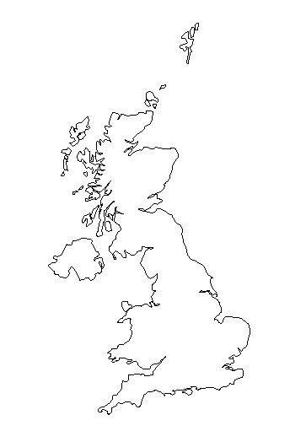
Year 7 Weekly Homework 1.4 Population in the UK KB: page 15
1. Are these statements TRUE or FALSE? Britain consists of England and Wales: __________________ The capital city of Northern Ireland is Dublin: __________________ The countryside is more densely populated than cities: __________________ Wales is located west of England: __________________ Ireland is located south east of Scotland: __________________ The British Isles consists of two large islands: __________________ London, Cardiff and Belfast are densely populated: __________________ | 3. Answer the following questions: Why are some places densely populated? Why are some places sparsely populated? What is a choropleth map?
2a. Shade in the population distribution of the UK: 2b. Name one ‘crowded’ place in the UK. ________________________________________ 2c. Name one ‘medium populated’ place in the UK. ________________________________________ 2d. Name one place in the UK with ‘few people’. ________________________________________ | 4. Connect these words (you must make at least 4 connections):
Key:
Crowded
Medium
Few People
Cities
Densely Populated
Snowdonia National Park
Sparsely Populated
Countryside
London

Slide 7
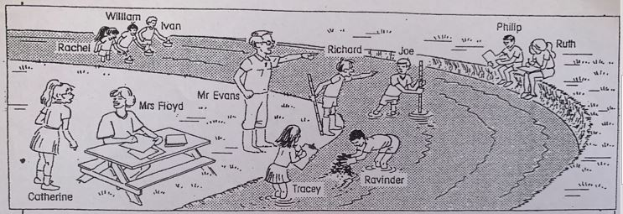
Year 7 Weekly Homework 1.5 River Meanders. KB Page 19
The drawing above shows some of year 8 from Riverside School on a geography visit
Rachel, William and Ivan are using floats to measure the speed of the river current. Whose float will travel fastest ? Explain your answer.
Paige and Ruth are drawing a field sketch of the area. Mr Evans has seen where they are sitting and is telling them it is dangerous. Why is the river bank so dangerous at this point ?
Richard and Joe are measuring the depth of the river. Richard says Joe will e able to keep his trousers dry as he goes across because the water is shallower on the other side. Is it ? Explain your answer
Catherine has told Mrs Floyd that in a few years time the river will have eroded away the land where the picnic table is. Is she right ? Explain your answer .

Slide 8
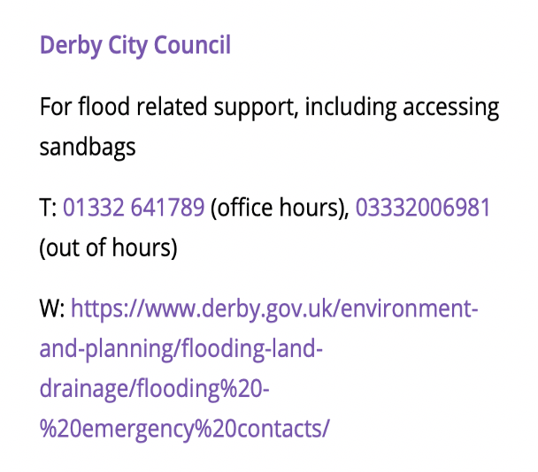
Year 7 Weekly Homework 1.6 The 2019 Flood in Derby. Task : Read the article and answer the questions on the next page
Flooding caused problems across Derby and Derbyshire yesterday as heavy rain again hit the area.
A months worth of rain fell in a day. A woman was swept away when wading through fast moving floodwater and found dead later the same day.
During a visit to Matlock, Boris Johnson, the British Prime minister said the floods were “not like something we need to escalate to the level of a national emergency”
A number of carparks at Chatsworth House, were closed with access to the Christmas market restricted. The flooding also led to the closure of the Hope valley train service from Sheffield to Manchester. Evening lectures at the university of Derby were cancelled.
Five schools announced that they would be closed.
The flooding meant that drivers faced difficult conditions on the roads, as standing water affected motorists travelling in Markeaton Lane and Raynesway in Derby, and on the Pektron roundabout , near Breadsall.
Road closures were in place in Mackworth, Ilkeston and Borrowash.
City Council
We are saddened to hear about the Derbyshire and Derby floods
this weekend.
We know that our homes are often our sanctuaries and
understand the impact an event like this can have.
Support is available for anyone affected by the floods.
We are also here to offer emotional support.
For further details about financial / practical support,
use the contact details on the right
Timeline 8/11/2019
1.30 pm
Flood gates have closed and road closures are in place. Please follow diversion signs
2.46pm
The underpass heading into St. Alkmunds way has standing water and is unpassable
3.45om
Derby bus station is currently being evacuated. We are gritting the whole network of Derby roads this evening as the temperature is expected to go below freezing. Additional salt is being added to prevent surface water freezing. Do not travel to known flooded areas.
6.35pm
Traffic is very heavy and there are major delays on all routes. We are working hard to manage the travel flow. Please only travel if necessary. There are no buses travelling into Derby.
7.35pm
The A52 in closed inbound from J25 due to flood water. Trent Barton has suspended all bus services
10.15pm
We are aware of the power shortage in the city centre and we are visiting affected residents and many have chosen to go to stay with friends or family

Slide 9
1. How much rain fell ? ___________________________________________________________
2. How many people died ? _______________________________________________________
3. How was Chatsworth House affected? _____________________________________________________________________________
4. Which types of Transport were affected by the floods ? ________________________________________________________________
5. Why would drivers find it difficult in the Rain ? ______________________________________________________________________
6. What happened at 1.30 ? _______________________________________________________________________________________
7. Why were the roads being gritted ? Why was ‘extra salt’ being added ? __________________________________________________
____________________________________________________________________________________________________________
____________________________________________________________________________________________________________
8. What support was being offered by Derby council and Derbyshire Council ? _______________________________________________
____________________________________________________________________________________________________________
___________________________________________________________________________________________________________
9. What was your families experience of the floods of 2019 ?Ask your parents if you cannot remember them.
____________________________________________________________________________________________________________
____________________________________________________________________________________________________________
_____________________________________________________________________________________________________________

Slide 10
Year 7 Weekly Homework 1.7 Global Imports and Exports. KB Page 27
Task 1. Complete the paragraph below using the words from the box.
You can use the words more than once.
Imports exports interdependent raw materials trade
The word used to describe buying, selling and swapping goods and services is ……………….. . It can happen at different scales. Two people might swap Pokemon cards, while large countries exchange different goods.
Countries …………………… for lots of reasons. They might not have the ……………………………. they need, or the climate might not be ideal, or they might not have the right skills to manufacture a product.
Raw materials, goods and services that a country buys are called …………………… . Raw materials goods and services that a country sells are called …………………………..….. . Countries that trade goods and services with each other are called …………………………..…………… .
Task 2 : Use your Knowledge book P25 in order to answer the following questions
1. What is a countries ‘balance of trade’ ? _____________________________________________________________________________
2. A country is making a ______________ if it earns more from exports than it pays for imports and a loss if it does not.
3. The UK is the 6th / 9th / 14th largest economy in the world
4. Examples of the types of products we import are ___________________________________________________________
5. Examples of the types of products we export are ___________________________________________________________

Slide 11
Year 7 Weekly Homework 1.8 Why did Toyota locate in Derbyshire ? KB Page 26
Why did Manufacturing in the UK decline ? ______________________________________________________________________________________
What type of industries declined ? _____________________________________________________________________________________________
Derby had to ‘sell’ themselves to Toyota, and explain to them why Burnaston was the best site for the Toyota plant. Transform the ‘selling points’ of Burnaston below into images to help you to remember them
Derbyshire has a strong history of manufacturing with large multinational companies such as Rolls Royce
B. A highly skilled and flexible workforce
C. Derbyshire is a central UK county
E. Excellent transport links. The Burnaston site crosses the A38 and the A50 roads.
D. The Burnaston site is 600 acres and is relatively flat and was a disused airfield

Slide 12
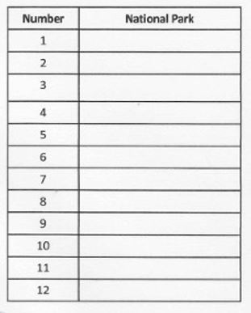
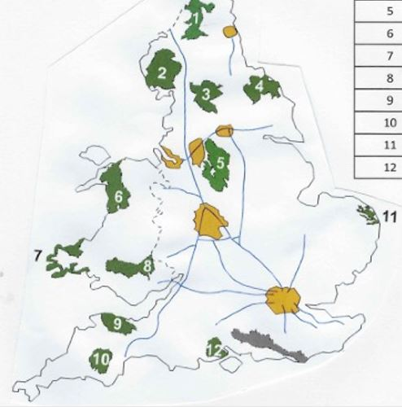
Year 7 Weekly Homework 1.9 What is a National Park ? KB Page 22
Task 1 : Use P22 of your knowledge book to label the National Parks correctly in the table to the right
Task 2 : What is a National Park ?
________________________________________________________________________________________________________________________
Task 3 : When was the first national Park created ? ___________________
Task 4 : What is the closest National Park to Derby ? _____________________

Slide 13
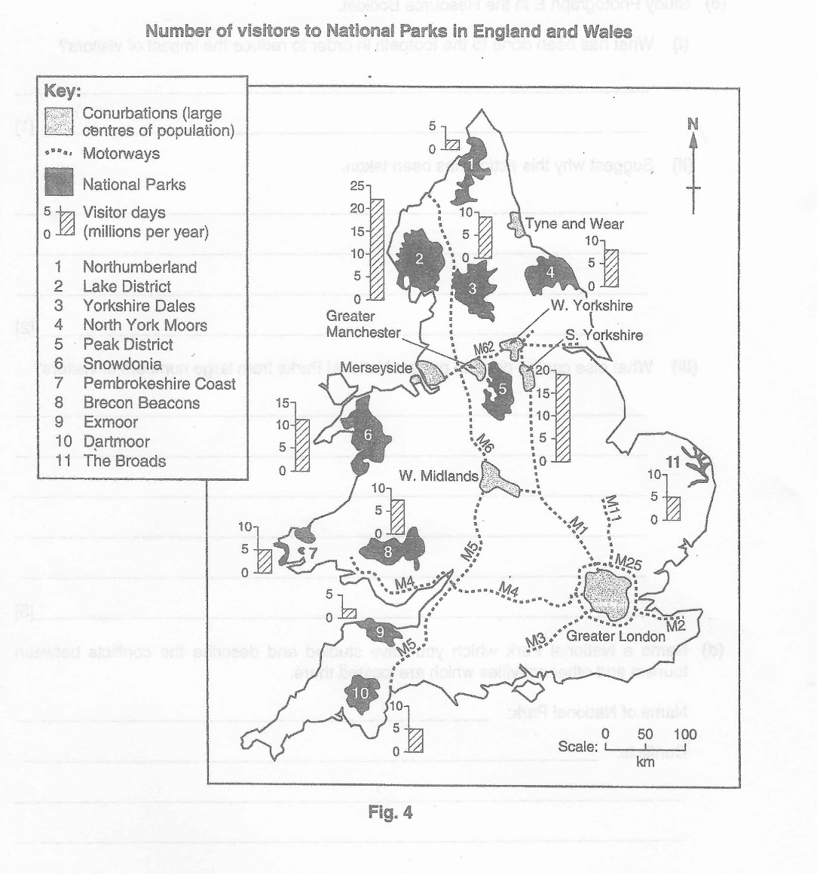
Year 7 Weekly Homework Autumn 1.10 Conflict in National Parks
Use Figure 4 in order to help you to answer the questions on the next page.

Slide 14
Year 7 Weekly Homework 1.10 Continued Conflict in National Parks
Task 1 : Which two of the following statements about National Parks are correct ? Put a circle around the two numbers you choose
National Parks contain areas of Mountains, Lakes and coasts.
When National Parks are full, the wardens close the gates to stop more visitors going in.
Shops, factories and hotels are banned in National Parks
It is free to go into National Parks
Task 2 : Study Figure 4 on the opposite page. Which National Park is located west of the M6 and North of the M62 ? __________________________
Task 3 : Complete the table below by putting in the missing National Park
Task 4 . Suggest two reasons why the Peak District has more visitors than the broads
__________________________________________________________________________________________________________
2. ___________________________________________________________________________________________________________
National Park | Visitor Days ( millions per year )
Lake District | 22
 | 11
North York Moors | 8
 | 2

Slide 15
Questions to ask:
Notes:
___________________________________________________________________________________________________________________________________________________________________________________________________________________________________________________________________________________________________________________________________________________________________________________________________________________________________________________________________________
___________________________________________________________________________________________________________________________________________________________________________________________________________________________________________________________________________________________________________________________________________________________________________________________________________________________________________________________________________

Slide 16
Questions to ask:
Notes:
___________________________________________________________________________________________________________________________________________________________________________________________________________________________________________________________________________________________________________________________________________________________________________________________________________________________________________________________________________
___________________________________________________________________________________________________________________________________________________________________________________________________________________________________________________________________________________________________________________________________________________________________________________________________________________________________________________________________________

