Slide 1
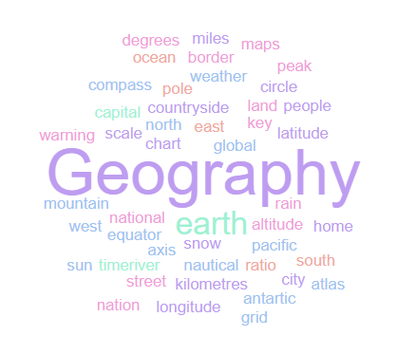
Geography Homework Booklet
Year 7 Spring: Russia
Name:
Class:
Teacher:
Homework Expectations:
You must keep this booklet neat and presentable
All homework must be completed for the date set
High effort is expected in all tasks
You will boost all work in red pen

Slide 2
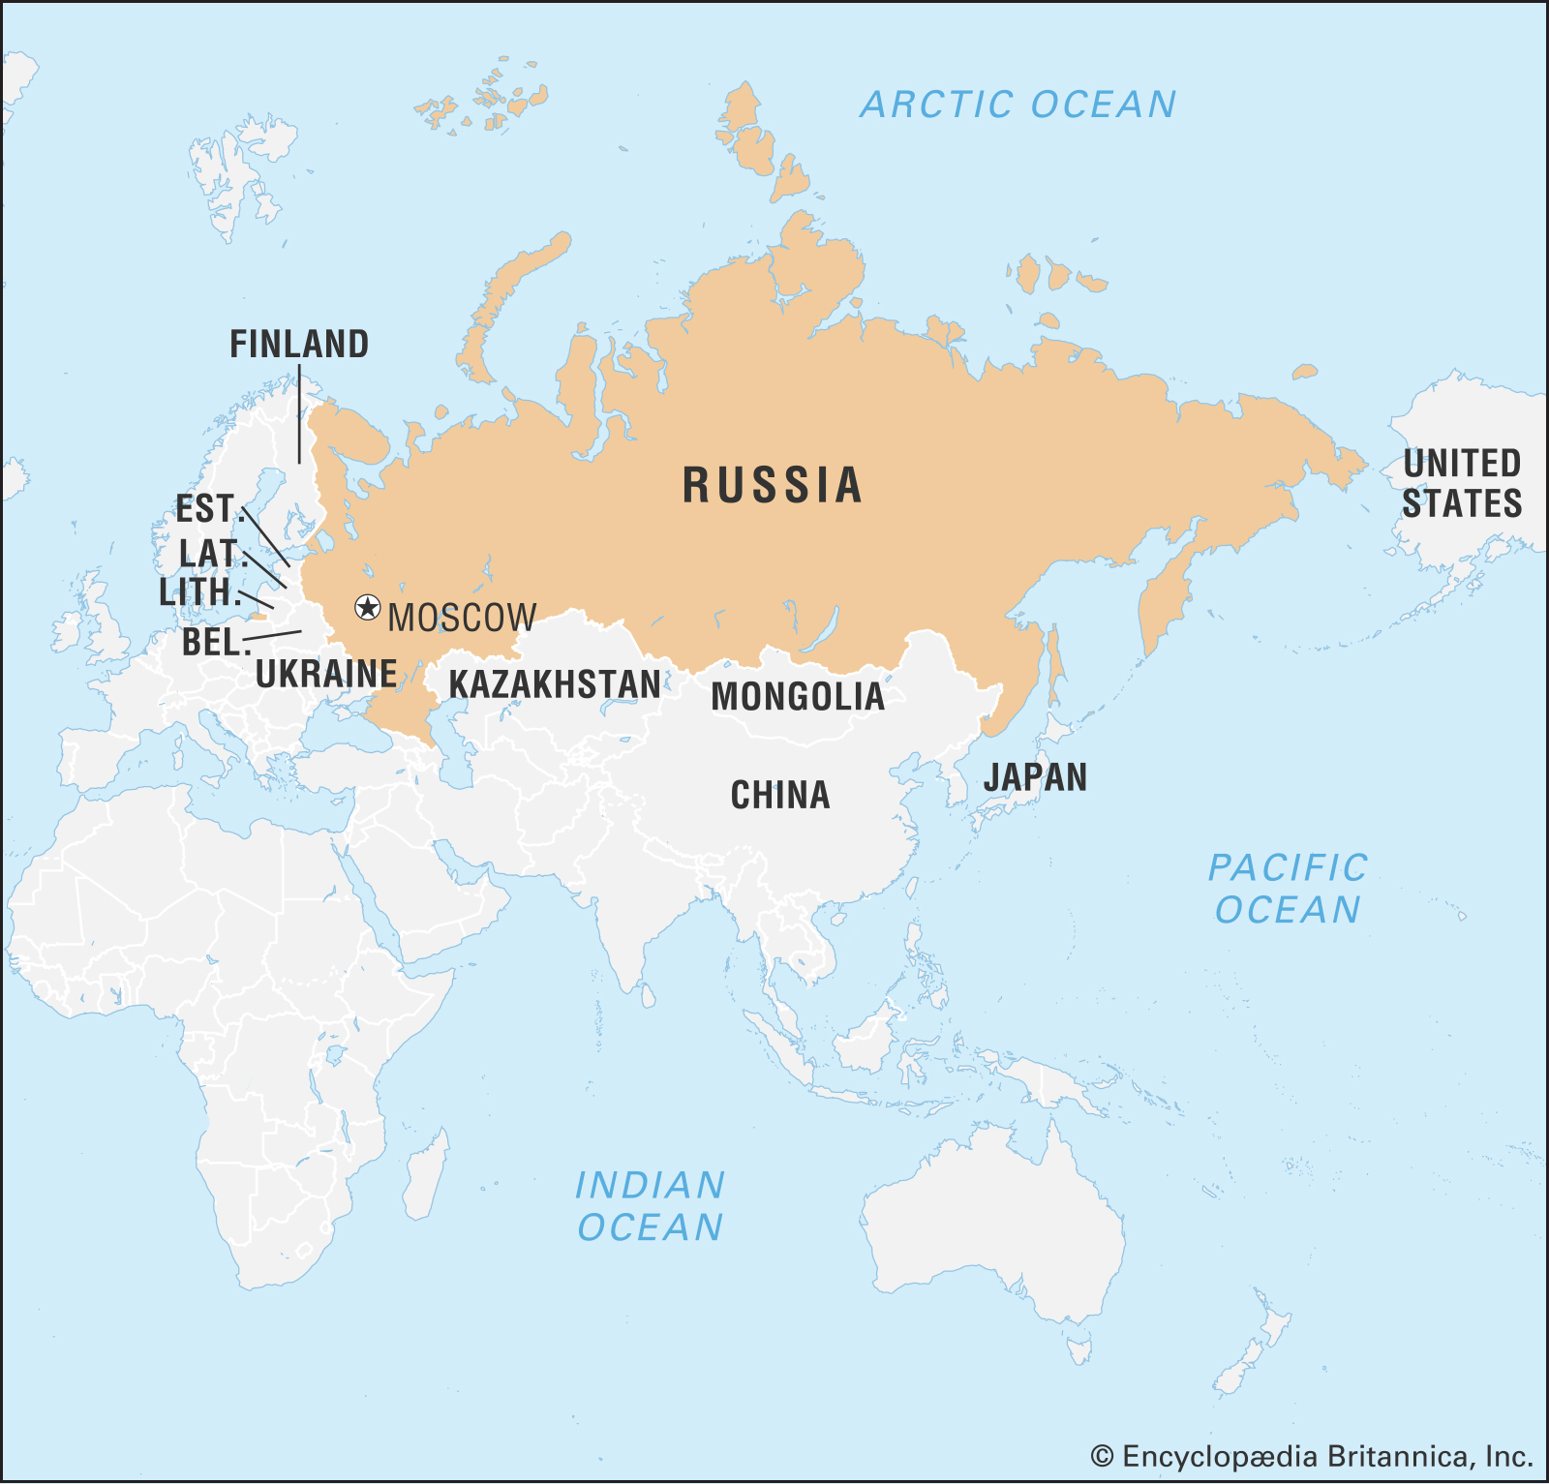
Year 7 Weekly Homework Spring 1.1 Physical Features of Russia Knowledge Book: P49-50
1. Are these statements TRUE or FALSE? Russia is the largest country on Earth: _______________________ It covers 1/5 of all land on Earth: _______________________ It has a population of 1.4 billion: _______________________ 20% of the worlds forests are found there: _______________________ The capital city is Moscow: _______________________ Russia is mostly located in Europe: _______________________ It’s surrounded by the Arctic and Pacific Ocean: _______________________ | 3. Describe the location of Russia using the map below [4 marks]:
2. Answer the following questions using P49-50 in your KB: What mountain range is found in Russia? How tall is Mount Elbrus? Across how many time zones does Russian span? Which two continents is Russia located in? Why can’t Russia use its coastal ports all year round?
N
__________________________________________________________________________________________________________________________________________________________________________________________________________________________________________________________________________________________________________________________________________________________________________________________________________________________________________________________________

Slide 3
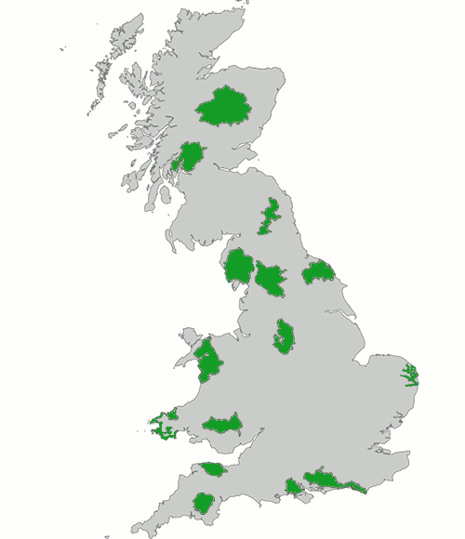
Year 7 Weekly Homework Spring 1.2 Recap: The UK’s National Parks Knowledge Book: P21-23
Answer the following questions: What is a national park? In what year was the UK’s first national park established? What is the name of the UK’s first national park? Who manages the national parks? e) How many national parks are there in England and Wales? | Explain two reasons why the tourism numbers in national parks have increased:
2. Identify the UK’s national parks: | 4. Tick the correct box for which the following statements are true:
Statement | Limestone | Gritstone
This rock is also referred to as the ‘White Peak’
This rock is soluble so it can be dissolved
This rock is also referred to as the ‘Dark Peak’
Intricate cave systems have been carved out of this rock type
This rock is insoluble
This rock supports the heather moorland and bog environments
These areas are intensively farmed with sheep and dairy usage
1- Cairngorms
2- Loch Lomond and the Trossachs
3-
4-
5-
6-
7-
8-
9-
10-
11-
12-
13-
14-
15-
1
2
3
5
6
4
9
7
8
10
11
12
15
13
14

Slide 4
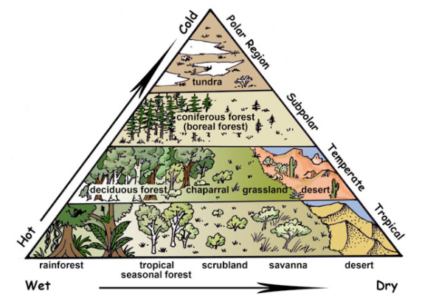
Year 7 Weekly Homework Spring 1.3 The Biomes and Climate of Russia Knowledge Book: P51, P56
1. Label ‘North-East Russia’ and ‘Central Russia’ onto the climate diagram: | 2. P56: Make links between the words – explain at least 4 links you make
Answer the following questions: What are the two main biomes that exist in Russia? TRUE or FALSE: Russia experiences high volumes of rainfall throughout the year? In January, what are the temperatures in West Russia like, compared to the temperatures in East Russia? What percentage of the worlds conifers are found in Russia? | 4. Tick the correct box for which the following statements are true:
Tundra
Seasons
Plants include: fungus, grasses and shrubs. They grow low to the ground to protect themselves from the cold and wind
Plants/ Vegetation
Taiga
Russia
Statement | Tundra | Taiga
Plants including: fungus, grasses and shrubs grow here
Found in the northern hemisphere
Coniferous forests grow in this biome
Located mostly in northern Russia
Largest biome in Russia
This biome experiences very cold temperatures

Slide 5
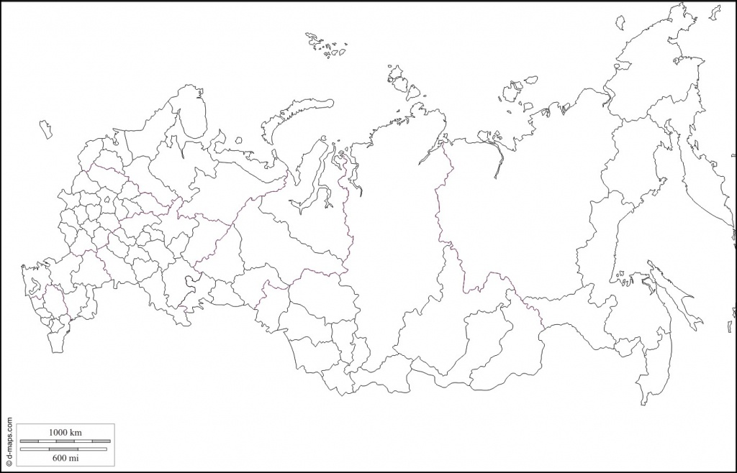
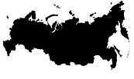
Year 7 Weekly Homework Spring 1.4 Russia’s Population Knowledge Book: P57
1. Fill in the key terms and definitions for the following: | 3. Look at the reasons for population density on P57, sort them into reasons for a sparse population and reasons for a dense population. Can you add any of your own?
2. Draw an image/ icon for the following key terms: | 4. Create your own choropleth map by shading in the population density of Russia. Use a pencil and REMEMBER your key!! (The black shading already on the map is Moscow)
Key Term | Definition
 | A small amount of people in a given area.
Densely Populated
Choropleth Map
 | The number of people living in a given area, usually within 1km²
Reasons for a dense population | Reasons for a sparse population
Rich soil for farming
Densely Populated
Medium Populated
Sparsely Populated
Choropleth Map
Densely Populated

Slide 6
Year 7 Weekly Homework Spring 1.5 Russia’s Economy Knowledge Book: P58
Fill in the definitions for the following key terms: 2. Using a protractor and a pencil, complete the pie chart to show Russia’s economy by marking on the degrees: | 3. Around the mind-map, label all of the natural resources available in Russia:
 | 4. Answer the following questions: What percentage of the worlds natural gas comes from Russia? What mode of transport does Russia mostly use to transport goods? What is the name of Russia’s capital city? Why are Russian roads in poor condition? Why do you think Russia struggles to move goods from the East to the West?
Key Term | Definition
Primary Sector
Secondary Sector
Tertiary Sector
Coal
Natural Resources in Russia
Primary: 9.4% (34°)
Secondary: 27.6% (99°)
Tertiary: 63% (227°)

Slide 7
Year 7 Weekly Homework Spring 1.6 Recap: UK Trade Knowledge Book: P24-25
Decide whether the following statements are TRUE or FALSE: Manufacturing in the UK has declined ________________ Iron, steel, ship building and textiles are still big business in the UK ________________ Toyota has 1 plant/site in the UK ________________ In 1992 the first car drove off the production line at Burnaston _______________ Derbyshire is a central county in the UK _______________ The government is dissuading (putting off) foreign industries _______________ Burnaston is a 60 acre site ________________ A lack of trade and industry has led to unemployment ________________ | 3a. Use P25 to define the following key terms: Imports- Exports- 3b. Use ‘imports’ and ‘exports’ in a sentence: ________________________________________________________________________________________________________________________________________________________________________________________________________________________________________________________________________________________________________________ ____________________________________________________________________________
2. Explain two reasons why Toyota chose Burnaston: One reason Toyota chose Burnaston was __________________________________________ ____________________________________________________________________________ This means that… _____________________________________________________________ ________________________________________________________________________________________________________________________________________________________ Another reason Toyota chose Burnaston was _______________________________________ ____________________________________________________________________________ This means that… _____________________________________________________________ ________________________________________________________________________________________________________________________________________________________ | 4. Connect these words (you must make at least 4 connections):
Imports
Exports
The UK is the 9th largest exporter in the world. It’s main exports are: manufactured goods, oil, and machinery.
United Kingdom
Economy
Manufactured Goods
Trade

Slide 8
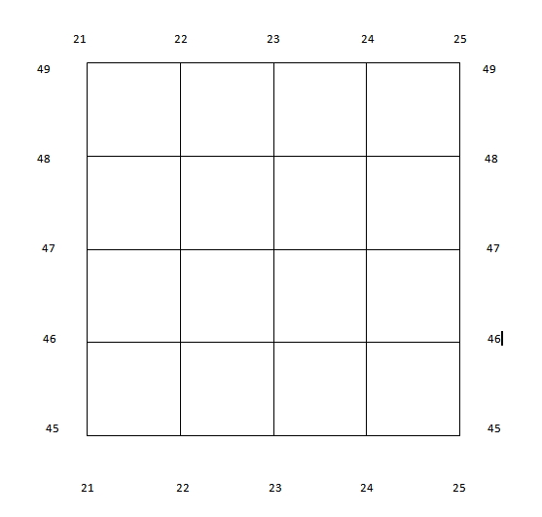
Year 7 Weekly Homework Spring 1.7 Map Skills: Grid References Knowledge Book P11
Complete the questions on 4 and 6 figure grid references:
4 Figure Grid References:
What is the 4 figure grid reference for the ? _______________________________
What is the 4 figure grid reference for the ? _______________________________
What is the 4 figure grid reference for the ? _______________________________
What is the 4 figure grid reference for the ? _______________________________
Which shape is found in grid reference 23,46? _________________________________
Which shape is found in grid reference 21,48? _________________________________
Which shape is found in grid reference 23,47? _________________________________
Draw a in grid reference 21,47
6 Figure Grid References:
What is the 6 figure grid reference for the ? _______________________________
What is the 6 figure grid reference for the ? _______________________________
What is the 6 figure grid reference for the ? _______________________________
What is the 6 figure grid reference for the ? _______________________________
Which shape is found in grid reference 225,468? ______________________________
Which shape is found in grid reference 248,488? ______________________________
Which shape is found in grid reference 212,452? ______________________________
Draw a in grid reference 236,453

Slide 9
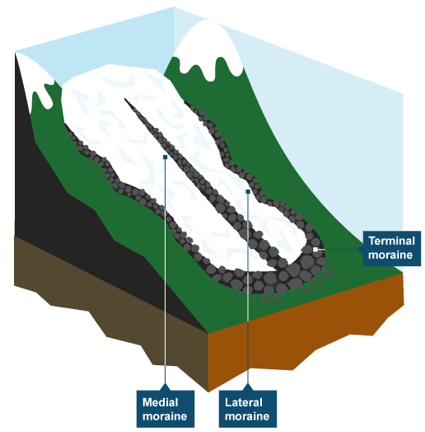
Year 7 Weekly Homework Spring 1.8 Glaciation in Russia Knowledge Book: P52-55
Fill in the definitions for these key terms: | 3. Use P55 to assist you labelling the four types of glacial moraine onto the diagram:
2. Read the last section on P52. Describe what ‘freeze-thaw weathering’ is, then draw an icon to help you remember: ___________________________________________ ___________________________________________ ___________________________________________ ___________________________________________ ___________________________________________ ___________________________________________ ___________________________________________ ___________________________________________ ___________________________________________ | 4. Decide whether the following statements are TRUE or FALSE: Glacier erode the land through ‘hydraulic action’ and ‘abrasion’ _______________ Glaciers are fast flowing rivers of ice _______________ A ‘U-Shaped Valley’ is a landform of erosion __________________ Drumlins are shallow at the upstream end and steep at the downstream end __________ Glaciers can transport material over long distances ______________ The heavy weight of glaciers causes them to move downhill ______________ All the glaciers that ever existed are now completely melted _______________
Key Term | Definition
Glacier
Abrasion
Till
Morraines
Erratics

Slide 10
Year 7 Weekly Homework Spring 1.9 Russia and the Arctic Knowledge Book: P60-61
New Survey of Arctic’s mineral riches could stoke international strife
The battle for the Arctic’s hidden mineral riches is likely to get worse after a survey revealing the energy reserves present beneath the ice.
A map of potential oil and gas reserves in the region, published today in Science Magazine, shows that about 30% of the world’s unexploited gas and 13% of oil, lie under the seas around the North Pole. Billions of barrels of oil and trillions of cubic feet of gas lie within the Arctic Circle, where, until now, permanent ice has prevented drilling. One-third of that oil and more than half of the gas is buried on an off Russia’s coastline.
The report is likely to further stoke international competition for mineral, tourism and shipping rights in the region. Exploration and drilling for oil and gas have become easier as warming temperatures melt the ice, and all countries with borders inside the Arctic Circle are fighting to claim their share. ‘For better or worse, limited exploration prospects in the rest of the world combined with technological advances make the Arctic increasingly attractive for development,’ said Paul Berkman of the Scott Polar Research Institute at the University of Cambridge.
Read the article (to the left) and answer the following questions:
Which two minerals have been discovered in the Arctic? _____________________________
What global percentage of these minerals lie in the Arctic? __________________________
_______________________________________________________________________________
Why is it now easier to access these two minerals in the Arctic? _______________________
_______________________________________________________________________________
_______________________________________________________________________________
Having read the article, why do you think Russia is keen to control the Arctic? Explain your reasons. ____________________________________________________________________
_____________________________________________________________________________________________________________________________________________________________________________________________________________________________________________
How could we put a stop to any conflict that may occur due to countries arguing over who should control the Arctic? ______________________________________________________
_____________________________________________________________________________________________________________________________________________________________________________________________________________________________________________

Slide 11
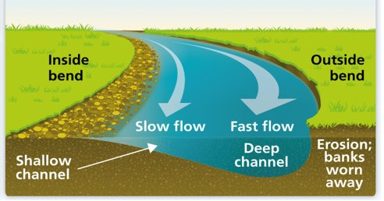
Year 7 Weekly Homework Spring 2.0 Recap: How does a Meander Form? Knowledge Book: P19
Use P19 to label the diagram below: | 3. Use P12 to define the following key terms: Erosion- ____________________________________________________________________ Deposition- _________________________________________________________________ 4. Use ‘erosion’ and ‘deposition’ in a sentence: ________________________________________________________________________________________________________________________________________________________________________________________________________________________________________________________________________________________________________________
2a. Describe the formation of river cliffs. ____________________________________________________________________________________________________________________________________________________________________________________________________________________________________ 2b. Describe the formation of slip off slopes. ____________________________________________________________________________________________________________________________________________________________________________________________________________________________________ | 5. Match the term to the definition
Key Term
Hydraulic Action
Abrasion
Attrition
Solution
Definition
Rocks carried by the river rub and scrape along the riverbed and banks, wearing them down.
Slightly acidic water dissolves certain types of rock.
The force of the river water compresses air into cracks along the river banks.
Rocks carried by the river collide with each other and break into smaller pieces.

Slide 12
Questions to ask:
Notes:
___________________________________________________________________________________________________________________________________________________________________________________________________________________________________________________________________________________________________________________________________________________________________________________________________________________________________________________________________________
___________________________________________________________________________________________________________________________________________________________________________________________________________________________________________________________________________________________________________________________________________________________________________________________________________________________________________________________________________

Slide 13
Questions to ask:
Notes:
___________________________________________________________________________________________________________________________________________________________________________________________________________________________________________________________________________________________________________________________________________________________________________________________________________________________________________________________________________
___________________________________________________________________________________________________________________________________________________________________________________________________________________________________________________________________________________________________________________________________________________________________________________________________________________________________________________________________________

Slide 14
Questions to ask:
Notes:
___________________________________________________________________________________________________________________________________________________________________________________________________________________________________________________________________________________________________________________________________________________________________________________________________________________________________________________________________________
___________________________________________________________________________________________________________________________________________________________________________________________________________________________________________________________________________________________________________________________________________________________________________________________________________________________________________________________________________

Slide 15
Questions to ask:
Notes:
___________________________________________________________________________________________________________________________________________________________________________________________________________________________________________________________________________________________________________________________________________________________________________________________________________________________________________________________________________
___________________________________________________________________________________________________________________________________________________________________________________________________________________________________________________________________________________________________________________________________________________________________________________________________________________________________________________________________________

