Slide 1
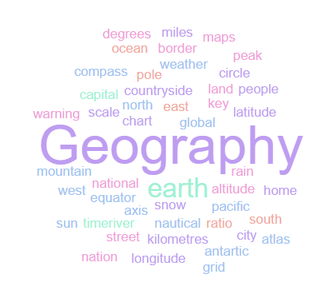
Geography Homework Booklet
Year 7 Spring 2: America’s Part 2
Name:
Class:
Teacher:
Homework Expectations:
You must keep this booklet neat and presentable
All homework must be completed for the date set
High effort is expected in all tasks
You will boost all work in red pen

Slide 2
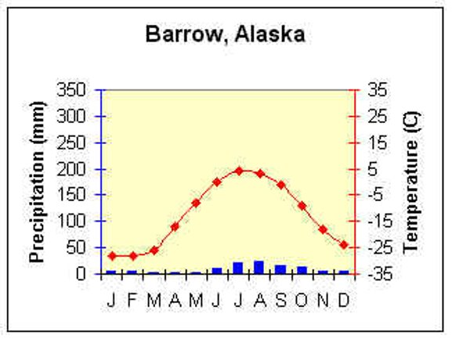
Year 7 Weekly Homework Spring 2.1 Alaska Knowledge Book 32-33
1. Study the graph on P32 - Draw the temperature line onto the graph below: | 3. Fill in the key terms and definitions for the following:
Answer the following questions about the climate of Barrow, Alaska: Name the most Northern city in the USA. Which three months receive the least rainfall ? Which month received the most rainfall? TRUE or FALSE: There are no hot months in Barrow, Alaska. What is the average temperature in January and February? TRUE or FALSE: Barrow, Alaska receives a lot of rainfall. | 4. Explain one positive and one negative effect of oil drilling in Alaska: One positive effect of oil drilling is _________________________________________ _____________________________________________________________________ This is a benefit because ________________________________________________ __________________________________________________________________________________________________________________________________________ One negative effect of oil drilling is ________________________________________ _____________________________________________________________________ This is a disadvantage because __________________________________________ __________________________________________________________________________________________________________________________________________
Key Term | Definition
Stakeholder
 | Money and Jobs.
Social
Environmental
 | The Government

Slide 3
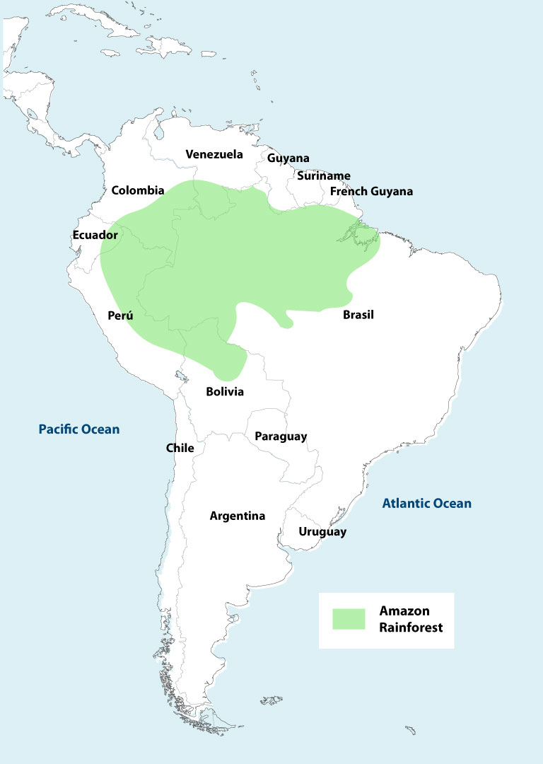
Year 7 Weekly Homework Spring 2.2 Brazils Tropical Rainforests Knowledge Book P34
1. Use the axis to draw and label the 4 different layers of the tropical rainforest:
Answer the following questions about the climate of the Tropical Rainforest: Which month receives the least rainfall? ________________________________________ Which month received the most rainfall? _______________________________________ TRUE or FALSE: There are no cold months in Manaus, Brazil. ________________________ What month has the highest temperature? _____________________________________ TRUE or FALSE: Manaus, Brazil receives very little rainfall __________________________ How many millimetres of rain fall in March? _____________________________________ TRUE or FALSE: Brazil has a hot, humid climate. __________________________________
3. Study the map. Describe the location of the Amazon Rainforest in South America [4]:
________________________________________________________________________________________________________________________________________________________________________________________________________________________________________________________________________________________________________________________________________________________________________________________________________________________________________________________________________
________________________________________________________________________________________________________________________________________________________
____________________________________________________________________________
50m
40m
30m
20m
10m

Slide 4
Year 7 Weekly Homework Spring 2.3 Tropical Rainforest Food Chains and Adaptations Knowledge Book P5, 35-36
Use P5 to find a key term/ definition to complete the table. Then use P35 to provide an example from the Tropical Rainforest to complete the food chain in the final column.
4. Use P36, describe the following plant adaptations and draw a picture:
3. Research an animal that lives in the Tropical Rainforest. In the space below, draw a picture of that animal, then underneath, describe how it is specifically adapted to survive:
____________________________________________________________________________
________________________________________________________________________________________________________________________________________________________________________________________________________________________________________________________________________________________________________________________________________________________________________________________________________________________________________________________________________
________________________________________________________________________________________________________________________________________________________
________________________________________________________________________________________________________________________________________________________
Key Term | Definition | Example
Producer |  | Trees
 | Animals that eat vegetation (producers). These are usually herbivores.
Secondary Consumer
 | Eat primary and secondary consumers as their main source of food. They are the top of the food chain.
Adaptation | Description of Adaptation | Drawing of Adaptation
Drip Tip Leaves
Buttress Roots
Lianas

Slide 5
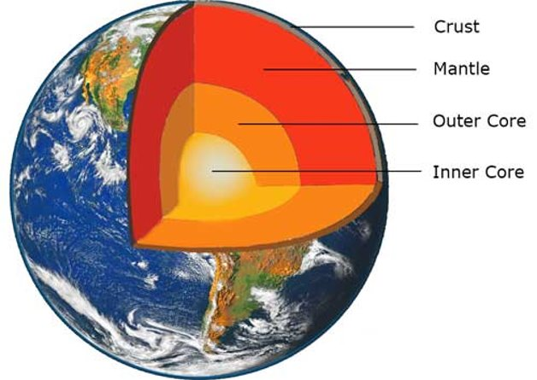
Year 7 Weekly Homework Spring 2.4 The Structure of the Earth Knowledge Book 37-38
Label the diagram correctly: | 3. Fill in the blanks using the word bank below to understand the different types of crust: There are two types of crust; there is ___________________ crust and _____________ crust. Continental crust is found under the ______________. It is ___________________ and ___________________ than oceanic crust. This is because continental crust is much _____________________ than oceanic crust and this means that continental crust cannot be subducted, therefore it cannot be melted in the mantle and so we have some very old rocks forming the continental crust. Oceanic crust is found under ______________ and it is _____________ and ______________ than continental crust. It is also more _____________ which means it’s heavier. Dense Oceans Bigger Continental Oceanic Lighter Smaller Land Older Younger
2. Tick the correct boxes for which the following statements are true:
Statement | Crust | Mantle | Outer Core | Inner Core
Made of iron and nickel
The biggest/ thickest layer
Solid
Molten rock / viscous
Thinnest layer
Extremely hot (5000°C)
Under extreme pressure

Slide 6
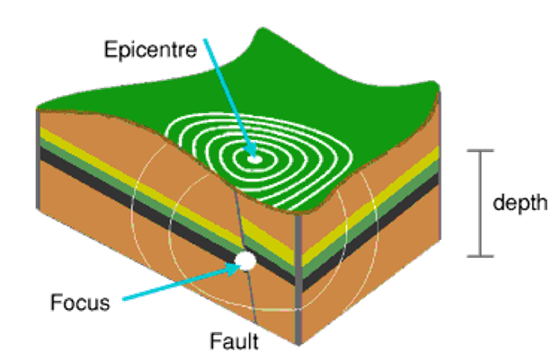
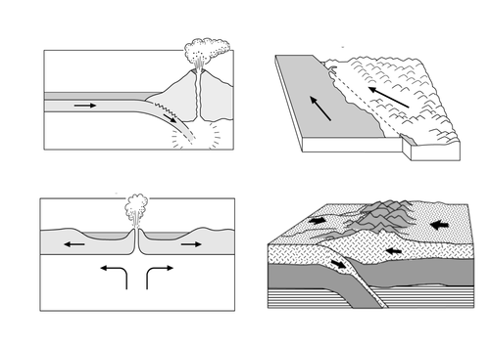
Year 7 Weekly Homework Spring 2.5 Plate Boundaries and Earthquakes Knowledge Book 39-40
Label the diagram correctly: | Fill in the key terms and definitions for the following:
2. Use P39 to complete the information in the blank boxes:
Key Term | Definition
Subducts
 | Waves of energy that travel through the Earth’s surface.
Epicentre
Focus
 | The point where two tectonic plates meet.
Plate Boundary | Description | Diagram | What Occurs?
Conservative | Two plates slide past each other either in the same or in opposite directions. Often the plates become stuck on one another due to friction and this causes pressure to build up. |  | Earthquakes

Slide 7
Questions to ask:
Notes:
___________________________________________________________________________________________________________________________________________________________________________________________________________________________________________________________________________________________________________________________________________________________________________________________________________________________________________________________________________
___________________________________________________________________________________________________________________________________________________________________________________________________________________________________________________________________________________________________________________________________________________________________________________________________________________________________________________________________________

Slide 8
Questions to ask:
Notes:
___________________________________________________________________________________________________________________________________________________________________________________________________________________________________________________________________________________________________________________________________________________________________________________________________________________________________________________________________________
___________________________________________________________________________________________________________________________________________________________________________________________________________________________________________________________________________________________________________________________________________________________________________________________________________________________________________________________________________

Slide 9
Questions to ask:
Notes:
___________________________________________________________________________________________________________________________________________________________________________________________________________________________________________________________________________________________________________________________________________________________________________________________________________________________________________________________________________
___________________________________________________________________________________________________________________________________________________________________________________________________________________________________________________________________________________________________________________________________________________________________________________________________________________________________________________________________________

Slide 10
Questions to ask:
Notes:
___________________________________________________________________________________________________________________________________________________________________________________________________________________________________________________________________________________________________________________________________________________________________________________________________________________________________________________________________________
___________________________________________________________________________________________________________________________________________________________________________________________________________________________________________________________________________________________________________________________________________________________________________________________________________________________________________________________________________

