Slide 1
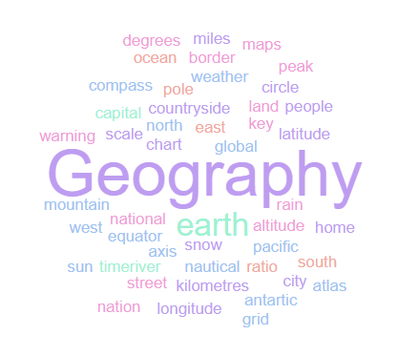
Geography Homework Booklet
Year 7 Spring 1: America’s Part 1
Name:
Class:
Teacher:
Homework Expectations:
You must keep this booklet neat and presentable
All homework must be completed for the date set
High effort is expected in all tasks
You will boost all work in red pen

Slide 2
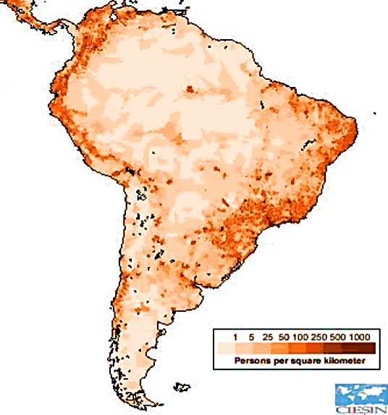
Year 7 Weekly Homework Spring 1.1 How Are Populations Changing in the Americas? KB: page 27-28
1. Fill in the key terms and definitions for the following: | 3. Use P27 and P28 in your KB to fill in the blanks: The _______________ is the most populated country in North America. It has a population of _________________________ people. Brazil is the most populated country in ____________________________. It has a population of __________________________ people. Wealthy countries are known as __________________________________ (HIC’s) and poorer countries are known as ____________________________________ (LIC’s). Population is not evenly distributed. Some countries are ______________ populated, with lots of people living in one area, and other areas are ________________ populated, with very few people living in one area. One reason for unequal population distribution is _________________________________.
2. Draw an image/ icon for the following key terms: | 4. Use compass points to describe the population distribution in South America [3]
Key Term | Definition
Population
 | A small amount of people in a given area.
Densely Populated
Population Distribution
 | The number of people living in a given area, usually within 1km²
HIC
LIC
______________________________________________________________________________________________________________________________________________________________________________________________________________________________________________________________________________
N
Sparsely Populated
Densely Populated

Slide 3
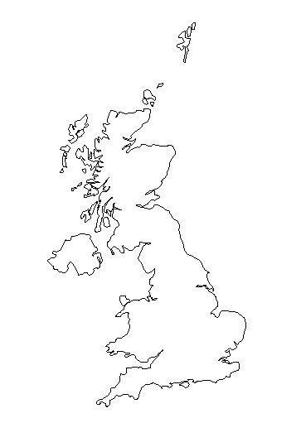
Year 7 Weekly Homework Spring 1.2 Population in the UK KB: page 8-9
1. Are these statements TRUE or FALSE? Britain consists of England and Wales: __________________ The capital city of Northern Ireland is Dublin: __________________ The countryside is more densely populated than cities: __________________ Wales is located west of England: __________________ Ireland is located south east of Scotland: __________________ The British Isles consists of two large islands: __________________ London, Cardiff and Belfast are densely populated: __________________ | 3. Answer the following questions: Why are some places densely populated? Why are some places sparsely populated? What is a choropleth map?
2a. Shade in the population distribution of the UK: 2b. Name one ‘crowded’ place in the UK. ________________________________________ 2c. Name one ‘medium populated’ place in the UK. ________________________________________ 2d. Name one place in the UK with ‘few people’. ________________________________________ | 4. Connect these words (you must make at least 4 connections):
Key:
Crowded
Medium
Few People
Cities
Densely Populated
Snowdonia National Park
Sparsely Populated
Countryside
London

Slide 4
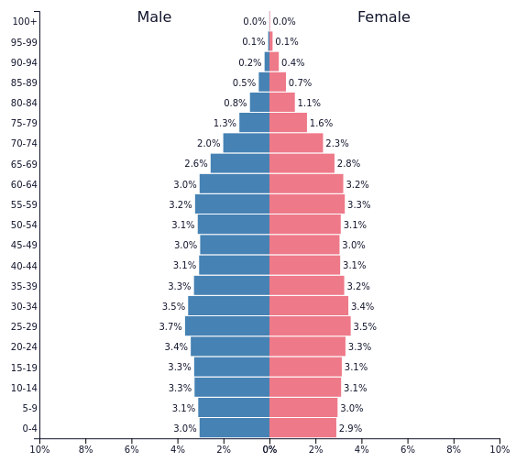
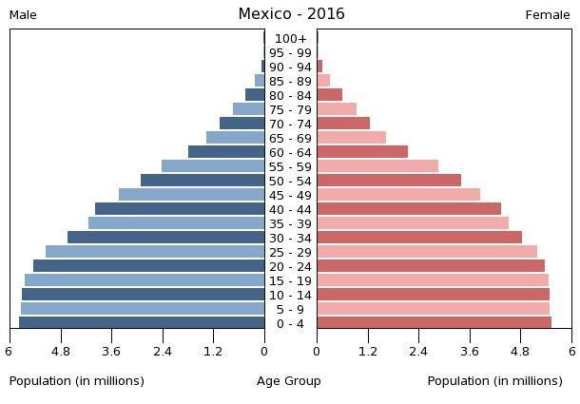
Year 7 Weekly Homework Spring 1.3 Americas Population: USA Vs. Mexico Knowledge Book 29-30
1. Compare the population statistics of the USA and Mexico: | 3. Which countries population pyramid is this? Explain what it shows.
2. Which countries population pyramid is this? Explain what it shows. | 4. What effects occur because of the populations in USA and Mexico?
_______________________________________________________________________________________________________________________________________________________________________________________________________________
Country | USA | Mexico
Population
Life expectancy
Birth rate
Death rate
______________________________________________________________________________________________________________________________________________________________________________________________________________________________________
Issue | The effect of this…
USA has an elderly population and high life expectancy
Mexico has a large young dependent population
The effects on Mexico of large amounts of people migrating away
The effects on USA of large amounts of migrants from Mexico
Male
Female

Slide 5
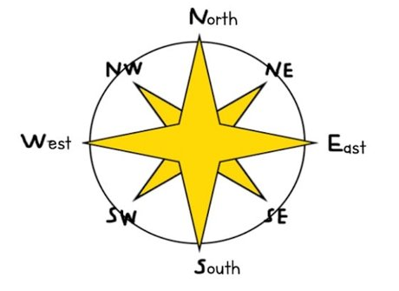
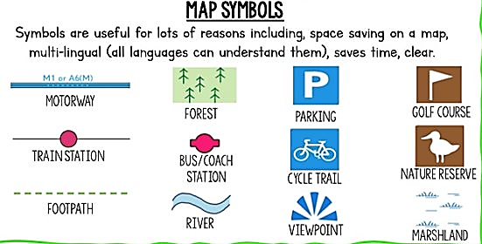
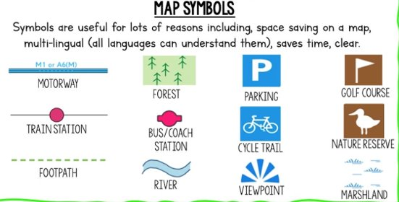
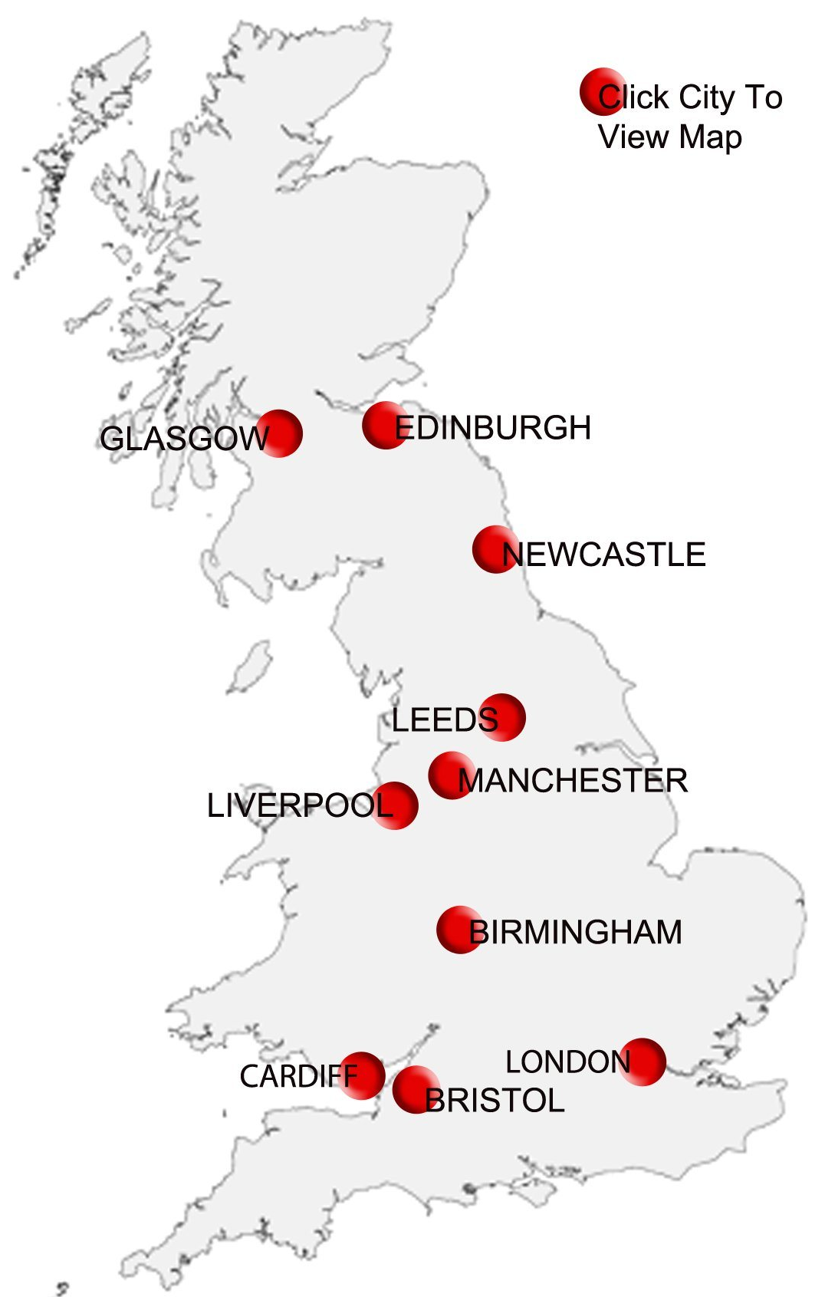
Year 7 Weekly Homework Spring 1.4 Map Skills: Compass Points and Symbols Knowledge Book 10
Correctly label the directions on the compass (write in full words, not initials):
2. Add the compass direction to complete these sentences: Edinburgh is located ___________________ of Glasgow Newcastle is located ___________________ of Leeds Cardiff is located ______________________ of Bristol Bristol is located ______________________ of Cardiff Birmingham is located _________________ of Cardiff Leeds is located ______________________ of Edinburgh Liverpool is located ___________________ of London Birmingham is located _________________ of Liverpool Manchester is located _________________ of Leeds Glasgow is located ____________________ of Manchester
3. Complete the table by either naming or drawing the map symbol:
Name of Symbol | Picture of Symbol
Train Station
Golf Course
Viewpoint
Parking

Slide 6
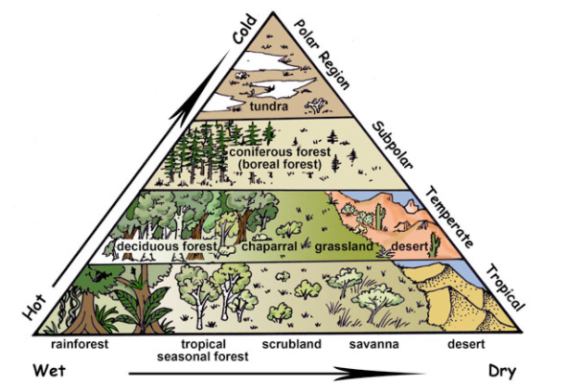
Year 7 Weekly Homework Spring 1.5 Biomes of the Americas Knowledge Book Page 31
1a. Define the following key terms: Biome- _____________________________________________________________________ Ecosystem- __________________________________________________________________ ____________________________________________________________________________ 1b. List 3 biotic (living) components in an ecosystem: 1c. List 3 abiotic (non-living) components in an ecosystem: | 2. Study the map on P31 – List all the different biomes found in the Americas:
3. Decide if the following statements are TRUE or FALSE: The America’s have many different climates and biomes ____________ The main biomes of South America are Grasslands and Taiga ____________ Tropical Rainforest biome is found in South America ____________ North America is mainly Taiga and Tundra biome ____________ South America is colder than North America ____________ The USA has no deserts ____________ | 4. Label these countries on the diagram:
Tropical Rainforest
Biomes in the Americas
Brazil
Canada
Mexico

Slide 7
Questions to ask:
Notes:
___________________________________________________________________________________________________________________________________________________________________________________________________________________________________________________________________________________________________________________________________________________________________________________________________________________________________________________________________________
___________________________________________________________________________________________________________________________________________________________________________________________________________________________________________________________________________________________________________________________________________________________________________________________________________________________________________________________________________

Slide 8
Questions to ask:
Notes:
___________________________________________________________________________________________________________________________________________________________________________________________________________________________________________________________________________________________________________________________________________________________________________________________________________________________________________________________________________
___________________________________________________________________________________________________________________________________________________________________________________________________________________________________________________________________________________________________________________________________________________________________________________________________________________________________________________________________________

Slide 9
Questions to ask:
Notes:
___________________________________________________________________________________________________________________________________________________________________________________________________________________________________________________________________________________________________________________________________________________________________________________________________________________________________________________________________________
___________________________________________________________________________________________________________________________________________________________________________________________________________________________________________________________________________________________________________________________________________________________________________________________________________________________________________________________________________

Slide 10
Questions to ask:
Notes:
___________________________________________________________________________________________________________________________________________________________________________________________________________________________________________________________________________________________________________________________________________________________________________________________________________________________________________________________________________
___________________________________________________________________________________________________________________________________________________________________________________________________________________________________________________________________________________________________________________________________________________________________________________________________________________________________________________________________________

