Slide 1

History Homework Booklet
Year 7 Autumn 1
Name:
Class:
Teacher:
HISTORY
Homework Expectations:
You must keep this booklet neat and presentable.
All homework must be completed for the date set.
High effort is expected in all tasks.
You will BOOST all work in red pen.
There is space at the back of the booklet for notes and any questions you may have.

Slide 2
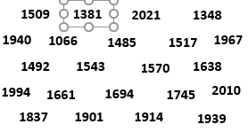
Year 7 Weekly Homework Autumn 1.1 Understanding time
1a. | 2. Create a mind map to show what areas of history you have already learnt.
decade
100 years
century
1000 years
What have I already learnt?
week
10 years
millennium
365 days
year
7 days
3. Use the timeline to put these dates into the correct order.
1381

Slide 3





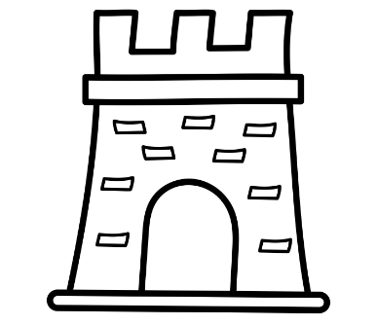
Year 7 Weekly Homework Autumn 1.2
1. Identify what kind of evidence each picture is. They can be either written or spoken or physical
3. Write which century each year below was in. Use the example to help you:​ ​ EXAMPLE: 2022​ Take off the last two numbers from the year 2022 ​ Then add 1 to the remaining number- 20 + 1 = 21st century​ ​ 1107 = ​ ​ 1381 = ​ ​ 1914 =
2. Find the matching definitions of these themes
An event that happens without intention or cause..
Political
The effect of the religious figures or the church .
Economic
When a ruler is fighting for power e.g. war.
Social
People’s everyday life at work and at home.
Conflict
How people earn money and spend their money.
Religion
Chance
Government and rights.

Slide 4
Year 7 Weekly Homework Autumn 1.3 Contenders for the English throne Knowledge Book Page: 5
1. Rank the Contenders for the English throne from most powerful to least powerful. | 2. Tier 2 language task​ ​ The word 'Contender' means 'a person or group competing with others to achieve something'.​ ​ Use 'Contender' in two sentences below
3a. Explain why you have chosen your most powerful contender. 3b. Explain why you have chosen your least powerful contender. | 4. Create a quiz, with answers, about the 3 contenders below:
Most powerful
____________________________________________________________________________________________________________________________________________________________________________________________________________________________________
Least powerful
________________________________________________________________________________________________________________________________________________________
Question | Answer
________________________________________________________________________________________________________________________________________________________

Slide 5
Year 7 Weekly Homework Autumn 1.4 Armies at Hastings Knowledge Book Page: 7
1. Use the look, cover, write, check method to fill in the gaps on the table below using your knowledge book
2. Create a 5 question quiz, with answers about the 2 armies at Hastings
Question | Answer
William’s Army​
Mercenaries​ ​ | Professional _____________ Well ___________ and equipped.​ ​
Archers​ ​ | Equipped with _________ and __________ Effective ___________ but limited in short-range fighting​ ​
Knights​ ​ | Fought on ______________ Could charge at high speeds towards enemies.​ ​
Godwinson’s Army​
Fyrd​ | Untrained _____________ No _____________ Equipped with _____________ tools.​
Housecarls​ | Trained professional soldiers.​ Well armoured.​ Equipped with ______________ and shields​
3. Explain who you think had the better army and why: POINT: I think ____________________ had the better army at Hastings. EVIDENCE: I think this because they ____________________________________________ __________________________________________________________________________ __________________________________________________________________________ EXPLAIN: This shows they had the better army because this meant they could__________ __________________________________________________________________________ __________________________________________________________________________

Slide 6
Year 7 Weekly Homework Autumn 1.5 Feudal System and Domesday Book Knowledge Book Pages: 8-9
1. Recreate the Feudal system below using the look, cover, write, check method: | 2. Answer the quiz about the Feudal system below:
 | 4. Explain how the Domesday book helped William when he became King: POINT: The Domesday book helped William when he became King of England in 1066. EVIDENCE: This is because it _________________________________________________ __________________________________________________________________________ __________________________________________________________________________ EXPLAIN: This would have helped William because _______________________________ __________________________________________________________________________ __________________________________________________________________________
Question | Answer
What did the King lend to the barons to keep them loyal?
What did the Barons do for the King in times of war?
Which group is at the bottom of the Feudal system?
Why is this group at the bottom of the Feudal system?
How did the Knights show their loyalty to the Barons?

Slide 7
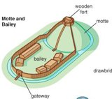
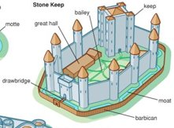
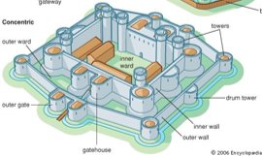
Year 7 Weekly Homework Autumn 1.6 Castles Knowledge Book Page: 10
1. Describe each of the castles below in 1 sentence. Motte and Bailey: Stone Keep: Concentric Castle | 2.Label the key features of the castle below ​
3. Label the key features of the castle below | 4. Label the key features of the castle below
____________________________________________________________________________
____________________________________________________________________________
____________________________________________________________________________

Slide 8
Questions to ask:
Notes:
___________________________________________________________________________________________________________________________________________________________________________________________________________________________________________________________________________________________________________________________________________________________________________________________________________________________________________________________________________
___________________________________________________________________________________________________________________________________________________________________________________________________________________________________________________________________________________________________________________________________________________________________________________________________________________________________________________________________________

