Slide 1

History Homework Booklet
Year 9 Autumn book 1
Name:
Class:
Teacher:
HISTORY
Homework Expectations:
You must keep this booklet neat and presentable.
All homework must be completed for the date set.
High effort is expected in all tasks.
You will BOOST all work in red pen.

Slide 2
Year 9 Weekly Homework Autumn 1.1 The Paris Peace Treaties 1 Knowledge Book pages 4-5
Match the Leader with their aims | 2. Correct the following false statements: The Big Three were the representatives of the defeated nations at the Paris Peace talks. ____________________________________________________________________________________________________________________________ 2. The idea that nations should be rules by others is called "Self –determination". __________________________________________________________________________________________________________________________________ 3. Reparation were payments given to defeated nations as compensation. __________________________________________________________________________________________________________________________________ 4. Wilson’s rules to create world peace were called the Twelve Points. __________________________________________________________________________________________________________________________________
3. Explain two ways that Germany was affected by the Treaty of Versailles. __________________________________________________________________________________________________________________________________________________________________________________________________________________________________________________________________________________________________________________________________________________________________________________________________________________________________________________________________________________________________________________________________________________________________________________________________________________________________________________________________________ | 4. Create a 4 part picture to summarise the effect of the Versailles Treaty on Germany.
Clemenceau (France) |  | Wanted self determination for the nations that had been in Empires
 |  | Wanted to avoid punishing Germany too harshly; afraid they would seek revenge.
Lloyd George (UK) |  | Wanted to cut the German armed forces
 |  | Wanted to set up the League of Nations to prevent war.
Wilson (USA) |  | Wanted to cripple Germany, making sure it could not attack France again and gain revenge.
 |  | Wanted Germany to be a strong trading partner, to have a reason to keep the peace.

Slide 3
Year 9 Weekly Homework Autumn 1.2 The Paris Peace Treaties 2 Knowledge Book pages 6-7
1. Which statements are T (true) and F (false): Lloyd George wanted everyone to have access to the seas. Lloyd George wanted to protect the UK’s naval dominance Clemenceau wanted to protect France from German invasion Lloyd George wanted to keep Germany strong as an ally against France. The USA wanted revenge on Germany for their losses and damage The USA had not suffered the same as the other Allies and feared that a harsh Treaty would lead to further wars. Britain had the World’s largest Empire and wanted to protect it. The USA had the World’s largest Empire and wanted to protect it. | 2. Create a diagram to show the differences that existed between Clemenceau, Lloyd George and Wilson.
3. Write on sentence to explain how the following affected the Settlement. (a) The Armistice ________________________________________________________________________________________________________________________________________________________(b) Prior agreements ________________________________________________________________________________________________________________________________________________________ (c) Time Constraints ________________________________________________________________________________________________________________________________________________________ (d) The State of Europe ________________________________________________________________________________________________________________________________________________________ (e) Conflicts of Interest ________________________________________________________________________________________________________________________________________________________ | 4. Rank the pressures the Big 3 faced in 1919 in order of seriousness. Justify your choice.

Slide 4
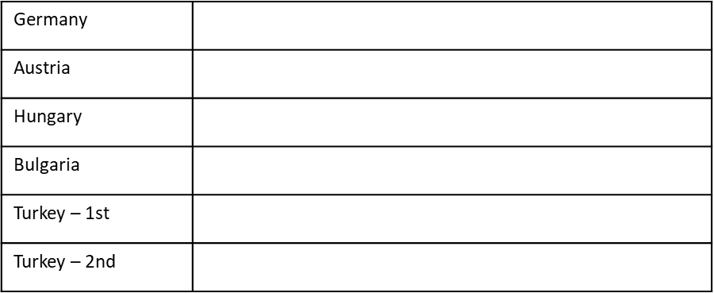
Year 9 Weekly Homework Autumn 1.3 The Paris Peace Treaties 3 Knowledge Book pages 8
Name the Treaty dealing with the defeated nation. | 2. What military restrictions were places on each nation?
3. Which land was lost by each nation? | 4. Which nation suffered the harshest treaty after World War 1? Justify your choice. _____________________________________________________________________________________________________________________________________________________________________________________________________________________________________________________________________________________________________________________________________________________________________________________________________________________________________________________________________________________________________________________________________________________________________________________________________________________________
Germany
Austria
Hungary
Bulgaria
Turkey – 1st
Turkey – 2nd

Slide 5

Year 9 Weekly Homework Autumn 1.4 Was the Versailles Treaty fair? Knowledge Book pages 9-10
1. Match the following key terms with their definitions | 2. Define the following key terms
3. Provide the evidence to support the ideas that the Treaty was or was not fair. | 4. In one paragraph explain your point of view – was the Treaty of Versailles fair? __________________________________________________________________________________________________________________________________________________________________________________________________________________________________________________________________________________________________________________________________________________________________________________________________________________________________________________________________
Ratify |  | When a nation does not get involved in foreign affairs.
Abdicate |  | Rules setting out how a country is ruled
Democratic |  | System of government where the people vote for their leaders
Hyperinflation |  | To give up a throne
Isolationism |  | Agree or make official
Constitution |  | When money becomes worthless.
Diktat
Clause
Anschluss
Demilitarise
Mandates
Propaganda
Yes
No

Slide 6
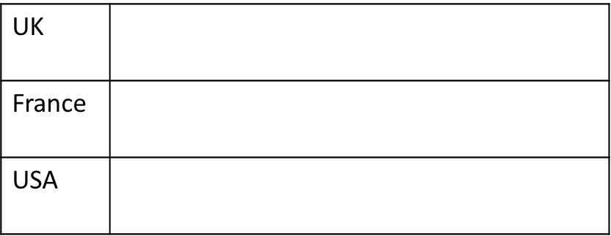
Year 9 Weekly Homework Autumn 1.5 The Reaction to the Versailles Treaty. Knowledge Book pages 11-12
1. Summarise how the leaders in each nation felt about the Treaty. | 2. Summarise how the public in each nation felt about the Treaty.
3. Create a diagram that shows the impact of the Versailles Treaty on Germany. | 4. Create a flow chart to show what happened to Germany in the 6 years after World War 1
Lloyd George
Clemenceau
Wilson

Slide 7
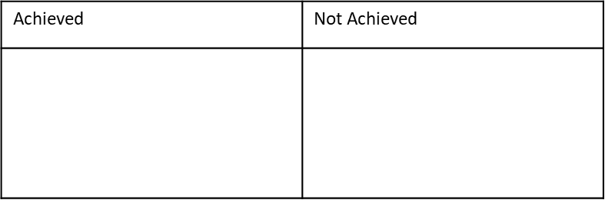
Year 9 Weekly Homework Autumn 1.6 How Satisfied were the Big 3? Knowledge Book pages 13
How happy was George Clemenceau of France with the treaty? Overall judgement? ___________________________________________________________________________________________________________________________________________________________________________________________________ | 2. How happy was David Lloyd George of Britain with the treaty? Overall judgement? ___________________________________________________________________________________________________________________________________________________________________________________________________
3. How happy was Woodrow Wilson of the USA with the treaty? Overall judgement? ___________________________________________________________________________________________________________________________________________________________________________________________________ | 4. Which member of the Big 3 would be most happy with the outcome of the Treaty of Versailles and why? __________________________________________________________________________________________________________________________________________________________________________________________________________________________________________________________________________________________________________________________________________________________________________________________________________________________________________________________________________________________________________________________________________________________________________________________________________________________________________________________________________
Achieved | Not Achieved
Achieved | Not Achieved

Slide 8
Questions | Answers
Questions | Answers

