Slide 1
History Homework Booklet
Year 7 Spring 1
Name:
Class:
Teacher:
HISTORY
Homework Expectations:
You must keep this booklet neat and presentable.
All homework must be completed for the date set.
High effort is expected in all tasks.
You will BOOST all work in red pen.
There is space at the back of the booklet for notes and any questions you may have.

Slide 2
Year 7 Weekly Homework Spring 1.1 Cromwell vs the Merry Monarch Knowledge Books Pages: 36
Use your knowledge book to answer this quiz | 2. Draw 3 examples of hobbies that became popular again and label them
3. Using the scale show how good of a ruler Charles was | 4. Use the table to show me differences in Charles’ England compared to Cromwell's
Question | Answer
1. What did the ‘Clarendon Code’ discourage?
2. What was Charles nickname?
3. How many times did Charles have to call parliament every 3 years?
4. Which things where allowed that Cromwell was very strict about?
5. By limiting Charles political power what was he allowed to do?
Cromwell’s England | Charles’ England
Bad
Good

Slide 3
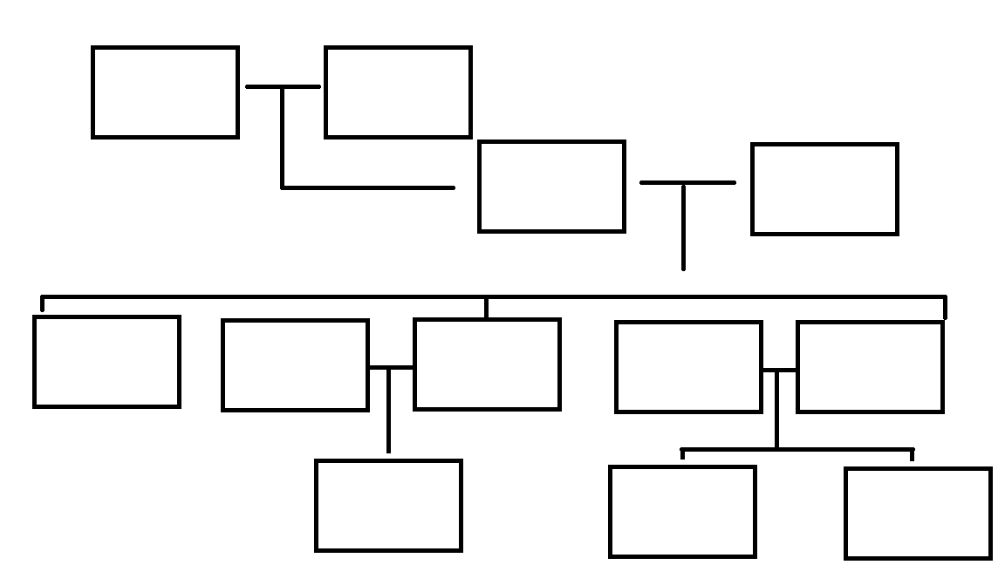
Year 7 Weekly Homework Spring 1.2 The Glorious revolution Knowledge Books Pages: 37-39
1. Tier 2 language task Give the Definition of ‘Succession’ Use ‘Succession’ in two sentences below. | 2. Complete Charles’ Family tree
3. Mind map the reasons for the Glorious Revolution | 4a. Give an example of the role of each factor in the ‘Glorious Revolution Power Religion Economy
Reasons for the Glorious Revolution

Slide 4
Year 7 Weekly Homework Autumn 1.3 Derby before 1066 KB page: 5
Create a storyboard about the History of Derby before 1066- use images and simple symbols to represent the written information
Between 60 and 80 AD the Romans used a wooden fort at Strutt’s Park, between Duffield Road and Belper Road. | A second fort was build at Little Chester in 80 AD | 601-700 AD: a settlement called Northworthy had been set up near to Iron Gate and Queen Street.
701- 800 AD: A second settlement was set up called Wardwick. The two settlements grew and merged. | The Danes conquered Northworthy in 874 AD and renamed the town Derby. | Derby was conquered again by the English at the Battle of Derby in 917AD.

Slide 5
Year 7 Weekly Homework Spring 1.3 Joseph Wright and Enlightenment Knowledge Books Pages: 43
1. Describe the word ‘Enlighten’. __________________________________________________________________________________________________________________________________ Use ‘Enlighten’ in a sentence. ___________________________________________________________________________________________________________________________________________________________________________________________________ | 2. Summarise the achievements of these famous people.
3. Rank the 6 men from most important to least important. | 4. Use Point, Evidence, Explain and Link to answer the question ‘Which was the most important member of the derby enlightenment and why?’ _______________________________________________________________________________________________________________________________________________________________________________________________________________________________________________________________________________________________________________________________________________________________________________________________________________________________________________________________________
……………….. was the most important because:
_____________________________________________________________________
……………….. was the least important because:
_____________________________________________________________________

Slide 6
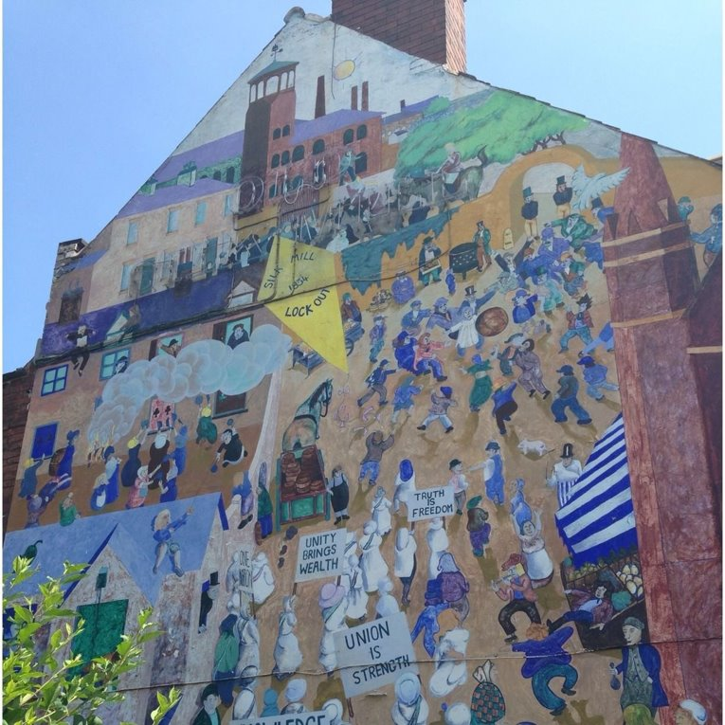
Year 7 Weekly Homework Spring 1.4 Textiles in Derby and Public Health Knowledge Books Pages: 44
1. Describe what a Trade Union is and how it affected Derby's textile industry. ______________________________________________________________________________________________________________________________________________________________________________________________________________________________________________________________________________________________________________________________________________________________________________________________________ 3. Give three examples why public health was bad in English towns in the 19th century. Example 1. ________________________________________________________________________________________________________________________________________________________ Example 2. ________________________________________________________________________________________________________________________________________________________ Example 3. ________________________________________________________________________________________________________________________________________________________ | 2. Annotate this picture and show events celebrated in this mural.

Slide 7
Year 7 Weekly Homework Spring 1.5 Railways and Rolls Royce Knowledge Books Pages: 44
1. Draw a timeline of Derby's railway. | 2. Show on the line how important were railways to the development of Derby in the 19th Century? Explain your reasoning.
3. Summarise the history of Rolls Royce in 20 words. | 4. Fill in the missing words. In World War 2 many of the ______ planes had Rolls Royce ______ and in ______ the company started to make ______ engines.​ Rolls Royce works were a target for ______ ______ ______ in World War ______ .​ In ______ Rolls Royce stopped making ______ in ______ .
1839
1878
___________________________________________________________________________________________________________________________________________________________________________________________________________________________________________
1844
___________________________________________________________________________________________________________________________________________________________________________________________________________________________________________

Slide 8
Year 7 Weekly Homework Spring 1.6 Culloden & impact Knowledge Books Pages: 40-41
Explain what a Jacobite is. | 2. Draw and Summarise the events of Bonnie Prince Charlie
3. Using the diagram below rank the reasons for the Jacobites defeat. The top being most important and the bottom being least important. | 4. Create a paragraph using Point, Evidence, Explain and Link to answer the question ‘What was the result of the Jacobites defeat?’. (Consider the long-term and short-term effect)
____________________________________________________________________________________________________________________________________________________________________________________________
2__________________________________________________
Explain where the term Jacobite comes from
____________________________________________________________________________________________________________________________________________________________________________________________
1__________________________________________________
3__________________________________________________
1. By April 1746 the Jacobite army were back in Scotland and were short of money and food. | 2. The help they expected from France did not arrive. | 3. Government forces defeated them at the Battle of Culloden.
4. Many of the defeated Jacobites had been Gaelic speaking Highland Scots. | 5. Over the next couple of decades Gaelic Highland Scots culture was swept away.
_________________________________________________________________________________________________________________________________________________________________________________________________________________________________________________________________________________________________________________________________________

Slide 9
Year 7 Weekly Homework Spring 1.7 Great Reform Act & Chartism Knowledge Books Pages: 45
1. ‘Only Members of parliament and well off men were permitted to vote’. Identify and describe two problems. | 2. Explain the goal of the Chartists. Were the chartist successful? Explain your answer.
3. Give two examples why factory reforms need to be implemented in the 19th century. Example 1. ___________________________________________________________________________________________________________________________________________________________________________________________________ Example 2. ___________________________________________________________________________________________________________________________________________________________________________________________________ | 4. show on the line how important you think the factory reforms of the 19th Century were? Explain your reasoning.
_____________________________________________________________________________________________________________________________________________
________________________________________________
Only Members of parliament and well off men can vote
________________________________________________
_____________________________________________________________________________________________________________________________________________
___________________________________________________________________________________________________________________________________________________________________________________________________________________________________________

Slide 10
Year 7 Weekly Homework Spring 1.8 Legacy of Queen Victoria Knowledge Books Pages: 47
1A. What effect did Victoria’s reign have on Population?
1B. What effect did Victoria’s reign have on Transport?
1C. What effect did Victoria’s reign have on the Vote?
1D. What effect did Victoria’s reign have on Education?
1E. What effect did Victoria’s reign have on Industry?
1F. What effect did Victoria’s reign have on Military?
2. Create two Point, Evidence, Explain and Link paragraphs answering the question ‘How successful was the reign of Queen Victoria?’.
______________________________________________________________________________________________
________________________________________________________________________________________________________________________________________________________________________________________________________________________________________________________________________________________________________________________________________________________________________________________
______________________________________________________________________________________________
______________________________________________________________________________________________
______________________________________________________________________________________________
________________________________________________________________________________________________________________________________________________________________________________________________________________________________________________________________________________________________________________________________________________________________________________________
______________________________________________________________________________________________
______________________________________________________________________________________________

Slide 11
Year 7 Weekly Homework Spring 1.9 Ireland and Home Rule Knowledge Books Pages: 48
1. Alter the flag to show how it changed after 1800 when the Kings Parliament in Dublin passed the Act of Union with Great Britain.
3. Choose 3 key events that you think were important in the history of Irish Home Rule. Rank these 3 from most important to least important and explain why you chose your most important.
2. Create a timeline showing the events of Irish history from 1801 to 1916.
1801
……………….. was the most important because:
________________________________________________________________________________________________________________________________________________________________________
1916

Slide 12
Questions to ask:
Notes:
___________________________________________________________________________________________________________________________________________________________________________________________________________________________________________________________________________________________________________________________________________________________________________________________________________________________________________________________________________
___________________________________________________________________________________________________________________________________________________________________________________________________________________________________________________________________________________________________________________________________________________________________________________________________________________________________________________________________________

