Slide 1

History Homework Booklet
Year 8 Spring 2
Name:
Class:
Teacher:
HISTORY
Homework Expectations:
You must keep this booklet neat and presentable.
All homework must be completed for the date set.
High effort is expected in all tasks.
You will BOOST all work in red pen.
There is space at the back of the booklet for notes and any questions you may have.

Slide 2
Year 8 Weekly Homework Spring 2.1 The American Revolution Knowledge Book pages 6-8
CAUSES: Using KB page 6 to answer the quiz questions about the causes of the American Revolution | 2. EVENTS: Use your knowledge about the events of the American Revolution to decide whether the statements below are TRUE or FALSE (KB p.7) The Declaration of Freedom was signed in 1776: TRUE or FALSE During the Battle of Bunker Hill Britain lost 3000 men: TRUE or FALSE France supported America against the British during the revolution: TRUE or FALSE Britain defeated the Americans at the Battle of Yorktown: TRUE or FALSE The Treaty of Paris was signed in 1783: TRUE or FALSE Correct any FALSE statements below: ____________________________________________________________________ ____________________________________________________________________ ____________________________________________________________________
3. CONSEQUENCES: Use KB p.8 to explain what happened to each of the countries as a result of the American Revolution | 4. OVERVIEW: Draw a set of 3 images to summarise the causes, events and consequences of the American Revolution (KB.6-7)
Question | Answer
1. Why were Britain and France involved in the 7 Years War?
2. What was the Stamp Act?
3. When was the Boston Massacre?
4. What happened during the Boston Tea Party?
5. How did Britain restrict American trade?
America:
France:
India:
Australia & New Zealand:

Slide 3
Year 8 Weekly Homework Spring 2.2 The French Revolution Knowledge Book pages 9-12
CAUSES: Using KB pages 8-9 to answer the quiz questions about the causes of the French Revolution | 2. EVENTS: Use your knowledge about the events of the French Revolution to decide whether the statements below are TRUE or FALSE (KB p.10) The Declaration of Rights of Man and Woman was created in 1789: TRUE or FALSE A crowd of 1 million broke into the Bastille: TRUE or FALSE The storming of the Bastille was on the 14th July 1789: TRUE or FALSE The nobles (2nd Estate) never joined the National Assembly: TRUE or FALSE Correct any FALSE statements below: ____________________________________________________________________ ____________________________________________________________________ ____________________________________________________________________
3. CONSEQUENCES: Use KB p.11-12 to explain what happened to France after the revolution | 4. OVERVIEW: Draw a set of 3 images to summarise the causes, events and consequences of the French Revolution (KB.8-12)
Question | Answer
1. How many people were in the 3rd Estate?
2. Which revolution had the French helped in during 1765-1783?
3. Which problems did famine between 1788-89 cause?
4. Why did the King call the Estates General?
5. What was the name of the new government the Third Estate created?
Louis XVI was...
War broke out with...
Robespierre came to power and...
On the 16th October 1793...

Slide 4
Year 8 Weekly Homework Spring 2.3 The Russian Revolution Knowledge Book pages 13-17
Using KB pages 13-14 to answer the quiz questions about the causes of the Russian Revolution | 2. EVENTS: Use your knowledge about the events of the Russian Revolution to decide whether the statements below are TRUE or FALSE (KB p.14) The Tsar left the Duma in charge when he went to the warfront: TRUE or FALSE The Russians were beat the Germans at Tannenburg: TRUE or FALSE 4 million workers went on strike on the 7th March 1917: TRUE or FALSE Soldiers refused to shoot the protesters: TRUE or FALSE The protesters wanted the Tsar to abdicate: TRUE or FALSE Correct any FALSE statements below: ____________________________________________________________________ ____________________________________________________________________ ____________________________________________________________________
3. CONSEQUENCES: Use KB p.15 & 17to explain what happened to Russia after the revolution | 4. OVERVIEW: Draw a set of 3 images to summarise the causes, events and consequences of the Russian Revolution (KB.13-17)
Question | Answer
1. What percentage of the population were workers?
2. How many workers were involved in the 1905 Revolution?
3. Which nickname was given to Tsar Nicholas after the 1905 Revolution?
4. How many Russia soldiers had died in WW1 by the end of 1914?
5. How many Russia soldiers had died in WW1 by March 1917?
In November 1917, the Bolsheviks...
The lives of workers improved as...
Some peasants had to...
The Treaty of...

Slide 5
Year 8 Weekly Homework Spring 2.4 East India Company and the Indian Rebellion Knowledge Book pages 67-68
1. Create a profile about the Indian Rebellion: (KB p.69) Date: What happened:______________________________________________________________ ____________________________________________________________________________ ____________________________________________________________________________ ____________________________________________________________________________ What was the impact:_________________________________________________________ ____________________________________________________________________________ ____________________________________________________________________________ ____________________________________________________________________________ | 2. Use your knowledge about the East India Company to create a quiz, with answers (KB p.68):
3. Compare the Indian Rebellion (KB p.69) to the Nat Turner Revolt (KB p.45), focus on causes, aims, methods and consequences: Similarity:___________________________________________________________________ ____________________________________________________________________________ ____________________________________________________________________________ ____________________________________________________________________________ Difference:__________________________________________________________________ ____________________________________________________________________________ ____________________________________________________________________________ | 4. Explain how the East India company grew (KB p.68):
Question | Answer
1. Setup?
2. Fought?
3. Battle of Plassey?
4. Power?

Slide 6
Year 8 Weekly Homework Spring 2.5 The British Raj Knowledge Book page 69
Draw a set of images, at least 3, to explain why people in India were fed up with the British Raj (KB p.70): | 2. Compare the end of the British Raj (KB p.70) to the American Revolution (KB p.5-7), focus on causes, aims, methods and consequences: Similarity:___________________________________________________________________ ____________________________________________________________________________ ____________________________________________________________________________ ____________________________________________________________________________ Difference:__________________________________________________________________ ____________________________________________________________________________ ____________________________________________________________________________
3. Explain who Gandhi was and what he did to protest against the British Raj (KB p.70): He led the ___________________________________________________________________ ____________________________________________________________________________ He organised_________________________________________________________________ ____________________________________________________________________________ The Salt March was important as_________________________________________________ ____________________________________________________________________________ | 4. Use your knowledge about the British Raj to create a quiz, with answers (KB p.70):
Question | Answer

Slide 7
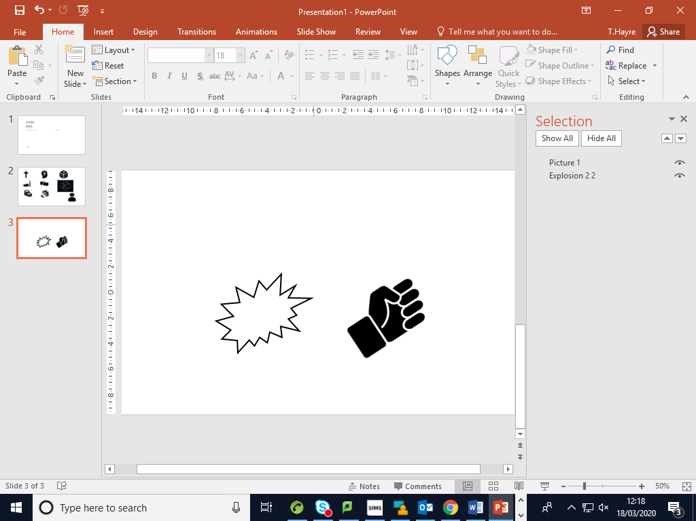



Year 8 Weekly Homework Spring 2.6 Indian Independence Knowledge Book pages 70-71
Explain how Indian gained independence in 1947 using the flowchart below (KB p.71) | 2. Explain how the following factors led to India gaining independence in 1947 (KB p.71):
3. Explain what the partition of India was (KB p.71): The partition of India was ______________________________________________________ ___________________________________________________________________________ ___________________________________________________________________________ ___________________________________________________________________________ ___________________________________________________________________________ ___________________________________________________________________________ ___________________________________________________________________________ | 4. Compare the independence of India (KB p.71) to the independence of Kenya (KB p.52-53), focus on causes, aims, methods and consequences: Similarity:___________________________________________________________________ ____________________________________________________________________________ ____________________________________________________________________________ ____________________________________________________________________________ Difference:__________________________________________________________________ ____________________________________________________________________________ ____________________________________________________________________________
War and violence: __________________________________________________
_________________________________________________________________
_________________________________________________________________
Communication: ___________________________________________________
_________________________________________________________________
_________________________________________________________________
Economy: ________________________________________________________
_________________________________________________________________
_________________________________________________________________

Slide 8
Question to ask:
Notes:
___________________________________________________________________________________________________________________________________________________________________________________________________________________________________________________________________________________________________________________________________________________________________________________________________________________________________________________________________________
___________________________________________________________________________________________________________________________________________________________________________________________________________________________________________________________________________________________________________________________________________________________________________________________________________________________________________________________________________

