Slide 1

History Homework Booklet
Year 8 Spring 1
Name:
Class:
Teacher:
HISTORY
Homework Expectations:
You must keep this booklet neat and presentable.
All homework must be completed for the date set.
High effort is expected in all tasks.
You will BOOST all work in red pen.
There is space at the back of the booklet for notes and any questions you may have.

Slide 2
Year 8 Weekly Homework Autumn 2.5 The Fall of the Berlin Wall Knowledge Book pages 21-26
1. Explain two differences between Capitalism and Communism (KB p.22) One difference is_______________________________________________________ ____________________________________________________________________ ____________________________________________________________________ Another difference is___________________________________________________ ____________________________________________________________________ ____________________________________________________________________ | 2. Make links between the words – explain at least 4 links you make
3. Decide whether each statement below is True or False (KB p.23-24): America gave the Chinese government 20,000 soldiers: TRUE or FALSE The Korean War led to 5 million total deaths: TRUE or FALSE 20% of East Germany’s population fled to West Berlin: TRUE or FALSE The Cuban Missile Crisis lasted for 43 days: TRUE or FALSE North Vietnam was supported by America during the war: TRUE or FALSE America sold weapons to the Taliban in Afghanistan: TRUE or FALSE Correct any FALSE statements below: ____________________________________________________________________ ____________________________________________________________________ ____________________________________________________________________ | 4. Rank the causes of the fall of the Berlin Wall in 1989 in order of importance (KB p.26): Explain your ranking:
Second World War
America
Iron Curtain
USSR
East Germany
blockade

Slide 3
Year 8 Weekly Homework Autumn 2.6 African Empires Knowledge Book pages 29-33
1. List the 5 African Empires you have studied in chronological order from when they were formed: | 2. Answer the quiz questions below about the Mali and Ashanti Empires (KB p.31 and p.33)
3. Explain the consequence the conversion to Christianity had on the Kongo (KB p.32 and p.126): ____________________________________________________________________________ ____________________________________________________________________________ ____________________________________________________________________________ ____________________________________________________________________________ ____________________________________________________________________________ ____________________________________________________________________________ ____________________________________________________________________________ ____________________________________________________________________________ ____________________________________________________________________________ | 4. Which empire had the most important legacy? Rank them below and explain your ranking: Explain your ranking:
Question | Answer
1. Who did the Mali Empire sell slaves to?
2. Which religion was followed in the Mali Empire?
3. Name one way the Mali Empire had a fair society.
4. What did the Ashanti Empire trade? (3 answers)
5. Who can trace their ancestors back to the Ashanti Empire today?
Name of Empire | Dates (formed-ended)

Slide 4
Year 8 Weekly Homework Autumn 2.7 The treatment of African slaves Knowledge Book pages 37-41
1. Use your knowledge about the treatment of African slaves in Africa to decide whether the statements below are TRUE or FALSE (KB p.38) Chattel slaves were sold and seen as property: TRUE or FALSE Many former slaves wrote about how well they were treated: TRUE or FALSE Most slaves in Africa rebelled against their masters: TRUE or FALSE It is estimated that there are 410 million slaves in the world today: TRUE or FALSE The last country to abolish slavery was Tunisia: TRUE or FALSE Correct any FALSE statements below: ____________________________________________________________________ ____________________________________________________________________ ____________________________________________________________________ | 2. Use your knowledge about the treatment of African slaves in Brazil to answer the quiz questions below (KB p.39)
3. Use your knowledge about the treatment of African slaves in the Southern States of America to explain: (KB p.40) How were African slaves treated in the Southern States? ____________________________________________________________________________ ____________________________________________________________________________ ____________________________________________________________________________ How did African slaves resist in the Southern States? ____________________________________________________________________________ ____________________________________________________________________________ ____________________________________________________________________________ | 4. Use your knowledge about the treatment of African slaves in England to explain: (KB p.41) Explain your views about the fact the British government paid the slave owners the equivalent of £20 billion in 1833 to end slavery but gave the slaves nothing. ____________________________________________________________________________ ____________________________________________________________________________ ____________________________________________________________________________ ____________________________________________________________________________ ____________________________________________________________________________ ____________________________________________________________________________ ____________________________________________________________________________
Question | Answer
1. What percentage of Brazil’s population was made up of African slaves?
2. What did African slaves in Brazil do from 1690?
3. What did runaway slaves in Brazil create?
4. When was slavery abolished in Brazil?
5. What fraction of Brazil’s prison population are Afro-Brazilian today?

Slide 5
Year 8 Weekly Homework Autumn 2.8 Slave Revolts Knowledge Book pages 42-43
1. Create a profile about the Haitian Revolution: (KB p.42) Date: What happened:______________________________________________________________ ____________________________________________________________________________ ____________________________________________________________________________ ____________________________________________________________________________ What was the impact:_________________________________________________________ ____________________________________________________________________________ ____________________________________________________________________________ ____________________________________________________________________________ | 2. Explain how successful the Maroon slaves were in ending slavery in Jamaica by marking on your ranking on the scale below and explaining your choice (KB p.42): ____________________________________________________________________________ ____________________________________________________________________________ ____________________________________________________________________________ ____________________________________________________________________________ ____________________________________________________________________________ ____________________________________________________________________________ ____________________________________________________________________________
3. ‘The Amistad slave revolt was a complete failure.’ How far do agree with this statement? (KB p.43) ____________________________________________________________________________ ____________________________________________________________________________ ____________________________________________________________________________ ____________________________________________________________________________ ____________________________________________________________________________ ____________________________________________________________________________ ____________________________________________________________________________ ____________________________________________________________________________ | 4. Create a flow chart of the events and consequences of the Baptist War in Jamaica (KB p.443)
_______________________________________________________________________________________
_______________________________________________________________________________________
_______________________________________________________________________________________
_____________________________
1. Who was involved?
2. What happened?
3. What happened to the slave owners?
4. What did this lead to in the British empire?

Slide 6
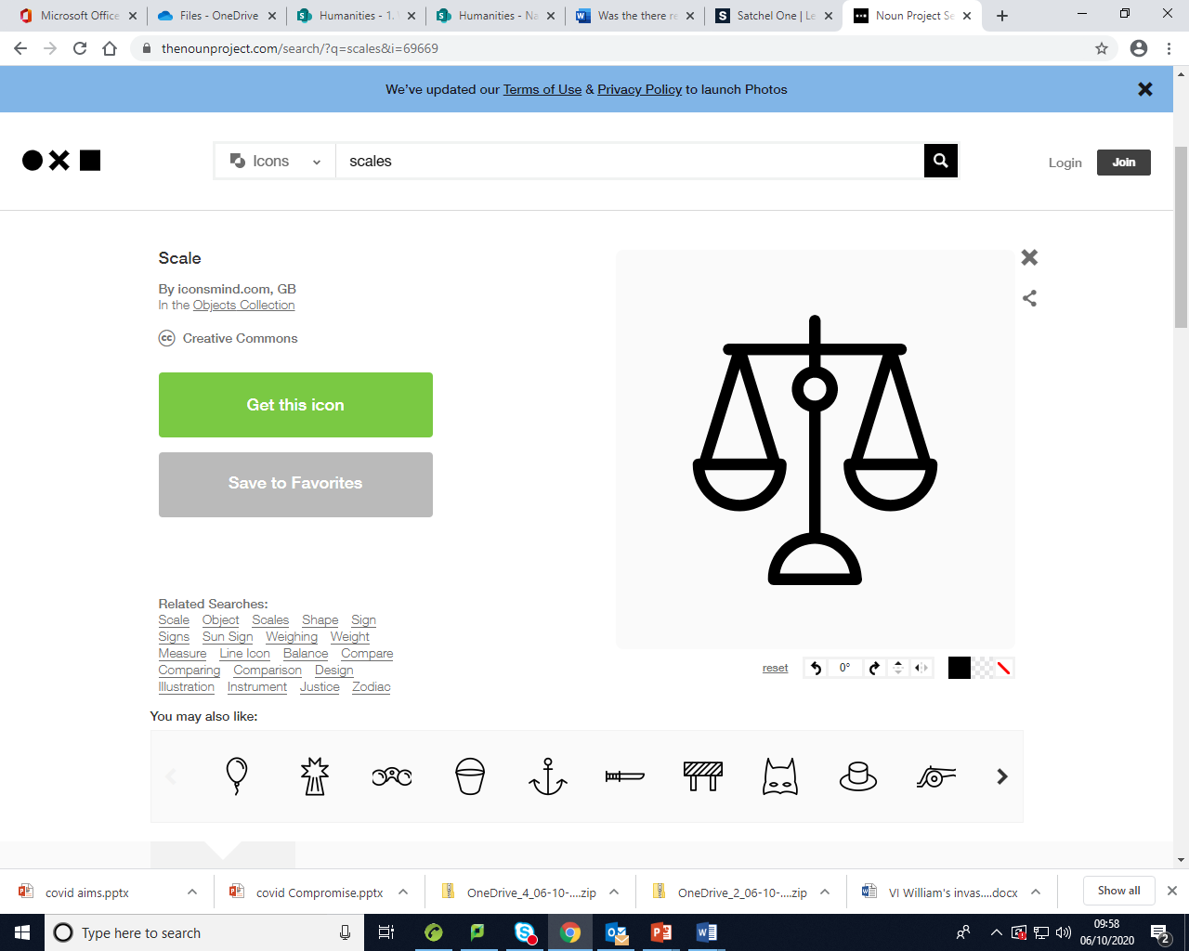
Year 8 Weekly Homework Spring 1.1 Scramble for Africa Knowledge Book pages 44-45
Why did European countries want land in Africa? (KB p.44) Fill in the gaps: Britain, France and Germany were ________________________ against each other over trade. Bismarck, who was the leader of ______________________ wanted to build up his ________________. In Africa there was lots of ______________ materials which would make European countries very rich. A British coloniser, called Cecil ___________________ made a fortune from the _________________ and gold mines in ___________________ Africa. Many Christians felt they needed to __________________ the Africans and saw this as their duty. The industrial revolution in Britain had increased its need for _________________ oil which Africa was rich in. | 2. Decide whether each statement below is True or False (KB p.44): Turkey was involved in the Scramble for Africa: TRUE or FALSE By 1914,100% of Africa was under European rule: TRUE or FALSE The start of the Scramble for Africa was at the Berlin Conference: TRUE or FALSE The Berlin Conference was in 1885: TRUE or FALSE During the Berlin Conference European countries decided which areas of Africa they would control: TRUE or FALSE Correct any FALSE statements below: ____________________________________________________________________ ____________________________________________________________________ ____________________________________________________________________
3. Explain how the Scramble for Africa benefitted the European countries. (KB p.45) ____________________________________________________________________________ ____________________________________________________________________________ ____________________________________________________________________________ ____________________________________________________________________________ ____________________________________________________________________________ ____________________________________________________________________________ ____________________________________________________________________________ ____________________________________________________________________________ | 4. Write facts around the scale below to show the impact the Scramble for Africa had on the African countries (KB p.45)
Positive impact
Negative impact

Slide 7
Year 8 Weekly Homework Spring 1.2 Impact of the wars Knowledge Book pages 46-50
Explain the jobs of each of the different groups below during the First World War (KB p.46-48) African soldiers: _____________________________________________________________ ___________________________________________________________________________ Caribbean/West Indies soldiers: ________________________________________________ ___________________________________________________________________________ African American soldiers:_____________________________________________________ ___________________________________________________________________________ | 2. How were African American soldiers treated in the Second World War? (KB p.48) ____________________________________________________________________________ ____________________________________________________________________________ ____________________________________________________________________________ ____________________________________________________________________________ ____________________________________________________________________________ ____________________________________________________________________________ ____________________________________________________________________________ ____________________________________________________________________________ ____________________________________________________________________________
3. How did the world wars affect black soldiers? (KB p.49-50) | 4. ‘Britain treated black soldiers better than America’. How far do you agree with this statement? (KB p.46-50) ____________________________________________________________________________ ____________________________________________________________________________ ____________________________________________________________________________ ____________________________________________________________________________ ____________________________________________________________________________ ____________________________________________________________________________ ____________________________________________________________________________ ____________________________________________________________________________
Positives | Negatives

Slide 8
Year 8 Weekly Homework Spring 1.3 Independence in Africa Knowledge Book pages 51-55
Using page 51 in your Knowledge Book, rank the reasons why countries in Africa gained their independence after the Second World War from most important to least. Then explain your order: Explain your ranking: | 2. Create a flowchart to show the events which led to the independence of Kenya and the impact (KB p.52:
3. Create a flowchart to show the events which led to the independence of Zimbabwe and the impact (KB p.54): | 4. Compare the impact of the independence of Kenya to the independence of Zimbabwe, in what ways were they similar? (KB p.53 and p.55) ____________________________________________________________________________ ____________________________________________________________________________ ____________________________________________________________________________ ____________________________________________________________________________ ____________________________________________________________________________ ____________________________________________________________________________ ____________________________________________________________________________ ____________________________________________________________________________

Slide 9
Year 8 Weekly Homework Spring 1.4 Arab Spring Knowledge Book pages 59-64
Using KB page 59 to answer the quiz questions about the Arab Spring: | 2. Use your knowledge about the events of the Arab Spring movement in Tunisia to decide whether the statements below are TRUE or FALSE (KB p.60) Mohammed Bouazizi set himself on fire to protest against corruption: TRUE or FALSE Protestors used TikTok to help to organise themselves: TRUE or FALSE The movement was also known as the Daisy Revolution: TRUE or FALSE David Ali was the president of Tunisia: TRUE or FALSE The president of Tunisia had to flee the country: TRUE or FALSE Correct any FALSE statements below: ____________________________________________________________________ ____________________________________________________________________ ____________________________________________________________________
3. Explain who Colonel Muammar Gaddafi was, use p.61 in your KB to help you: He was the __________________________________________________________________ Why did the Tunisian people protest against him? ________________________________________ ________________________________________ ________________________________________ ________________________________________ ________________________________________ | 4. Answer the quiz questions below about the Arab Spring movement in Syria (KB p.63)
Question | Answer
1. When did the movement start?
2. Name two countries involved in the Arab Spring movement.
3. What did the protestors want?
4. How did protestors use social media during the movement?
5. Which social media platforms were used?
Question | Answer
1. Who was the Syrian president?
2. What were Syrian people not allowed to do for fear of being imprisoned?
3. Which countries supported, and still do, the protestors?
4. Which countries support the Syrian leader?
5. How many people have been killed in Syria so far due to this conflict?

Slide 10
Year 8 Weekly Homework Spring 1.5 Arab Spring Knowledge Book pages 59-64
Using your own knowledge about the Arab Spring movement in Egypt and KB p.62 create a flowchart of the causes and events: | 2. Compare the causes of the Yellow Revolution (KB p.20-21) to the causes of the Arab Spring movement in Libya (KB p.61) and explain 2 similarities: 1.__________________________________________________________________________ ____________________________________________________________________________ ____________________________________________________________________________ ____________________________________________________________________________ 2.__________________________________________________________________________ ____________________________________________________________________________ ____________________________________________________________________________ ____________________________________________________________________________
3. Using your knowledge of the Arab Spring movement to complete the connect diagram below: | 4. Explain the impact of the Arab Spring movement (KB p.64)
Positives | Negatives
Corrupt
Facebook
Inspired
Freedom of speech
Demonstrations

Slide 11
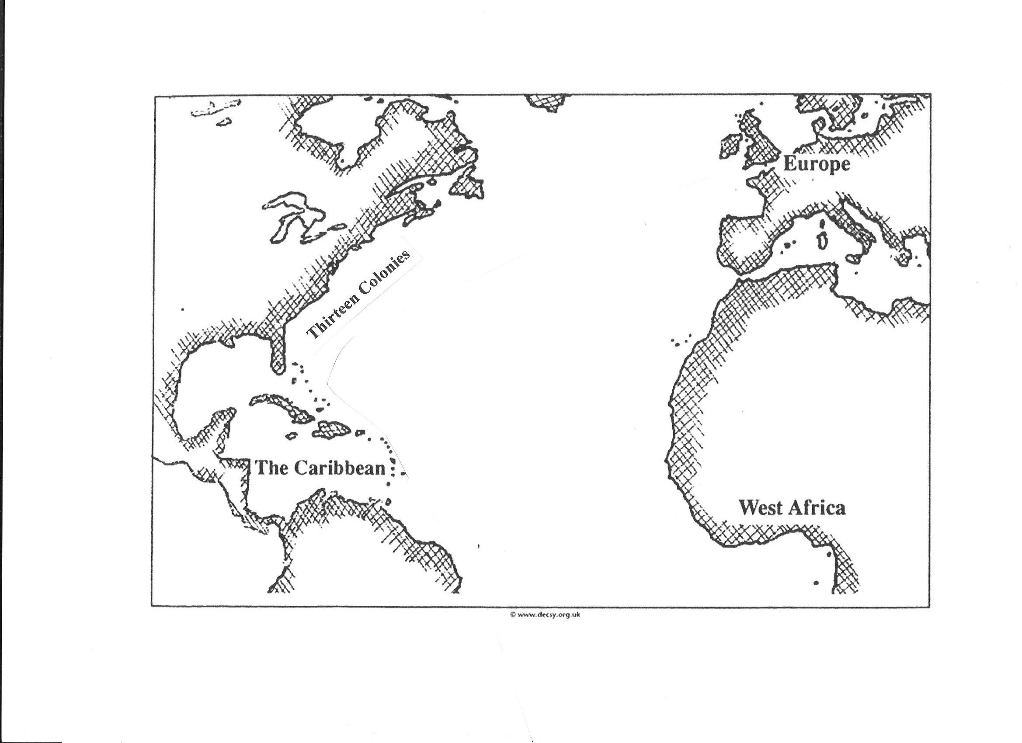
Year 8 Weekly Homework Spring 1.6 The Transatlantic Slave Trade Knowledge Book pages 37-42
1. Use KB p.37 to answer the quiz questions below about the Transatlantic slave trade: | 2. Label the diagram below to show what was being taken and moved along the arrow (KB p.37):
3. Use your knowledge about the the legacy and impact of the transatlantic slave trade in Brazil to decide whether the statements below are TRUE or FALSE (KB p.40): Slavery in Brazil was abolished in 1899: TRUE or FALSE When slaves were free they were not given any land or money: TRUE or FALSE Today, millions of Afro-Brazilians live in rich, well-off areas : TRUE or FALSE Afro-Brazilians make up 1/3 of Brazil’s victims of violent crime: TRUE or FALSE 2/3 of Brazil’s prison population are Afro-Brazilian: TRUE or FALSE Correct any FALSE statements below: ____________________________________________________________________ ____________________________________________________________________ ____________________________________________________________________ | 4. Use KB p.41 to answer the quiz questions below about the legacy and impact of the transatlantic slave trade in the Southern States of America:
Question | Answer
1. Where were African slaves taken?
2. How many African slaves were taken?
3. What were African slaves bought with?
4. When was the slave trade abolished in the British Empire?
5. When did slavery continue till?
Question | Answer
1. When was slavery abolished in America?
2. Which laws were introduced to keep black and white people separate?
3. Where were these laws introduced in America?
4. When were these laws removed?
5. What problems do Africa-Americans still face? (Name 1)

Slide 12
Year 8 Weekly Homework Spring 1.7 The French Revolution and the Yellow Revolution Knowledge Book pages 8-12/ 20-22
1. Draw a set of images to explain at least 3 causes of the French Revolution (KB p.8-10): | 2. Define the following key terms linked to the French Revolution (KB p.8-12)
3. Draw a set of images to explain at least 3 causes of the Yellow Revolution (KB p.20-21): | 4. Define the following key terms linked to the Yellow Revolution (KB p.20-22)
Key term | Definition
1. Absolute monarch
2. Estates General
3. National Assembly
4. Declaration of the Rights of Man and Citizen
5. The Terror
Key term | Definition
1. Military coup
2. Imeldific
3. Electoral fraud
4. Civil disobedience
5. Democracy

Slide 13
Year 8 Weekly Homework Spring 1.8 The Mughal Empire Knowledge Book pages 66-67
1. Use the map on KB p.66 to describe the location of the Mughal Empire in 1525. Make sure you use continent, compass points and describe which bodies of water it was near: ____________________________________________________________________________ ____________________________________________________________________________ ____________________________________________________________________________ ____________________________________________________________________________ ____________________________________________________________________________ ____________________________________________________________________________ | 2. Define the following key terms linked to the Mughal Empire (KB p.66-67):
3. Using KB p.66 answer the quiz questions below about how the Mughal Empire developed their economy (KB p.66): | 4. Draw a set of images to show the legacy of the Mughal Empire (KB p.67):
Key term | Definition
1. Rupee
2. Agriculture
3. Feudal system
4. Zamindars
5. Subah
Question | Answer
1. When did the Mughal Empire have the largest economy in the world?
2. Which places was it richer than?
3. What was their economy based on?
4. What did they build to help trade develop?
5. How long was the Mughal Empire around for?

Slide 14
Question to ask:
Notes:
___________________________________________________________________________________________________________________________________________________________________________________________________________________________________________________________________________________________________________________________________________________________________________________________________________________________________________________________________________
___________________________________________________________________________________________________________________________________________________________________________________________________________________________________________________________________________________________________________________________________________________________________________________________________________________________________________________________________________

