Slide 1

History Homework Booklet
Year 8 Autumn 2
Name:
Class:
Teacher:
HISTORY
Homework Expectations:
You must keep this booklet neat and presentable.
All homework must be completed for the date set.
High effort is expected in all tasks.
You will BOOST all work in red pen.
There is space at the back of the booklet for notes and any questions you may have.

Slide 2

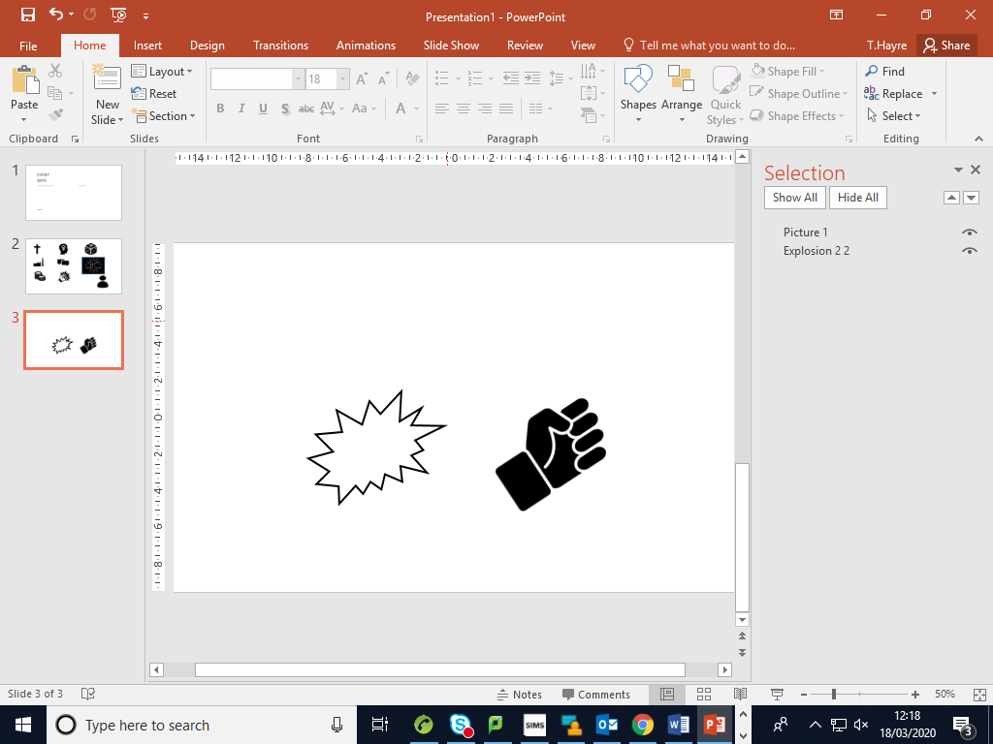

Year 8 Weekly Homework Autumn 2.1 Russian Revolution Knowledge Book pages 13-16
1. CAUSES: Using KB p.14 describe the problems faced by the groups below in Russia: | 2. CAUSES: Use KB p.15 to explain how the factors below caused the Russian Revolution
3. EVENTS: Using KB p.15 complete the gap fill below using the word bank at the bottom: On the 7th of March 40,0000 _________________ went on strike for higher ______________. In the days that followed thousands more workers, men and women who demanded food, _____________, better conditions and a new _____________________. When the Tsar ordered soldiers to use force to put down the revolution on the 12th of _________________ they refused and joined the workers. They showed their support by tying ____________ ribbons to their _______________. Some even _____________ their officers. They marched with the other protestors and demanded the Tsar’s ______________________. WORD BANK wages abdication red workers fuel shot government weapons March | 4. CONSEQUENCES: Use KB p.16 describe what happened to the following people/groups after the March 1917:
Group | What were the problems they faced?
Peasants
Workers
Soldiers
Factor | How did this cause the March 1917 Russian Revolution?
 | 1905 Revolution:
 | The First World War:
 | Impact of the First World War:
Tsar Nicholas II:
Provisional Government:
Bolsheviks:

Slide 3




Year 8 Weekly Homework Autumn 2.2 Bolshevik Revolution Knowledge Book pages 17-18
1. CAUSES: Use KB p.17 to describe how the Russian government changed after the abdication of the Tsar: | 2. CAUSES: Using the images below, your own knowledge and KB p.17 explain why the Bolsheviks gained more support after the Tsar abdicated(think about what they promised the Russian people):
3. EVENTS: Using KB p.17 EITHER draw a set of images OR write at least 3 sentences explaining how the Bolsheviks took over Russia: | 4. CONSEQUENCES: Use KB p.18 to complete the gap fill below, the word bank is at the bottom: In the short term, after the Bolsheviks took over Russia they ordered the murder of the ___________________ family at Ekaterinburg in 1918. Russia ended their involvement in the _________________ World War. A _________________ war broke out between the Bolsheviks and the ________________. Russia lost many resources, including 89% of it _______________ through the Treaty of ________________ ___________________. In the long term, all _________________ was taken away from the rich and businesses were ________________________. ______________________ with extra grain were forced to hand it over to the government. This led to __________________________ under Stalin. ___________________ died in 1924 and Stalin took over. He _______________________ Russia using his 5 Year Plans. WORD BANK: civil collectivisation peasants Brest Litovsk royal land Whites nationalised industrialised First Lenin coal
Provisional Government
Petrograd Soviet
Who appointed them?
Who were their rivals?
Which groups of people made up this part of the government?
What was Order No.1?

Slide 4
Year 8 Weekly Homework Autumn 2.3 American, French and Russian Revolution Knowledge Book pages 6-18
Using your own knowledge and the History section of your KB write down: 1 example of an economic/social cause of the American Revolution (KB page 6): ____________________________________________________________________ 1 example of an economic/social cause of the French Revolution (KB page 9-10): ____________________________________________________________________ 1 example of an economic/social cause of the Russian Revolution (KB page 13-14): ____________________________________________________________________ | 2. Tier 2 language task The word ‘society' means ‘a large number of people and the way they live'. Use ‘society' in three sentences below. Make sure the sentences link to the American, French and Russian revolutions: American: __________________________________________________________ French: __________________________________________________________ Russian: __________________________________________________________
3. Match the key individual to their description: (KB p.11-12 and p.13-14) | 4. Answer the quiz questions below about the American Revolution: (KB p.7-8)
Name |  | Description
Louis XVI |  | He was the leader of the Terror and encouraged the execution of more than 17,000 enemies of the Revolution.
Tsar Nicholas II |  | He was executed by his people due to his unfair tax system and because he did not listen to the Estates General.
Marie Antoinette |  | Wife to Nicholas II. She was German and disliked by Russian society.
Robespierre |  | He was the ruler of Russia who eventually had to abdicate due to a revolution against the impact of WW1
Tsarina |  | She was disliked by society as she spent too much money on gambling and building her palace (Petit Trinon)
Question | Answer
1. When was the Declaration of Independence signed?
2. What happened at the Battle of Yorktown?
3. Which treaty ended Britain’s control over America?
4. Which country became the jewel of the British empire after the American Revolution?
5. Which country was inspired to start their own revolution after the American revolution?

Slide 5
Year 8 Weekly Homework Autumn 2.4 The Chinese Revolution Knowledge Book page 19
Using KB p.19 to answer the quiz questions about the causes of the Russian Revolution | 2. EVENTS: Use your knowledge about the events of the Russian Revolution to decide whether the statements below are TRUE or FALSE (KB p.19) In 1947 Mao Zedong setup the People's Republic of China: TRUE or FALSE The Great Leap Forward were farming reforms: TRUE or FALSE The Great Leap Forward started in 1598: TRUE or FALSE The Cultural Revolution was used to make China capitalist: TRUE or FALSE During the Cultural Revolution opposition was removed: TRUE or FALSE Correct any FALSE statements below: ____________________________________________________________________ ____________________________________________________________________ ____________________________________________________________________
3. CONSEQUENCES: Use KB p.19 to explain what happened to Russia after the revolution | 4. OVERVIEW: Draw a set of 3 images OR write 3 bulletpoints to summarise the causes, events and consequences of the Chinese Revolution(KB p.19)
Question | Answer
1. Who invaded China between 1937-1945?
2. Which 2 groups were fighting a civil war in China before the invasion?
3. Which country offered to try and stop the spread of Communism?
4. Who became the leader of the country after the Chinese Civil War?
5. Which political system did he believe in?
Many people moved to the...
Certain people were attacked, for example...
After Mao's death...
The economy...

Slide 6
Year 8 Weekly Homework Autumn 2.5 The Yellow Revolution Knowledge Book page 20-21
Using KB p.20 to answer the quiz questions about the causes of the Yellow Revolution | 2. EVENTS: Use your knowledge about the events of the Russian Revolution to decide whether the statements below are TRUE or FALSE (KB p.21) The Yellow Revolution started in 1988: TRUE or FALSE General Ramos joined the protestors: TRUE or FALSE The Protestant Church urged the protestors to use peaceful methods: TRUE or FALSE The protestors seized control of buildings on the main road in Manila: TRUE or FALSE Civilians gathered on the DSAE to stop the army shooting protestors : TRUE or FALSE Correct any FALSE statements below: ____________________________________________________________________ ____________________________________________________________________ ____________________________________________________________________
3. CONSEQUENCES: Use KB p.21 to explain what happened to Russia after the revolution | 4. OVERVIEW: Draw a set of 3 images OR write 3 bulletpoints to summarise the causes, events and consequences of the Yellow Revolution (KB p.20-21)
Question | Answer
1. Who was the leader of the Philippines?
2. What did he shut down?
3. Who was Ninoy Aquino?
4. What alleged happened during the 1986 elections?
5. In what way did Imelda Marcos anger the Filipino people?
On the ______________________Marcos fled to...
The Yellow Revolution inspired...
The Philippines became...

Slide 7
Year 8 Weekly Homework Autumn 2.6 Chinese and Yellow Revolutions Knowledge Book pages 19-21
Using your own knowledge about the Chinese Revolution and KB p. 19 to explain: What the Great Leap Forward was: ____________________________________________________________________ What the Cultural Revolution was: ____________________________________________________________________ Who Mao Zedong was: ____________________________________________________________________ | 2. Tier 2 language task The word ‘conflict' means ‘a struggle or clash between different forces/people/groups'. Use ‘conflict' in two sentences below. Make sure the sentences link to the Chinese and Yellow Revolutions: Chinese Revolution: ___________________________________________________________ ____________________________________________________________________________ Yellow Revolution: ____________________________________________________________ ____________________________________________________________________________
3. Using your knowledge of the Yellow Revolution and KB p.20 explain: 1 economic cause of the Yellow Revolution: ____________________________________________________________________ 1 political cause of the Yellow Revolution: ____________________________________________________________________ 1 social cause of the Yellow Revolution: ____________________________________________________________________ | 4. Answer the quiz questions below about the Yellow Revolution: (KB p.21)
Question | Answer
1. Who was in charge of the police force in the Philippines?
2. Who encouraged the civilians to peacefully protest?
3. Where did the Marcos flee to in 1986?
4. What did the Philippines become after the revolution?
5. Which other event did the Yellow Revolution inspire in Europe?

Slide 8
Question to ask:
Notes:
___________________________________________________________________________________________________________________________________________________________________________________________________________________________________________________________________________________________________________________________________________________________________________________________________________________________________________________________________________
___________________________________________________________________________________________________________________________________________________________________________________________________________________________________________________________________________________________________________________________________________________________________________________________________________________________________________________________________________

