Slide 1
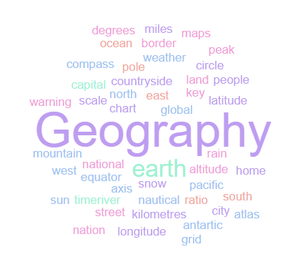
Geography Homework Booklet
Threats to Ecosystems
Name:
Class:
Teacher:
Homework Expectations:
You must keep this booklet neat and presentable
All homework must be completed for the date set
High effort is expected in all tasks
You will boost all work in red pen

Slide 2
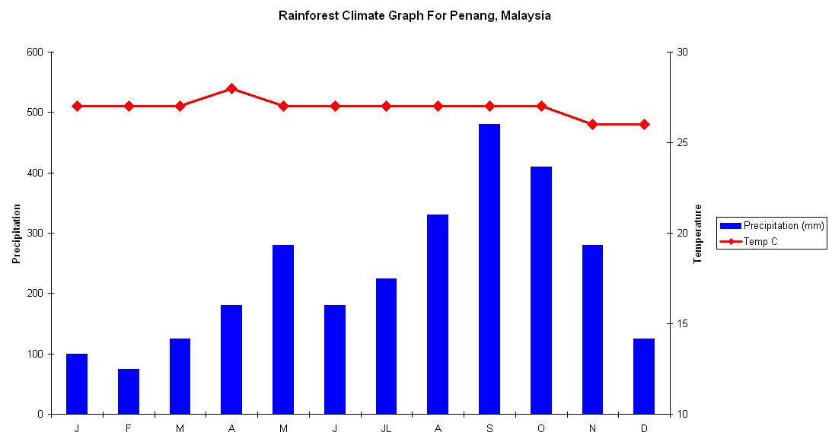
Weekly Homework Ecosystems 1.1 Ecosystems Function Recap Knowledge Book P133, P137
1. Study the Penang Climate graph on P53 - Draw the missing data onto the graph below: | 3. Fill in the key terms and definitions for the following, using P50:
Use P53. Answer these questions about Penang’s climate: Identify the wettest month. ___________________________________________ How low is the lowest temperature? ___________________________________ Which month(s) have the hottest temperature? ___________________________ TRUE or FALSE: There are no dry months in Penang? ____________________ Which is the driest month in Penang? __________________________________ Approx. How much rainfall, falls in August? ___________________________ What is the average temperature in Penang? _____________________________
Key Term | Definition
Ecosystem
Climate
 | A climate of hot temperatures and rainfall for only half the year.
 | A climate of hot and humid conditions all year round.
Photosynthesis
 | Adjust/ or to change.
Stakeholder
Xerophytic
 | Evaporation from leaves, trees, and vegetation.

Slide 3

Weekly Homework Ecosystems 1.2 Food Chains and Adaptations Recap Knowledge Book P133, 139, 147
Use P133 to find a key term/ definition to complete the table. Then use P147 to provide an example from the Semi-arid Grassland to complete the food chain in the final column. | 3. Use P133 to find a key term/ definition to complete the table.
Use P139, describe the following plant adaptations and draw a picture: | 4. Use P146. Around the Acacia tree, label all the different adaptations:
Key Term | Definition
 | Leaves that have fallen to the ground and are decomposing.
Biomass
Decomposers
 | When a plant or animal adjusts or changes to suit its environment.
Key Term | Definition | Example
Producer |  | Acacia Tree
Primary Consumer
Secondary Consumer
 | Eat primary and secondary consumers as their main source of food. They are the top of the food chain.
Adaptation | Description of Adaptation | Drawing of Adaptation
Drip Tip Leaves
Buttress Roots
Lianas

Slide 4
Weekly Homework Ecosystems 1.3 Deforestation Knowledge Book P154-P156
1a. What is deforestation? ________________________________________________________________________________________________________________________________________________________ 1b. Draw an icon/ image to help you remember what deforestation is:
2. Read the local and global effects of deforestation below. Decide whether they are social, environmental, or economic effects. Millions of species have died and become extinct. ________________________________ Less CO2 is being absorbed from the atmosphere. _______________________________ Indigenous people have been forced to relocate. _________________________________ Deforestation can consume a country’s only natural resource meaning they may one day have nothing to trade on the global market. ____________________________________ Biodiversity in the tropical rainforest is decreasing. _______________________________ Potential cures to human diseases are being lost. ________________________________ Less trees means the soil becomes loose and more likely to wash away, leading to desertification. ____________________________________________________________ Large quantities of CO2 are being re-released when trees are felled. _________________ Whole tribes have been lost to western diseases e.g. Malaria._______________________
3. Use P68 in your KB. “Explain the causes of deforestation” [6 marks]
Deforestation is… _____________________________________________________________
___________________________________________________________________________.
One cause of deforestation is… __________________________________________________.
This is where trees are cut down to… _____________________________________________
________________________________________________________________________________________________________________________________________________________________________________________________________________________________________________________________________________________________________________
Another cause of deforestation is… ______________________________________________.
Here, tree’s are removed because… ______________________________________________
________________________________________________________________________________________________________________________________________________________________________________________________________________________________________________________________________________________________________________
A third reason for deforestation is… ______________________________________________.
Trees are cut down due to… _____________________________________________________
________________________________________________________________________________________________________________________________________________________________________________________________________________________________________________________________________________________________________________

Slide 5
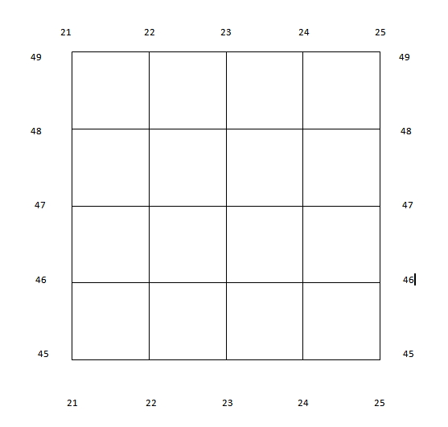
Weekly Homework Ecosystems 1.4 Map Skills: Scale, Distance, Compass Points and Grid References
N
Interpreting Scale:
2cm on the map is what distance in real life? _______________________________
3cm on the map is what distance in real life? _______________________________
0.5km in real life is how many ‘cm’ on the map? ____________________________
4.5km in real life is how many ‘cm’ on the map? ____________________________
Measuring Distance:
On the map, how many ‘cm’ apart are and ? _____________________
On the map, how many ‘cm’ apart are and ? _____________________
In real life, how far apart in ‘km’ are and ? _______________________
In real life, how far apart in ‘km’ are and ? _______________________
Compass Points (Identify the correct compass direction):
To get from to you travel… ___________________________________
To get from to you travel… ___________________________________
To get from to you travel… ___________________________________
To get from to you travel… ___________________________________
6- Figure Grid References:
What is the 6 figure grid reference for the ? ____________________________
Which shape is found in grid reference 225,468? ____________________________
Draw a in grid reference 236,453
2cm
2cm: 1km
1km

Slide 6
Weekly Homework Ecosystems 1.5 Sustainable Management of Tropical Rainforests Knowledge Book P157-158
1a. Define the following key terms: Sustainable- _________________________________________________________________ ________________________________________________________________________________________________________________________________________________________ Ecotourism- _________________________________________________________________ ____________________________________________________________________________ 1b. Come up with your own definition of ‘management’: Management- ________________________________________________________________ ________________________________________________________________________________________________________________________________________________________
3. Study P72. Answer the following questions about the case study Costa Rica: In which continent is Costa Rica located? _______________________________________ With which country do they have a ‘debt for nature swap’ with? ____________________ How much of the land is classified as protected in Costa Rica? ______________________ What are countries looking to create throughout the whole of Central America? _______ ___________________________________________________________________________ By the year ________. How much will Costa Rica earn from ecotourism? ______________
3. Use P71 in your KB. “Explain how the tropical rainforest can be sustainably managed” [6]
Sustainable management is… ___________________________________________________
___________________________________________________________________________.
One way the rainforest can be sustainably manages is creating national parks. This is when… ____________________________________________________________________________ ____________________________________________________________________________
____________________________________________________________________________This is sustainable because… ____________________________________________________ ________________________________________________________________________________________________________________________________________________________However, one problem with this strategy is… _______________________________________
________________________________________________________________________________________________________________________________________________________Another management strategy is … ______________________________________________.
This involves… _______________________________________________________________
________________________________________________________________________________________________________________________________________________________An advantage of this strategy is… ________________________________________________ ________________________________________________________________________________________________________________________________________________________
However, an issue with this strategy is… ___________________________________________ ____________________________________________________________________________

Slide 7
Weekly Homework Ecosystems 1.6 Coastal Landforms Knowledge Book: P68-76
1. Fill in the key terms and definitions for the following: | 3. Draw a diagram, then explain the formation of wave-cut platform:
2. Which landform is being described? This landform joins together two headlands. __________________________________ Alternating bands of hard rock and soft rock. __________________________________ Hydraulic action creates a wave-cut notch in the cliff. ___________________________ Form where the coast suddenly changes direction. _____________________________ Sub-aerial processes attack the top of the archway. _____________________________ Strong winds curve the end of this landform. __________________________________ A real-world example is Old ‘Harry Rocks’. _____________________________________ This landform causes the cliff to retreat overtime. ______________________________ A lagoon forms behind this landform. ________________________________________
Key Term | Definition
Hydraulic Action
 | Naturally occurring material that is broken down by processes of weathering and erosion.
Abrasion
Lagoon
_______________________________________________________________________________________________________________________________________________________________________________________________________________________________________________________________________________________________________________________________________________________________________________________________________________________________________________________________________________________________________________

Slide 8
Weekly Homework Ecosystems 1.7 Threats and Management of Semi-Arid Grasslands Knowledge Book P160
3. Use P73 to complete the table about threats to semi-arid grasslands. Create an icon to help you remember the threat.
3. Use P73 in your KB. “Explain how semi-arid grasslands can be sustainably managed” [6]
One way semi-arid grasslands can be managed is by… ______________________________
This is where… ______________________________________________________________
__________________________________________________________________________
It sustainably manages the ecosystem because…___________________________________ ______________________________________________________________________________________________________________________________________________________________________________________________________________________________
Another management strategy is… _____________________________________________
This involves… ______________________________________________________________
__________________________________________________________________________
It is sustainable because... ____________________________________________________
______________________________________________________________________________________________________________________________________________________________________________________________________________________________
A third sustainable management strategy is… _____________________________________ This is when… ______________________________________________________________
__________________________________________________________________________
It’s a sustainable technique because… ___________________________________________ __________________________________________________________________________
____________________________________________________________________________________________________________________________________________________
The Threat | Description of Threat | Icon/ Diagram
Fires
Monoculture
Tourism
Hunting & Poaching
Urbanisation

Slide 9

Weekly Homework Ecosystems 1.8 Small Scale Ecosystem: Attenborough Nature Reserve Knowledge Book P149
Use P64. Read the information about Attenborough and answer the questions: How many miles is Attenborough Nature Reserve from Nottingham? _________________ Which river creates the moving water ecosystem? ________________________________ What type of consumer is a frog? ______________________________________________ In geography, someone with a vested interest is called a ___________________________ Before it was a nature reserve, Attenborough was a… _____________________________ Identify two stakeholder. ____________________________________________________ Why do people visit Attenborough Nature Reserve? _______________________________
Use P64 to draw out and label a food chain found in Attenborough Nature Reserve:
3. Use the table on P64. Identify the opinions and conflicts of different stakeholders:
Stakeholder | Why they like Attenborough Nature Reserve | Which stakeholder do they conflict with and why?
Wildlife Trust Member | Attracts a wide variety of birds = good for bird watching Provides a protected breeding ground for rare species | Teachers because the visitor centre/ classroom ruins the natural feel of the area Joggers because they may scare off the wildlife
Teacher
Attenborough Resident
Jogger
Birch Tree
____________
____________
____________
____________
Producer
________________________
________________________
________________________
________________________

Slide 10
Questions to ask:
Notes:
___________________________________________________________________________________________________________________________________________________________________________________________________________________________________________________________________________________________________________________________________________________________________________________________________________________________________________________________________________
___________________________________________________________________________________________________________________________________________________________________________________________________________________________________________________________________________________________________________________________________________________________________________________________________________________________________________________________________________

Slide 11
Questions to ask:
Notes:
___________________________________________________________________________________________________________________________________________________________________________________________________________________________________________________________________________________________________________________________________________________________________________________________________________________________________________________________________________
___________________________________________________________________________________________________________________________________________________________________________________________________________________________________________________________________________________________________________________________________________________________________________________________________________________________________________________________________________

Slide 12
Questions to ask:
Notes:
___________________________________________________________________________________________________________________________________________________________________________________________________________________________________________________________________________________________________________________________________________________________________________________________________________________________________________________________________________
___________________________________________________________________________________________________________________________________________________________________________________________________________________________________________________________________________________________________________________________________________________________________________________________________________________________________________________________________________

Slide 13
Questions to ask:
Notes:
___________________________________________________________________________________________________________________________________________________________________________________________________________________________________________________________________________________________________________________________________________________________________________________________________________________________________________________________________________
___________________________________________________________________________________________________________________________________________________________________________________________________________________________________________________________________________________________________________________________________________________________________________________________________________________________________________________________________________

