Slide 1
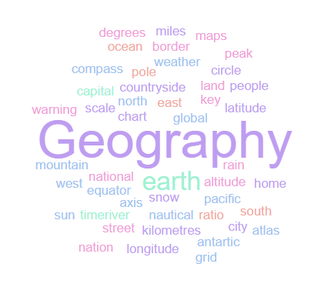
Geography Homework Booklet
Year 8 Summer 2: Africa 2
Name:
Class:
Teacher:
Homework Expectations:
You must keep this booklet neat and presentable
All homework must be completed for the date set
High effort is expected in all tasks
You will boost all work in red pen

Slide 2
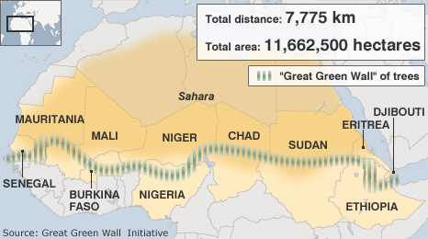
Year 8 Weekly Homework Summer 2.1 Desertification in the Sahel KB: P48
1. Fill in the key terms and definitions for the following: | 3a. Explain how over farming and overgrazing leads to desertification: ________________________________________________________________________________________________________________________________________________________________________________________________________________________________________________________________________________________________________________ 3b. Explain how afforestation (Great Green Wall) will help stop desertification: ________________________________________________________________________________________________________________________________________________________________________________________________________________________________________________________________________________________________________________
2. Draw an image/ icon for the following key terms: | 4. Use P48 to identify and label the 11 countries contributing to the Great Green Wall:
Key Term | Definition
Drought
 | The process of fertile land becoming a desert.
Famine
Irrigate
 | A collective of plants found in a given area
Soil Erosion
Drought
Famine

Slide 3
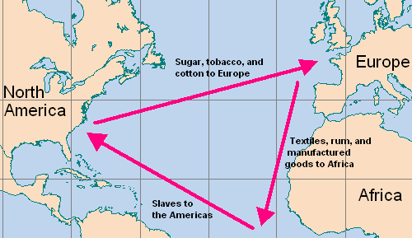
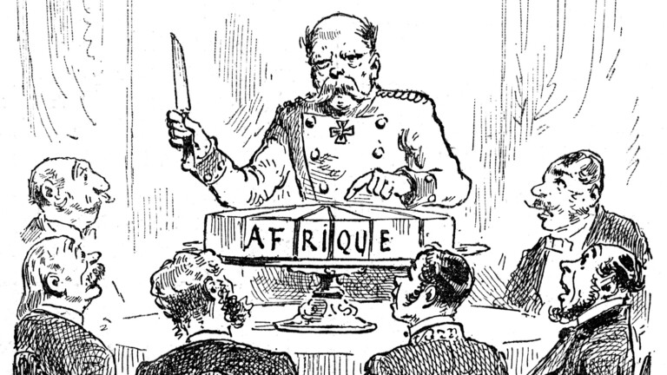
Year 8 Weekly Homework Summer 2.2 Consequences of the Past Knowledge Book P49
1a. Label the ‘Atlantic Slave Trade Triangle’ correctly with the key terms below: | Answer the following questions: How many African’s were sold into slavery? _____________________________________ In what decade did African countries start gaining their independence? _______________ Who took control of the Congo Basin? _________________________________________ What was the name of the conference held in 1884? ______________________________ How many European countries was Africa divided between? _______________________ What natural resource were the Congolese forced to collect? _______________________ How many Congolese locals died as a result of the cruelty? _________________________ What manufactured goods did the Europeans trade for slaves? _____________________ ____________________________________________________________________________ What raw materials did North America provide to Europe? _________________________ ____________________________________________________________________________
1b. Using the diagram above, describe how the Atlantic Slave Trade operated: ________________________________________________________________________________________________________________________________________________________________________________________________________________________________________________________________________________________________________________________________________________________________________________________________________________________________________________________________________ ________________________________________________________________________________________________________________________________________________________ | 3. Annotate this political cartoon (What event? Who are the people? What is going on here?)
Africa Manufactured Goods North America Slaves Europe Raw Materials

Slide 4
Year 8 Weekly Homework Summer 2.3 Africa’s Development Knowledge Book P50- 51
1. Fill in the key terms and definitions for the following: | 3a. What is ‘Human Development Index’ (HDI)?: ________________________________________________________________________________________________________________________________________________________ 3b. Identify an advantage of using HDI to measure development: ________________________________________________________________________________________________________________________________________________________ 3c. Identify an environmental indicator that could be added to improve HDI: ____________________________________________________________________________
2. Use P51 and explain two factors that cause unequal development in Africa: One factor is ____________________________________. This causes unequal development because… ___________________________________________________________________ ____________________________________________________________________________________________________________________________________________________________________________________________________________________________________ Another factor is _________________________________. This causes unequal development because… ___________________________________________________________________ ____________________________________________________________________________ ________________________________________________________________________________________________________________________________________________________ | 4. Connect these words (you must make at least 4 connections):
Key Term | Definition
Death Rate
 | The total number of infants dying before reaching one year old, per 1000 live births.
Purchasing Power Parity
Literacy Rate
Birth Rate
Life Expectancy
High Income Country
Low Income Country
Gross National Income (GNI)
Access to clean water

Slide 5
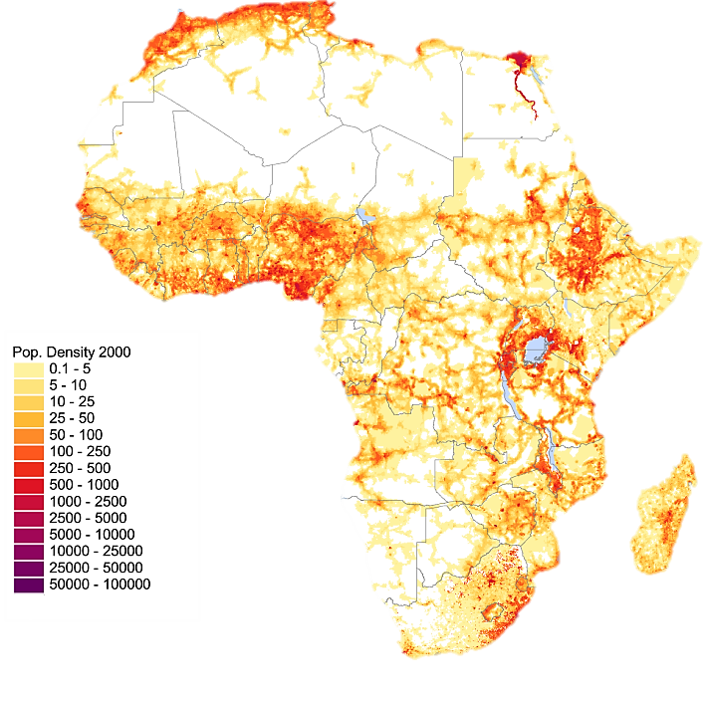
Year 8 Weekly Homework Summer 2.4 How Are Populations Changing in Africa? KB: page 52-53
1. Fill in the key terms and definitions for the following: | 3. Use P52 and P53 in your KB to fill in the blanks: Africa has a population of _________________ people. However, the population is not equally d_________________. Africa also has the youngest population globally, with _____% of the population below _______ years old. Some of the challenges facing Africa’s population is that the b__________ r________ remains high, with an average of _________ children per woman. Another issue is due to the lack of ________ and c_____________ g_____________; many young people are migrating away. However, there are some positive opportunities too, including the i_________________ in life expectancy (average life expectancy is now _______ years). Also, many m___________________ c_______________ looking for cheap labour are moving their factories to Africa.
2. Draw an image/ icon for the following key terms: | 4. Use compass points to describe the population distribution in Africa [3]
Key Term | Definition
Population
 | A small amount of people in a given area.
Densely Populated
Population Distribution
 | The number of people living in a given area, usually within 1km²
Young Dependent
Old Dependent
______________________________________________________________________________________________________________________________________________________________________________________________________________________________________________________________________________
N
Young Dependent Population
Densely Populated

Slide 6
Year 8 Weekly Homework Summer 2.5 Africa: Urbanisation Knowledge Book: P54
1a. Study the map on P54. Draw out the pie charts for Nigeria and South Africa to show the proportion of the urban population living in slums: 1b. Compare the pie charts of Nigeria and South Africa and describe what they show: ____________________________________________________________________________________________________________________________________________________________________________________________________________________________________ | 3. Use P54 to define the following key term: Urbanisation - ________________________________________________________________ ____________________________________________________________________________ 4. Use the word ‘urbanisation’ in a sentence: ________________________________________________________________________________________________________________________________________________________________________________________________________________________________________________________________________________________________________________
2. Decide if the following statements are TRUE or FALSE: Africa has the lowest rate of urbanisation in the world ____________ There are 30 African cities with over a million inhabitants ____________ There are over 100 million people living in Ethiopia ____________ Slums are areas of high quality, expensive housing ____________ Of the urban population, 83% of people live in slum housing ____________ The majority of Ethiopia’s population live rurally ____________ The growth of cities has only negative consequences ____________ | 5. Mind-map as many characteristics of slums that you can think of:
Nigeria
South Africa
Key:
Share of urban population living in slums
Rest of urban population (living in regular housing)
Poor quality homes made of scrap materials
Characteristics of Slums

Slide 7
Year 8 Weekly Homework Summer 2.6 Improving Africa’s Development Knowledge Book P55
1. Answer the following questions: Identify two multi-national companies. _________________________________________ What is aid? ______________________________________________________________ Identify the two types of aid. _________________________________________________ China has built a 460 mile long rail line between _______________ and ______________ In what year did China become Africa’s largest trade partner? _______________________ What percentage of Africa’s exports go to China? _________________________________ What percentage of Africa’s imports are from China?______________________________ How can we improve trade links between Africa and other countries? ________________ ____________________________________________________________________________ | 3a. Use P41 to define the following key term: Development - _______________________________________________________________ ____________________________________________________________________________ Infrastructure - _______________________________________________________________ ____________________________________________________________________________ 3b. Use the words ‘development’ and ‘infrastructure’ in a sentence: ________________________________________________________________________________________________________________________________________________________ ____________________________________________________________________________
2. Explain two methods of improving development in Africa: One method is _____________________________________. This can improve development because… ___________________________________________________________________ ____________________________________________________________________________________________________________________________________________________________________________________________________________________________________ Another method is ______________________________________. This can aid development because… ___________________________________________________________________ ____________________________________________________________________________ ________________________________________________________________________________________________________________________________________________________ | 4. Connect these words (you must make at least 4 connections):
Imports
Exports
China
Africa
Development
Infrastructure

Slide 8
Questions to ask:
Notes:
___________________________________________________________________________________________________________________________________________________________________________________________________________________________________________________________________________________________________________________________________________________________________________________________________________________________________________________________________________
___________________________________________________________________________________________________________________________________________________________________________________________________________________________________________________________________________________________________________________________________________________________________________________________________________________________________________________________________________

Slide 9
Questions to ask:
Notes:
___________________________________________________________________________________________________________________________________________________________________________________________________________________________________________________________________________________________________________________________________________________________________________________________________________________________________________________________________________
___________________________________________________________________________________________________________________________________________________________________________________________________________________________________________________________________________________________________________________________________________________________________________________________________________________________________________________________________________

Slide 10
Questions to ask:
Notes:
___________________________________________________________________________________________________________________________________________________________________________________________________________________________________________________________________________________________________________________________________________________________________________________________________________________________________________________________________________
___________________________________________________________________________________________________________________________________________________________________________________________________________________________________________________________________________________________________________________________________________________________________________________________________________________________________________________________________________

Slide 11
Questions to ask:
Notes:
___________________________________________________________________________________________________________________________________________________________________________________________________________________________________________________________________________________________________________________________________________________________________________________________________________________________________________________________________________
___________________________________________________________________________________________________________________________________________________________________________________________________________________________________________________________________________________________________________________________________________________________________________________________________________________________________________________________________________

