Slide 1
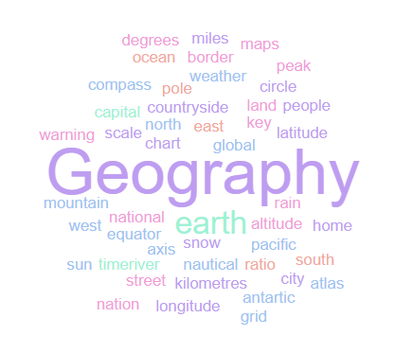
Geography Homework Booklet
Year 9 Summer 1
Name:
Class:
Teacher:
Homework Expectations:
You must keep this booklet neat and presentable
All homework must be completed for the date set
High effort is expected in all tasks
You will boost all work in red pen

Slide 2
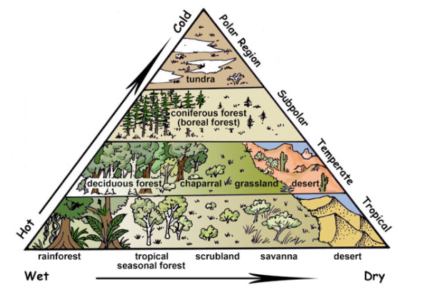
Year 9 Weekly Homework Summer 1.1 Global Biomes Knowledge Book P50- 52
1a. Define the following key terms: Biome- _____________________________________________________________________ Climate- ____________________________________________________________________ ____________________________________________________________________________ 1b. List 3 biotic (living) components in an ecosystem: 1c. List 3 abiotic (non-living) components in an ecosystem: | 2. Study the map on P37– Describe the distribution of the world’s biomes [4]:
3. Decide if the following statements are TRUE or FALSE: Antarctica is the world’s largest desert ____________ The main biomes of the UK are Mountainous and Tundra ____________ Tropical Rainforest biome is found along the equator ____________ Northern Africa is mainly Desert and Savannah biome ____________ Savannah Grasslands experience all 4 seasons ____________ Deciduous woodlands are considered an extreme environment ____________ | 4. Label these countries on the diagram:
___________________________________________________________________________________________________________________________________________________________________________________________________________________________________________________________________________________________________________________________________________________________________________________________________________________________________________________________________________________________________________________________________________________________
UK
Egypt
Greenland
Brazil
Canada

Slide 3
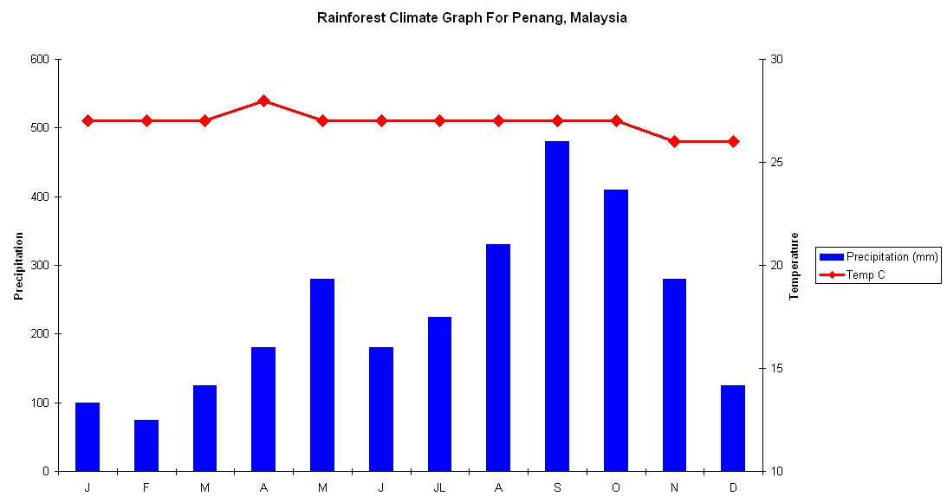
Year 9 Weekly Homework Summer 1.2 Location and Climate Knowledge Book P50, P53, P59
1. Study the Penang Climate graph on P53 - Draw the missing data onto the graph below: | 3. Fill in the key terms and definitions for the following, using P50:
Use P53. Answer these questions about Penang’s climate: Identify the wettest month. ___________________________________________ How hot is the highest temperature? ___________________________________ Which month(s) have the coldest temperature? ___________________________ TRUE or FALSE: There are no cold months in Penang? ____________________ Which is the driest month in Penang? __________________________________ Approx. How much rainfall, falls in September? ___________________________ What is the average temperature in Penang? _____________________________ | 4. Explain two characteristic of the Semi-arid Grassland biome: One characteristic of this biome is _________________________________________ _____________________________________________________________________ This means that…______________________________________________________ __________________________________________________________________________________________________________________________________________ Another characteristic of this biome is ______________________________________ _____________________________________________________________________ This means that…______________________________________________________ __________________________________________________________________________________________________________________________________________
Key Term | Definition
Ecosystem
Climate
 | A climate of hot temperatures and rainfall for only half the year.
 | A climate of hot and humid conditions all year round.

Slide 4
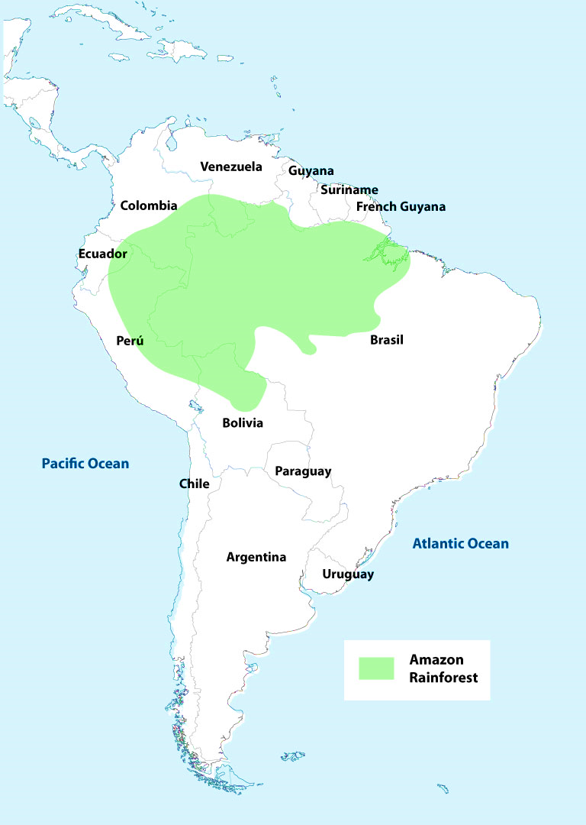
Year 9 Weekly Homework Summer 1.3 Brazils Tropical Rainforests Knowledge Book P53-54
1. Use the axis to draw and label the 4 different layers of the tropical rainforest:
Answer the following questions about the climate of the Tropical Rainforest: Which month receives the least rainfall? Which month received the most rainfall? TRUE or FALSE: There are no cold months in Penang, Malaysia What month has the highest temperature? TRUE or FALSE: Penang, Malaysia receives very little rainfall How many millimetres of rain fall in Septemeber? TRUE or FALSE: Penang, Malaysia has a hot, humid climate.
3. Study the map. Describe the location of the Amazon Rainforest in South America [4]:
________________________________________________________________________________________________________________________________________________________________________________________________________________________________________________________________________________________________________________
________________________________________________________________________________________________________________________________________________________
________________________________________________________________________________________________________________________________________________________
____________________________________________________________________________
50m
40m
30m
20m
10m

Slide 5
Year 9 Weekly Homework Summer 1.4 Tropical Rainforest Food Chains and Adaptations Knowledge Book P50, 55-56
Use P35 to find a key term/ definition to complete the table. Then use P41 to provide an example from the Tropical Rainforest to complete the food chain in the final column.
4. Use P40, describe the following plant adaptations and draw a picture:
3. Research an animal that lives in the Tropical Rainforest. In the space below, draw a picture of that animal, then underneath, describe how it is specifically adapted to survive:
________________________________________________________________________________________________________________________________________________________________________________________________________________________________________________________________________________________________________________________________________________________________________________________________________________________________________________________________________________________________________________________________________________________________________________________________________________________________________________________________________________________________________________________________________________
Key Term | Definition | Example
Producer |  | Orchid
 | Animals that eat vegetation (producers). These are usually herbivores.
Secondary Consumer
 | Eat primary and secondary consumers as their main source of food. They are the top of the food chain.
Found:
Status:
Adaptations:
Adaptation | Description of Adaptation | Drawing of Adaptation
Drip Tip Leaves
Buttress Roots
Lianas

Slide 6
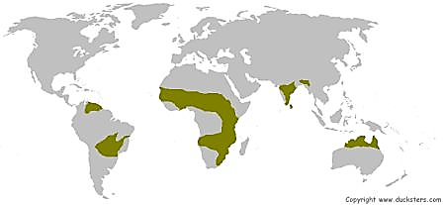
Year 9 Weekly Homework Summer 1.5 Semi-Arid Grasslands Knowledge Book P50, P59
1. Define the following key terms: rainforest: Semi-Arid Climate- _____________________________________________________________ _____________________________________________________________________________ Xerophytic- ___________________________________________________________________ _____________________________________________________________________________ Ecosystem- ___________________________________________________________________ _____________________________________________________________________________
Answer the following questions about the climate of semi-arid grasslands: Which month in the Serengeti receives the most rainfall? Which month in Zinder receives the most rainfall? TRUE or FALSE: There are no cold months in Zinder or the Serengeti? What month in Zinder has the highest temperature? TRUE or FALSE: The Serengeti has a wet season and a dry season? How many millimetres of rain fall in April in the Serengeti? TRUE or FALSE: Zinder’s dry season is between May and October?
3. Study the map. Describe the location of the world’s semi-arid grasslands [4]:
___________________________________________________________________________________________________________________________________________________________________________________________________________________________________________________________________________________________________________________________________________________________________________________________________________________________________________________________________________________________________
__________________________________________________________________________________________________________________________________________

Slide 7

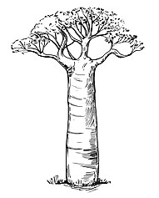
Year 9 Weekly Homework Summer 1.6 Semi-Arid Grassland Food Chains and Adaptations Knowledge Book P50, 60-62
Use P35 to find a key term/ definition to complete the table.
4. Use P47 to draw out an label a food chain from the semi-arid grassland:
3. Use P45 and P46. Around each tree, label all the different adaptations:
Key Term | Definition
 | Leaves that have fallen to the ground and are decomposing.
Biomass
Decomposers
 | When a plant or animal adjusts or changes to suit its environment.
Acacia Tree
Acacia Tree
_______________
_______________
_______________
Producer
____________________________
____________________________
____________________________
Baobab Tree

Slide 8
Questions to ask:
Notes:
___________________________________________________________________________________________________________________________________________________________________________________________________________________________________________________________________________________________________________________________________________________________________________________________________________________________________________________________________________
___________________________________________________________________________________________________________________________________________________________________________________________________________________________________________________________________________________________________________________________________________________________________________________________________________________________________________________________________________

Slide 9
Questions to ask:
Notes:
___________________________________________________________________________________________________________________________________________________________________________________________________________________________________________________________________________________________________________________________________________________________________________________________________________________________________________________________________________
___________________________________________________________________________________________________________________________________________________________________________________________________________________________________________________________________________________________________________________________________________________________________________________________________________________________________________________________________________

Slide 10
Questions to ask:
Notes:
___________________________________________________________________________________________________________________________________________________________________________________________________________________________________________________________________________________________________________________________________________________________________________________________________________________________________________________________________________
___________________________________________________________________________________________________________________________________________________________________________________________________________________________________________________________________________________________________________________________________________________________________________________________________________________________________________________________________________

Slide 11
Questions to ask:
Notes:
___________________________________________________________________________________________________________________________________________________________________________________________________________________________________________________________________________________________________________________________________________________________________________________________________________________________________________________________________________
___________________________________________________________________________________________________________________________________________________________________________________________________________________________________________________________________________________________________________________________________________________________________________________________________________________________________________________________________________

