Slide 1
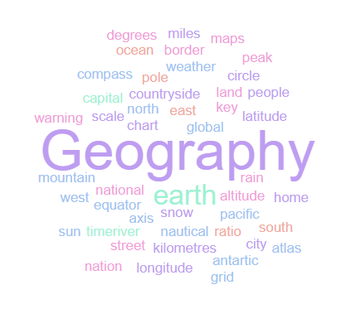
Geography Homework Booklet
Year 8 Summer 1: Africa 1
Name:
Class:
Teacher:
Homework Expectations:
You must keep this booklet neat and presentable
All homework must be completed for the date set
High effort is expected in all tasks
You will boost all work in red pen

Slide 2
Year 8 Weekly Homework Summer 1.1 A Single-Story Africa
1a. Define the word ‘Stereotype’ ________________________________________________________________________________________________________________________________________________________ 1b. Where do our stereotypes come from? Bullet point your answers: | 3a. Why is it important that we overcome these stereotypes and misconceptions? ________________________________________________________________________________________________________________________________________________________________________________________________________________________________________________________________________________________________________________ ____________________________________________________________________________ 3b. Suggest 3 ways we can overcome these stereotypes and misconceptions:
2. Mind-map as many stereotypes and misconceptions you know exist about Africa: | 4. Connect these words (you must make at least 4 connections):
Media
Prejudice
All of Africa is poor
Stereotypes
Stereotypes about
Africa
Africa
Unfair/ Untrue
Diverse

Slide 3
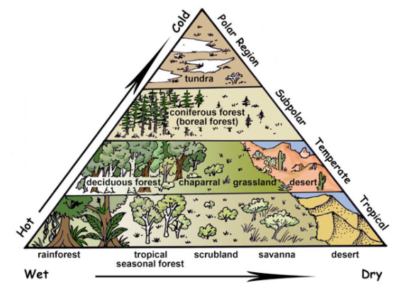
Year 8 Weekly Homework Summer 1.2 The Biomes of Africa Knowledge Book Page 41-42
1a. Define the following key terms: Biome- _____________________________________________________________________ Climate- ____________________________________________________________________ ____________________________________________________________________________ 1b. List 3 biotic (living) components in an ecosystem: 1c. List 3 abiotic (non-living) components in an ecosystem: | 2. Study the map on P42 – Describe the distribution of Africa’s biomes:
3. Decide if the following statements are TRUE or FALSE: Africa has many different climates and biomes ____________ The main biomes of Africa are Mountainous and Tundra ____________ Tropical Rainforest biome is found in central Africa ____________ Northern Africa is mainly Desert and Savannah biome ____________ Savannah Grasslands experience all 4 seasons ____________ Deciduous woodlands are considered an extreme environment ____________ | 4. Label these countries on the diagram:
___________________________________________________________________________________________________________________________________________________________________________________________________________________________________________________________________________________________________________________________________________________________________________________________________________________________________________________________________________________________________________________________________________________________
Algeria
Somalia
Zambia
Cameroon

Slide 4
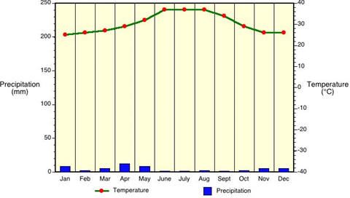
Year 8 Weekly Homework Summer 1.3 Africa’s Climate Knowledge Book P42
1. Study the Algeria Desert Biome graph on P42 - Draw the temperature line onto the graph below: | 3. Fill in the key terms and definitions for the following:
Use P42. Answer these questions about the 4 African climates: Name the wettest biome. ____________________________________________ Which biome has the largest range in temperature? _______________________ Which biome only experiences 2 seasons? ______________________________ TRUE or FALSE: There are no seasons in the Tropical Rainforest. ____________ Which is the wettest month in Zambia? _________________________________ Which biome experiences the hottest temperatures? _______________________ | 4. Explain two characteristic of the Tropical Rainforest biome: One characteristic of this biome is _________________________________________ _____________________________________________________________________ This means that…______________________________________________________ __________________________________________________________________________________________________________________________________________ Another characteristic of this biome is ______________________________________ _____________________________________________________________________ This means that…______________________________________________________ __________________________________________________________________________________________________________________________________________
Key Term | Definition
Stakeholder
 | Money and Jobs.
Social
Environmental
 | The Government

Slide 5
Year 8 Weekly Homework Summer 1.4 Africa’s Physical Landscape Knowledge Book 43
1a. What is a physical feature? ________________________________________________________________________________________________________________________________________________________ 1b. Draw an icon/ image to help you remember what a physical features is:
2. Study the table on P43. Answer the following questions: How many miles do the Atlas Mountains extend for? ______________________________ What type of landform is Mt Kilimanjaro? _______________________________________ In which direction does the Rive Nile flow? ______________________________________ Which type of plate boundary formed the Great Rift Valley? ________________________ 25% of the African continent is covered by which landform? ________________________ In which African country is Mt Kilimanjaro located? _______________________________ This landform forms a border between Zambia and Zimbabwe?______________________ Who were the original inhabitants of the Atlas Mountains? _________________________ How large is the Sahara Desert? ______________________________________________ This landform was made a World Heritage site in 1989? ___________________________
3. Study the table on P43. Select one of the 6 physical features and create a fact file poster on your chosen feature (include: pictures/ drawings/ facts & info/ location/ countries):

Slide 6
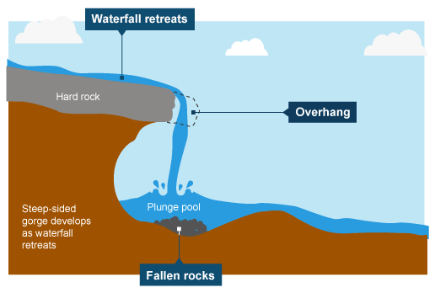
Year 8 Weekly Homework Summer 1.5 Waterfalls and Steep-Sided Gorges KB: P44 – P45
Use P45 to label the diagram below using the key terms provided: | 3. Use P44 to define the following key terms: Erosion- ____________________________________________________________________ Deposition- _________________________________________________________________ 4. What is the difference between ‘saltation’ and ‘traction’? ________________________________________________________________________________________________________________________________________________________________________________________________________________________________________________________________________________________________________________
2. Use P45 to describe the formation of a waterfall and steep-sided gorge [6 marks] ____________________________________________________________________________________________________________________________________________________________________________________________________________________________________ ____________________________________________________________________________________________________________________________________________________________________________________________________________________________________ ____________________________________________________________________________________________________________________________________________________________________________________________________________________________________ | 5. Match the term to the definition
Waterfall retreats
Overhang
Soft Rock
Hard Rock
Plunge Pool
Waterfall
Fallen Rocks
Key Term | Definition
Hydraulic Action | Rocks carried by the river rub and scrape along the riverbed and banks, wearing them down.
Abrasion | Slightly acidic water dissolves certain types of rock.
Attrition | The force of the river water compresses air into cracks along the river banks.
Solution | Rocks carried by the river collide with each other and break into smaller pieces.

Slide 7
Questions to ask:
Notes:
___________________________________________________________________________________________________________________________________________________________________________________________________________________________________________________________________________________________________________________________________________________________________________________________________________________________________________________________________________
___________________________________________________________________________________________________________________________________________________________________________________________________________________________________________________________________________________________________________________________________________________________________________________________________________________________________________________________________________

Slide 8
Questions to ask:
Notes:
___________________________________________________________________________________________________________________________________________________________________________________________________________________________________________________________________________________________________________________________________________________________________________________________________________________________________________________________________________
___________________________________________________________________________________________________________________________________________________________________________________________________________________________________________________________________________________________________________________________________________________________________________________________________________________________________________________________________________

Slide 9
Questions to ask:
Notes:
___________________________________________________________________________________________________________________________________________________________________________________________________________________________________________________________________________________________________________________________________________________________________________________________________________________________________________________________________________
___________________________________________________________________________________________________________________________________________________________________________________________________________________________________________________________________________________________________________________________________________________________________________________________________________________________________________________________________________

Slide 10
Questions to ask:
Notes:
___________________________________________________________________________________________________________________________________________________________________________________________________________________________________________________________________________________________________________________________________________________________________________________________________________________________________________________________________________
___________________________________________________________________________________________________________________________________________________________________________________________________________________________________________________________________________________________________________________________________________________________________________________________________________________________________________________________________________

