Slide 1
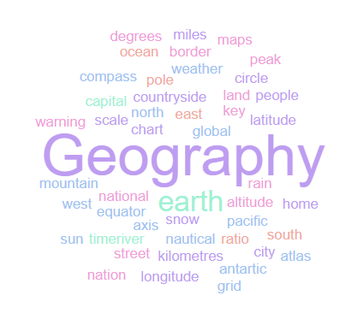
Geography Homework Booklet
Year 8 Spring: Middle East
Name:
Class:
Teacher:
Homework Expectations:
You must keep this booklet neat and presentable
All homework must be completed for the date set
High effort is expected in all tasks
You will boost all work in red pen

Slide 2
Year 8 Weekly Homework Spring 1.1 The Middle East: An Important World Region KB: page 32- 33
Match the capitals to the country:​ | 2. Define the term ‘Diversifying’​ ______________________________________________________________________________________________________________________________________________________________________________________________________________________________ 3. Explain why it is important for the Middle East to diversify: ​ ________________________________________________________________________________________________________________________________________________________________________________________________________________________________________________________________________________________________________​____________________________________________________________________________________________________________________________________________________
3. Are these statements TRUE or FALSE?​ The Middle East is where Africa, Asia and Europe meet? TRUE/ FALSE​ It is sometimes called South-East Asia? TRUE/ FALSE​ ‘Middle East’ describes the geography and the culture of the area? TRUE/ FALSE​ The Middle East is home to the largest oil reserves in the world? TRUE/ FALSE The area has suffered from conflicts and unrest? TRUE/ FALSE​ Its biggest natural resource is gemstones? TRUE/ FALSE​ The two main biomes are mountain and desert? TRUE/ FALSE | 4. ​Fill in the key terms and definitions for the following:
CAPITAL​ | COUNTRY​
Cairo​ | Saudi Arabia
Ankara​ | United Arab Emirates
Doha | Egypt​
Abu Dhabi | Yemen
Beirut | Turkey​
Riyadh | Qatar
Sana’a | Lebanon
Key Term | Definition
Crude Oil
 | An area within a country
Forced Migration
Mediterranean Climate

Slide 3
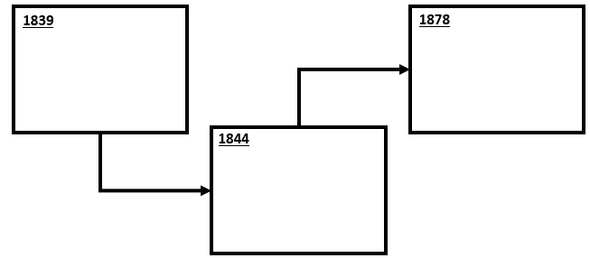
Year 8 Weekly Homework Spring 1.2 Physical Geography & Climate of the Middle East Knowledge Book Page 34-36
What is the difference in climate between the north and south: | 2. Use the flow diagram below to show how the Middle East has been affected by plate tectonics (pg31)
3. Explain how plate tectonics in the Middle East has formed mountains and volcanoes ________________________________________________________________________________________________________________________________________________________________________________________________________________________________________________________________________________________________________________________________________________________________________________________________________________________________________________________________________________________________________________________________________________________________ | 4. Answer the questions below: What mountain ranges can be found in Tukey? ___________________________ What mountain ranges can be found in Iran? ___________________________ What is found in the south of the Middle East?? _______________________________________ There are 3 rivers basins in the Middle East, name them: _________________________________ _________________________________ _________________________________
North | South
2__________________________________________________
1__________________________________________________
3__________________________________________________

Slide 4
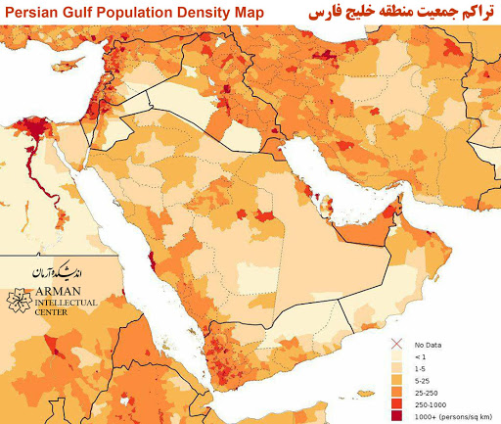
Year 8 Weekly Homework Spring 1.3 How Are Populations Changing in the Middle East? Knowledge Book: P60
1. Use P52 to fill in the key terms and definitions for the following: | 3. Use compass points to describe the population distribution of the Middle East [4]
2. Draw an image/ icon for the following key terms:
Key Term | Definition
 | The number of people living in a given area, usually within 1km²
 | A small amount of people in a given area.
Densely Populated
Population Distribution
Old Dependent
Young Dependent
 | All the inhabitants of a particular place.
N
__________________________________________________________________________________________________________________________________________________________________________________________________________________________________________________________________________________________________________________________________________________________________________________________________________________________________________________________________
Old Dependent Population
Sparsely Populated

Slide 5
Year 8 Weekly Homework Spring 1.4 Middle East Population & Economy Knowledge Book 37-38
Answer the following questions: Which country has the highest population? _________________________ Which country has the lowest population? _________________________ What country had a population of 28.3 million in 2017? _______________ How many people live in Lebanon? _____________________________ What is the population of the Middle East in total? ___________________ Which country contains the most populated areas? __________________ Which regions are most densely populated? ________________________ | 2. Complete the following statements about the Middle East: It is the _______________ source of crude oil Oil was discovered in ___________ in 1908 The ____________ plate holds ____% of the worlds oil reserve The discovery of oil came at the same time as the _______________ of the car. The __________ and ________ became very interested in the ________ Oil has brought great _______________ to some parts of the region The Middle East has been a ___________ point for trade routes for ______ years The region is home to three major religions: _____________, ____________ and ____________.
3. Rank the reasons for the diversity of the Middle East. E.g. “It connects Asia, Africa & Europe” (pg33) | 4. Explain why Oil is important to the Middle East economy: ____________________________________________________________________________________________________________________________________________________________________________________________________________________________________________________________________________________________________________________________________________________________________________________________________________________________________________________________________________________________

Slide 6
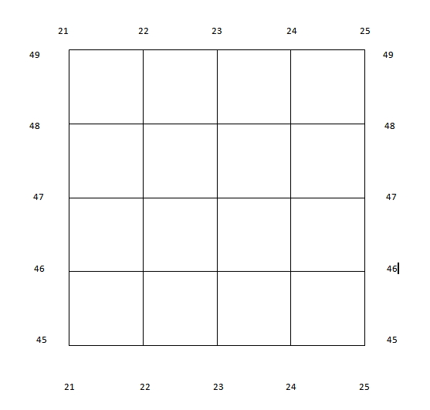
Year 8 Weekly Homework Spring 1.5 Map Skills: Scale, Distance, Compass Points and Grid References
N
Interpreting Scale:
2cm on the map is what distance in real life? _______________________________
3cm on the map is what distance in real life? _______________________________
0.5km in real life is how many ‘cm’ on the map? ____________________________
4.5km in real life is how many ‘cm’ on the map? ____________________________
Measuring Distance:
On the map, how many ‘cm’ apart are and ? _____________________
On the map, how many ‘cm’ apart are and ? _____________________
In real life, how far apart in ‘km’ are and ? _______________________
In real life, how far apart in ‘km’ are and ? _______________________
Compass Points (Identify the correct compass direction):
To get from to you travel… ___________________________________
To get from to you travel… ___________________________________
To get from to you travel… ___________________________________
To get from to you travel… ___________________________________
6- Figure Grid References:
What is the 6 figure grid reference for the ? ____________________________
Which shape is found in grid reference 238,477? ____________________________
Draw a in grid reference 244,467
2cm
2cm: 4km
1km

Slide 7
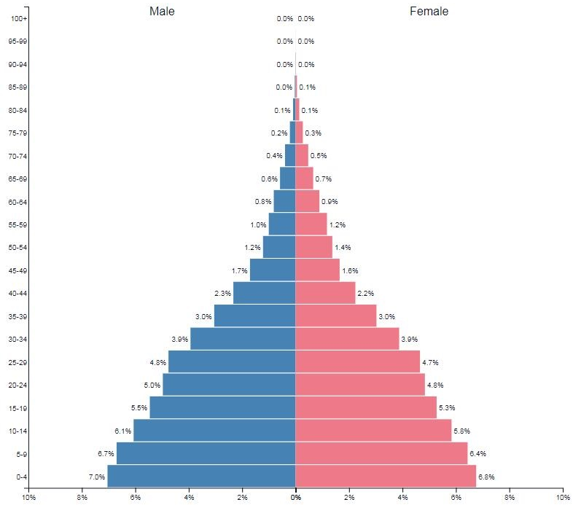
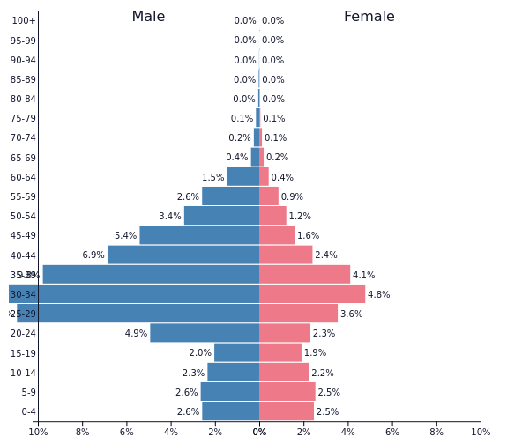
Year 8 Weekly Homework Spring 1.6 Middle East Population: UAE Vs. Yemen Knowledge Book 39-40
1. Which countries population pyramid is this? Explain what it shows. | 3a. Look at the population pyramids for UAE and Yemen. Tick the statements that are true for each location
2. Which countries population pyramid is this? Explain what it shows. | 4. Wha 3b. Explain why UAE population is so distorted and suggest what schemes/ resources the UAE government should invest in to suit it’s population. ______________________________________________________________________________________________________________________________________________________________________________________________________________________________________________________________________________________________________________________________________________________________________________________________________________________________________________________________________________________________________________________________________
_______________________________________________________________________________________________________________________________________________________________________________________________________________
 | UAE | Yemen
High birth rate
Largest population
Unequal distribution of males and females
A larger young dependent population
Larger working population
Lower birth rate
______________________________________________________________________________________________________________________________________________________________________________________________________________________________________

Slide 8
Year 8 Weekly Homework Spring 1.7 Middle East Development: Dollar Street (Access the website link on SMH)
1. Correctly define the following key terms:
High Income Country (HIC) - _________________________________________________________________________________________________________________________________
Middle Income Country (MIC) - ______________________________________________________________________________________________________________________________
Newly Emerging Economy (NEE) - ____________________________________________________________________________________________________________________________
Low Income Country (LIC) -__________________________________________________________________________________________________________________________________
2. Use the ‘Dollar Street Website’. Select any family living in either Iran, Jordan, Lebanon or Palestine, then answer the following questions about them…
Name of Family: _________________________________________________
Where do they live (which country)? _________________________________
Monthly Income? _______________________________________________
Description of family (who is in the family?)
Describe the bathroom/ toilet in their house…
Describe the kitchen in their house…
Describe the bedrooms/ beds in their house….
How do they make a living?
What challenges do they face?
What do they dream of?

Slide 9
Year 8 Weekly Homework Spring 1.8 Middle East: The Development of Yemen and the UAE Knowledge Book 39-42
1. Pick 3 ways the UAE has been able to diversity. Label them a draw an icon: | 2. Connect these words (you must make at least 4 connections):
3. Match the statement to the feature of Yemen | 4. Explain how the UAE has been able to develop successfully, but Yemen hasn’t. ____________________________________________________________________________________________________________________________________________________________________________________________________________________________________________________________________________________________________________________________________________________________________________________________________________________________________________________________________________
2__________________________________________________
Population
Government
Yemen
UAE
1__________________________________________________
3__________________________________________________
Development
Diversify
Feature |  | Statement
Oil |  | Civil War has drained its oil reserves
Gender inequality |  | They are the 7th most water stressed country in the world
Infrastructure |  | They are running out of oil
Tourism |  | 49% of women are illiterate
Population |  | They have no railways
Water |  | It has great potential but is not viable until war has ended
Conflict |  | 2/3rds of people are under 24, 60% of these are unemployed

Slide 10
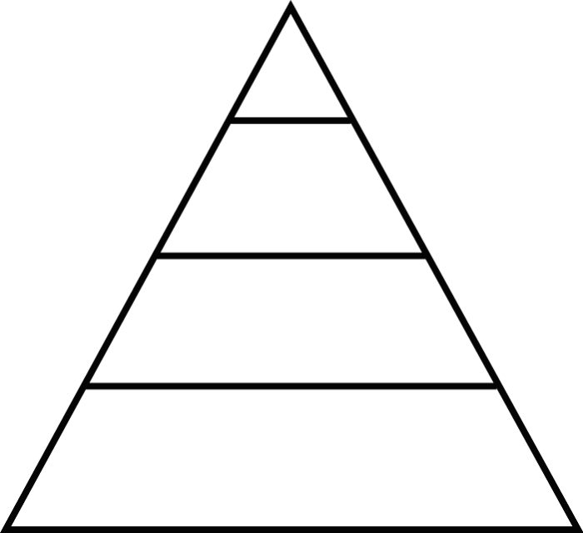
Year 8 Weekly Homework Spring 1.9 Conflict in the Middle East Knowledge Book 43-45
1. Study P38. Fill in the figures and statistics about the conflict in Syria: __________________________ people have been killed since the conflict began in 2011. What is the estimated economic loss suffered by Syria? ___________________________ There are __________________________ registered Syrian refugees. Average life expectancy has dropped from ____________ years to ____________years. _____________ Syrians live below the poverty line ($1.90 per day). How many people have been wounded as a result of the conflict? ___________________ The unemployment rate jumped from _________ to _________ between 2010 and 2014. What percentage of school children did not attend school today? ____________________ ________________________ Syrians have lost their primary source of income.
2. Use P37 and explain two factors that have caused conflict in the Middle East: One factor is ____________________________________. This has lead to conflict because… ____________________________________________________________________________ ____________________________________________________________________________________________________________________________________________________________________________________________________________________________________ Another factor is _________________________________. This has lead to conflict because… ____________________________________________________________________________ ____________________________________________________________________________ ________________________________________________________________________________________________________________________________________________________
3a. P38 - Look at the 4 reasons for the conflict in Syria, rank them on the pyramid (top as the most important cause for the conflict, bottom as the least important cause)
2. Use P37 and explain two factors that have caused conflict in the Middle East:
3b. Explain the order you have ranked the causes for conflict on the pyramid:
________________________________________________________________________________________________________________________________________________________ ________________________________________________________________________________________________________________________________________________________ ________________________________________________________________________________________________________________________________________________________ ____________________________________________________________________________

Slide 11
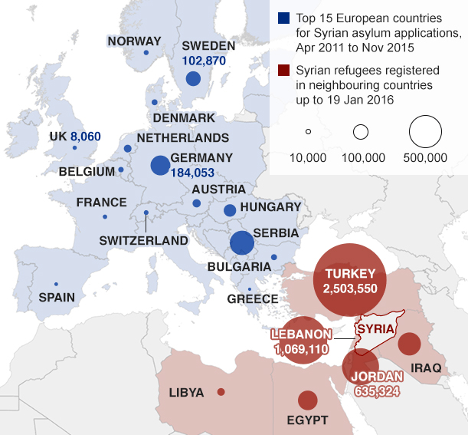
Year 8 Weekly Homework Spring 2.0 Conflict in Syria: The Impacts KB: page 44-45
2a. P39 - Look at the 4 impacts of the Syrian conflict listed below, rank them on the pyramid (top as the most important impact, bottom as the least important impact)
1. Study map below to describe the distribution of Syrian refugees in the Middle East and Europe [4]
11.5% of people killed or injured
5 million refugees
Refugees make dangerous journeys to Europe
Children experience violence and brutality
___________________________________________________________________________________________________________________________________________________________________________________________________________________________________________________________________________________________________________________________________________________________________________________________________________________________________________________________________________________________________________________________________________________________________________________________________________________________________________________________________________________________________
2b. Explain the order you have ranked the impacts of conflict on the pyramid:
________________________________________________________________________________________________________________________________________________________ ________________________________________________________________________________________________________________________________________________________ ________________________________________________________________________________________________________________________________________________________ ____________________________________________________________________________

Slide 12
Questions to ask:
Notes:
___________________________________________________________________________________________________________________________________________________________________________________________________________________________________________________________________________________________________________________________________________________________________________________________________________________________________________________________________________
___________________________________________________________________________________________________________________________________________________________________________________________________________________________________________________________________________________________________________________________________________________________________________________________________________________________________________________________________________

Slide 13
Questions to ask:
Notes:
___________________________________________________________________________________________________________________________________________________________________________________________________________________________________________________________________________________________________________________________________________________________________________________________________________________________________________________________________________
___________________________________________________________________________________________________________________________________________________________________________________________________________________________________________________________________________________________________________________________________________________________________________________________________________________________________________________________________________

Slide 14
Questions to ask:
Notes:
___________________________________________________________________________________________________________________________________________________________________________________________________________________________________________________________________________________________________________________________________________________________________________________________________________________________________________________________________________
___________________________________________________________________________________________________________________________________________________________________________________________________________________________________________________________________________________________________________________________________________________________________________________________________________________________________________________________________________

Slide 15
Questions to ask:
Notes:
___________________________________________________________________________________________________________________________________________________________________________________________________________________________________________________________________________________________________________________________________________________________________________________________________________________________________________________________________________
___________________________________________________________________________________________________________________________________________________________________________________________________________________________________________________________________________________________________________________________________________________________________________________________________________________________________________________________________________

