Slide 1
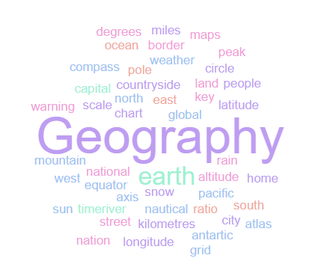
Year 9 Geography Homework Booklet
Does Globalisation help everyone ?
Name:
Class:
Teacher:
Homework Expectations:
You must keep this booklet neat and presentable
All homework must be completed for the date set
High effort is expected in all tasks
You will boost all work in red pen

Slide 2
Homework 1.1 : What is development and how can we measure it ?
Task : Use P35-38 in your knowledge book to help you to complete the definitions below, and then answer the 3 questions .
Key term | Definition
Low Income Countries (LICs)
 | Richer countries with a Gross National Income of more than $12.375/year, per person, e.g. UK, USA, Germany.
Poverty Line
 | Jobs that the government are aware of and that pay tax so can help reinvest into the country. They have contracts and come with workers protection.
Informal jobs | Jobs that don’t pay taxes, that don’t have formal contracts, benefits or protection. HICs have Many / Few informal jobs with LICs having Many / Few .
Social development indicator
Infrastructure is …
Newly Industrialising Countries ( NIC’s )
Globalisation
Question 1 : | Development is ….
Question 2 : | We can use social indicators such as ________________________________________ to measure development
Question 3 : | Or they can be ________________________ Indicators such as GDP ( gross domestic product ) , GNI ( Gross national income ) or employment rate.

Slide 3
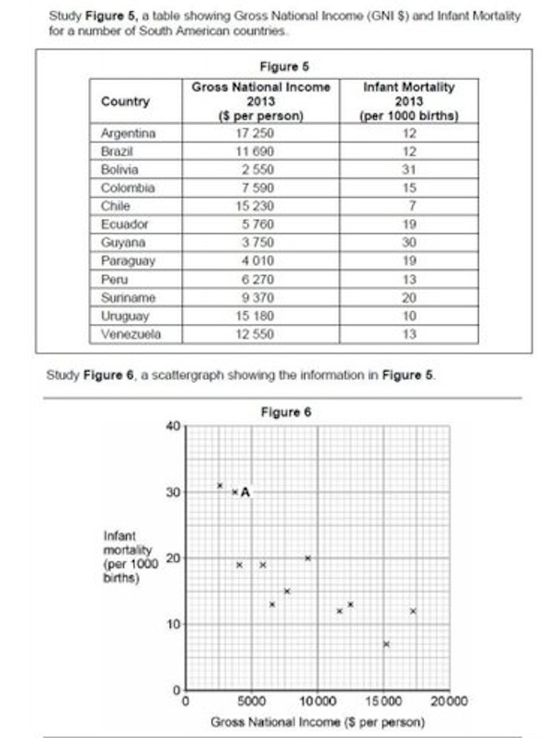
Homework 1.2 Development Indicators and Scatter Graphs Knowledge Book P41
1. Name the country at point A on the scatter graph ( 1 )
……………………………………………………………………………………..
2. The scattergraph shows that there is a negative relationship – as a countries GNI increases its infant mortality mate decreases. Explain why this would occur
……………………………………………………………………………………..
……………………………………………………………………………………..
……………………………………………………………………………………..
……………………………………………………………………………………..
……………………………………………………………………………………..
3. Using the data in figure 5, calculate the mean ( average )
infant mortality rate for the 12 countries shown.
Show your working in the space below ( 2 )

Slide 4
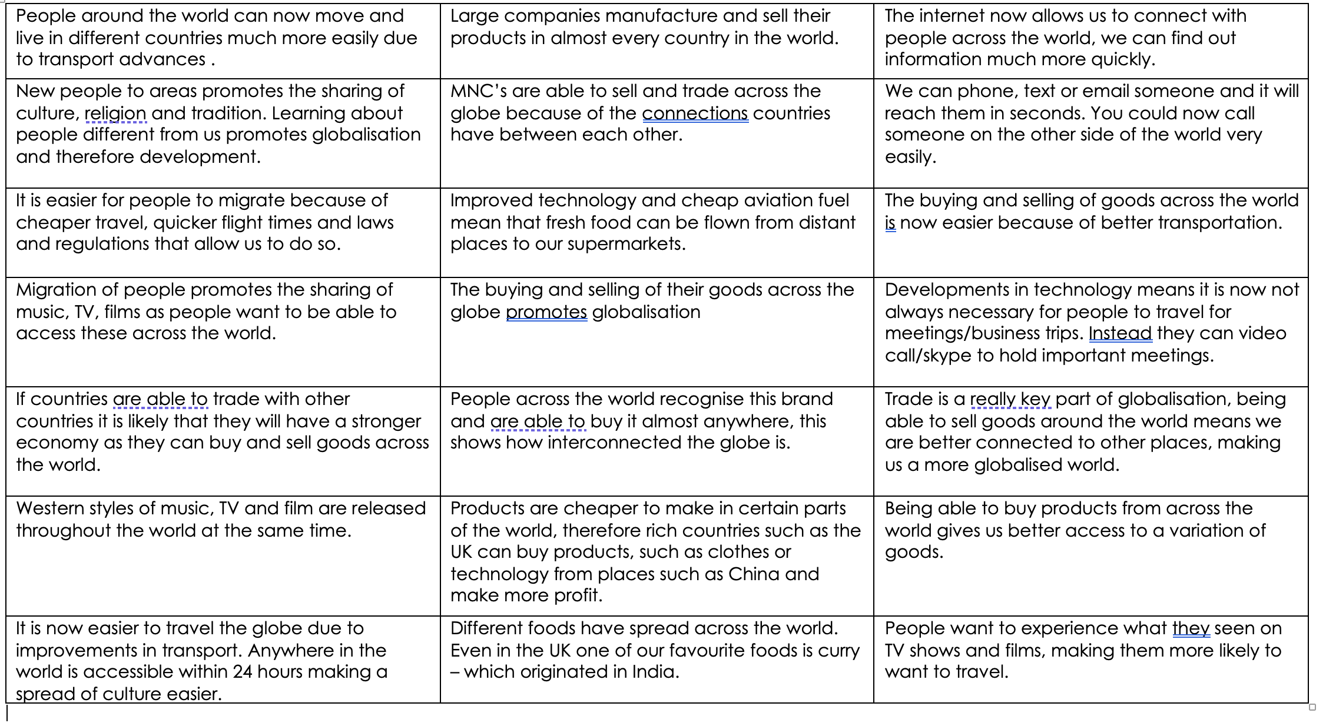
Homework 1.3 Globalisation 1 : Colour code the statements below to show the reasons for the growth in Globalisation
Trade and transport
Culture
Multinational Companies
Communication – smartphones, internet and technology

Slide 5
Homework 1.4 Globalisation 2 : : Draw a simple field sketch of a room in your house and label items with connections to other
countries. ( to show how Global you are ) . The next page shows you examples of this homework

Slide 6
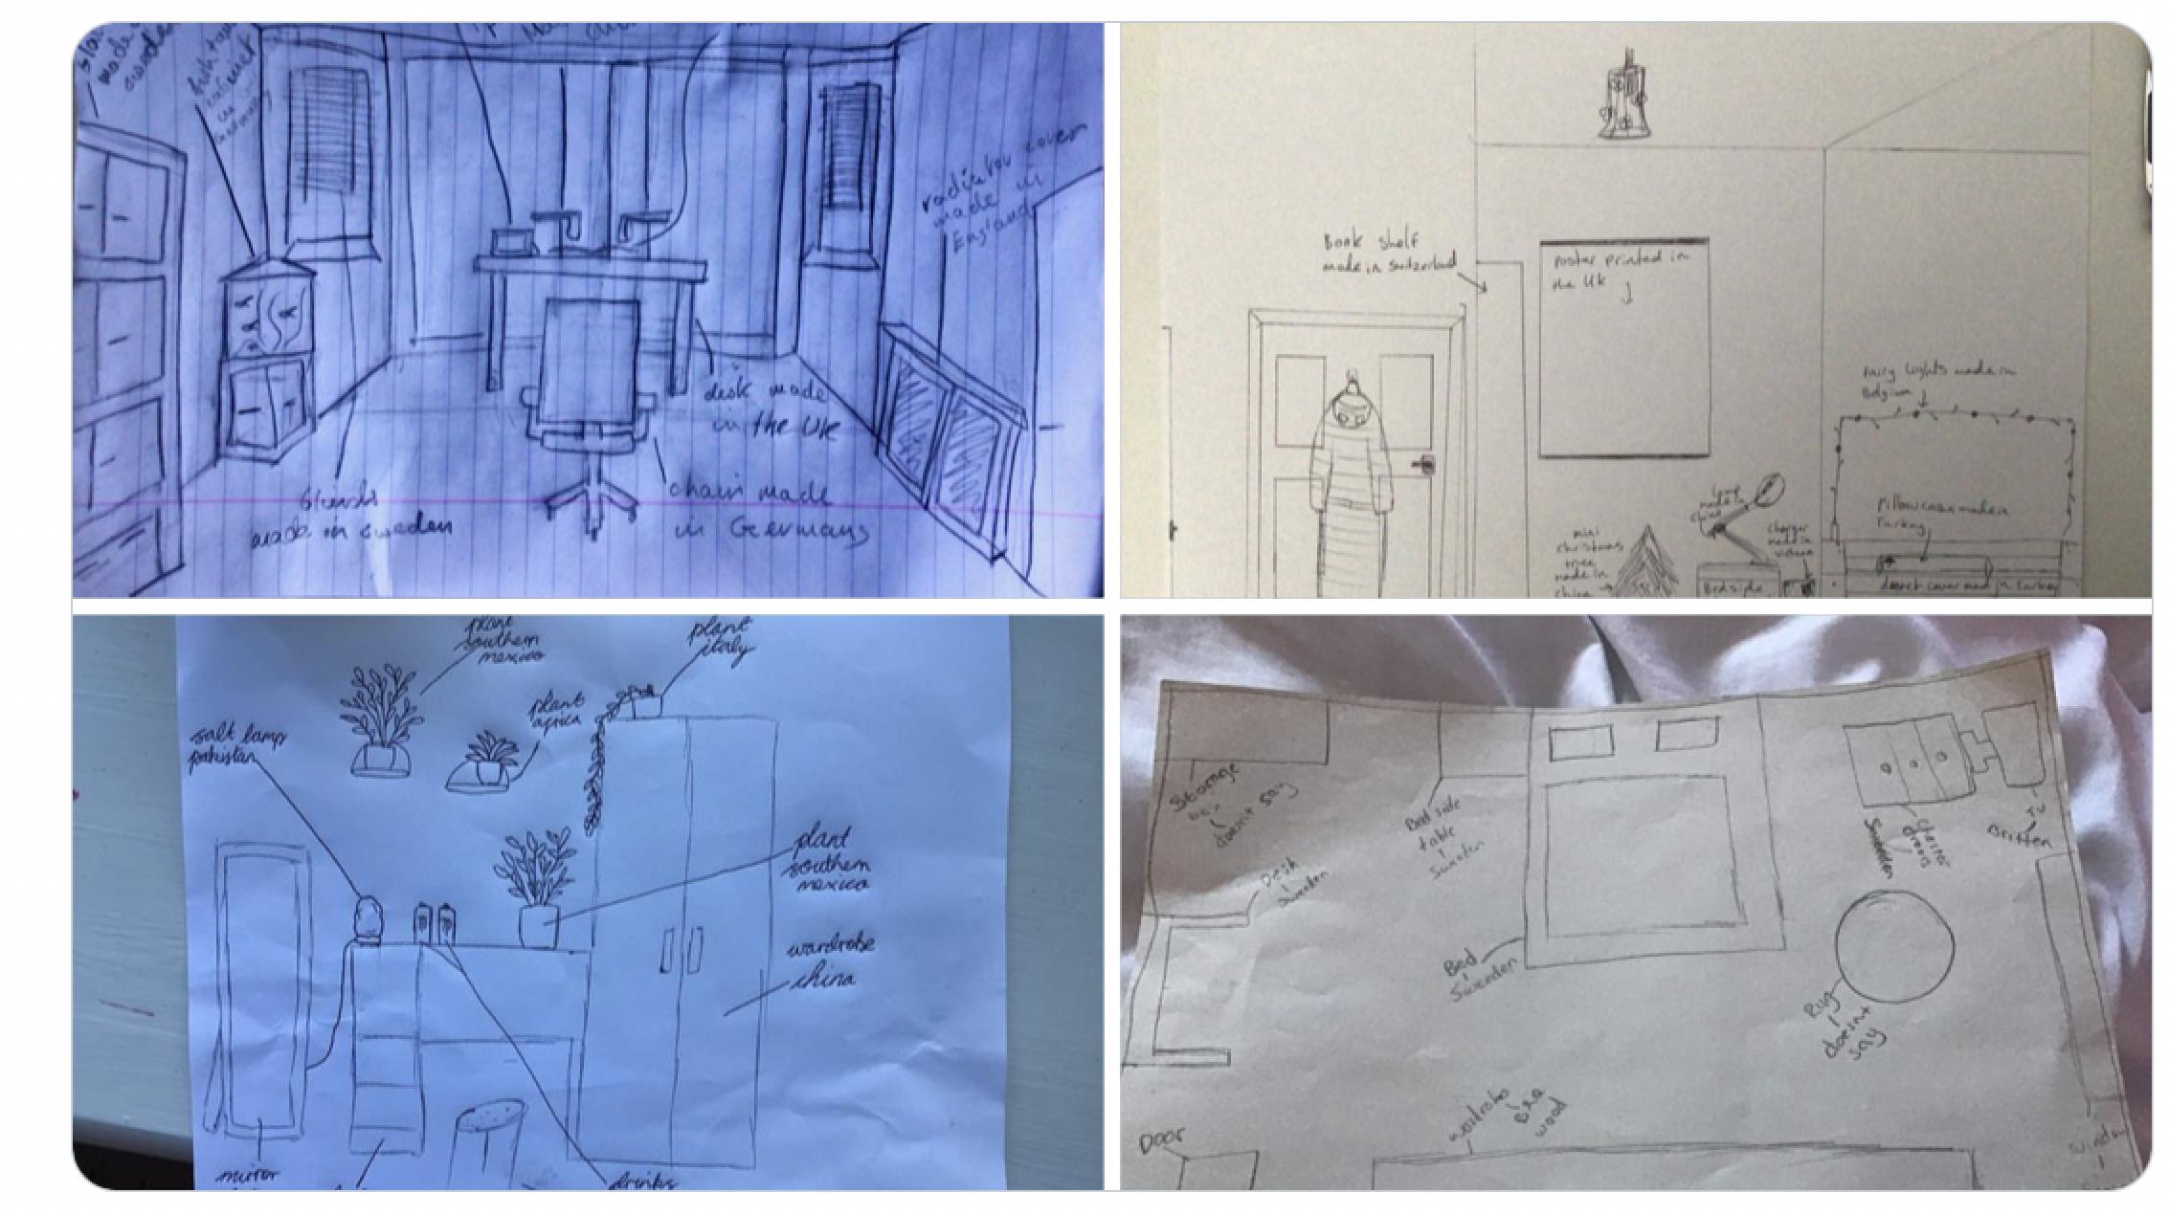
Homework 1.4 examples

Slide 7
Homework 1.5 Using your knowledge from the lesson on Rana Plaza and P46 in your KB to explain why each of the following
people could be blamed for the Rana Plaza disaster
Building inspectors in Bangladesh could be blamed because ….
Mr Rana could be blamed because ….
The Bangladesh Government could be blamed because ….
Primark / western MNC’s could be blamed because ….
We could be blamed because ….
Overall, I want to blame _______________ for the Rana Plaza disaster because ….

Slide 8


Homework 1.6. Using your knowledge from your lesson on Apple, and P48 in your KB, what is your opinion on Apple and your tech
devices ?
Apple are not the only company who exploit their workers and China is not the only country in which this happens.
This is what companies do to keep the prices as low as possible for people like us, the consumer.
So, are we to blame as much as companies like Apple??
Has today’s lesson changed your view towards Apple and your tech devices?
Mark on where would you sit on the opinion line below and explain why in the box beneath
Be as honest as you can, there is no right or wrong answer.
I have marked my view on the opinion line above. I think it belongs here because ………….

