Slide 1
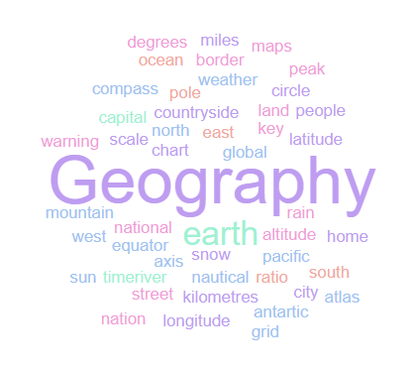
Geography Homework Booklet
Year 9 Autumn 2: Coasts 2
Name:
Class:
Teacher:
Homework Expectations:
You must keep this booklet neat and presentable
All homework must be completed for the date set
High effort is expected in all tasks
You will boost all work in red pen

Slide 2
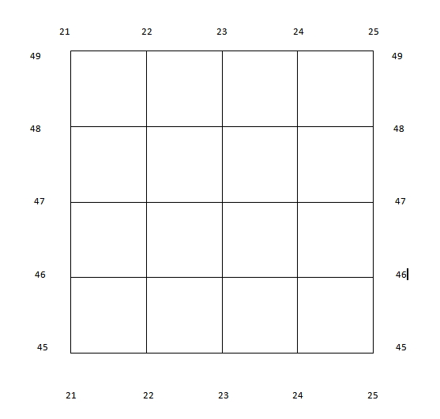
Year 9 Weekly Homework Autumn 2.1 Map Skills: Grid References
Complete the questions on 4 and 6 figure grid references:
4 Figure Grid References:
What is the 4 figure grid reference for the ? _______________________________
What is the 4 figure grid reference for the ? _______________________________
What is the 4 figure grid reference for the ? _______________________________
What is the 4 figure grid reference for the ? _______________________________
Which shape is found in grid reference 21,48? _________________________________
Which shape is found in grid reference 23,48? _________________________________
Which shape is found in grid reference 22,45? _________________________________
Draw a in grid reference 23,45
6 Figure Grid References:
What is the 6 figure grid reference for the ? _______________________________
What is the 6 figure grid reference for the ? _______________________________
What is the 6 figure grid reference for the ? _______________________________
What is the 6 figure grid reference for the ? _______________________________
Which shape is found in grid reference 243,458? ______________________________
Which shape is found in grid reference 223,453? ______________________________
Which shape is found in grid reference 212,452? ______________________________
Draw a in grid reference 245,477

Slide 3
Year 9 Weekly Homework Autumn 2.2 Uses and Threats to the Coast Knowledge Book: page 24- 25
1. Colour code the following into either a ‘use’ of the coast, or a ‘threat’ to the coast: | 3. P25- Explain two threats to the coast: One threat the coast is facing is… ______________________________________. This is when… _____________________________________________________________________ It has (social/ environmental/ economic) disadvantages because… ______________________ ________________________________________________________________________________________________________________________________________________________Another threat to the coast is ____________________________________. This involves … ____________________________________________________________________________ It has (social/ environmental/ economic) disadvantages because… ______________________ ________________________________________________________________________________________________________________________________________________________
2. P24- Explain two uses of the coast: One use of the coast is ______________________________________. This involves … _____ ____________________________________________________________________________ It has (social/ environmental/ economic) benefits because… ___________________________ ________________________________________________________________________________________________________________________________________________________Another use of the coast is ____________________________________. This involves …____ ____________________________________________________________________________ It has (social/ environmental/ economic) benefits because… ___________________________ ________________________________________________________________________________________________________________________________________________________ | 4. Create your own ‘use’ and ‘threat’ to the coast. Draw an icon and briefly explain it:
Water Sports | Offshore Wind Farm (Energy) | Oil Spillages
Overfishing | Tourism | Increased Erosion
Coral Bleaching | Beach Litter / Garbage Dumping | Ports and Harbours
Security / Rescue | Coastal Flooding | Fishing
Use
Threat
________________________________________________________________________________________________
________________________________________________________________________________________________

Slide 4
Year 9 Weekly Homework Autumn 2.3 Shoreline Management Plans & Stakeholders Knowledge Book: P26
1. Define the following key terms, then draw an icon to help you remember:
2. Answer the following question: Define ‘Shoreline Management Plan’ : _________________________________________ ________________________________________________________________________________________________________________________________________________________ Why do councils create shoreline management plans? ____________________________ ____________________________________________________________________________ What is meant by ‘cost-benefit analysis’? _______________________________________ ____________________________________________________________________________ d) What are the 4 types of shoreline management plan? _____________________________ ____________________________________________________________________________
3. Complete the table explaining different stakeholder views:
Key Term | Definition | Icon
Do Nothing
Hold the line
Retreat the line
Advance the line
Stakeholder | Type of Shoreline Management Plan they want… | Why they want it… | Who do they conflict with?
Resident living along cliff edge | Hold the line or Advance the line | Their homes are at risk of mass movement. Could be forced to relocate | Conservationist Environment Agency Local resident further along coast
Environment Agency
Business Owner along cliff edge
Conservationist/ Environmentalist
Local resident living further along the coastline (after sea defences)

Slide 5
Year 9 Weekly Homework Autumn 2.4 Coastal Management Strategies Knowledge Book: P26-P28
1a. Define the following key terms: Hard Engineering- ____________________________________________________________ ____________________________________________________________________________ Soft Engineering- _____________________________________________________________ ____________________________________________________________________________ 1b. Draw and icon to help you remember ‘hard engineering’ and ‘soft engineering’: | 3. Make links between words – along the line you draw explain at least 4 links:
2. Identify the specific type of engineering being described. (Name the strategy) Concrete walls that reflect waves. ____________________________________________ Planting vegetation to stabilise sand dunes. _____________________________________ Adding large quantities of sand and shingle to an area. ____________________________ Wooden fences built at right angles to the coast. _________________________________ Benefits include: creating habitats and preventing flooding. ________________________ A disadvantage is that strong winds can move the boulders. ________________________ These increase erosion rates further down the coast. _____________________________ | 4. Pick one of the 6 engineering strategies. Draw a diagram of it and label how it prevents erosion/ coastal flooding:
Beach Nourishment
Cost
Soft Engineering
Erosion
A type of hard engineering strategy where large boulders are piled along the base of cliffs.
Hard Engineering
Rock Armour
Maintenance
Hard Engineering
Soft Engineering

Slide 6
Year 9 Weekly Homework Autumn 2.5 The Holderness Coastline Knowledge Book: Page 29-30
1a. Use P30 to define the following key term: Terminal Groyne Syndrome- ___________________________________________________ __________________________________________________________________________ 1b. Correctly use ‘terminal groyne syndrome’ in a sentence: ________________________________________________________________________________________________________________________________________________________________________________________________________________________________________________________________________________________________________
2. P29 – Around this mind-map, label and briefly explain the causes of rapid erosion.
Use P29 in your KB. “Explain the effects of rapid erosion along the Holderness Coast” [6]
Erosion is… __________________________________________________________________
___________________________________________________________________________.
One social effect of rapid coastal erosion is… _______________________________________.
This negatively effects local people because… ______________________________________
____________________________________________________________________________________________________________________________________________________________________________________________________________________________________________________________________________________________________________
An environmental effect of coastal erosion is… _____________________________________.
This negatively effects the environment because… ___________________________________
____________________________________________________________________________________________________________________________________________________________________________________________________________________________________________________________________________________________________________
An economic effect of rapid erosion is… __________________________________________.
This has negative effects on the economy of Holderness because… _____________________
____________________________________________________________________________________________________________________________________________________________________________________________________________________________________________________________________________________________________________
__________________________________________________________________________________
Reasons for Rapid Erosion at Holderness

Slide 7
Year 9 Weekly Homework Autumn 2.6 Climate Change and the Maldives Knowledge Book 31-33
1. Define the following key terms and write out the definitions:
2. Answer the following questions: What is ‘thermal expansion’? ________________________________________________ ____________________________________________________________________________ Identify 1 political impact of coastal flooding: ____________________________________ ____________________________________________________________________________ How much are global sea levels rising by per year? _______________________________ Scientist predict the Maldives will be submerged in how many years? ________________ By what year could sea levels have risen by 30cm – 1m? ___________________________
Use P33 in your KB. “Explain the effects of coastal flooding in the Maldives” [6 marks]
Coastal flooding is… ___________________________________________________________
___________________________________________________________________________.
One social effect of coastal flooding is… ___________________________________________.
This negatively effects local people because… ______________________________________
____________________________________________________________________________________________________________________________________________________________________________________________________________________________________________________________________________________________________________
An environmental effect of coastal flooding is… ____________________________________.
This negatively effects the environment because… ___________________________________
____________________________________________________________________________________________________________________________________________________________________________________________________________________________________________________________________________________________________________
An economic effect of coastal flooding is… ________________________________________.
This has negative effects on the economy of the Maldives because… ____________________
____________________________________________________________________________________________________________________________________________________________________________________________________________________________________________________________________________________________________________
__________________________________________________________________________________
Key Term | Definition
Global Warming
Submerged
 | Action to remove as much carbon dioxide from the atmosphere as each put into it.
Desalination

Slide 8
Year 9 Weekly Homework 2.7 Coastal Landforms Recap Knowledge Book: P15-18, 21-23
1. Fill in the key terms and definitions for the following: | 3. Draw a diagram, then explain the formation of wave-cut platform:
2. Which landform is being described? This landform joins together two headlands. __________________________________ Alternating bands of hard rock and soft rock. __________________________________ Hydraulic action creates a wave-cut notch in the cliff. ___________________________ Form where the coast suddenly changes direction. _____________________________ Sub-aerial processes attack the top of the archway. _____________________________ Strong winds curve the end of this landform. __________________________________ A real-world example is Old ‘Harry Rocks’. _____________________________________ This landform causes the cliff to retreat overtime. ______________________________ A lagoon forms behind this landform. ________________________________________
Key Term | Definition
Hydraulic Action
 | Naturally occurring material that is broken down by processes of weathering and erosion.
Abrasion
Lagoon
_______________________________________________________________________________________________________________________________________________________________________________________________________________________________________________________________________________________________________________________________________________________________________________________________________________________________________________________________________________________________________________

Slide 9
Year 8 Weekly Homework Autumn 2.8 Map Skills: Scale, Distance, Compass Points and Grid References
N
Interpreting Scale:
2cm on the map is what distance in real life? _______________________________
3cm on the map is what distance in real life? _______________________________
0.5km in real life is how many ‘cm’ on the map? ____________________________
4.5km in real life is how many ‘cm’ on the map? ____________________________
Measuring Distance:
On the map, how many ‘cm’ apart are and ? _____________________
On the map, how many ‘cm’ apart are and ? _____________________
In real life, how far apart in ‘km’ are and ? _______________________
In real life, how far apart in ‘km’ are and ? _______________________
Compass Points (Identify the correct compass direction):
To get from to you travel… ___________________________________
To get from to you travel… ___________________________________
To get from to you travel… ___________________________________
To get from to you travel… ___________________________________
6- Figure Grid References:
What is the 6 figure grid reference for the ? ____________________________
Which shape is found in grid reference 225,468? ____________________________
Draw a in grid reference 236,453
2cm
2cm: 1km
1km

Slide 10
Questions to ask:
Notes:
___________________________________________________________________________________________________________________________________________________________________________________________________________________________________________________________________________________________________________________________________________________________________________________________________________________________________________________________________________
___________________________________________________________________________________________________________________________________________________________________________________________________________________________________________________________________________________________________________________________________________________________________________________________________________________________________________________________________________

Slide 11
Questions to ask:
Notes:
___________________________________________________________________________________________________________________________________________________________________________________________________________________________________________________________________________________________________________________________________________________________________________________________________________________________________________________________________________
___________________________________________________________________________________________________________________________________________________________________________________________________________________________________________________________________________________________________________________________________________________________________________________________________________________________________________________________________________

Slide 12
Questions to ask:
Notes:
___________________________________________________________________________________________________________________________________________________________________________________________________________________________________________________________________________________________________________________________________________________________________________________________________________________________________________________________________________
___________________________________________________________________________________________________________________________________________________________________________________________________________________________________________________________________________________________________________________________________________________________________________________________________________________________________________________________________________

Slide 13
Questions to ask:
Notes:
___________________________________________________________________________________________________________________________________________________________________________________________________________________________________________________________________________________________________________________________________________________________________________________________________________________________________________________________________________
___________________________________________________________________________________________________________________________________________________________________________________________________________________________________________________________________________________________________________________________________________________________________________________________________________________________________________________________________________

