Slide 1
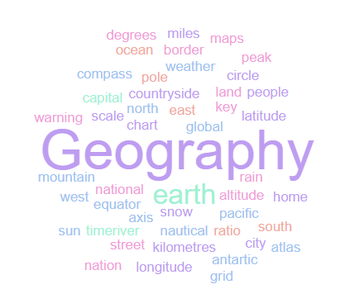
Geography Homework Booklet
Year 8 : Asia
Name:
Class:
Teacher:
Homework Expectations:
You must keep this booklet neat and presentable
All homework must be completed for the date set
High effort is expected in all tasks
You will boost all work in red pen

Slide 2
Year 8 Weekly Homework 1.1 Physical Features of Asia KB: page 11-12
1. Are these statements TRUE or FALSE? Asia means WEST: _______________________ There are 49 countries in Asia: _______________________ It has a population of 2.3 billion _______________________ 75% of its population is found in India _______________________ Turkey is in Asia _______________________ There are no mountains in Asia _______________________ | 2. Draw a diagram to show how a monsoon forms:
3. Answer the following questions: What mountain range is found in Asia? What is the worlds tallest mountain? How many metres above sea level is it? What is the name of the desert in Asia? Name both of the Oceans that can be found in Asia: | 4. Connect these words:
July
Rain
September
Agriculture
50%
15%
3/4

Slide 3
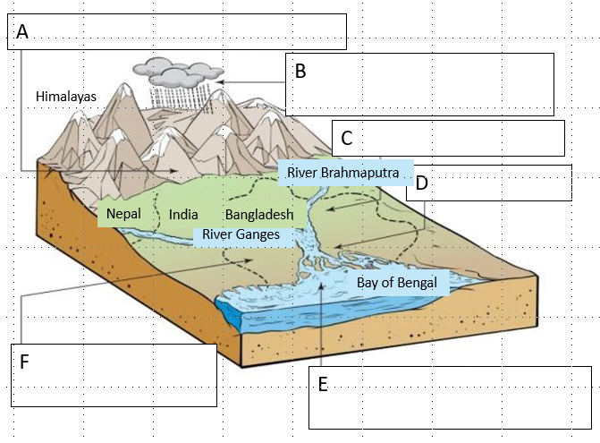
Year 8 Weekly Homework 1.2 2017 Bangladesh Floods in Asia Knowledge Book: Page 14-15
Answer the following questions: How many people died in the floods? _______________________ How many children were affected? ____________________ What country saw 8 million people affected? _______________________ How many homes were destroyed? ______________________________ What % of those killed were children? _______________ | 2. What caused the flooding in Bangladesh – complete the diagram:
3. Are these statements TRUE or FALSE? A cyclone is just a bad thunder storm TRUE/FALSE There 2 million homes destroyed in Nepal: TRUE/FALSE 31 million people in India lost their jobs/homes/cattle/property: TRUE/FALSE 80% of Bangladesh lies on a flood plain TRUE/FALSE Deforestation was a cause of the 2017 floods TRUE/FALSE Rivers split due to soil erosion TRUE/FALSE The Bay of Bengal is in Bangladesh TRUE/FALSE

Slide 4
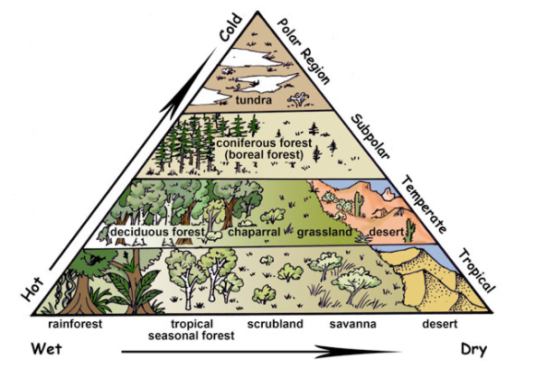
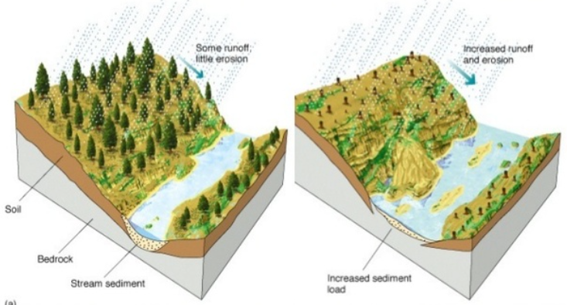
Year 8 Weekly Homework 1.3 The Biomes in Asia Knowledge Book P16-17
1. Label Nepal on this diagram | 2. Make links between the words – explain at least 4 links you make
List 5 reasons for deforestation in Nepal ________________________________________________________________________________________________________________________ ________________________________________________________________________________________________________________________ ________________________________________________________________________________________________________________________ ________________________________________________________________________________________________________________________ ________________________________________________________________________________________________________________________ | 4. Use page 10 to add detail to this diagram about the impact of deforestation:
Nepal
Poverty
Flood
Erosion
Deforestation
Timber

Slide 5
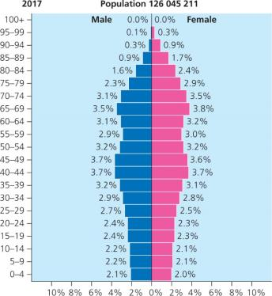
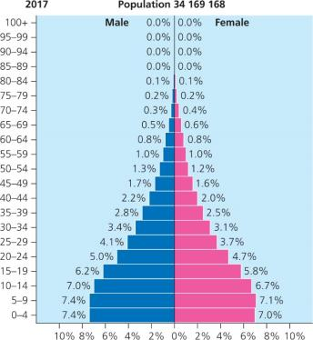
Year 8 Weekly Homework 1.4 Asia: Population: Japan vs Afghanistan Knowledge Book 18-22
1. Compare the population statistics of Japan and Afghanistan: | 3. Which countries population pyramid is this? Explain what it shows.
2. Which countries population pyramid is this? Explain what it shows. | 4. How should we solve the population problems in Japan and Afghanistan
Country | Japan | Afghanistan
Population
Life expectancy
Birth rate
Future?
_______________________________________________________________________________________________________________________________________________________________________________________________________________
_______________________________________________________________________________________________________________________________________________________________________________________________________________
Issue | Solution
Japan has an ageing, shrinking population
There is a shortage of workers in Japan
The population in Afghanistan is set to double
Women have an average of 6 children in their lifetimes

Slide 6
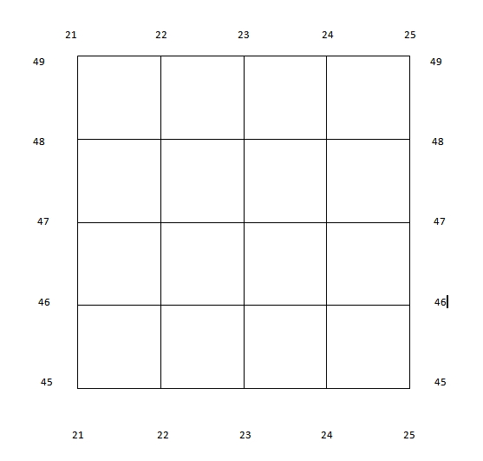
Year 8 Weekly Homework 1.5 Map Skills: Grid References
Complete the questions on 4 and 6 figure grid references:
4 Figure Grid References:
What is the 4 figure grid reference for the ? _______________________________
What is the 4 figure grid reference for the ? _______________________________
What is the 4 figure grid reference for the ? _______________________________
What is the 4 figure grid reference for the ? _______________________________
Which shape is found in grid reference 21,48? _________________________________
Which shape is found in grid reference 23,48? _________________________________
Which shape is found in grid reference 22,45? _________________________________
Draw a in grid reference 23,45
6 Figure Grid References:
What is the 6 figure grid reference for the ? _______________________________
What is the 6 figure grid reference for the ? _______________________________
What is the 6 figure grid reference for the ? _______________________________
What is the 6 figure grid reference for the ? _______________________________
Which shape is found in grid reference 243,458? ______________________________
Which shape is found in grid reference 223,453? ______________________________
Which shape is found in grid reference 212,452? ______________________________
Draw a in grid reference 245,477

Slide 7
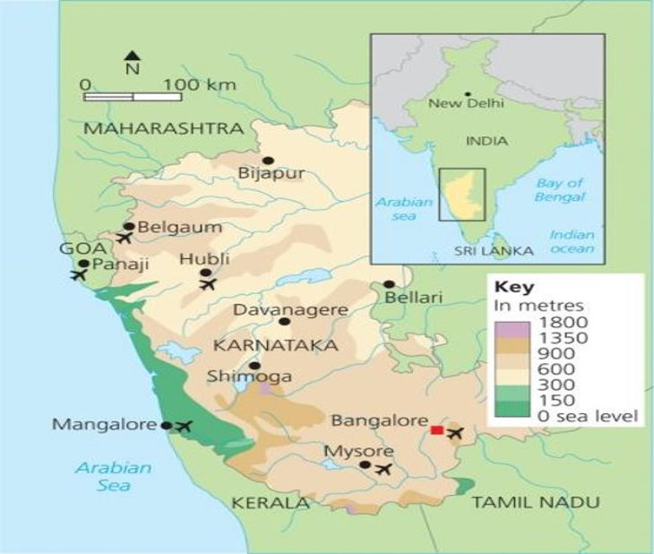
Year 8 Weekly Homework 1.6 Urbanisation in Karnataka: Bangalore Knowledge Book: P23-24
Are these statements TRUE or FALSE? Bangalore has a population of over 1 million _______________________ Infant mortality rate is 24 deaths / 1000 _______________________ Karnataka has a population of 6.1 million _______________________ 40% of the population is under 3yrs old _______________________ Karnataka is located in South-West India _______________________ 32% of people live below the poverty line _______________________
3. Use P23 – Identify 2 causes, 2 effects, 2 responses to Bangalores increasing population.
3. Study the map below. Describe the location of Bangalore using the CLOCK acronym (4):
____________________________________________________________________________
________________________________________________________________________________________________________________________________________________________________________________________________________________________________________________________________________________________________________________________________________________________________________________________________________________________________________________________________________
________________________________________________________________________________________________________________________________________________________
____________________________________________________________________________
C – Continent/ Country
L – Latitude
O – Ocean / Seas
C – Compass Points
K – Kilometres (distance)
Causes: | Effects (problems): | Responses:
Push Factor:
Pull Factor:
Rain

Slide 8
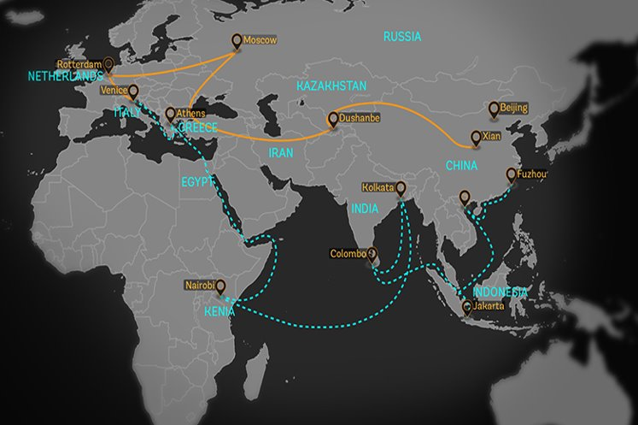
Year 8 Weekly Homework 1.7 China’s Economic Growth Knowledge Book: Page 25-26
Answer the following questions: What is the belt and road initiative? ___________________________________________ ____________________________________________________________________________ When was the belt and road initiative created? __________________________________ What infrastructure is being built to allow for more trading routes? __________________ ____________________________________________________________________________ How many countries have supported the belt and road initiative? ___________________ TRUE or FALSE: China is the biggest producer and consumer of coal? _________________ Since 1990, how many people in China have been lifted out of poverty? ______________
2. P24- Explain two reasons behind China’s economic growth: One reason is ______________________________________. This can improve economic growth because… _____________________________________________________________ ____________________________________________________________________________________________________________________________________________________________________________________________________________________________________ Another reason is ______________________________________. This can enhance economic growth because… ____________________________________________________ ____________________________________________________________________________ ________________________________________________________________________________________________________________________________________________________
3. Study the map below and on P25. Describe the journey of the belt and road initiative over land (orange line) and over sea (blue dotted line) (4):
____________________________________________________________________________
________________________________________________________________________________________________________________________________________________________________________________________________________________________________________________________________________________________________________________________________________________________________________________________________________________________________________________________________________
________________________________________________________________________________________________________________________________________________________
____________________________________________________________________________
N

Slide 9
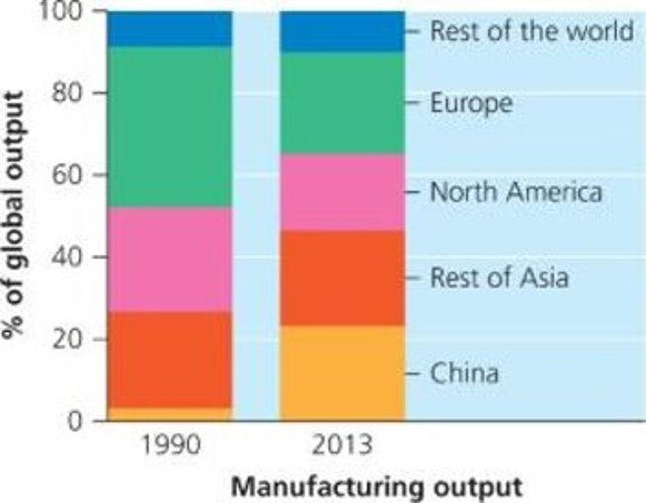
Year 8 Weekly Homework 1.8 Asia: World Trade Knowledge Book P27
1. Are these statements TRUE or FALSE? China and India rank in the top 10 countries for global wealth: ________________ The economic growth is known as ‘Asian Wonder’ ________________ It’s estimated India’s economy will overtake USA by 2020 ________________ By 2050 China’s economy will be 50% bigger than America’s ________________ Wages for factory workers in China average $6.70 per day ________________ China held the largest % of global output in 1990 ________________ Europe’s % of global output decreased from 1990- 2013 ________________
Connect these words then write along the lines to explain how they are connected:
3. Describe the change in percentage of global manufacturing output for China and the Rest of Asia, from the year 1990 to 2013.
____________________________________________________________________________
________________________________________________________________________________________________________________________________________________________________________________________________________________________________________________________________________________________________________________________________________________________________________________________________________________________________________________________________________
________________________________________________________________________________________________________________________________________________________
________________________________________________________________________________________________________________________________________________________
China
Wages
China and India now rank in the top 10 countries for global wealth.
Global Wealth
2050
Vietnam

Slide 10
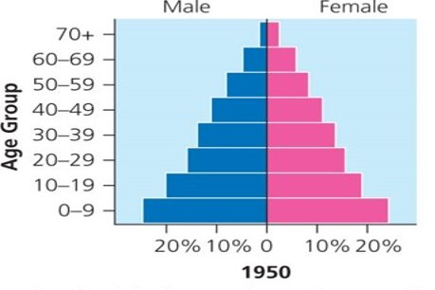
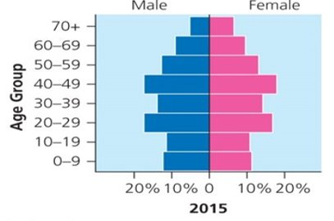
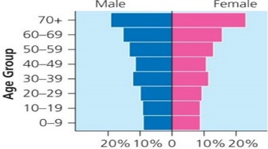
Year 8 Weekly Homework Autumn 1.9 China’s One Child Policy Knowledge Book 28-29
1. Use P27 and P28 to answer the following questions: What was the population of China in 1970? _____________________________________ How much was the population have expected to grow by 2020? ____________________ In what year was the one child policy introduced? ________________________________ For how many years was the one child policy in place? ____________________________ TRUE or FALSE: China now has a young dependent population? _____________________ How many more marriage-age men are there than women? ________________________ How much has the population decreased by since the policy? _______________________ | Read P27 and P28 and identify advantages and disadvantages of the one child policy:
2. Use P27 and P28 to fill in the details about China’s population pyramids:
Advantages of the Policy | Disadvantages of the Policy
Diagram | Which Year? | Describe the shape of the pyramid | What problems occur due to this kind of population?

Slide 11
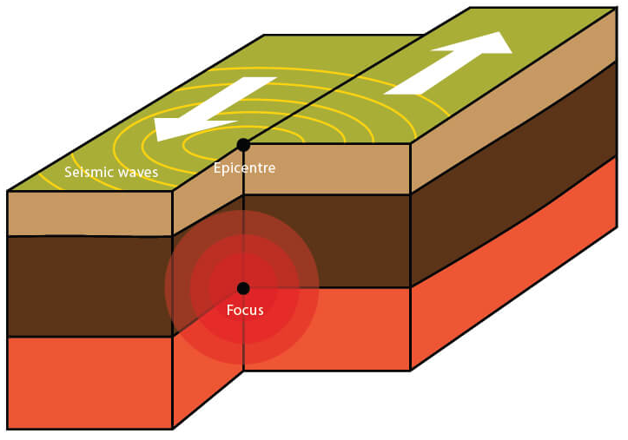
Year 8 Weekly Homework 2.0 Nepal Earthquake Knowledge Book 30, 34-36
Label the diagram correctly: Seismic Waves / Focus / Epicentre | Fill in the key terms and definitions for the following:
2. Use P34 to P36 to answer the following questions: What was the date of earthquake? ____________________________________________ What time did the earthquake occur? __________________________________________ How powerful was the Earthquake on the Richter Scale ? _________________ What plates were involved ? ____________________________ Where was the epicentre? ___________________________________________________ How high was the Tsunami wave ? ____________________________________ How many people died because of the earthquake? ______________________________ | 4. Connect these words then write along the lines to explain how they are connected:
Key Term | Definition
Conservative plate boundary
 | Waves of energy that travel through the Earth’s surface.
Epicentre
Focus
 | Pieces of Earth’s crust and uppermost mantle.
Nuclear Power
Economy
Tohoku Earthquake
The earthquake left 6,152 people injured.
6,152
Transport

Slide 12
Year 8 Weekly Homework 2.1 Map Skills: Scale, Distance, Compass Points and Grid References
N
Interpreting Scale:
2cm on the map is what distance in real life? _______________________________
3cm on the map is what distance in real life? _______________________________
0.5km in real life is how many ‘cm’ on the map? ____________________________
4.5km in real life is how many ‘cm’ on the map? ____________________________
Measuring Distance:
On the map, how many ‘cm’ apart are and ? _____________________
On the map, how many ‘cm’ apart are and ? _____________________
In real life, how far apart in ‘km’ are and ? _______________________
In real life, how far apart in ‘km’ are and ? _______________________
Compass Points (Identify the correct compass direction):
To get from to you travel… ___________________________________
To get from to you travel… ___________________________________
To get from to you travel… ___________________________________
To get from to you travel… ___________________________________
6- Figure Grid References:
What is the 6 figure grid reference for the ? ____________________________
Which shape is found in grid reference 225,468? ____________________________
Draw a in grid reference 236,453
2cm
2cm: 1km
1km

