Slide 1
Weekly Homework Grids and Extended Responses
YEAR 11 BOOKLET – Part 1
SPRING
Name: _____________________________
Teacher: ____________________________
Room: ______________________________

Slide 2
Year 11 Weekly Homework Name: ________________________________________ Spring 1.1
Why did Dickens think we should help the poor? (Give a two reasons – try to link them to 'A Christmas Carol) 1._____________________________________________________________________________________________________________________________________________________________________________________________________________________________________________________________________________________________________ 2._____________________________________________________________________________________________________________________________________________________________________________________________________________________________________________________________________________________________________ | 2. Key facts about 'A Christmas Carol' 1. What is the first line of the novel? __________________________________________________________________________________________________ 2. How many ghosts visit Scrooge? ___________________________________________________________________________________________________________________________________________________ 3. How many nephews does Scrooge have? __________________________________________________________________________________________________ 4. What item does Scrooge buy the Cratchit family at the end of the novel? __________________________________________________________________________________________________ | 3. Using your knowledge of 'Romeo and Juliet' write one developed SEAL paragraph. A student having read 'Romeo and Juliet' said: 'Lord Capulet is a cruel father'. To what extent do you agree? ___________________________________________________________________________________________________________________________________________________________________________________________________________________________________________________________________________________________________________________________________________________________________________________________________________________________________________________________________________________________________________________________________________________________________________________________________________________________________________________________________________________________________________________________________________________________________________________________________________________________________________________________________________________________________________________________________________________________________________________________________________________________________________________________________________________________________________________________________________________________________________________________________________________________________________________________________________________________________________________________________________________________________________
4. Spell the following character names correctly: A) Tibalt ______________________________ B) Montegue ______________________________ C) Rome _______________________________ D) Fredereck _______________________________ E) Pikilton _______________________________ F) Crachit _______________________________ G) The Ghost of Christmas Future _______________________________ | 5. Summarise in no more than 20 words the following poems: Exposure: _____________________________________________________________________________________________________________________________________________________________________________________________________________________________________________________ Bayonet Charge: _____________________________________________________________________________________________________________________________________________________________________________________________________________________________________________________ (Extension: write an essay (2 PETALCPETAL paragraphs) focusing on how war is presented)

Slide 3
Week 1 Language HW: Paper __ Q: ____
Name of Source: _____________________
_____________________________________________________________________________________________________________________________________________________________________________________________________________________________________________________________________________________________________________________________________________________________________________________________________________________________________________________________________________________________________________________________________________________________________________________________________________________________________________________________________________________________________________________________________________________________________________________________________________________________________________________________________________________________________________________________________________________________________________________________________________________________
____________________________________________________________________________________________________________________________________________________________________________________________________________________________________________________________________________________________________________________________________________________________________________________________________________________________________________________________________________________________________________________________________________________________________________________________________________________________________________________________________________________________________________________________________________________________________________________________________________________________________________________________________________________________

Slide 4




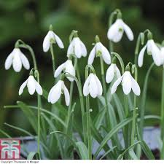
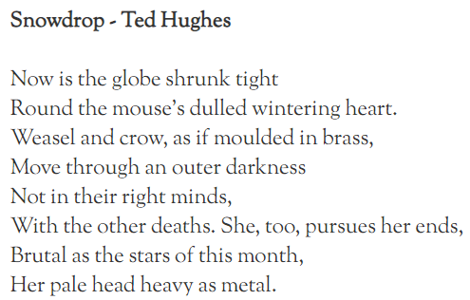

Year 11 Weekly Homework Name: ________________________________________ Spring 1.2
1. Transform the following images from 'A Christmas Carol' into words: Stave 1 Stave 3 Stave 4 1. _____________________________________________ _______________________________________________ 2. _____________________________________________ _______________________________________________ 3. _____________________________________________ _______________________________________________ Extension: Can you explain the significance of the order of the above events? | 2. Why does Shakespeare use the following imagery in 'Romeo and Juliet': ________________________________________________________________________________________________________________________________________________________________________________________________________________________________________________________________________________________________________________________________________________________________________________________________________________________________________________________________________________________________________________________________________________ | 3. This is an unseen practice. How does the poet present the weather in the following poem? _______________________________________________________________________________________________________________________________________________________________________________________________________________________________________________________________________________________________________________________________________________________________________________________________________________________________________________________________________________________________________________________________________________________________________________________________________________________________________________________________________________________________________________________________
4. Explain the following quote from ‘Remains’ 'but near to the knuckle, here and now, his bloody life in my bloody hands.' ____________________________________________________________________________________________________________________________________________________________________________________________________________________________________________________________________________________________________________________________________________________________________________________________________________________________________________________________________________________________________ | 5 . What is the context linked to the poem 'The Charge of the Light Brigade'? (try to explain your answer by linking it to the poem). _______________________________________________________________________________________________________________________________________________________________________________________________________________________________________________________________________________________________________________________________________________________________________________________________________________________________________________________________________________________________________________________________________________

Slide 5
Week 2 Language HW: Paper __ Q: ____
Name of Source: _____________________
_____________________________________________________________________________________________________________________________________________________________________________________________________________________________________________________________________________________________________________________________________________________________________________________________________________________________________________________________________________________________________________________________________________________________________________________________________________________________________________________________________________________________________________________________________________________________________________________________________________________________________________________________________________________________________________________________________________________________________________________________________________________________
____________________________________________________________________________________________________________________________________________________________________________________________________________________________________________________________________________________________________________________________________________________________________________________________________________________________________________________________________________________________________________________________________________________________________________________________________________________________________________________________________________________________________________________________________________________________________________________________________________________________________________________________________________________________

Slide 6


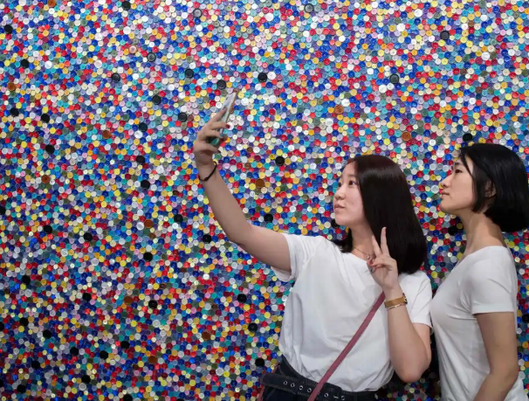
Year 11 Weekly Homework Name: ________________________________________ Spring 1.3
1. Complete the following quotes: A) 'If building were ___________, I might feel their ____________.' (Tissue) B) 'There once _____ a country … I left as a ________' (The Emigree) C) 'she still ______ the Russian snow a healing star among the wounded' D) 'till gradually we too _______________ to be _________, to live as though he had never _______________.' (Kamikaze) E) 'the world ___________________ like a treasure chest.' (Poppies) (Challenge: select one of the quotes above, explain the theme highlighted by the quote and analyse the language.) | 2. 2. Quick character timeline – describe the character at the different points in the timeline: (For a perceptive response, consider changes or no changes in the character and its significance) | 3. How is Thomas Malthus a significant figure in your study of 'A Christmas Carol'? _________________________________ ____________________________________________________________________________________________________________________________________________________________________________________________________ ________________________________________________ ____________________________________________________________________________________________________________________________________________________________________________________________________
4. Based on the title, how does the writer of the below article feel about selfies? Explain your answer. Switch off your phone and get lost in a gallery ________________________________________________________________________________________________________________________________________________________________________________________________________________________________________________________________________________________________________________________________________________________________________________________________________ (Extension – write your own opinion piece on 'selfies') | 5. Correct the following false statements about 'Romeo and Juliet': 1. Romeo is in love with Juliet at the start of the play. _________________________________________________________________________________________________ 2. Juliet is present when his father speaks to Paris about her marriage. __________________________________________________________________________________________________ 3. The Nurse helps Juliet with the sleeping potion plan. __________________________________________________________________________________________________ (Challenge: explain the significance of one of the events above.) | 6. Which theme is more prevalent in 'A Christmas Carol': Poverty Charity Greed (Challenge: explain your top answer)
JULIET
B
M
E

Slide 7
Week 3 Language HW: Paper __ Q: ____
Name of Source: _____________________
_____________________________________________________________________________________________________________________________________________________________________________________________________________________________________________________________________________________________________________________________________________________________________________________________________________________________________________________________________________________________________________________________________________________________________________________________________________________________________________________________________________________________________________________________________________________________________________________________________________________________________________________________________________________________________________________________________________________________________________________________________________________________
____________________________________________________________________________________________________________________________________________________________________________________________________________________________________________________________________________________________________________________________________________________________________________________________________________________________________________________________________________________________________________________________________________________________________________________________________________________________________________________________________________________________________________________________________________________________________________________________________________________________________________________________________________________________

Slide 8

Year 11 Weekly Homework Name: ________________________________________ Spring 1.4
Which poem best explores ideas of loss: Poppies Kamikaze The Emigree (Challenge: explain your top answer) | 2. Think of 3 words to describe The Ghost of Christmas Present and explain one of them. ______________________________________________________________________________________________________________________________________________________________________________________________________________________________________________________________________________________________________ | 3. Find a quotation that demonstrates each of the following types of language in the 'Romeo and Juliet'. Explain the effects. Religious Imagery: _________________________________ ____________________________________________________________________________________________________________________________________________________________________________________________________ Semantic field : _________________________________ ____________________________________________________________________________________________________________________________________________________________________________________________________
4. Re-write by completing the fragments: 1. singing along to the wonderful tune ___________________________________________________________________________________________________________________________________________________ 2. thoughtfully ___________________________________________________________________________________________________________________________________________________ 3. as the clouds scattered ___________________________________________________________________________________________________________________________________________________ | 5. Identify two techniques in the below short poem and explain their effect. How does the poet present the speaker's feelings? To Heck With Tech A little old lady, I do not mind being. What I find I don't like are the changes I'm seeing. My marbles are still rolling in the right direction. I enjoy this old world, though it has imperfections. ... The words that you say have a new meaning now. I admit that I find they confuse me, somehow. Websites were something we swished with the broom. We wouldn't have endured a mouse in the room. (Tips – Remember to first get the overall feeling – does the speaker of the poem see books as positive or negative? Then identify the language feature/s used and explain their effects.) | 1._______________________________________________________________________________________________________________________________________________________________________________________________________________________________________________________________________________________________________________________________________________________________________________________________________ 2. ______________________________________________________________________________________________________________________________________________________________________________________________________________________________________________________________________________________________________________________________________________________________________________________________________

Slide 9
Week 4 Language HW: Paper __ Q: ____
Name of Source: _____________________
_____________________________________________________________________________________________________________________________________________________________________________________________________________________________________________________________________________________________________________________________________________________________________________________________________________________________________________________________________________________________________________________________________________________________________________________________________________________________________________________________________________________________________________________________________________________________________________________________________________________________________________________________________________________________________________________________________________________________________________________________________________________________
____________________________________________________________________________________________________________________________________________________________________________________________________________________________________________________________________________________________________________________________________________________________________________________________________________________________________________________________________________________________________________________________________________________________________________________________________________________________________________________________________________________________________________________________________________________________________________________________________________________________________________________________________________________________

Slide 10


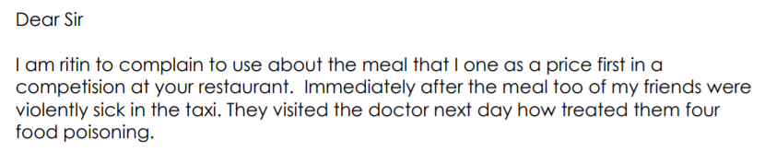
Year 11 Weekly Homework Name: ________________________________________ Spring 1.5
1. Answer the following comprehension questions for the poem 'The Emigree': A) What do you learn about the speaker from the opening? ___________________________________________________________________________________________________________________________________________________ B) What has happened to her country since she left? ___________________________________________________________________________________________________________________________________________________ C) Find one example of personification in the poem. __________________________________________________________________________________________________ (Extension: analyse the meaning created by your response to C) | 2. Think of 3 words to describe Tiny Tim and explain one of them. ______________________________________________________________________________________________________________________________________________________________________________________________________________________________________________________________________________________________________ | 3. Summarise the poem using the below icons: Poem:_______________________________________________________________________________________________________________________________________________________________________________________________ ___________________________________________________________________________________________________________________________________________________
4. Proof-read and re-write the following opening to a letter: ______________________________________________________________________________________________________________________________________________________________________________________________________________________________________________________________________________________________________ __________________________________________________________________________________________________ | 5. Think about the below characters in 'Romeo and Juliet'. Summarise who they are and what they symbolise: Lady Capulet: _______________________________ __________________________________________ Symbolic: _________________ The Nurse: _______________________________ __________________________________________ Symbolic: _________________ Rosaline: _______________________________ __________________________________________ Symbolic: _________________ | 6. How should you structure your Paper 2 Question 5 answer. Look at your KO, PAGE 13. (Challenge: write an opinion piece on 'Education'.)

Slide 11
Week 5 Literature HW: Poetry Comparison
Explore how the power of a place is presented through ‘Exposure’ and one other poem of your choice.
_____________________________________________________________________________________________________________________________________________________________________________________________________________________________________________________________________________________________________________________________________________________________________________________________________________________________________________________________________________________________________________________________________________________________________________________________________________________________________________________________________________________________________________________________________________________________________________________________________________________________________________________________________________________________________________________________________________________________________________________________________________________________
____________________________________________________________________________________________________________________________________________________________________________________________________________________________________________________________________________________________________________________________________________________________________________________________________________________________________________________________________________________________________________________________________________________________________________________________________________________________________________________________________________________________________________________________________________________________________________________________________________________________________________________________________________________________

Slide 12
Year 11 Weekly Homework Name: ________________________________________ Spring 1.6
1. Explain when Juliet is saying the following quote: 'It is the lark that sings so out of tune,/ Straining harsh discords and unpleasing sharps.' __________________________________________________________________________________________________________________________________________________________________________________________________________________________________________________________________________________________________________________________________________________________________________________________________________________________________________________________________________________________________________ | 2. Can you summarise what is happening in the following 'A Christmas Carol' quotation? Embed key words that would help you in an exam: 'Its tenderness and flavours, size and cheapness, were the themes of universal admiration. Eked out by the apple sauce and mashed potatoes, it was sufficient dinner for the whole family; as Mrs Cratchit said with a great delight (surveying one small atom of a bone upon a dish) they hadn't ate it all at last!' ______________________________________________________________________________________________________________________________________________________________________________________________________________________________________________________________________________________________________ | 3. Look at the Prologue, what is the significance of the following line: “star-crossed lovers take their life” __________________________________________________________________________________________________________________________________________________________________________________________________________________________________________________________________________________________________________________________________________________________________________________________________________________________________________________________________________________________________________
4. Look at the ending of 'Romeo and Juliet' - how is the Prince's comment significant? "See what a scourage is laid upon your hate, That heaven finds means to kill your joys with love." __________________________________________________________________________________________________________________________________________________________________________________________________________________________________________________________________________________________________________________________________________________________________________________________________________________________________________________________________________________________________________ | 5. Complete the following mini connections map – explain a minimum of 3 connections: (Extension: write two PETALCPETAL paragraphs for two poems of your choice – focus the question on power or conflict)
First person voice
The sun
reality
Conflict
'Tissue'
'The Emigree'
heritage
'Kamikaze'

Slide 13
Week 6 Language HW: Paper __ Q: ____
Name of Source: _____________________
_____________________________________________________________________________________________________________________________________________________________________________________________________________________________________________________________________________________________________________________________________________________________________________________________________________________________________________________________________________________________________________________________________________________________________________________________________________________________________________________________________________________________________________________________________________________________________________________________________________________________________________________________________________________________________________________________________________________________________________________________________________________________
____________________________________________________________________________________________________________________________________________________________________________________________________________________________________________________________________________________________________________________________________________________________________________________________________________________________________________________________________________________________________________________________________________________________________________________________________________________________________________________________________________________________________________________________________________________________________________________________________________________________________________________________________________________________

