Slide 1
Weekly Homework Grids and Extended Responses
YEAR 11 BOOKLET
AUTUMN PART 2
Name: _____________________________
Teacher: ____________________________
Room: ______________________________
Week ​​ | Effort Grade​​
1​.1​ | ​​
1.2​ | ​​
1.3​ | ​​
1.4​ | ​​
1.5​​ | ​​

Slide 2
https://www.loom.com/share/08dbb23f783049d4b309a359697d9ecf
This is an extract from Bram Stoker’s novel, Dracula. In the extract, the narrator – Jonathan Harker, a solicitor- describes a terrifying encounter with Count Dracula.
When I had written in my diary and had fortunately replaced the book and pen in my pocket I felt sleepy. The Count's warning came into my mind, but I took pleasure in disobeying it. The sense of sleep was upon me, and with it the obstinacy which sleep brings as outrider. The soft moonlight soothed, and the wide expanse without gave a sense of freedom which refreshed me. I determined not to return tonight to the gloom-haunted rooms, but to sleep here, where, of old, ladies had sat and sung and lived sweet lives whilst their gentle breasts were sad for their menfolk away in the midst of remorseless wars. I drew a great couch out of its place near the corner, so that as I lay, I could look at the lovely view to east and south,and unthinking of and uncaring for the dust, composed myself for sleep. I suppose I must have fallen asleep. I hope so, but I fear, for all that followed was startlingly real, so real that now sitting here in the broad, full sunlight of the morning, I cannot in the least believe that it was all sleep.
I was not alone.The room was the same, unchanged in any way since I came into it.I could see along the floor, in the brilliant moonlight,my own footsteps marked where I had disturbed the long accumulation of dust. In the moonlight opposite me were three young women, ladies by their dress and manner. I thought at the time that I must be dreaming when I saw them, they threw no shadow on the floor. They came close to me, and looked at me for some time, and then whispered together. Two were dark, and had high aquiline noses, like the Count, and great dark, piercing eyes, that seemed to be almost red when contrasted with the pale yellow moon. The other was fair,as fair as can be, with great masses of golden hair and eyes like pale sapphires. I seemed somehow to know her face, and to know it in connection with some dreamy fear, but I could not recollect at the moment how or where. All three had brilliant white
teeth that shone like pearls against the ruby of their voluptuous lips.
I was afraid to raise my eyelids,but looked out and saw perfectly under the
lashes. The girl went on her knees, and bent over me, simply gloating.There was a deliberate voluptuousness which was both thrilling and repulsive, and as she arched her neck she actually licked her lips like an animal, till I could see in
the moonlight the moisture shining on the scarlet lips and on the red tongue as it lapped the white sharp teeth. Lower and lower went her head as the lips went below the range of my mouth and chin and seemed to fasten on my throat. Then she paused, and I could hear the churning sound of her tongue as it licked her teeth and lips, and I could feel the hot breath on my neck. Then the skin of my throat began to tingle as one's flesh does when the hand that is to tickle it approaches nearer, nearer. I could feel the soft, shivering touch of the lips on the super sensitive skin of my throat, and the hard dents of two sharp teeth, just touching and pausing there. I closed my eyes in languorous ecstasy and waited, waited with beating heart.
But at that instant, another sensation swept through me as quick as lightning.I was conscious of the presence of the Count, and of his being as if lapped in a storm of fury. As my eyes opened involuntarily I saw his strong hand grasp the slender neck of the fair woman and with giant's power draw it back, the blue eyes transformed with fury, the white teeth champing with rage, and the fair cheeks blazing red with passion. But the Count! Never did I imagine such wrath and fury, even to the demons of the pit. His eyes were positively blazing. The red light in them was lurid, as if the flames of hell fire blazed behind them. His face was deathly pale, and the lines of it were hard like drawn wires. The thick eyebrows that met over the nose now seemed like a heaving bar of white-hot metal. With a fierce sweep of his arm, he hurled the woman from him, and then motioned to the others, as though he were beating them back. It was the same imperious gesture that I had seen used to the wolves. In a voice which,though low and almost in a whisper seemed to cut through the air and then ring in the room he said,
"How dare you touch him, any of you? How dare you cast eyes on him when I had forbidden it? Back, I tell you all! This man belongs to me! Beware how you meddle with him, or you'll have to deal with me."
11
Paper 1 – Dracula
20
5

Slide 3
Paper 1 – Dracula continued…
Q2: How does the writer use language to describe Dracula’s appearance and mood? [8 marks]
Q2: Look in detail at this extract from lines 20-31 of the source:
​
But at that instant, another sensation swept through me as quick as lightning.I was conscious of the presence of the Count, and of his being as if lapped in a storm of fury. As my eyes opened involuntarily I saw his strong hand grasp the slender neck of the fair woman and with giant's power draw it back, the blue eyes transformed with fury, the white teeth champing with rage, and the fair cheeks blazing red with passion. But the Count! Never did I imagine such wrath and fury, even to the demons of the pit. His eyes were positively blazing. The red light in them was lurid, as if the flames of hell fire blazed behind them. His face was deathly pale, and the lines of it were hard like drawn wires. The thick eyebrows that met over the nose now seemed like a heaving bar of white-hot metal. With a fierce sweep of his arm, he hurled the woman from him, and then motioned to the others, as though he were beating them back. It was the same imperious gesture that I had seen used to the wolves. In a voice which,though low and almost in a whisper seemed to cut through the air and then ring in the room he said, "How dare you touch him, any of you? How dare you cast eyes on him when I had forbidden it? Back, I tell you all! This man belongs to me!
The fair girl, with a laugh of ribald coquetry, turned to answer him. "You yourself never loved. You never love!" On this the other women joined,and such a mirthless, hard, soulless laughter rang through the room that it almost made me faint to hear. It seemed like the pleasure of fiends.
Then the Count turned, after looking at my face attentively, and said in a soft whisper, "Yes, I too can love.You yourselves can tell it from the past. Is it not so? Well,now I promise you that when I am done with him you shall kiss him at your will.Now go! Go! I must awaken him, for there is work to be done."
"Are we to have nothing tonight?"said one of them, with a low laugh, as she pointed to the bag which he had thrown upon the floor, and which moved as though there were some living thing within it. For answer he nodded his head. One of the women jumped forward and opened it.If my ears did not deceive me there was a gasp and a low wail, as of a half smothered child. The women closed round, whilst I was aghast with horror. But as I looked,they disappeared, and with them the dreadful bag.There was no door near them, and they could not have passed me without my noticing.They simply seemed to fade into the rays of the moonlight and pass out through the window, for I could see outside the dim, shadowy forms for a moment before they entirely faded away.
Then the horror overcame me,and I sank down unconscious.
Q3: You now need to think about the whole of the source.
This text is from the end of a chapter near the beginning of the book.​
How has the writer structured the text to interest you as a reader? [8 marks]
Q1: Read again the first part of the source, lines 5-11.
​
List 4 details about the appearance of the three young women.
​[4 marks]​
Q4: Focus this part of your answer on the second part of the source from line 20 to the end of the extract.
A student, having read this part of the text said: “The writer makes this moment of the story very dramatic.”​
​
To what extent do you agree? [20 marks]

Slide 4

Year 11 Weekly Homework Name: ________________________________________ Autumn 1.6
1. Answer the following comprehension questions for the poem 'The Prelude': A) What does the boy steal in the poem? ___________________________________________________________________________________________________________________________________________________ B) What does the boy see in the poem? ___________________________________________________________________________________________________________________________________________________ C)How does the boy feel by the end of the poem? Why? ______________________________________________________________________________________________________________________________________________ (Extension: analyse the meaning created by your response to B) | 2. Think of 3 words to describe Juliet and explain one of them. ______________________________________________________________________________________________________________________________________________________________________________________________________________________________________________________________________________________________________ | 3. What could the following items be symbolic of in the poem 'Ozymandias' (try to link your idea to ideas of power and/or conflict)? 'colossal wreck': __________________________________ ____________________________________________________________________________________________________________________________________________________________________________________________________ 'lone and level sands stretch far away' : ______________ ____________________________________________________________________________________________________________________________________________________________________________________________________
4. The below technical terms have been spelt incorrectly. Re-write the technical terms spelling them correctly. A) alegori _______________ B) metaphore _______________ C) forshadow ____________________ D) anniphora _________________________ E) alution ________________________ F) hipophora _________________________ G) simele __________________________ H) riter __________________________ I) simbolisess ___________________________ J) oxymorins ________________________ | 5. Think about the below characters in 'A Christmas Carol'. Summarise who they are and what they symbolise: Tiny Tim : _______________________________ __________________________________________ Symbolic: _________________ Fred : _______________________________ __________________________________________ Symbolic: _________________ Mr Fezziwig: _______________________________ __________________________________________ Symbolic: _________________ (Challenge: create a connection map using the above characters and adding 3 other) | 6. Complete the following quotations from 'Romeo and Juliet' and write who says the quotation: 1. ‘Rebellious subjects, _____________ to peace’, (A1 S1) ______________________ 2. ‘she doth teach the___________ to burn ______’ (A1 S5) _______________________ 3. ‘This alliance may so _________ prove to turn your household ___________ to pure love’ (A2 S3) _______________________ 4. ‘These violent _________ have __________ ends’ (A2 S6) _______________________ 5. ' I think she will be ___________/ In all respects by _____’ (A3 S4) _______________________ (Challenge: write a PETAL paragraph explaining the significance of one of the above quotations)

Slide 5
Week 6 Language HW: Paper 1 Q: 1 and 2
_____________________________________________________________________________________________________________________________________________________________________________________________________________________________________________________________________________________________________________________________________________________________________________________________________________________________________________________________________________________________________________________________________________________________________________________________________________________________________________________________________________________________________________________________________________________________________________________________________________________________________________________________________________________________________________________________________________________________________________________________________________________________
https://www.loom.com/share/56c13a93f6214492bd394ccd47338c98?sharedAppSource=personal_library
Q2: How does the writer use language to describe Dracula’s appearance and mood? [8 marks]
https://www.loom.com/share/f4099e02266349788f8db7125a0e87e0?sharedAppSource=personal_library
____________________________________________________________________________________________________________________________________________________________________________________________________________________________________________________________________________________________________________________________________________________________________________________________________________________________________________________________________________________________________________________________________________________________________________________________________________________________________________________________________________________________________________________________________________________________________________________________________________________________________________________________________________________________
Q1: Read again the first part of the source, lines 5-11 (labelled for you)
​
List 4 details about the appearance of the three young women.
​[4 marks]​

Slide 6
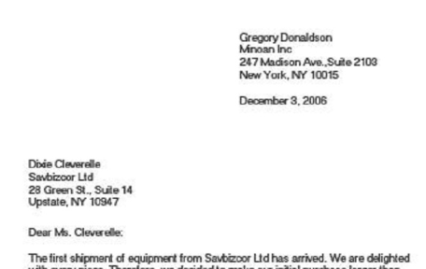
Year 11 Weekly Homework Name: ________________________________________ Autumn 1.7
1. Label the features of a letter: | 2. Look at the beginning of 'Bayonet Charge' - what's the significance and effect of the first line: 'suddenly he awoke and was running – raw' __________________________________________________________________________________________________________________________________________________________________________________________________________________________________________________________________________________________________________________________________________________________________________________________________________________________________________________________________________________________________________ | 3. Look at the beginning of 'War Photographer', what's the significance of the first line: 'In his darkroom he is finally alone' __________________________________________________________________________________________________________________________________________________________________________________________________________________________________________________________________________________________________________________________________________________________________________________________________________________________________________________________________________________________________________
4. Look at the ending of 'The Charge of the Light Brigade' - what's the significance and effect of the last three lines: 'Honour the charge they made! Honour the Light Brigade, Noble six hundred' __________________________________________________________________________________________________________________________________________________________________________________________________________________________________________________________________________________________________________________________________________________________________________________________________________________________________________________________________________________________________________ | 5. Complete the following mini connections map – explain a minimum of 3 connections: (Extension: write two PETALCPETAL paragraphs for two poems of your choice – focus the question on power or conflict)
First person voice
'My Last Duchess'
Metaphor
Conflict
Power
'The Prelude'
‘Remains'

Slide 7
Week 7 Language HW: Paper 1 Q: 3
_____________________________________________________________________________________________________________________________________________________________________________________________________________________________________________________________________________________________________________________________________________________________________________________________________________________________________________________________________________________________________________________________________________________________________________________________________________________________________________________________________________________________________________________________________________________________________________________________________________________________________________________________________________________________________________________________________________________________________________________________________________________________
https://www.loom.com/share/b801657ee9e745bca62e38cec8f95f6c?sharedAppSource=personal_library
Q3: You now need to think about the whole of the source.
This text is from the end of a chapter near the beginning of the book.​
How has the writer structured the text to interest you as a reader? [8 marks]
____________________________________________________________________________________________________________________________________________________________________________________________________________________________________________________________________________________________________________________________________________________________________________________________________________________________________________________________________________________________________________________________________________________________________________________________________________________________________________________________________________________________________________________________________________________________________________________________________________________________________________________________________________________________

Slide 8
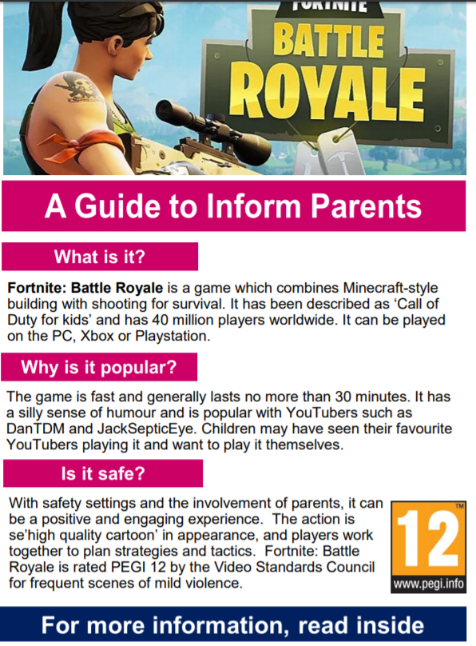
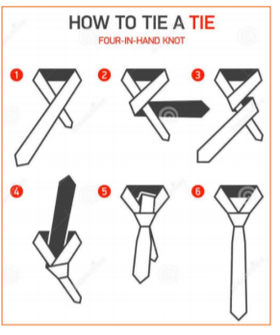


Year 11 Weekly Homework Name: ________________________________________ Autumn 1.8
1. What are the possible effects of the following structural techniques: A) Flashback: ___________________________________________________________________________________________________________________________________________________ B) Chronological order: ___________________________________________________________________________________________________________________________________________________ C) Introducing the setting first: ___________________________________________________________________________________________________________________________________________________ | 2. How would you answer Paper 2 Question 4? (Draw a flow chart or make a list of instructions) | 3. List four things you learn about the boy: The boy stretched his body full length, touching the wall at his head with his hands, and the bedfoot with his toes; then he sprung out, like a fish leaping from water. And it was cold, cold. He always dressed rapidly to try and conserve his night-warmth till the sun rose two hours later; but by the time he had on his clothes his hands were numbed and he could scarcely hold his shoes. From Sun on the Veld by Dorothy Lessing A) _______________________________________ B) _______________________________________ C) _______________________________________ D) _______________________________________
4. Can you determine the purpose for each text? Explain your answer: (Choose from: persuade, instruct and inform) |  | 5. Insert the correctly spelled word in each of the following pairs of sentences: A) Your/ you're ______________ not going out like that. I asked __________ sister to bring it. B) Where/ wear/ we're Turn it off or it will _______________ out. We have no idea ___________ it is but _________going anyway. C) To/ too/ two There were only ___________ exams _________ sit but that was one _______________ many. He ____________ wanted to go to the cinema.

Slide 9
Week 8 Language HW: Paper 1 Q: 4
_____________________________________________________________________________________________________________________________________________________________________________________________________________________________________________________________________________________________________________________________________________________________________________________________________________________________________________________________________________________________________________________________________________________________________________________________________________________________________________________________________________________________________________________________________________________________________________________________________________________________________________________________________________________________________________________________________________________________________________________________________________________________
https://www.loom.com/share/fbb5214a977d4668a5fc7035b43fade7?sharedAppSource=personal_library
Q4: Focus this part of your answer on the second part of the source from line 20 to the end of the extract. (labelled)
A student, having read this part of the text said: “The writer makes this moment of the story very dramatic.”​
​
To what extent do you agree? [20 marks]
____________________________________________________________________________________________________________________________________________________________________________________________________________________________________________________________________________________________________________________________________________________________________________________________________________________________________________________________________________________________________________________________________________________________________________________________________________________________________________________________________________________________________________________________________________________________________________________________________________________________________________________________________________________________

Slide 10




Year 11 Weekly Homework Name: ________________________________________ Autumn 1.9
1. Quick character timeline – describe the character at the different points in the timeline: (For a perceptive response, consider changes or no changes in the character and its significance) | 2. What ideas do the below images emphasise about ideas explored in 'A Christmas Carol'. ______________________________________________________________________________________________________________________________________________________________________________________________________________________________________________________________________________________________________ | 4. Insert the correct form of the verb 'to be' or 'to do': Present tense: A) You __________ a great singer. B) They __________ trying hard. Simple past: C) We ______ waiting for you. D) He _________ what they told him to do. Perfect: E) She ___________ my friend for years. F) They ____________ all their exams now. Simple past + past perfect G) We _____________ happy because we ______________ all the exercises.
4. Explain the conflict presented in two different poems. 1. ______________________________________________________________________________________________________________________________________________________________________ 2. ______________________________________________________________________________________________________________________________________________________________________ | 5. Who is the most powerful character in 'Romeo and Juliet'? Select three characters and rank them. Explain your top one.
Lord Capulet
B
M
E

Slide 11
Week 9 Literature HW: Poetry Comparison
__________________________________________________________________________________________________________________________________________________________________________________________________________________________________________________________________________________________________________________________________________________________________________________________________________________________________________________________________________________________________________________________________________________________________________________________________________________________________________________________________________________________________________________________________________________________________________________________________________________________________________________________________________________________________________________________________________________________________________________________________________________________________________________________________________________________________
Use pages 96 and 97 of your Knowledge Book and the loom videos about the poem to write a minimum of one CPETALCPETAL paragraph.
Compare how power is presented in Ozymandias and one other poem of your choice. (You can use London and the ideas in the resources of course!)
________________________________________________________________________________________________________________________________________________________________________________________________________________________________________________________________________________________________________________________________________________________________________________________________________________________________________________________________________________________________________________________________________________________________________________________________________________________________________________________________________________________________________________________________________________________________________________________________________________________________________________________________________________________________

Slide 12
Week 9 Literature HW: Poetry Comparison
Continued …..
__________________________________________________________________________________________________________________________________________________________________________________________________________________________________________________________________________________________________________________________________________________________________________________________________________________________________________________________________________________________________________________________________________________________________________________________________________________________________________________________________________________________________________________________________________________________________________________________________________________________________________________________________________________________________________________________________________________________________________________________________________________________________________________________________________________________________
________________________________________________________________________________________________________________________________________________________________________________________________________________________________________________________________________________________________________________________________________________________________________________________________________________________________________________________________________________________________________________________________________________________________________________________________________________________________________________________________________________________________________________________________________________________________________________________________________________________________________________________________________________________________

Slide 13


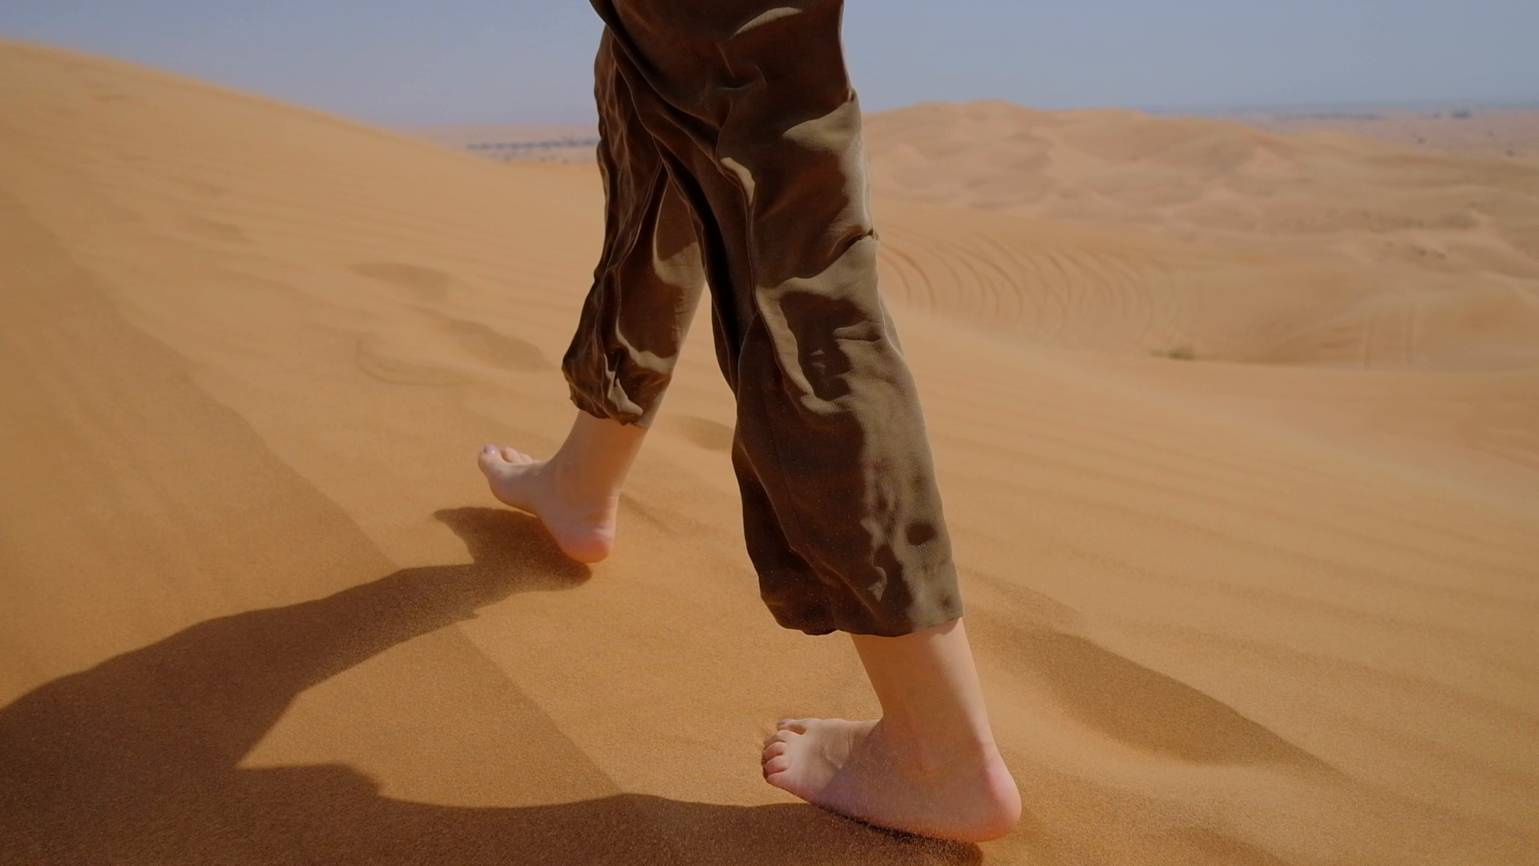
Year 11 Weekly Homework Name: ________________________________________ Autumn 1.10
1. Identify the technique in the song and explain the effect: 'Try play it coy Try make it disappear But just like the battle of Troy There's nothing subtle here' What is this technique? ____________ Challenge: what is the effect? _____________________________________________________________________________________________________________________________________________________________________________________________________________________________ | 2. Summarise the poem using these icons: Poem:_______________________________________________________________________________________________________________________________________________________________________________________________ ___________________________________________________________________________________________________________________________________________________ | 3. Explain the following theme from 'Romeo and Juliet'
4. Add the missing apostrophes and explain why you needed them: A) Peters cars were very expensive. ____________________________________________________________________________________ B) The girls shoes were beautiful. (3 girls) ____________________________________________________________________________________ C) Its cold outside. ____________________________________________________________________________________ | 5. Write a short description suggested by the image. Use linguistic features in your piece: ___________________________________________________________________________________________________________________________________________________________________________________________________________________________________________________________________________________________________________________________________________________________________________________________________________________________________________________________________________________________________________________________________________________________________________________________________________________________________________________________________________________________________________________________________________________________________________________________________________________________________________________________________________________________________________________________________________________________________________________________________________________________________________________________________________________________________________________________________________________________________________________________________________________________________________________________________________________________________________________________________________________________________________________________________________________________________________________________________________________________________________________________________________________________________________ (You can write a full version for We Are Writers)

Slide 14
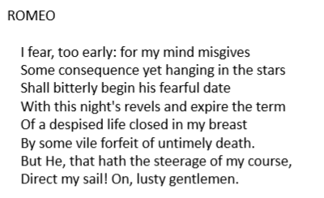
Week 10 Literature HW: Romeo and Juliet
_____________________________________________________________________________________________________________________________________________________________________________________________________________________________________________________________________________________________________________________________________________________________________________________________________________________________________________________________________________________________________________________________________________________________________________________________________________________________________________________________________________________________________________________________________________________________________________________________________________________________________________________________________________________________________________________________________________________________________________________________________________________________
Use the attached PowerPoint with voiceover and your 'Romeo and Juliet' KB.
Starting with this speech, explore how Shakespeare presents fate in Romeo and Juliet.
Write about:
• how Shakespeare presents fate in this speech.
• how Shakespeare presents fate in the play as a whole.
__________________________________________________________________________________________________________________________________________________________________________________________________________________________________________________________________________________________________________________________________________________________________________________________________________________________________________________________________________________________________________________________________________________________________________________________________________________________________________________________________________________________________________________________________________________________________________________________________________________________________________________________________________________________________________________________________________________________________

Slide 15
Week 10 Literature HW: Romeo and Juliet
Continue...
_____________________________________________________________________________________________________________________________________________________________________________________________________________________________________________________________________________________________________________________________________________________________________________________________________________________________________________________________________________________________________________________________________________________________________________________________________________________________________________________________________________________________________________________________________________________________________________________________________________________________________________________________________________________________________________________________________________________________________________________________________________________________
__________________________________________________________________________________________________________________________________________________________________________________________________________________________________________________________________________________________________________________________________________________________________________________________________________________________________________________________________________________________________________________________________________________________________________________________________________________________________________________________________________________________________________________________________________________________________________________________________________________________________________________________________________________________________________________________________________________________________

Slide 16
Year 11 PPE DATES: _____________ Revision page
____________________________________________________________________________________________________________________________________________________________________________________________________________________________________________________________________________________________________________________________________________________________________________________________________________________________________________________________________________________________________________________________________________________________________________________________________________________________________________________________________________________________________________________________________________________________________________________________________________________________________________________________________________________________
___________________________________________________________________________________________________________________________________________________________________________________________________________________________________________________________________________________________________________________________________________________________________________________________________________________________________________________________________________________________________________________________________________________________________________________________________________________________________________________________________________________________________________________________________________________________________________________________________________________________________________________________________________________________

