Slide 1

History Homework Booklet
Year 11 Autumn 1
Name:
Class:
Teacher:
HISTORY
Homework Expectations:
You must keep this booklet neat and presentable
All homework must be completed for the date set
High effort is expected in all tasks
You will boost all work in red pen

Slide 2
Year 11 Weekly Homework Autumn 1.1 The LON: Membership & structure KB: page 53-54
Which of these statements are true and which are false? Correct the false ones. The assembly met twice a year TRUE / FALSE There were 4 permanent members of the Council TRUE / FALSE Decisions in the assembly could be majority vote TRUE / FALSE Economic sanctions were applied before mitigation. TRUE / FALSE The LON had an army to enforce its decisions. TRUE / FALSE CORRECTIONS: ____________________________________________________________________________________________________________________________________________________________________________________________________________________________________ | 2. Transform the 3 step process for dealing with issues into 3 icons
3. Explain how each one of the statements below are a weakness for the LON: | 4. Identify one success and one failure for each of these commissions:
USA was absent | It had no army | Decisions had to be unanimous
Commission | Success | Failure
Slavery Commission
ILO
Refugee Commission

Slide 3
Year 11 Weekly Homework Autumn 1.2 The Failure of the LON & the Great Depression KB: page 61
Answer these true or false questions: The LON was too ambitious: True/False Germany & Russia had been allowed to join in 1919: True/False Sanctions worked well: True/False The Great Depression made the LON’s job harder: True/False The LON gave speedy decisions: True/False Britain and France were too self-interested: True/False | 2. Answer the following questions about the Great Depression When did America join WWI? ________________________ When did the Wall Street Crash happen? ____________________ Why did extremist parties come to power? ________________________________________________________ How did the Depression make the LONs job more difficult? ________________________________________________________________________________________________________________________ When did WWI end? ______________________ Who lent Germany money to pay their reparations? ______________
3. Explain how the Great Depression led to the rise of the European dictators: ________________________________________________________________________________________________________________________________________________________________________________________________________________________________________________________________________________________________________________________________________________________________________________________________________________________________________________________________________________________________________________________________________ | What would happened if: America had been a member of the LON from the start? ____________________________________________________________________________________________________________________________________________________________________________________________________________________________________ The Great Depression hadn’t have happened? ____________________________________________________________________________________________________________________________________________________________________________________________________________________________________

Slide 4
Year 11 Weekly Homework Autumn 1.3 Germany: 1890-1918 KB 6-7
Answer the following questions: When was the naval arms race? _______________________ When did Kaiser Wilhelm become Emperor? ____________________ When did the Kaiser abdicate? ___________________________ When was the unification of Germany? ______________ When did Germany’s iron & steel production overtake Britain? _______________________ What was the Kiel mutiny?________________________ When was the Armistice signed? _________________ | 2. Match the problem with the explanation:
3. The Problems caused by WWI: Create a 5 question & answer quiz based on page 7: | 4. Define each word below:
Term |  | Definition
Debt |  | The Socialists (who did not like the Kaiser) got 1/3 of votes in elections to the Reichstag.​​
Socialists |  | Germany was competing with Britain and other nations over the size of the militaries and empires.​
Competition |  | Germany was in debt as the Kaiser was spending lots of money on building up his navy.​
Term | Definition
Socialism
SPD
Trade Unions
Weltpolitik
Naval Laws
Question | Answer

Slide 5
Year 11 Weekly Homework Autumn 1.4 Germany: Terror, Propaganda & Opposition KB 38-39
Explain how each element of Propaganda helped the Nazis keep power: | 2. Make links between the elements of the police state – explain at least 4 links you make
3. Pick an opposition group and explain HOW they opposed Hitler and what happened to them: ________________________________________________________________________________________________________________________________________________________________________________________________________________________________________________________________________________________________________________________________________________________________________________________________________________________________________________________________________________________________________________________________________________________________ | 4. Explain why you think opposition to Hitler and the Nazis failed: ________________________________________________________________________________________________________________________________________________________________________________________________________________________________________________________________________________________________________________________________________________________________________________________________________________________________________________________________________________________________________________________________________________________________
Term | Explanation of how it helped the Nazis keep power
Newspapers
Radio
Rallies
Films
Concentration Camps
SS
Police & Courts
Gestapo

Slide 6
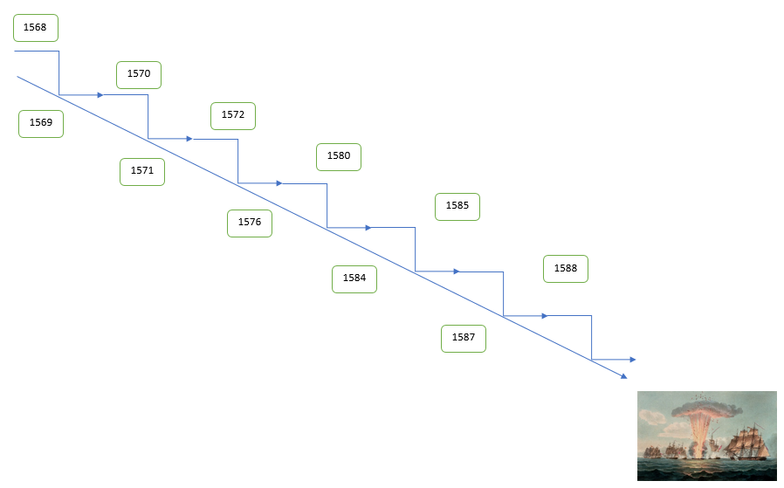
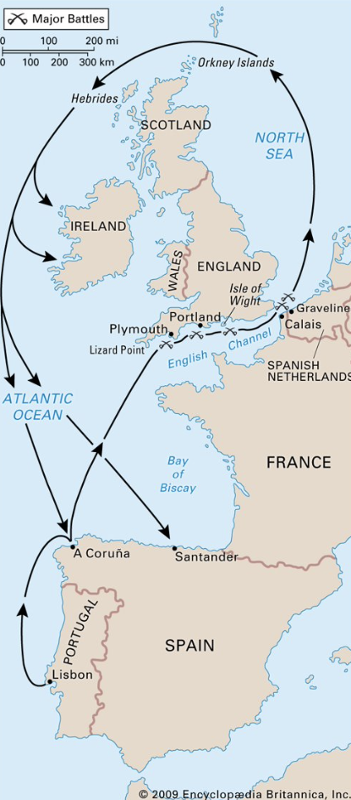
Year 11 Weekly Homework Autumn 1.5 Elizabeth: Foreign Policy KB 103-105
Answer the following questions: Who had Philip II been married to? _______________________ What had happened in the Netherlands in 1566? ___________________________________________ What did Elizabeth do in 1572? ______________________________ What had happened to Elizabeth in 1570? _____________________ What did Drake do in 1587? _________________________________ What happened in 1585?____________________________________ What happened in 1568? ___________________________________ | 2. Complete the diagram with at least 5 dates (choose the most significant)
3. Label this diagram: | 4. Explain how each tactic helped the English to beat the Spanish Armada:
Tactic | Explanation
English tactics
Spanish mistakes
Weather

Slide 7
Year 11 Weekly Homework Autumn 1.6 Elizabeth: Treatment of Catholics KB 96-98
1. Match the definitions: | 2. Explain how the Catholics posed a threat to Elizabeth in: 1569________________________________________________________________________________________________________________________________ 1583________________________________________________________________________________________________________________________________ 1586________________________________________________________________________________________________________________________________
3. What did Elizabeth do to the Catholics in the following years? 1571: ________________________________________________________________________________________________________________________________________ 1581: ________________________________________________________________________________________________________________________________________ 1585: ________________________________________________________________________________________________________________________________________ 1593: ________________________________________________________________________________________________________________________________________ | 4. Draw a series of icons to show what Edmund Campion did between 1580-1
Term |  | Definition
Recusancy |  | Officially remove from the Catholic Church by the Pope
Martyr |  | Involved in the Throckmorton and Babington plots. Cardinal on the recommendation of Philip II. Set up the Seminary College at Douai
Seminary |  | A training college for priests
Excommunicate |  | Someone willing to die for their belief.
William Allen |  | When a person refused to attend Church of England services

Slide 8
Year 11 Weekly Homework Autumn 1.7 Power: Voting & The Great Reform Act 1832 KB 131
Match the people to their definition: | 3. Correct the following statements: The Nottingham Political Union organised the first petition to Parliament __________________________________________________________________ The Tory party were replaced by Labour __________________________________________________________________ The Great Reform Act helped the nobility __________________________________________________________________ The Great Reform Act was passed in 1732 __________________________________________________________________ The Great Reform Act gave everyone the vote __________________________________________________________________ William IV hated the idea of voting reform __________________________________________________________________ The number of voters decreased after the Great Reform Act __________________________________________________________________ The Great Reform Act was in the Renaissance period __________________________________________________________________
2. Complete the table to show similarities and differences between The Magna Carta and the Great Reform Act
Key Individuals |  | Details
Henry Hunt |  | Became King in 1830, was in favour of reform.
William IV |  | Founder of the Birmingham Political Union
Earl Grey |  | Second leader of the Chartists from 1842, believed in violent methods.
Thomas Attwood |  | Famous speak who wanted reform. Was speaking at Peterloo
William Lovett |  | Queen of England at the time of the Chartists petition
Feargus O’Connor |  | The Whig Prime Minister who passed the Great Reform Act
Queen Victoria |  | Founder of the Chartists, believed in peaceful methods.
Similarities | Differences

Slide 9
Year 11 Weekly Homework Autumn 1.8 Power: Chartism KB 132-33
1. What happened on these dates? Highlight them on whether they benefitted the working class: | 2. Create 6 icons for the 6 demands of the Chartists:
3. Explain the significance of the Chartist movement: | 4. Explain how the Chartist movement links to the other events below:
Date | Description
1834
1839
1842
1848
Short term significance | Long term significance
Women’s Suffrage
French Revolution
1st & 2nd Barons war
English Revolution

Slide 10
Questions to ask:
Notes:
___________________________________________________________________________________________________________________________________________________________________________________________________________________________________________________________________________________________________________________________________________________________________________________________________________________________________________________________________________
___________________________________________________________________________________________________________________________________________________________________________________________________________________________________________________________________________________________________________________________________________________________________________________________________________________________________________________________________________

