Slide 1
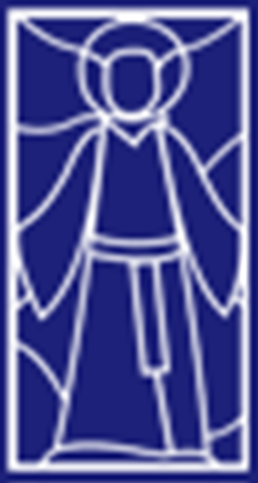
Religious Studies Homework Booklet
Year 8 Advent 2
Name:
Class:
Teacher:
Homework Expectations:
You must keep this booklet neat and presentable
All homework must be completed for the date set
High effort is expected in all tasks
You will boost all work in red pen
Due on: | Checked by: | Due on: | Checked by:
Homework 1 |  | Homework 4
Homework 2 |  | Homework 5
Homework 3 |  | Homework 6

Slide 2


Year 8 - Advent 2 - Homework 1 Recap of Year 7 Content
These statements are false, make them true. You can be a Saint only whilst you are alive. __________________________________________________________________________________________________________ Catholics pray to Saints the same as they would pray to God. __________________________________________________________________________________________________________ A Saint is someone that we know is in hell. __________________________________________________________________________________________________________​ | 2. Name three types of miracle performed by Jesus. Give an example for each. 1. 2. 3.
3. What are each of these symbols and what do they mean? _______________ ______________ ______________ _______________ ______________ ______________ _______________ ______________ ______________ _______________ ______________ ______________ _______________ ______________ ______________ | 4. The Ten Commandments Answer the following questions about the Ten Commandments 1. Who received the Ten Commandments? 2. What is the purpose of the Ten Commandments? 3. What two categories can all of the Ten Commandments be split into? 4. Where in the Bible are the Ten Commandments found?

Slide 3
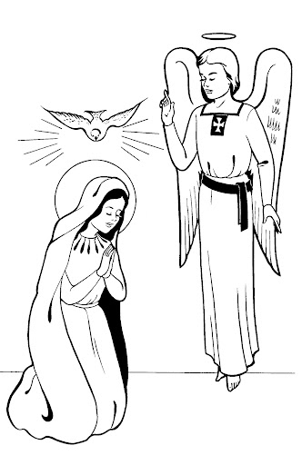
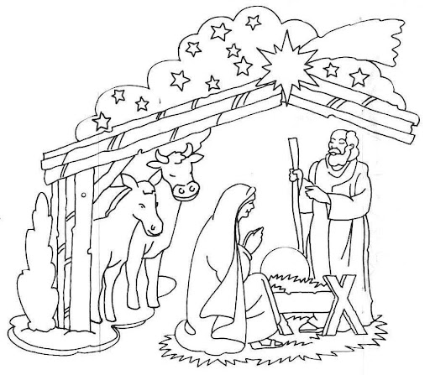
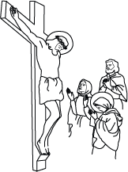
Year 8 - Advent 2 - Homework 2 The Bible
​1. Old Testament Read through the story and then say how a Literal Christian and a Liberal Christian would interpret the account. Noah's Ark 1. Noah was told to build and ark, all the evil people in the world were to be killed by a flood. 2. Noah was the only good man and God was going to save him. 3. Noah's 400th birthday was when the rain started. 4. Noah, his family and the animals were saved on the ark. 5. On Noah's 401st birthday he was able to step back on land. 6. God made a promise not to flood the earth again and the sign of this is the rainbow. Literal meaning of the story: _______________________________________________________________________________________________________________________________________________________________ Liberal meaning of the story: _______________________________________________________________________________________________________________________________________________________________ | 2. New Testament Write a sentence for each picture – say what is happening in the picture.
Picture 1 ________________________________________________________________________________________
Picture 2
________________________________________________________________________________
Picture 3
________________________________________________________________________________________

Slide 4
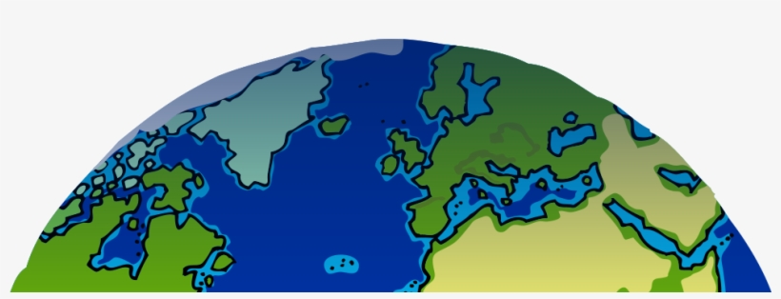
Year 8 - Advent 2 - Homework 3 Recap of Year 7 Learning – Creation of the World
​What happened on each day of creation? You may write or draw it in each section. What do Catholics believe about this story? (You must include the words Bible, the Big Bang Theory, God, all-powerful and created) ________________________________________________________________________________________________________________________________________________________________________________________________________________________________________________________________________________________________________________________________________________________________________________________________________________________________________________
5.
6.
3.
4.
2.
1.
7.

Slide 5
Year 8 - Advent 2 - Homework 4 Saint Benedict
Fill in the gaps. Saint Benedict was born in Italy. His family were ______, and he was sent to __________ to study. Benedict did not like the bad behaviour of the other students. He also did not like that others ____________ in lots of God’s rather than ______ God. He left the city and on the mountain of Subiaco there was a ________ where he lived three years alone. One day, the _________ tried to ________ him with bad thoughts. When he realised what was happening, he threw myself into a bush of long, sharp _________. He did not feel any more ______________ like that again. People wanted ____________ to teach them how to become holy. Some men came to ask if he would be their leader and help them become ________. However, they tried to ___________ him. He made the Sign of the _________ over the poisoned wine and the glass shattered into pieces before he could drink it. Other men asked him to lead them, they became good monks. His monks greatly __________ the people around out _______________. They were taught to read and write, how to farm and how to work at different jobs. Benedict could read _______, tell the future and drive out __________. He died on March 21st _______. The _________ eventually proclaimed him the Patron Saint of _____________. ​Words to use: Benedict, cave, rich, Pope, cross, Rome, poison, tempt, monasteries, devil, one, thorns, minds, demons, 547, temptations, Europe, helped, believed, holy. | 2. Answer these questions in full sentences. Where did Saint Benedict live? _________________________________________________ How was he saved from poisoning? ___________________________________________________________________________________________________________________________________________________ How did he save himself from temptation? ___________________________________________________________________________________________________________________________________________________ How did Saint Benedict show faith to God? (You need to mention 3 ways he showed faith) _________________________________________________________________________________________________________________________________________________________________________________________________________________________________________________________________________________________________________________________________________________________________________________________________________________________________________________________

Slide 6
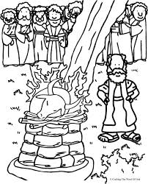
Year 8 - Advent 2 - Homework 5 Bible
1. Answer the questions in order from 1-4. ​ ​ | 2. Link the words together, for each link give a reason why.
4. How does this act show faith?
___________________________________________________________________________________________________________________
3. Why was this poured?
________________________________________________________________________________
Bible
Old Testament
New Testament
Prophets
Mary
2. What has been poured on this altar?
________________
Miracles
Jesus
1. Who is this?
________________
Holy Spirit
God

Slide 7
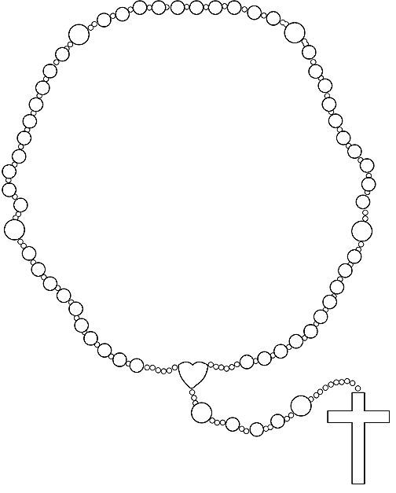
Year 8 - Advent 2 - Homework 6 Mary – The Rosary
1. The Hail Mary. What do each of these lines mean? Hail Mary, Full of Grace Meaning:_____________________________________________________________________________________________________________________________________________________ The Lord is with thee Meaning:_____________________________________________________________________________________________________________________________________________________ | 3. Label the Rosary beads with the correct prayers.
2. What are the four mysteries of the Rosary? 1. 2. 3. 4.

Slide 8
Year 8 Advent 2 – extra paper for any task you cannot fit into the activity box.
Activity this links to: ___________________________
Activity this links to: ___________________________
________________________________________________________________________________________________________________________________________________________________________________________________________________________________________________________________________________________________________________________________________________________________________________________________________________________________________________________________________________________________________________________________________________________________________________________________________________________________________________________________________________________________________________________________________________________________________________________________________________________________________________________________________________________________
__________________________________________________________________________________________________________________________________________________________________________________________________________________________________________________________________________________________________________________________________________________________________________________________________________________________________________________________________________________________________________________________________________________________________________________________________________________________________________________________________________________________________________________________________________________________________________________________________________________________________________________________________________________________________________________

