Slide 1

Religious Studies Homework Booklet
Year 8 Advent 1
Name:
Class:
Teacher:
Homework Expectations:
You must keep this booklet neat and presentable
All homework must be completed for the date set
High effort is expected in all tasks
You will boost all work in red pen
Due on: | Checked by: | Due on: | Checked by:
Homework 1 |  | Homework 4
Homework 2 |  | Homework 5
Homework 3 |  | Homework 6

Slide 2
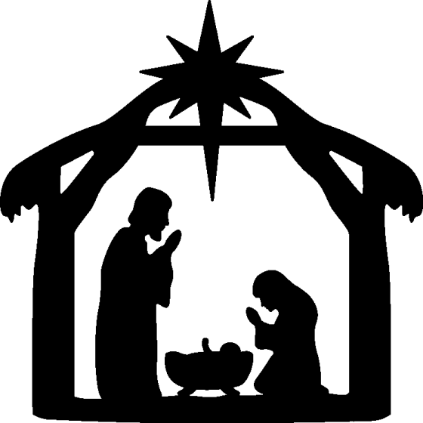
Year 8 - Advent 1 - Homework 1 Recap of Year 7 Learning - Jesus
1. Are the statements true or false? ​ Jesus taught with parables Jesus was a Christian There is no proof of Jesus existing Jesus was baptised by his cousin John Jesus told miracles Christians believe Jesus is the reincarnation of God | 2. Define each of these names for Jesus: Rabbi ________________________________________________________________________________________________________ Redeemer ________________________________________________________________________________________________________ Lamb of God ________________________________________________________________________________________________________
3. Did Jesus exist? 1. Identify two pieces of evidence for Jesus' existence __________________________________________________________________________________________________________ 2. What is the 'criterion of embarrassment'? __________________________________________________________________________________________________________ 3. Which piece of evidence is the most convincing to prove Jesus existed? __________________________________________________________________________________________________________ | 4. Label the image below with the people who are there. Who is missing?
True | False

Slide 3

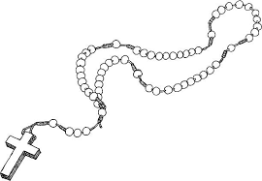
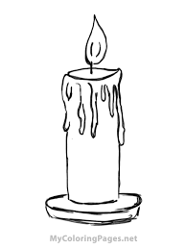
Year 8 - Advent 1 - Homework 2 Recap of Year 7 Learning – Prayer and Worship
​What is each item and how it is used in prayer? ​ | 2. Types of Prayer. Fill in the missing parts of the table? Identify each type of prayer within the Lord’s Prayer.
Name of item _______________________________
How is it used? ______________________________________________________________
P | Asking something for myself
Adoration
Thanksgiving | Thanking God for what he has done
I
Name of item _______________________________
How is it used? ______________________________________________________________
Our Father, Who art in Heaven, hallowed be Thy name; Thy Kingdom come, Thy will be done on earth as it is in Heaven. Give us this day our daily bread; and forgive us our trespasses as we forgive those who trespass against us; and lead us not into temptation, but deliver us from evil. Amen.
Name of item _______________________________
How is it used? ______________________________________________________________
Repentance

Slide 4
Year 8 - Advent 1 - Homework 3 Recap of Year 7 Learning - Christianity
​Read the information and answer the questions on the next page. 1054 the Great Schism - the Patriarch of Constantinople was excommunicated from the Christian church. This divided the European Christian church into two major branches: the Western Roman Catholic Church and the Eastern Orthodox Church. It came about due to a complex mix of religious disagreements and political conflicts. Rome believed that the Pope—the religious leader of the western church—should have authority over the patriarch—the religious authority of the eastern church. Constantinople disagreed. Each church recognised their own leaders, and when the western church eventually excommunicated the entire eastern church, the eastern church retaliated by excommunicating the Roman Pope Leo III and the Roman church. Today, the two branches of Christianity remain distinct expressions of a similar faith. Roman Catholicism is the single largest Christian denomination, with more than a billion followers around the world. Eastern Orthodoxy is the second-largest Christian denomination, with more than 260 million followers. | Answer the questions on the 1054 Great Schism. What is the Great Schism and when did it happen? _____________________________________________________ What are the titles of the Eastern and Western Churches leaders? __________________________________________________________________________________________________________ Why did the Great Schism happen? _______________________________________________________________________________________________________________________________________________________________ _______________________________________________________________________________________________________________________________________________________________ Why is this event so important in Church history? ______________________________________________________________________________________________________________________________________________________________________________________________________________________________________________________________________________________________________________________________

Slide 5
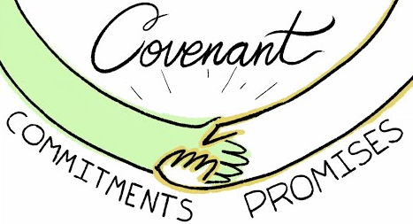
Year 8 - Advent 1 - Homework 4 Abraham – Use page 4 of your knowledge book.
1. Finish the sentence. A covenant is __________________________________ . Abraham was originally called ____________. Abraham's name means_________________. Abraham’s wife is called ____________. Abraham’s and his wife's son was called ____________. God promised Abraham _______________,_______________ and ___________________. ​ | 3. How does Abraham show faith? Create a flow chart of the story of Abraham. How does the story of Abraham show an example of faith in God ______________________________________________________________________________________________________________________________________________________________________________________________________________________________________________________________________________________________________________________________
2. Covenant – Tell us how this picture links God and Abraham together. _____________________ _____________________ _____________________ _______________________________________________________________________________________________________________________________________________________________ ​
God tells Abram to leave Ur

Slide 6
Year 8 - Advent 1 - Homework 5 Elijah – Use pages 3 and 5 of your knowledge book.
1. Look, Cover, Write, Check 1. What is meant by faith? __________________________________________________________________________________________________________ 2. What is meant by prophet __________________________________________________________________________________________________________ 3. What is meant by surrender? __________________________________________________________________________________________________________ 4. How do these words link to Elijah's story? ____________________________________________________________________________________________________________________________________________________________________________________________________________________ | 2. How does Elijah show faith? Rank these events in order of which would be more difficult for Elijah to have believed. 1. That the flour and oil will last during the famine 2. That God will protect him on the mountain 3. That God will show his followers He is real Hardest event _____________________________________________________ _____________________________________________________ _____________________________________________________ Easiest event How does Elijah's story show faith? _________________________________________________________________________________________________________________________________________________________________________________________________________________________________________________________________________

Slide 7
Year 8 - Advent 1 - Homework 6 Amos
1. Complete the gap fill using the words below. ​Amos was a shepherd and __________ farmer. He lived in Southern __________ and was sent by God to Northern ___________. He warns them that Israel is surrounded by _________. Amos also tells them that how the rich treat the ______ is not good enough for God. ________ reminds the people that God chose them for a great calling and ____________, which also means that not following his word leads to great _____________. He warns if they do not listen to God then others will come and destroy them. However he leaves them with some _______ that the messiah will come and restore the __________. hope, Israel, Amos, enemies, kingdom, fig tree, consequences, Judah, poor, responsibility, | 2. Key terms Define each of the key terms below. Give an example of these words in the story of Amos.
3. Being a prophet. Write a paragraph to explain why Amos did not want to be a prophet. ________________________________________________________________________________________________________________________________________________________________________________________________________________________________________________________________________________________________________________________________________________________________________________________________________________________________________​
Key term | Definition | Link to Amos' story
Faith
Justice
Idolatry
Prophet

Slide 8
Year 8 Advent 1 – extra paper for any task you cannot fit into the activity box.
Activity this links to: ___________________________
Activity this links to: ___________________________
________________________________________________________________________________________________________________________________________________________________________________________________________________________________________________________________________________________________________________________________________________________________________________________________________________________________________________________________________________________________________________________________________________________________________________________________________________________________________________________________________________________________________________________________________________________________________________________________________________________________________________________________________________________________
__________________________________________________________________________________________________________________________________________________________________________________________________________________________________________________________________________________________________________________________________________________________________________________________________________________________________________________________________________________________________________________________________________________________________________________________________________________________________________________________________________________________________________________________________________________________________________________________________________________________________________________________________________________________________________________

Slide 9
Year 8 Advent 1 – extra paper for any task you cannot fit into the activity box.
Activity this links to: ___________________________
Activity this links to: ___________________________
________________________________________________________________________________________________________________________________________________________________________________________________________________________________________________________________________________________________________________________________________________________________________________________________________________________________________________________________________________________________________________________________________________________________________________________________________________________________________________________________________________________________________________________________________________________________________________________________________________________________________________________________________________________________
__________________________________________________________________________________________________________________________________________________________________________________________________________________________________________________________________________________________________________________________________________________________________________________________________________________________________________________________________________________________________________________________________________________________________________________________________________________________________________________________________________________________________________________________________________________________________________________________________________________________________________________________________________________________________________________

Slide 10
Year 8 Advent 1 – extra paper for any task you cannot fit into the activity box.
Activity this links to: ___________________________
Activity this links to: ___________________________
________________________________________________________________________________________________________________________________________________________________________________________________________________________________________________________________________________________________________________________________________________________________________________________________________________________________________________________________________________________________________________________________________________________________________________________________________________________________________________________________________________________________________________________________________________________________________________________________________________________________________________________________________________________________
__________________________________________________________________________________________________________________________________________________________________________________________________________________________________________________________________________________________________________________________________________________________________________________________________________________________________________________________________________________________________________________________________________________________________________________________________________________________________________________________________________________________________________________________________________________________________________________________________________________________________________________________________________________________________________________

