Slide 1
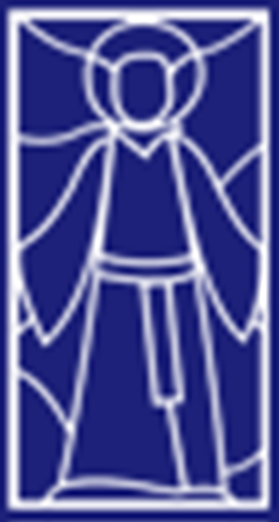
Religious Studies Homework Booklet
Year 7 Advent 2
Name:
Class:
Teacher:
Homework Expectations:
You must keep this booklet neat and presentable
All homework must be completed for the date set
High effort is expected in all tasks
You will boost all work in red pen
Due on: | Checked by: | Due on: | Checked by:
Homework 1 |  | Homework 4
Homework 2 |  | Homework 5
Homework 3 |  | Homework 6

Slide 2
Year 7 - Advent 2 – Homework 1 Jesus as a Teacher
1. This is the story of the Good Samaritan, put the sentences in the correct order. 1. The Samaritan paid an inn keeper to look after the man. 2. The Jewish priest passed by on the other side of the road. 3. The Samaritan stopped and bandaged the wounds. 4. A man was robbed and beaten and left for dead. 5. A teacher of the law passed by on the other side of the road. | 2. In 5 sentences or less explain the meaning of the Good Samaritan. ________________________________________________________________________________________________________________________________________________________________________________________________________________________________________________________________________________________________________________________________________________________________________________________________________________________________________
3. Create a modern-day version of the Good Samaritan. This can be in pictures or full sentences.

Slide 3
Year 7 - Advent 2 - Homework 2 Jesus as a Teacher
Jesus taught using instruction, experience and example.
Instruction
Experience
Example
What can you learn from this type of teaching? | School work, give another example...
What did Jesus teach with this type of teaching? |  |  | Parable of the Good Samaritan, Parable of the Sower
Why is this a good type of teaching? |  | This is a good type of teaching because...

Slide 4
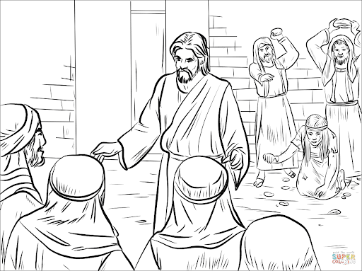
Year 7 - Advent 2 - Homework 3 Jesus as a Healer
1. What do each of the healings teach about Jesus? ​ 1. Jesus heals the paralysed man ____________________________________________________________________________________________________________________________________________________________ 2. Jesus heals the blind man ____________________________________________________________________________________________________________________________________________________________ | 2. Make links between the key words with explanation as to how they link.
3. The Adulterous Woman - What is happening in the picture? How is this an example of healing? ​
Sin
Healing
Forgiveness

Slide 5
Year 7 - Advent 2 – Homework 4 Christian Beliefs
1. The Apostle's Creed Use page 16 of your knowledge book to identify what Christians believe about: God Jesus The Holy Spirit Other beliefs | 2. The Ten Commandments Answer the following questions about the Ten Commandments 1. Who received the Ten Commandments? 2. What is the purpose of the Ten Commandments? 3. What two categories can all of the Ten Commandments be split into? 4. Where in the Bible are the Ten Commandments found?
 | 3. Rank the Ten Commandments into the order that most benefits society. Justify your answer.

Slide 6
Year 7 - Advent 2 - Homework 5 The Beatitudes
1. Link the People/Attitude and the reward. | 2. For each of the Beatitudes give an example of how this can be done today. 1. People who have realised they have done something wrong e.g. Lying. 2. 3. 4. 5. 6. 7. 8.
People/Attitude |  | Reward
1. Blessed are the poor in spirit |  | For they shall be satisfied.
2. Blessed are those who mourn |  | For theirs is the kingdom of heaven.
3. Blessed are the meek |  | For they shall obtain mercy.
4. Blessed are those who hunger and thirst for righteousness |  | For theirs is the kingdom of heaven.
5. Blessed are the merciful |  | For they shall be called sons of God.
6. Blessed are the pure in heart |  | For they shall inherit the earth.
7. Blessed are the peacemakers |  | For they shall be comforted.
8. Blessed are those who are persecuted for righteousness' sake |  | For they shall see God.

Slide 7



Year 7 - Advent 2 – Homework 6 Christian denominations and history
1. Similar beliefs Use page 19 to help you complete this Venn diagram of different Christian beliefs. | 2. Use page 20 of your knowledge book. Write a paragraph to explain which you think is the most important event that took place in the history of Christianity. ________________________________________________________________________________________________________________________________________________________________________________________________________________________________________________________________________________________________________________________________________________________________________________________________________________________________________
 | 3. What are each of these symbols and what do they mean? _______________ ______________ ______________ _______________ ______________ ______________ _______________ ______________ ______________ _______________ ______________ ______________ _______________ ______________ ______________
Roman Catholic
Protestant
Orthodox

Slide 8
Year 7 Advent 2 – extra paper for any task you cannot fit into the activity box.
Activity this links to: ___________________________
Activity this links to: ___________________________
________________________________________________________________________________________________________________________________________________________________________________________________________________________________________________________________________________________________________________________________________________________________________________________________________________________________________________________________________________________________________________________________________________________________________________________________________________________________________________________________________________________________________________________________________________________________________________________________________________________________________________________________________________________________
__________________________________________________________________________________________________________________________________________________________________________________________________________________________________________________________________________________________________________________________________________________________________________________________________________________________________________________________________________________________________________________________________________________________________________________________________________________________________________________________________________________________________________________________________________________________________________________________________________________________________________________________________________________________________________________

