Slide 1

Religious Studies Homework Booklet
Year 7 Advent 1
Name:
Class:
Teacher:
Homework Expectations:
You must keep this booklet neat and presentable
All homework must be completed for the date set
High effort is expected in all tasks
You will boost all work in red pen
Due on: | Checked by: | Due on: | Checked by:
Homework 1 |  | Homework 4
Homework 2 |  | Homework 5
Homework 3 |  | Homework 6

Slide 2



Year 7 - Advent 1 - Homework 1 Our Mission
1. Who said the phrase 'Be who God meant you to be and you will set the world on fire'? ____________________________________________________ 2. What does 'Be who God meant you to be' mean? ____________________________________________________ ____________________________________________________ 3. What does 'You will set the world on fire' mean? __________________________________________________________________________________________________________ | 2. Label the items that are associated with St Catherine of Siena. What does it represent? __________________________________________________________________________________________________________ __________________________________________________________________________________________________________ __________________________________________________________________________________________________________
3. True or False? Identify if the statement is true or false, then correct any false sentences. a. Saint Catherine was born in Italy. ____________________________________________________ 2. Saint Catherine's symbol is a red rose. ____________________________________________________ ____________________________________________________ 3. Stigmata represent Jesus' birth __________________________________________________________________________________________________________

Slide 3



Year 7 - Advent 1 - Homework 2 What do you already know about Jesus?
1. Complete the sentences. ​ 1. Jesus was born in​ ​ 2. Jesus lived in​ ​ 3. Jesus died in​ ​ 4. His parents were​ ​​ 5. His closest friends were known as | 2. Match the question to the correct answer.
3. Here is the answer, what is the question?. A) Immanuel B) Redeemer C) A replacement for the sacrifice of sin D) One who will suffer for others | 4. The icons below link to key terms. Which key terms do they represent? Write down how these three icons link together. ____________________________________________________________________________________________________________________________________________________________________________________________________________________
What religion was Jesus? |  | The Resurrection
Jesus taught his disciples to pray using which prayer? |  | Crucifixion
How was Jesus killed? |  | Jewish
What happened three days after Jesus died? |  | The Our Father

Slide 4
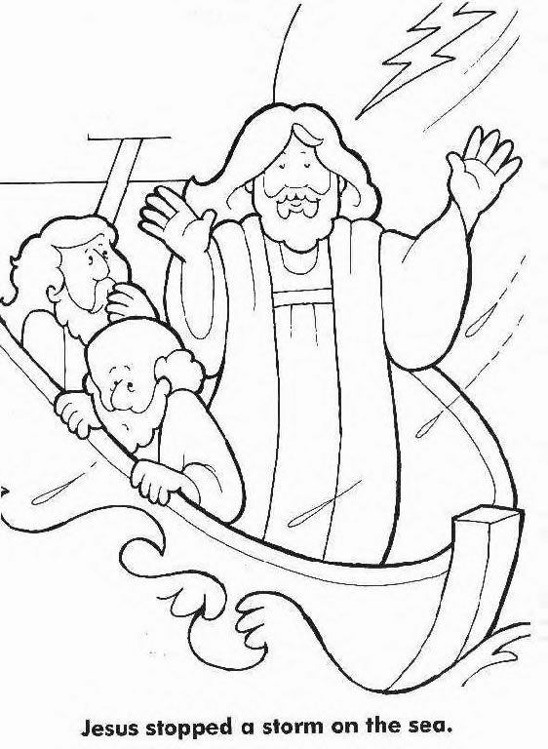
Year 7 - Advent 1 - Homework 3 Miracles of Jesus - Use KB pages 3 and 4
1. Look, Cover, Write, Check Define the key terms using page three of your knowledge book: Incarnation __________________________________________________________________________________________________________ Parable __________________________________________________________________________________________________________ Messiah __________________________________________________________________________________________________________ Rabbi __________________________________________________________________________________________________________ Inspiration __________________________________________________________________________________________________________ Prophet __________________________________________________________________________________________________________ | 2. Answer the questions. What is happening in this image? _________________________________ _________________________________ _________________________________ _________________________________ This is one of three miracle types, which one is it? How do you know? __________________________________________________________________________________________________________ What does this miracle teach Christians about Jesus? _______________________________________________________________________________________________________________________________________________________________ Name two other examples of this type of miracle that Jesus had performed. __________________________________________________________________________________________________________

Slide 5
Year 7 - Advent 1 - Homework 4 Miracles of Jesus – Use KB pages 3 and 4
Fill in the gaps using the words below the paragraph. Jesus was ___________ and preaching to _________ people. Eventually the __________ asked him to ______ the people away so they could _____. Jesus told them to find enough food for the people, the disciples said they did not have the _______ for that amount of food. A boy had 5 _______ and 2 _______, Jesus prayed to God and handed these out to the people. At the end they collected in _________ baskets of leftovers. Loaves, teaching, 5000, eat, twelve, disciples, send, fish, money | 3. Answer the questions. Which one of the three types of miracles is the Raising of Lazarus? _____________________________________________________ What does this type of miracle teach us about Jesus? __________________________________________________________________________________________________________ Which one of the three types of miracles is the Feeding of the 5000? _____________________________________________________ What does this type of miracle teach us about Jesus? __________________________________________________________________________________________________________ Which type of miracle do you think best shows how powerful Jesus is? Why do you think this? ______________________________________________________________________________________________________________________________________________________________________________________________________________________________________________________________________________________________________________________________
2. ​Summarise the Raising of Lazarus into 5 sentences. _____________________________________________________________________________________________________________________________________________________________________________________________________________________________________________________________________________________________________________________________________________________________________________________________________________________________________________________________________________________________________________________________________________________________

Slide 6
Year 7 - Advent 1 - Homework 5 Jesus – Use KB pages 3, 4, 5
1. Write one sentence using these key words. ​ Incarnation Parable Miracle | 3. Complete the table below by adding arguments which support the statements.
2. Link each of the key words below. Write a short explanation of how they link. ​ | Which side of the argument do you think is the most convincing? Write a paragraph to explain your answer. ________________________________________________________________________________________________________________________________________________________________________________________________________________________________________________________________________________________________________________________________________________________________________________________________________________________________________
Miracles are more important than parables | Parables are more important than miracles
Incarnation
Miracle
Parable

Slide 7
Year 7 - Advent 1 - Homework 6 Jesus – Use KB pages 2, 3, 11, 12
1. Write a definition for each of these names for Jesus. Alpha and Omega. Redeemer. Lamb of God. | 2. Give an example of how Jesus is an example of the below: Rabbi. Prince of Peace. Suffering Servant.
3. Jesus' mission had three parts. Complete the table below. | 4. Did Jesus exist? Use page 12 of your knowledge book to choose two pieces of evidence that are convincing. _____________________________________________________________________________________________________________________________________________________________________________________________________________________________________________________________________________________________________________________________________________________________________________________________________________________________________________________________________________________________
Role | Meaning | How can a Christian fulfil this mission today?
Priest
Prophet
King

Slide 8
Year 7 Advent 1 – extra paper for any task you cannot fit into the activity box.
Activity this links to: ___________________________
Activity this links to: ___________________________
________________________________________________________________________________________________________________________________________________________________________________________________________________________________________________________________________________________________________________________________________________________________________________________________________________________________________________________________________________________________________________________________________________________________________________________________________________________________________________________________________________________________________________________________________________________________________________________________________________________________________________________________________________________________
__________________________________________________________________________________________________________________________________________________________________________________________________________________________________________________________________________________________________________________________________________________________________________________________________________________________________________________________________________________________________________________________________________________________________________________________________________________________________________________________________________________________________________________________________________________________________________________________________________________________________________________________________________________________________________________

Slide 9
Year 7 Advent 1 – extra paper for any task you cannot fit into the activity box.
Activity this links to: ___________________________
Activity this links to: ___________________________
________________________________________________________________________________________________________________________________________________________________________________________________________________________________________________________________________________________________________________________________________________________________________________________________________________________________________________________________________________________________________________________________________________________________________________________________________________________________________________________________________________________________________________________________________________________________________________________________________________________________________________________________________________________________
__________________________________________________________________________________________________________________________________________________________________________________________________________________________________________________________________________________________________________________________________________________________________________________________________________________________________________________________________________________________________________________________________________________________________________________________________________________________________________________________________________________________________________________________________________________________________________________________________________________________________________________________________________________________________________________

Slide 10
Year 7 Advent 1 – extra paper for any task you cannot fit into the activity box.
Activity this links to: ___________________________
Activity this links to: ___________________________
________________________________________________________________________________________________________________________________________________________________________________________________________________________________________________________________________________________________________________________________________________________________________________________________________________________________________________________________________________________________________________________________________________________________________________________________________________________________________________________________________________________________________________________________________________________________________________________________________________________________________________________________________________________________
__________________________________________________________________________________________________________________________________________________________________________________________________________________________________________________________________________________________________________________________________________________________________________________________________________________________________________________________________________________________________________________________________________________________________________________________________________________________________________________________________________________________________________________________________________________________________________________________________________________________________________________________________________________________________________________

