Slide 1
Weekly Homework Grids and Extended Responses
YEAR 10 BOOKLET – Part 2
Summer
Name: _____________________________
Teacher: ____________________________
Room: ______________________________
Week | Effort Grade
1
2
3
4
5

Slide 2
Paper 2 Insert – Use this source for weeks 1, 2, 3 and 4
Source A: Charles Dickens writes about a ‘Gin-Shop’ in Sketches from Boz written in 1835.
The hum of many voices issues from that splendid gin-shop which forms the commencement of the two streets opposite; and the gay building with the fantastically ornamented parapet, the illuminated clock, the plate-glass windows surrounded by stucco rosettes, and its profusion of gas-lights in richly-gilt burners, is perfectly dazzling when contrasted with the darkness and dirt we have just left. The interior is even gayer than the exterior. A bar of French-polished mahogany, elegantly carved, extends the whole width of the place; and there are two side-aisles of great casks, painted green and gold, enclosed within a light brass rail, and bearing such inscriptions, as "Old Tom, 549"; "Young Tom, 360"; "Samson, 1421"--the figures agreeing, we presume, with "gallons," understand. Beyond the bar is a lofty and spacious saloon, full of the same enticing vessels, with a gallery running round it, equally well furnished. On the counter, in addition to the usual spirit apparatus, are two or three little baskets of cakes and biscuits, which are carefully secured at top with wicker-work, to prevent their contents being unlawfully abstracted. Behind it, are two showily-dressed damsels with large necklaces, dispensing the spirits and "compounds." They are assisted by the ostensible proprietor of the concern, a stout, coarse fellow in a fur cap, put on very much on one side to give him a knowing air, and to display his sandy whiskers to the best advantage. The young fellow in a brown coat and bright buttons, who, ushering in his two companions, and walking up to the bar in as careless a manner as if he had been used to green and gold ornaments all his life, winks at one of the young ladies with singular coolness, and calls for a 'kervorten and a three-out- glass,' just as if the place were his own. 'Gin for you, sir?' says the young lady when she has drawn it: carefully looking every way but the right one, to show that the wink had no effect upon her. 'For me, Mary, my dear,' replies the gentleman in brown. 'My name an't Mary as it happens,' says the young girl, rather relaxing as she delivers the change. 'Well, if it an't, it ought to be,' responds the irresistible one; 'all the Marys as ever I see, was handsome gals.'

Slide 3
Source B: A review in The Telegraph by Orla Pentelow in 2018, titled ‘The Coral Room Bar’.
Paper 2 Questions:
Q2 – 8 marks – 10 minutes
Write a summary of the differences between the atmosphere in each bar.
Q3 – 12 marks – 15 minutes
In source A how does the writer use language to describe the ‘GinShop’ he visits?
Q4- 16 marks – 20 minutes
Compare how the writers convey their attitudes to each bar and the people that work there.
You’d be forgiven for thinking, when entering the newly renovated Coral Room bar at the Bloomsbury London, that you had walked into something out of a Wes Anderson film set. The new all-day dining restaurant and bar - once a simple lobby in the Sir Edward Lutyens-designed Grade II-listed building - is a cavernous, coral-coloured 2,100sq ft double-height space at the front of the hotel. Designer Martin Brudnizki has kept the original panelled walls, spruced up with the vivid colour which gives the space its moniker, but what really catches the eye is the central bar. A Calacatta marble counter atop a glossy wooden front with antique-style mirroring and brass hardware provides a grand backdrop around which everything else is. The overall effect is an impressive, genuinely beautiful room, that is simultaneously reminiscent of 1920s decadence and Miami art deco. It manages to be design-conscious, luxurious and yet inviting at the same time. I followed a glass of British fizz with one of the bar’s signature cocktails. Staff did well to help us with recommendations, offering suggestions based on our spirits of choice, and assuring us that anything not found on the pink-hued menu can be rustled up behind that magic marble bar. A food menu of small plates and light bites works as a tapas-style evening meal. Breakfast options such as garden pea and feta smash on sourdough toast and rainbow acai bowls make the Coral Room just as suitable for morning meetings, and the bar also caters to teetotal clientele thanks to a small menu of Seedlip’s non-alcoholic spirits.

Slide 4
Year 10 Weekly Homework Summer 1.1
Circle the words that are synonyms to each other. : | 2. List 4 key themes found in the Power and Conflict anthology and explain their significance. | 3. How do you answer English Language Paper 1, Question 5?
4. Correct the following misspelt words: Inequility : ___________________​ Discrimmnation: ________________​ Partrirarchy: __________________​ Insdustrial : __________________ Rommanticcism: __________________ Partriotism: ______________________​ Labaour: ________________________ | 5. Compare and contrast Mercutio with Benvolio: | 6. Give two examples where characters are mirror each other or are parallels to each other (any text studied so far). What does it mean by mirroring or being parallels? __________________________________________________________________________________________ Example 1: _______________________________________________________________________________________________________________________________________ Example 2: _____________________________________________________________________________________________________________________________________
A) dull vigorously solemnly sprightly
B) hastily sluggishly speedily stationary
C) sheen fleeting elevated ephemeral

Slide 5
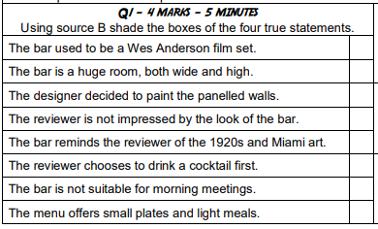
Week 1 Language HW:
Revision: Paper 2: Question 1 and 2
_____________________________________________________________________________________________________________________________________________________________________________________________________________________________________________________________________________________________________________________________________________________________________________________________________________________________________________________________________________________________________________________________________________________________________________________________________________________________________________________________________________________________________________________________________________________________________________________________________________________________________________________________________________________________________________________________________________________________________________________________________________________________
Q1: https://www.loom.com/share/ad455008a34e472e94864742f08d680b
Q2: https://www.loom.com/share/77c933048d154410a9ed2ff11df2b228
_________________________________________________________________________________________________________________________________________________________________________________________________________________________________________________________________________________________

Slide 6
Year 10 Weekly Homework Summer 1.2
1. Homophones: Write two sentences for each of the word pairs. Correctly use each word in a sentence. A. pair/ pear ________________________________________________________________________________________________________________________________________________________ B. sea/see ________________________________________________________________________________________________________________________________________________________ | 2. List 3 poems about the power of nature and summarise them in no more than 10 words. | 3. a) What is an sonnet? ______________________________________________________________________________________________________________________________________________________________________________________________ b) How is ‘Ozymandias’ an sonnet? ______________________________________________________________________________________________________________________________________________________________________________________________
4. What are the following characters from ‘Romeo and Juliet’ symbolic of? Explain your answer: Paris: Symbolic of ____________________________. Explanation: ___________________________ _________________________________________________________________________________. Sampson: Symbolic of ____________________. Explanation: ____________________________ _________________________________________________________________________________. | 5. Highlight or underline the nouns in the following extracts. A superb, straight-limbed young man now stepped forward into the ring and a cheer went up, for he had already earned some reputation. He was dressed, not in the heavy gold embroidered garments of the professional matador, but in Andalusian riding clothes – a broad black hat, short waistcoat, tight-fitting trousers and high-heeled boots. With cape folded, hat held to his breast, he faced the President’s box, bowed, raised his head, and in ringing tones dedicated the next bull to one of the virgins, whose name was Gloria. | 6. Based on the extract from task 5, list 4 things you learn about the man. 1_________________________________________________________________________. 2__________________________________________________________________________. 3__________________________________________________________________________. 4__________________________________________________________________________.

Slide 7
Week 2 Language HW:
Revision: Paper 2 Question 3.
_____________________________________________________________________________________________________________________________________________________________________________________________________________________________________________________________________________________________________________________________________________________________________________________________________________________________________________________________________________________________________________________________________________________________________________________________________________________________________________________________________________________________________________________________________________________________________________________________________________________________________________________________________________________________________________________________________________________________________________________________________________________________
https://www.loom.com/share/24c9b252ae804ab191992cab9e3fb3e0
____________________________________________________________________________________________________________________________________________________________________________________________________________________________________________________________________________________________________________________________________________________________________________________________________________________________________________________________________________________________________________________________________________________________________________________________________________________________________________________________________________________________________________________________________________________________________________________________________________________________________________________________________________________________

Slide 8
Year 10 Weekly Homework Summer 1.3
1. Use magic circles to explore the connotations of the 'golden' in these lines from 'Beast of England' song and explain: ​ ​ Hearken well and spread my tidings​ Of the golden future time​ ____________________________ _______________________________________________________________________________________ | 2. List 3 poems about war and summarise them in no more than 10 words. | 3. a) What is satire? ______________________________________________________________________________________________________________________________________________________________________________________________ b) How is ‘Animal Farm’ satirical? ______________________________________________________________________________________________________________________________________________________________________________________________
4. What are the following characters from ‘A Christmas Carol’ symbolic of? Explain your answer: Tiny Tim: Symbolic of _____________________. Explanation: _________________________________ _________________________________________________________________________________. Scrooge: Symbolic of ____________________. Explanation: ____________________________ _________________________________________________________________________________. | 5. Highlight or underline the proper nouns in the following extracts. He usually lost, and she was so good at arguing that he felt good about losing. She could explain why listening to Joni Mitchell and Bob Marley (who happened to be her two favourite singers) was much better for him than listening to Snoop Doggy Dogg, and why it was more important to read books than to play on the Gameboy his dad had given him. But he couldn’t pass any of this on to the kids at school. If he tried to tell Lee Hartley - the biggest and loudest and nastiest of the kids he’d met yesterday - that he didn’t approve of Snoop Doggy Dogg because Snoop Doggy Dogg had a bad attitude to women, Lee Hartley would thump him, or call him something that he didn’t want to be called. | 6. Use the extract from task 5 to answer the following inference question using quotations from the extract. What do you learn about the narrator? ________________________________________________________________________________________________________________________________________________________________________________________________________________________________________________________________________________________________________________________________________________

Slide 9
Week 2 Language HW:
Revision: Paper 2 Question 4.
_____________________________________________________________________________________________________________________________________________________________________________________________________________________________________________________________________________________________________________________________________________________________________________________________________________________________________________________________________________________________________________________________________________________________________________________________________________________________________________________________________________________________________________________________________________________________________________________________________________________________________________________________________________________________________________________________________________________________________________________________________________________________
https://www.loom.com/share/f64108b436904480b2eaf57590beb2bf
____________________________________________________________________________________________________________________________________________________________________________________________________________________________________________________________________________________________________________________________________________________________________________________________________________________________________________________________________________________________________________________________________________________________________________________________________________________________________________________________________________________________________________________________________________________________________________________________________________________________________________________________________________________________

Slide 10
Year 10 Weekly Homework – Revision Week Summer 1.4
c. R&J HW - Fate.pptx - this is the link to the PP
Write your own PETAL paragraph- either about the extract or the play as a whole
__________________________________________________________________________________________________________________________________________________________________________________________________________________________________________________________________________________________________________________________________________________________________________________________________________________________________________________________________________________________________________________________________________________________________________________________________________________________________________________________________________________
__________________________________________________________________________________________________________________________________________________________________________________________________________________________________________________________________________________________
Use the attached PowerPoint to make notes about how to write a response about afte in R&J.
Writer 5 things you learn fate: _______________________________________________________________________________________________________________________________________________________________________________________________________________________
Read/listen to the PETAL paragraph on slide 3. List 6 phrases or words that you would like to remember for the exam:
________________________________________________________________________________________________________________________________________________________________________________________________________________________________________________________________________________________________________________________________________________________

Slide 11
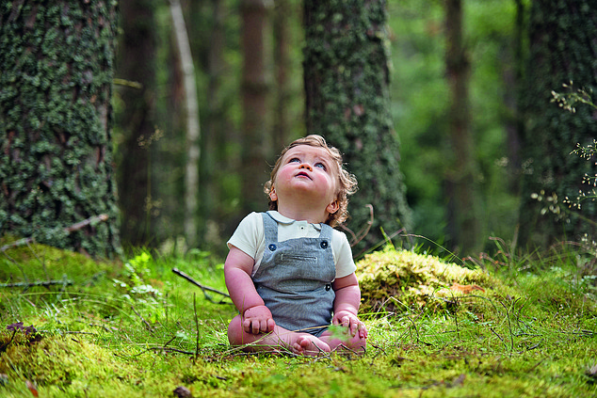
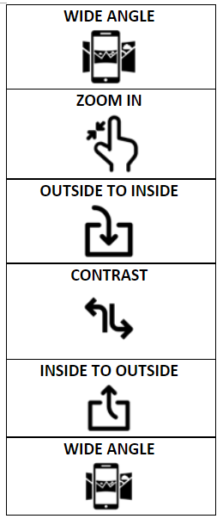
Week 4 Language HW:
_____________________________________________________________________________________________________________________________________________________________________________________________________________________________________________________________________________________________________________________________________________________________________________________________________________________________________________________________________________________________________________________________________________________________________________________________________________________________________________________________________________________________________________________________________________________________________________________________________________________________________________________________________________________________________________________________________________________________________________________________________________________________
Write a description suggested by the picture.
______________________________________________________________________________________________________________________________________________________________________________________________________________________________________________________________________________________________________________________________________________________________________________________________________________________________________________________________________________________________________________________________________________________________________________________________________________________________________________________________________________________________________________________________________________________________________________________________________________________________________________________________________________________________________________________________________________________

Slide 12
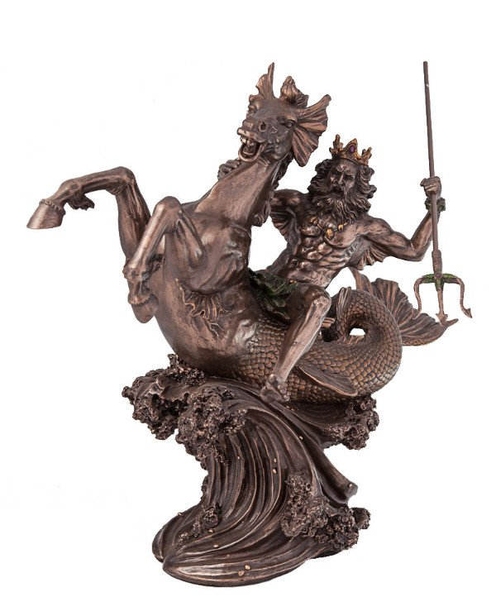
Year 10 Weekly Homework Summer 1.5
Compare and contrast War Photographer to one other poem. | 2. Revising the poem ‘My Last Duchess’. Explain how the following image is linked to the poem – find the quotation. | 3. a) What is anthropomorphism? __________________________________________________________________________________________________________________________________________________________________________________________________________________ b) Which text that you have read uses anthropomorphism? ______________________________________________________________________________________________________________________________________________________________________________________________
4. Which poems in the P&C anthology explore ideas of identity? Explain your answer. | 5. Tybalt says the below statement. Answer the questions that follow. Tybalt: “By the stock and honour of my kin To strike him dead I hold it not a sin ” Why does Tybalt say the above? __________________________________________________________________________________________ What does Tybalt’s comment tell you about loyalty to your family? _______________________________________________________________________________________________________________________________________ | 6. What are the two different ways you can use apostrophes: ​ 1.________________________________________________________________________________2.________________________________________________________________________________ Write 1 sentences where you use the different types of apostrophes: ​ 1._______________________________________________________________________________ ___________________________________________________________________________________________________________________________

Slide 13





Week 5 Language HW:
Planning your idea in detail and then write it!
‘The government should invest more money in public transport as there are so many good reasons to use it.’
Write a letter to the editor of your local newspaper, explaining your views on this statement.
Techniques you could use:
Anaphora Hypophora Triplets Simile Metaphors Rhetorical Question Allusions Direct Address Figures
EXPLAIN YOUR SECOND IDEA
Point
Explain
Example
Develop
EXPLAIN YOUR FIRST IDEA
Point
Explain
Example
Develop
Genre:______________ Subject: ___________
Audience: ___________ Purpose: ___________
Features of a letter:
STATE YOUR POSITION-
Use a technique.
INTRODUCE YOUR POSITION
Explain why is this topic important.
Explain why you feel this way.
Use techniques.
INTRODUCE A COUNTER-ARGUMENT
Some say that … but…
OFFER A SOLUTION OR SOLUTIONS
STATE YOUR POSITION AGAIN
Repeat a line or a technique from the start

Slide 14
Week 5 Language HW:
‘The government should invest more money in public transport as there are so many good reasons to use it.’
Write a letter to the editor of your local newspaper, explaining your views on this statement.
________________________________________________________________________________________________________________________________________________________________________________________________________________________________________________________________________________________________________________________________________________________________________________________________________________________________________________________________________________________________________________________________________________________________________________________________________________________________________________________________________________________________________________________________________________________________________________________________________________________________________________________________________________________________________________________________________________________________________________________________________________________
_________________________________________________________________________________________________________________________________________________________________________________________________________________________________________________________________________________________________________________________________________________________________________________________________________________________________________________________________________________________________________________________________________________________________________________________________________________________________________________________________________________________________________________________________________________________________________________________________________________________________________________

