Slide 1
Weekly Homework Grids and Extended Responses
YEAR 10 BOOKLET – Part 1
Summer
Name: _____________________________
Teacher: ____________________________
Room: ______________________________
Week | Effort Grade
1
2
3
4
5

Slide 2
Paper 1 Insert – Use this source for weeks 1, 2 and 3
The following extract is taken from the beginning of A Monster Calls by Patrick Ness. In this extract, Conor is awoken in the middle of the night by a monster.
The monster showed up just after midnight. As they do.
Conor was awake when it came.
He'd had a nightmare. Well, not a nightmare. The nightmare.
The one he'd been having a lot lately. The one with the darkness and the wind and the screaming. The one with the hands slipping from his grasp, no matter how hard he tried to hold on.
The one that always ended with -
"Go away," Conor whispered into the darkness of his bedroom, trying to push the nightmare back, not let it follow him into the world of waking. "Go away now."
He glanced over at the clock his mum had put on his bedside table. 12:07. Seven minutes past midnight. Which was late for a school night, late for a Sunday, certainly.
He'd told no one about the nightmare. Not his mum, obviously, but no one else either, not his dad in their fortnightly (or so) phone call, definitely not his grandma, and no one at school. Absolutely not.
What happened in the nightmare was something no one else ever needed to know.
Conor blinked groggily at his room, then he frowned. There was something he was missing. He sat up in his bed, waking a bit more. The nightmare was slipping from him, but there was something he couldn't put his finger on, something different, something -
He listened, straining against the silence, but all he could hear was the quiet house around him, the occasional tick from the empty downstairs or a rustle of bedding from his mum's room next door.
Nothing.
And then something. Something he realized was the thing that had woken him.
Someone was calling his name.
Conor.
He felt a rush of panic, his guts twisting. Had it followed him? Had it somehow stepped out of the nightmare and - ?
"Don't be stupid," he told himself. "You're too old for monsters."
And he was. He'd turned thirteen just last month. Monsters were for babies. Monsters were for bedwetters. Monsters were for -
Conor.
There it was again. Conor swallowed. It had been an unusually warm October, and his window was still open. Maybe the curtains shushing each other in the small breeze could have sounded like -
Conor.

Slide 3
No. Not his dad. This voice had a quality to it, a monstrous quality, wild and untamed.
Then he heard a heavy creak of wood outside, as if something gigantic was stepping across a timber floor.
He didn't want to go and look. But at the same time, a part of him wanted to look more than anything.
Wide awake now, he pushed back the covers, got out of bed, and went over to the window. In the pale half-light of the moon, he could clearly see the church tower up on the small hill behind his house, the one with the train tracks curving beside it, two hard steel lines glowing dully in the night. The moon shone, too, on the graveyard attached to the church, filled with tombstones you could hardly read anymore.
Conor could also see the great yew tree that rose from the center of the graveyard, a tree so ancient it almost seemed to be made of the same stone as the church. He only knew it was a yew because his mother had told him, first when he was little to make sure he didn't eat the berries, which were poisonous, and again this past year, when she'd started staring out of their kitchen window with a funny look on her face and saying, "That's a yew tree, you know."
And then he heard his name again.
Question 2:
Look in detail at this extract from the source:
He glanced over at the clock his mum had put on his bedside table. 12:07. Seven minutes past midnight. Which was late for a school night, late for a Sunday, certainly.
He'd told no one about the nightmare. Not his mum, obviously, but no one else either, not his dad in their fortnightly (or so) phone call, definitely not his grandma, and no one at school. Absolutely not.
What happened in the nightmare was something no one else ever needed to know.
Conor blinked groggily at his room, then he frowned. There was something he was missing. He sat up in his bed, waking a bit more. The nightmare was slipping from him, but there was something he couldn't put his finger on, something different, something -
He listened, straining against the silence, but all he could hear was the quiet house around him, the occasional tick from the empty downstairs or a rustle of bedding from his mum's room next door.
How does the writer use language to create fear and tension?
[8 marks]
Question 4:
Focus this part of your answer on the second part of the source from line 31 to the end of the extract.
A student, having read this part of the text said: “The writer makes this moment of the story very tense and terrifying.”
To what extent do you agree? [20 marks]
Question 1:
Read again the first part of the source, lines 1-7.
List 4 things you learn about Conor’s nightmare. [4 marks]

Slide 4
Year 10 Weekly Homework Summer 1.1
Circle the words that are synonyms to each other. : Challenge: Select 4 words and use each of them in a sentence. | 2. List 4 key themes found in ‘Animal Farm’ and explain their significance. Challenge: Explain one theme in detail (maybe use a PETAL paragraph to help you develop your answer). | 3. How do you answer English Language Paper 1, Question 4?
4. Select the correct homophone: 1. "I can't believe this class is one hour / our long," said John. 2. "I know, that's a long thyme / time , right?" I replied. 3. John is my best friend and I'll never meat / meet a better friend than him. 4. Our teacher was giving us a lessen / lesson on homophones. 5. It was still pretty early in the morning / mourning. | 5. Compare and contrast the Napoleon and Snowball: | 6. Give two examples where characters are foils to each other (any text studied so far). What is a foil? ___________________________________ _______________________________________________ Example 1: ___________________________________________________________________________________________________________________________________________________ Example 2: ___________________________________________________________________________________________________________________________________________________ Challenge: Explain how the characters are foils to each other using quotations and analysing language.
A) darkness freedom light obscurity​
B) splendour tall corpulent magnificent​
C) ominous harmonious parsimonious melodious​

Slide 5
Week 1 Language HW:
Revision: Complete Questions 1 and 2 using the loom videos.
_____________________________________________________________________________________________________________________________________________________________________________________________________________________________________________________________________________________________________________________________________________________________________________________________________________________________________________________________________________________________________________________________________________________________________________________________________________________________________________________________________________________________________________________________________________________________________________________________________________________________________________________________________________________________________________________________________________________________________________________________________________________________
Question 1: https://www.loom.com/share/3d2209597df048c3afc285479387462c
Question 2: https://www.loom.com/share/243d217441ce4c46a7a264d4593c3328
__________________________________________________________________________________________________________________________________________________________________________________________________________________________________________________________________________________________________________________________________________________________________________________________________________________________________________________________________________________________________________________________________________________________________________________________________________________________________________________________________________________________________________________________________________________________

Slide 6
Year 10 Weekly Homework Summer 1.2
1. Homophones: Write two sentences for each of the word pairs. Correctly use each word in a sentence. A. their / there ________________________________________________________________________________________________________________________________________________________________________ C. which / witch ________________________________________________________________________________________________________________________________________________________________________ | 2. List 4 key themes found in ‘A Christmas Carol’ and explain their significance. Challenge: Explain one theme in detail (maybe use a PETAL paragraph to help you develop your answer). | 3. a) What is an allegory? __________________________________________________________________________________________________________________________________________________________________________________________________________________ b) How is ‘Animal Farm’ an allegory? __________________________________________________________________________________________________________________________________________________________________________________________________________________
4. What are the following characters from ‘A Christmas Carol’ symbolic of? Explain your answer: Tiny Tim: Symbolic of ____________________________. Explanation: _________________________________ _________________________________________________________________________________________. Scrooge: Symbolic of ____________________. Explanation: _________________________________ _________________________________________________________________________________________. | 5. Circle the correct | 6. Match words to their meanings: ​ a) sonnet , b) dramatic monologue , c) irony Language that says one thing but implies the​ opposite and therefore highlights an issue eg. sarcasm.​ A 14 line poem, written in iambic pentameter, traditionally about love.​ Where only one person is speaking. Which poem from the Power and Conflict anthology is a dramatic monologue? ___________________ _________________________________________

Slide 7
Week 2 Language HW:
Revision: Complete Questions 4 using the loom videos.
_____________________________________________________________________________________________________________________________________________________________________________________________________________________________________________________________________________________________________________________________________________________________________________________________________________________________________________________________________________________________________________________________________________________________________________________________________________________________________________________________________________________________________________________________________________________________________________________________________________________________________________________________________________________________________________________________________________________________________________________________________________________________
https://www.loom.com/share/49469dbd8084413ab2536a8e7c6fb58c
____________________________________________________________________________________________________________________________________________________________________________________________________________________________________________________________________________________________________________________________________________________________________________________________________________________________________________________________________________________________________________________________________________________________________________________________________________________________________________________________________________________________________________________________________________________________________________________________________________________________________________________________________________________________

Slide 8
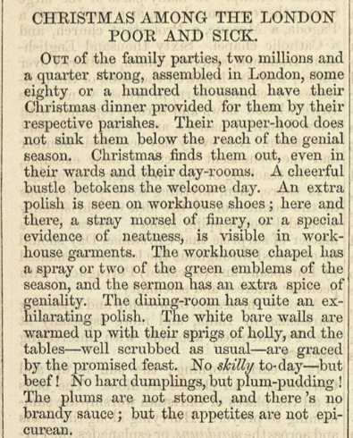
Year 10 Weekly Homework – Revision Week Summer 1.3
a. ACC HW - Scrooge's Transformation.pptx
Read/listen to the PETAL paragraph on slide 3. List 6 phrases or words that you would like to remember for the exam:
_________________________________________________________________________________________________________________________________________________________________________________________________________________________________________________________________________________________________________________________________________
Use the attached PowerPoint to make notes about how to write a response about Scrooge’s transformation.
Writer 5 things you learn about Scrooge: __________________________________________________________________________________________________________________________________________________________________________________________________________________________________________________________________________________________
Write 5 things you about how to answer a literature question: _________________________________________________________________________________________________________________________________________________________________________________________________________________________________________________________________________________________________________________________________________
Looking beyond:
This article 'Christmas among the London Poor and Sick' was published in Household Words (of which Charles Dickens was editor).
https://www.bl.uk/collection-items/christmas-among-the-london-poor-and-sick-from-household-words
How is this similar to the miner, sailors and the people the Ghost of Christmas Present shows Scrooge on their way to Fred’s party?

Slide 9
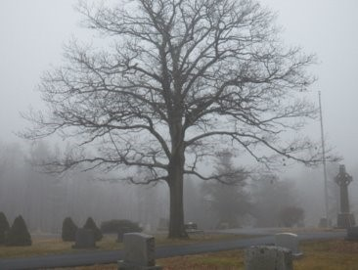
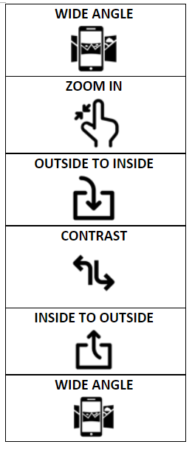
Week 3 Language HW:
_____________________________________________________________________________________________________________________________________________________________________________________________________________________________________________________________________________________________________________________________________________________________________________________________________________________________________________________________________________________________________________________________________________________________________________________________________________________________________________________________________________________________________________________________________________________________________________________________________________________________________________________________________________________________________________________________________________________________________________________________________________________________
Revision: Complete Questions 5 using the loom videos.
https://www.loom.com/share/ef8c31060cb64fa6ba8f4e0b1ddffdc5
______________________________________________________________________________________________________________________________________________________________________________________________________________________________________________________________________________________________________________________________________________________________________________________________________________________________________________________________________________________________________________________________________________________________________________________________________________________________________________________________________________________________________________________________________________________________________________________________________________________________________________________________________________________________________________________________________________________

Slide 10

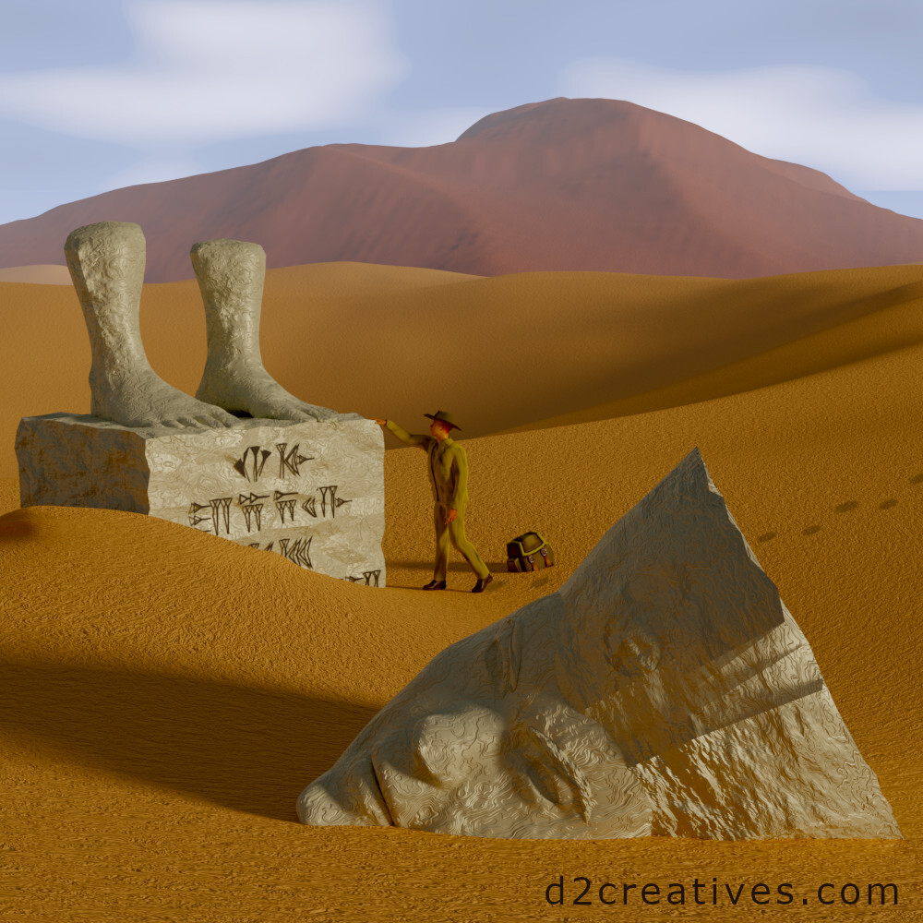
Year 10 Weekly Homework Summer 1.4
When writing a speech, what should you do at the start and at the end? Use the icons to explain: | 2. Revising the poem ‘Ozymandias’. Label the picture with quotations from the poem. | 3. a) What is an allusion? __________________________________________________________________________________________________________________________________________________________________________________________________________________ b) What is ‘Animal Farm’ an allusion to? __________________________________________________________________________________________________________________________________________________________________________________________________________________
4. Dickens uses motifs in his novel ACC. Can you explain the significance of the following motifs. ‘fire’ Explanation: _________________________________ _________________________________________________________________________________________. ‘food’ Explanation: _________________________________ _________________________________________________________________________________________. Write a PETAL paragraph on a separate piece of paper analysing the motif. | 5. Paris says the below statement. Answer the questions that follow. Tybalt: “Younger than she are happy mothers made” Why does Paris say the above? __________________________________________________________________________________________________ What is Paris symbolic of? __________________________________________________________________________________________________ What does Paris’ comment tell you about how women were viewed in society? __________________________________________________________________________________________________ | 6. Match words to their meanings: ​ a) enjambment , b)allegory, c) caesura ​ A pause near the middle of a line in poetry. ​ When the end of a line is not the end of a sentence and the meaning runs over to the next line. ​ A story, poem or picture that can be interpreted to reveal a hidden meaning, typically a political one.​ Challenge: Can you find examples in songs or the poems you have read.
Beginning
End

Slide 11




Week 4 Language HW:
Planning your idea in detail.
‘’Exams are the only way to fairly measure a person’s success. Everyone gets the same question, under the same conditions and the same amount of time.’
Write an article for newspaper broadsheet stating whether or not you agree with this view.
Techniques you could use:
Anaphora Hypophora Triplets Simile Metaphors Rhetorical Question Allusions Direct Address Figures
EXPLAIN YOUR SECOND IDEA
Point
Explain
Example
Develop
EXPLAIN YOUR FIRST IDEA
Point
Explain
Example
Develop
Genre:______________ Subject: ___________
Audience: ___________ Purpose: ___________
Title:
STATE YOUR POSITION-
Use a technique.
INTRODUCE YOUR POSITION
Explain why is this topic important.
Explain why you feel this way.
Use techniques.
INTRODUCE A COUNTER-ARGUMENT
Some say that … but…
OFFER A SOLUTION OR SOLUTIONS
STATE YOUR POSITION AGAIN
Repeat a line or a technique from the start

Slide 12



Year 10 Weekly Homework Summer 1.5
Transform the following events from ‘The Prelude’ into sentences. 1. _____________________________________________ _______________________________________________ 2. _____________________________________________ _______________________________________________ 3. _____________________________________________ _______________________________________________ Extension: Can you explain the significance of the order of the above events? | 2. Turn the following subordinate clauses into complex sentences – don’t forget the commas. Because it was cold ______________________________________________________________________________________________________________________________ 2) Beneath the willow tree ______________________________________________________________________________________________________________________________ Extension: Choose one of the sentences and change the position of the subordinate clause e.g. move the subordinate clause from the start to the middle of the sentence. | 3. Which theme is the most significant in ‘A Christmas Carol’? Rank the following themes and explain your top one: masculinity, family, love __________________________________________________________________________________________________________________________________________________________________________________________________________________ __________________________________________________________________________________________________________________________________________________________________________________________________________________
4. Vocabulary​ What is the meaning of this word?​ ​ Patriarchy ​ Type of word _______​ ​ Definition ____________________________ _________________________________________________________________________________________ What text you have studied explores the patriarchy? ________________________________________ | 5. Choose a task: Transform ‘My Last Duchess’ into 3 pictures. Summarise ‘My Last Duchess’ in no more than 50 words. | 6. Revising the poem ‘London’. Label the picture with quotations from the poem.

Slide 13
Week 5 Language HW:
‘’Exams are the only way to fairly measure a person’s success. Everyone gets the same question, under the same conditions and the same amount of time.’
Write an article for newspaper broadsheet stating whether or not you agree with this view.
__________________________________________________________________________________________________________________________________________________________________________________________________________________________________________________________________________________________________________________________________________________________________________________________________________________________________________________________________________________________________________________________________________________________________________________________________________________________________________________________________________________________________________________________________________________________________________________________________________________________________________________________________________________________________________________________________________________________________________________________________________________________________________________________________________________________________
________________________________________________________________________________________________________________________________________________________________________________________________________________________________________________________________________________________________________________________________________________________________________________________________________________________________________________________________________________________________________________________________________________________________________________________________________________________________________________________________________________________________________________________________________________________________________________________________________________________________________________________________________________________________________________________________________________

