Slide 1
Weekly Homework Grids and Extended Responses
YEAR 10 BOOKLET – Part 1
SPRING
Name: _____________________________
Teacher: ____________________________
Room: ______________________________

Slide 2



Year 10 Weekly Homework Name: ________________________________________ Spring 1.1
Summarise how the below images are linked to ‘Romeo and Juliet’ using your Knowledge Organiser: Challenge: Explain the significance of one of the above images by linking it to the story and context. | 2. List 4 key themes found in ‘A Christmas Carol’ and explain their significance. Challenge: Explain one theme in detail (maybe use a PETAL paragraph to help you develop your answer). | 3. How do you answer English Language Paper 1, Question 2?
4. Adverbs that describe how an action (a verb) is being carried out. Change the verb in the brackets into an adverb. He ____________________ reads a book. (quick) The class is ___________________loud today. (terrible) You can ___________________ open this tin. (easy) He drives the car ___________________. (careful) The dog barks _____________________. (loud) | 5. Compare and contrast the Nurse and The Friar: | 6. Give two examples where characters are foils to each other (any text studied so far). What is a foil? ___________________________________ _______________________________________________ Example 1: ___________________________________________________________________________________________________________________________________________________ Example 2: ___________________________________________________________________________________________________________________________________________________ Challenge: Explain how the characters are foils to each other using quotations and analysing language.

Slide 3

Week 1 Literature HW:
200 Words Task
‘Benjamin is as bad as Moses. He doesn’t help the animals’
To what extent do you agree?
- Use examples from the novel.
- Use your knowledge organiser for ideas
_____________________________________________________________________________________________________________________________________________________________________________________________________________________________________________________________________________________________________________________________________________________________________________________________________________________________________________________________________________________________________________________________________________________________________________________________________________________________________________________________________________________________________________________________________________________________________________________________________________________________________________________________________________________________________________________________________________________________________________________________________________________________
Focus on ideas of Benjamin and Moses
Link your answer to the Russian Revolution or society
__________________________________________________________________________________________________________________________________________________________________________________________________________________________________________________________________________________________________________________________________________________________________________________________________________________________________________________________________________________________________________________________________________________________________________________________________________________________________________________________________________________________________________________________________________________________
Success Criteria:
Use an example from the novel to support your idea
Mention the technique ‘allegory’

Slide 4
Year 10 Weekly Homework Name: ________________________________________ Spring 1.2
1. a) What is the difference between an adverb and an adjective? ___________________________________________________________________________________________________________________________________________________ b) Identify whether the underlined word is an adverb or an adjective: He is a careful child. He carefully placed the plate on the table. She sang beautifully. He sang well. Jonathan is a thoughtful individual. Laura has stylish nails. | 2. List 4 key themes found in ‘Romeo and Juliet’ and explain their significance. Challenge: Explain one theme in detail (maybe use a PETAL paragraph to help you develop your answer). | 3. a) What is an allegory? __________________________________________________________________________________________________________________________________________________________________________________________________________________ b) How is ‘A Christmas Carol’ an allegory? __________________________________________________________________________________________________________________________________________________________________________________________________________________
4. What are the following characters from ‘Romeo and Juliet’ symbolic of? Explain your answer: Paris: Symbolic of ____________________________. Explanation: _________________________________ _________________________________________________________________________________________. Lady Montague: Symbolic of ____________________. Explanation: _________________________________ _________________________________________________________________________________________. Challenge: Create a character profile for one of the above characters: summary of what they do, key quotes and contextual link. | 5. Select the correctly spelled word for each sentence: 1. I did them all except/accept the last one. 2. I except/accept your apology. 3. The weather seemed to have a bad affect/effect on everyone's mood. 4. I don't think the weather will affect/effect the result. 5. Nobody is aloud/allowed in here at lunchtime. 6. Mo really likes reading aloud/allowed in class. 7. Nobody got the write/right answer. 8. I'll write/right a letter and explain. 9. He couldn't return it because he didn't know who's/whose coat it was. 10. Tell me who's/whose going and then I'll decide. | 6. Match words to their meanings: ​ a) sonnet , b) dramatic monologue , c) irony Language that says one thing but implies the​ opposite and therefore highlights an issue eg. sarcasm.​ A 14 line poem, written in iambic pentameter, traditionally about love.​ Where only one person is speaking. Challenge: Can you find examples in songs or the poems you have read.

Slide 5
Week 2 Language HW:
200 Words Creative Writing Task
Write a story that starts with the sentence: ‘Stop!’
_____________________________________________________________________________________________________________________________________________________________________________________________________________________________________________________________________________________________________________________________________________________________________________________________________________________________________________________________________________________________________________________________________________________________________________________________________________________________________________________________________________________________________________________________________________________________________________________________________________________________________________________________________________________________________________________________________________________________________________________________________________________________
____________________________________________________________________________________________________________________________________________________________________________________________________________________________________________________________________________________________________________________________________________________________________________________________________________________________________________________________________________________________________________________________________________________________________________________________________________________________________________________________________________________________________________________________________________________________________________________________________________________________________________________________________________________________
Use a complex sentence
Use a minor sentence
Use a one sentence paragraph
Success Criteria:
Use a simile
Use personification

Slide 6
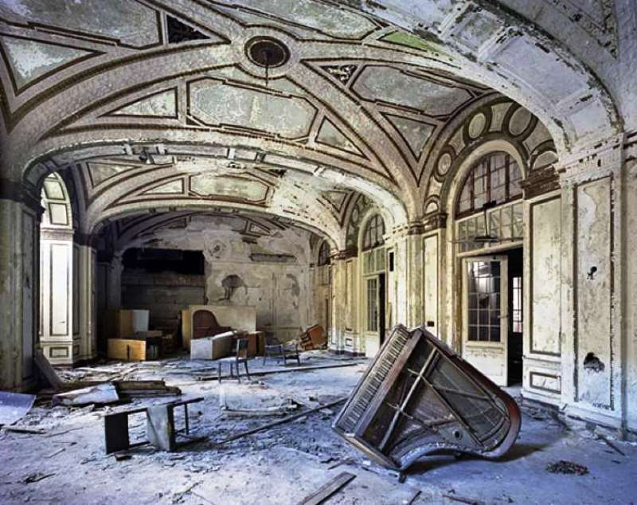
Year 10 Weekly Homework Name: ________________________________________ Spring 1.3
Define the following key words linked to the Romantic poets and transform them into an image: Transient - ​ Desolation - Realisation - Challenge: Choose one word and explain how it is linked to either a poet or a poem’s ideas. | 2. List 4 key themes found in ‘A Christmas Carol’ and explain their significance. | 3. Why is the word ‘pilgrim’ important in ‘Romeo and Juliet’? Who says it? ________________________ When do they say it? ____________________ To who do they say it? __________________ What does it emphasise about the character’s love?___________________________________________________________________________________________________________________________________________________________________________________________________________________________________________________________________________________________________________
4. What are the following characters from ‘A Christmas Carol’ symbolic of? Explain your answer: Ignorance: Symbolic of _________________________. Explanation: _________________________________ _________________________________________________________________________________________. Want: Symbolic of ___________________________. Explanation: _________________________________ _________________________________________________________________________________________. Challenge: Create a character profile for one of the above characters: summary of what they do, key quotes and contextual link. | 5. Write a short description as suggested by the below image (write a minimum of 8 sentences). Remember to use: similes, personification, metaphors, onomatopoeia). ____________________________________________________________________________________________________________________________________________________________________________________________________________________________________________________________________________________________________________________________________________________________________________________________________________________________________________________________________________________________________________________________________________________________________________________________________________________________________________________________________________________________________________________________________________________________________________________________________________________________________________________________________________________________________________________________________________________________________________________________________________________________________________________________________________________

Slide 7
Week 3 Literature HW:
200 Words Analysis Task
How does Shakespeare use language to present ideas of love in ‘Romeo and Juliet’?
_____________________________________________________________________________________________________________________________________________________________________________________________________________________________________________________________________________________________________________________________________________________________________________________________________________________________________________________________________________________________________________________________________________________________________________________________________________________________________________________________________________________________________________________________________________________________________________________________________________________________________________________________________________________________________________________________________________________________________________________________________________________________
Romeo:
Why then, O brawling love, O loving hate,
O anything of nothing first create!
O heavy lightness, serious vanity,
Misshapen chaos of well-seeming forms,
Feather of lead, bright smoke, cold fire, sick health,
Still-waking sleep that is not what it is!
____________________________________________________________________________________________________________________________________________________________________________________________________________________________________________________________________________________________________________________________________________________________________________________________________________________________________________________________________________________________________________________________________________________________________________________________________________________________________________________________________________________________________________________________________________________________________________________________________________________________________________________________________________________________
Success Criteria:
Zoom in on a word/phrase
Explain what ideas about love are presented through Romeo.
Mention a different character’s view on love

Slide 8



Year 10 Weekly Homework Name: ________________________________________ Spring 1.4
1. For Paper 1, Question 3 you have to analyse structure. What structural features do the images represent and what are their possible effects? | 2. Add semi-colons or colons to the below sentences: They love football____I can’t stand it. She knew what she was feeling ____fear. She asked if I was free___I was at another friend’s house sadly. For the cake, I need____ eggs, but only free range____ milk, preferably semi-skimmed_____a new whisk (after I trod on mine) and sunflower oil. Ingredients___eggs, flour, sugar, butter, milk, baking powder. David Walliams has written a number of wonderful novels___ ‘Grandpa’s Great Escape, ‘Demon Dentist’ and ‘Ratburger’ to name a few. Extension: Choose one of the sentences and explain how it has been used. | 3. a) What is a tragedy? __________________________________________________________________________________________________________________________________________________________________________________________________________________ b) How is ‘Romeo and Juliet’ a tragedy? __________________________________________________________________________________________________________________________________________________________________________________________________________________
4. What are the following characters from ‘Romeo and Juliet’ symbolic of? Explain your answer: Lord Capulet: Symbolic of _______________________. Explanation: _________________________________ _________________________________________________________________________________________. Prince Escalus: Symbolic of ____________________. Explanation: _________________________________ _________________________________________________________________________________________. Challenge: Create a character profile for one of the above characters: summary of what they do, key quotes and contextual link. | 5. Tybalt says the following after he spots Romeo at the ball and is reprimanded by Lord Capulet. Tybalt: “This intrusion shall,/ Now seeming sweet, convert to bitt’rest gall” Why does Tybalt say the above? __________________________________________________________________________________________________ How does Tybalt’s comment link to the line ‘from ancient grudge’? What is Shakespeare saying about ‘grudges’? __________________________________________________________________________________________________ | 6. Match words to their meanings: ​ a) enjambment , b)allegory, c) caesura ​ A pause near the middle of a line in poetry. ​ When the end of a line is not the end of a sentence and the meaning runs over to the next line. ​ A story, poem or picture that can be interpreted to reveal a hidden meaning, typically a political one.​ Challenge: Can you find examples in songs or the poems you have read.

Slide 9





Week 4 Language HW:
Planning your idea in detail.
‘It has never been easy being a teenager, but young people today face more challenges than they have ever done before.”
Write a speech for your school assembly, stating whether or not you agree with this view.
Techniques you could use:
Anaphora Hypophora Triplets Simile Metaphors Rhetorical Question Allusions Direct Address Figures
EXPLAIN YOUR SECOND IDEA
Point
Explain
Example
Develop
EXPLAIN YOUR FIRST IDEA
Point
Explain
Example
Develop
Genre:______________ Subject: ___________
Audience: ___________ Purpose: ___________
STATE YOUR POSITION-
Use a technique.
INTRODUCE YOUR POSITION
Explain why is this topic important.
Explain why you feel this way.
Use techniques.
INTRODUCE A COUNTER-ARGUMENT
Some say that … but…
OFFER A SOLUTION OR SOLUTIONS
STATE YOUR POSITION AGAIN
Repeat a line or a technique from the start

Slide 10



Year 10 Weekly Homework Name: ________________________________________ Spring 1.5
1. Transform the following events from ‘Romeo and Juliet’ into words. Act 1 Scene 2 Act 2 Scene 6 Act 3 Scene 4 1. _____________________________________________ _______________________________________________ 2. _____________________________________________ _______________________________________________ 3. _____________________________________________ _______________________________________________ Extension: Can you explain the significance of the order of the above events? | 2. Turn the following subordinate clauses into complex sentences – don’t forget the commas. although he was a great friend ______________________________________________________________________________________________________________________________ 2) because she had taught it yesterday ______________________________________________________________________________________________________________________________ Extension: Choose one of the sentences and change the position of the subordinate clause e.g. move the subordinate clause from the start to the middle of the sentence. | 3. Which theme is the most significant in ‘A Christmas Carol’? Rank the following themes and explain your top one: poverty, family and social class. __________________________________________________________________________________________________________________________________________________________________________________________________________________ __________________________________________________________________________________________________________________________________________________________________________________________________________________
4. Vocabulary​ What is the meaning of this word?​ ​ Novella​ ​ Type of word _______​ ​ Definition ____________________________ _________________________________________________________________________________________ What text you have studied is a novella? ________________________________________ | 5. Choose a task: Transform ‘Animal Farm’ into 3 pictures. Summarise ‘Animal Farm’ in no more than 50 words. | 6. Match words to their meanings: ​ a) patriarchy, b) autocracy, c) monarchy A system of government by one person with absolute power. A political system based upon the undivided sovereignty (rule) of a one person who (usually achieves) his position through heredity (birth right). A system of society in which the father or the eldest male is the head of the family. Challenge: Can you link this to any of the ideas so far.

Slide 11
Week 5 Language HW:
‘It has never been easy being a teenager, but young people today face more challenges than they have ever done before.”
Write a speech for your school assembly, stating whether or not you agree with this view.
__________________________________________________________________________________________________________________________________________________________________________________________________________________________________________________________________________________________________________________________________________________________________________________________________________________________________________________________________________________________________________________________________________________________________________________________________________________________________________________________________________________________________________________________________________________________________________________________________________________________________________________________________________________________________________________________________________________________________________________________________________________________________________________________________________________________________
________________________________________________________________________________________________________________________________________________________________________________________________________________________________________________________________________________________________________________________________________________________________________________________________________________________________________________________________________________________________________________________________________________________________________________________________________________________________________________________________________________________________________________________________________________________________________________________________________________________________________________________________________________________________________________________________________________

