Slide 1


Religious Studies Homework Booklet
Year 10 Advent 2
Name:
Class:
Teacher:
Homework Expectations:
You must keep this booklet neat and presentable
All homework must be completed for the date set
High effort is expected in all tasks
You will boost all work in red pen
Homework | Due on: | Checked by: | Homework | Due on: | Checked by:
Homework 1: |  |  | Homework 4:
Homework 2: |  |  | Homework 5:
Homework 3: |  |  | Homework 6:

Slide 2
Year 10 - Advent 2 - Homework 1 Incarnation
1. Define the words. ​1. Incarnation 2. Kenosis 3. Immanent | 3. Highlight or underline the parts of the text talking about Jesus. John 1: In the beginning was the Word, and the Word was with God, and the Word was God. He was in the beginning with God. All things came into being through him, and without him not one thing came into being. What has come into being in him was life, and the life was the light of all people. The light shines in the darkness, and the darkness did not overcome it. … He was in the world, and the world came into being through him; yet the world did not know him. He came to what was his own, and his own people did not accept him. But to all who received him, who believed in his name, he gave power to become children of God, who were born, not of blood or of the will of the flesh or of the will of man, but of God. What does John 1 teach Christians about Jesus? _________________________________________________________________________________________________________________________________________________________________________________________________________________________________________________________________________
2. Pick the correct statement, Jesus was God in the form of Man. Jesus was a Good man who knew God. Jesus was God cloaked as a Man. Jesus both Fully God and Fully Man. Jesus was half God and half Man. State why you have made your choice: _______________________________________________________________________________________________________________________________________________________________

Slide 3
Year 10 - Advent 2 - Homework 2 Interpretations of Scripture
​ For Catholics, is the Bible: Inspired by God through thoughts, visions and dreams The direct word of God given directly from Him to people. What are the two words used to describe the two different interpretations noted above: __________________ and _____________________ Using the two words above, write down 1 strength and 1 weakness of understanding the Bible in that manner. | 2. How could Noah's Ark be interpreted in two ways? How would the meaning change? Does it change the importance of the story? _________________________________________________________________________________________________________________________________________________________________________________________________________________________________________________________________________ _________________________________________________________________________________________________________________________________________________________________________________________________________________________________________________________________________ _________________________________________________________________________________________________________________________________________________________________________________________________________________________________________________________________________ __________________________________________________________________________________________________________
1._________________ | 2.__________________
A strength of this is… | A strength of this is…
A weakness of this is… | A weakness of this is…

Slide 4






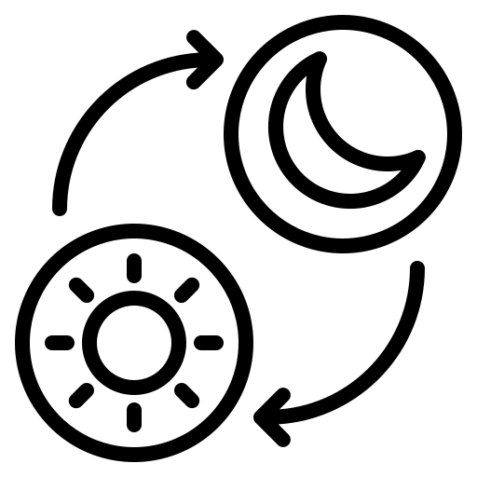


Year 10 - Advent 2 - Homework 3 The Creation of the World
1. Label the pictures and number them in order of what happens in Genesis 1. | 2. What does Saint Augustine believe Genesis 1 teaches us about God? 1. 2. 3. For each of the 3 now add a quote/example from the text which back this up. 1. 2. 3.

Slide 5
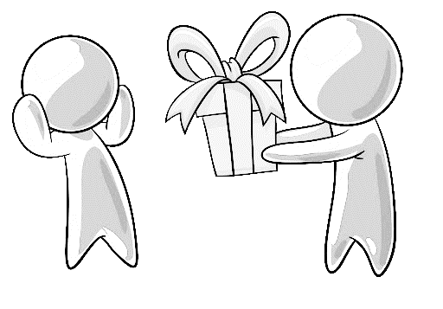
Year 10 - Advent 2 - Homework 4 Saint Augustine
What do each of these documents teach Christians about? Confessions De Trinitatae | 2. Who is Saint Augustine? What is another title given to Saint Augustine? ____________________________________________________ Where is he from? ____________________________________________________ When did he live? ____________________________________________________ Why is he important today? ________________________________________________________________________________________________________
2. Label the picture with both Saint Augustine's view on the Trinity and which person of the Trinity each part is.
 | 4. Use the picture in task 3 to explain what Saint Augutine believes about the Trinity. ________________________________________________________________________________________________________________________________________________________________________________________________________________________________________________________________________________________________________________________________________________________________________________________________________________________________________

Slide 6
Year 10 - Advent 2 - Homework 5 Genesis 1 and Genesis 2
1. Genesis 2 – Put the sentences in the correct order God breathed life into Adam's nostrils _____ God placed him in the garden of Eden _____ Adam named all the animals _____ Adam wanted a companion _____ God made Adam out of the dust _____ Eve and Adam became the first married couple _____ God made Eve out of Adam's rib _____ | 3. Complete the table – with at least 3 points on each side. Are Genesis 1 and Genesis 2 different creation stories, or a continuation of the same story? Why do you say this? _________________________________________________________________________________________________________________________________________________________________________________________________________________________________________________________________________
2. Answer the questions. What is Stewardship? __________________________________________________________________________________________________________ Where is stewardship shown in Genesis 2? __________________________________________________________________________________________________________ What does Genesis 2 tell us about God? ______________________________________________________________________________________________________________________________________________________________
Similarities between Genesis 1 and Genesis 2 | Differences between Genesis 1 and Genesis 2

Slide 7
Year 10 - Advent 2 - Homework 6 Catholic views on creation
1. Show how the Big Bang Theory and Genesis 1 can work together.
2. What does Pope John Paul II say about Science and Religion? _____________________________________________________________________________________________________________________________________________________________________________________________________________________________________________________________________________________________________________________________________________________________________________________________________________________________________________________________________________________________ | 3. Using task 1 and 2 explain the Catholic view on the creation of the world. _____________________________________________________________________________________________________________________________________________________________________________________________________________________________________________________________________________________________________________________________________________________________________________________________________________________________________________________________________________________________
Day 1 – Day and Night, Light and Dark
2. Elements are the first things created
Day 3 – Land and vegetation
4. Our sun is created

Slide 8
Year 10 Advent 2 – extra paper for any task you cannot fit into the activity box
Activity this links to: ___________________________
Activity this links to: ___________________________
________________________________________________________________________________________________________________________________________________________________________________________________________________________________________________________________________________________________________________________________________________________________________________________________________________________________________________________________________________________________________________________________________________________________________________________________________________________________________________________________________________________________________________________________________________________________________________________________________________________________________________________________________________________________
__________________________________________________________________________________________________________________________________________________________________________________________________________________________________________________________________________________________________________________________________________________________________________________________________________________________________________________________________________________________________________________________________________________________________________________________________________________________________________________________________________________________________________________________________________________________________________________________________________________________________________________________________________________________________________________

