Slide 1

Religious Studies Homework Booklet
Year 10 Advent 1
Name:
Class:
Teacher:
Homework Expectations:
You must keep this booklet neat and presentable
All homework must be completed for the date set
High effort is expected in all tasks
You will boost all work in red pen
Due on: | Checked by: | Due on: | Checked by:
Homework 1 |  | Homework 4
Homework 2 |  | Homework 5
Homework 3 |  | Homework 6

Slide 2
Year 10 - Advent 1 - Homework 1 God in Judaism
1. Define the characteristics of God. ​1. One 2. Creator 3. Judge 4. Lawgiver 5. Shekinah | 2. Which of the characteristics links with which bible verse? God saw how corrupt the earth had become, for all the people on earth had corrupted their ways. …I am surely going to destroy both them and the earth. By day the Lord went ahead of them in a pillar of cloud to guide them on their way and by night in a pillar of fire to give them light, so that they could travel by day or night.
3. The Shema. What is the Shema? When is it said? What does it teach about God? Why is the Shema important in Judaism? What is the first line of the Shema? | 4. Why did Maimonides create the 13 principles? Give three examples of them. _____________________________________________________________________________________________________________________________________________________________________________________________________________________________________________________________________________________________________________________________________________________________________________________________________________________________________________________________________________________________

Slide 3
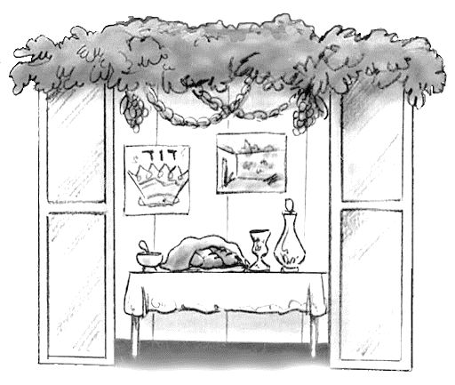
Year 10 - Advent 1 - Homework 2 Festival of Sukkot
​Label the Sukkah and explain the importance of each part. | 2. Complete the table about the Lulav. 3. State 3 things that happen during the festival and say why it is done.
Part of Lulav | Body part | Type of person
Myrtle | Eye – how you see life | Jews who perform mitzvot but no Torah knowledge

Slide 4
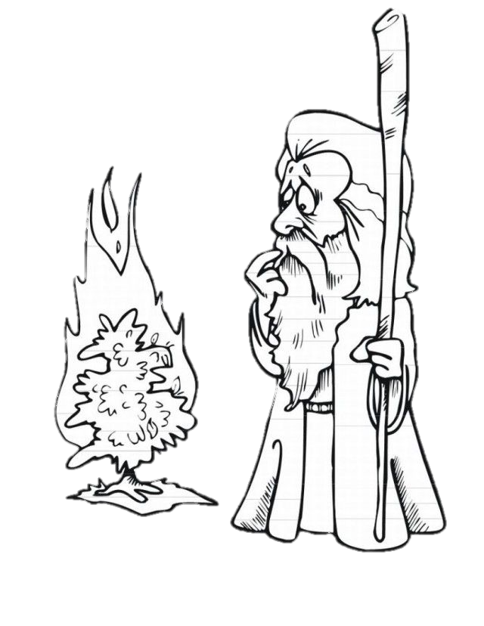
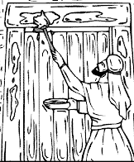
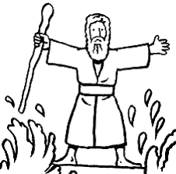
Year 10 - Advent 1 - Homework 3 The Origins of Pesach
 | 1. Answer the questions What is each image showing? 1.___________________________________________________2.___________________________________________________3.___________________________________________________ What is the covenant made in image 1? _____________________________________________________ Why is the action in image 2 so important? __________________________________________________________________________________________________________ Which Jewish characteristic of God helps the Israelites during image 3 and how is it seen by the people? __________________________________________________________________________________________________________Why is this story still important for Jewish people today? ____________________________________________________________________________________________________________________________________________________________________________________________________________________ _____________________________________________________
2
1
3

Slide 5
Year 10 - Advent 1 - Homework 4 Brit Milah
What is the role of each of these people/why are they needed? Sandek Mohel​ Minyan Baby Boy | 3. Answer the questions using the scripture. Who is speaking to whom in the scripture? _____________________________________________________ What is the sign of the covenant? __________________________________________________________________________________________________________ Who is to be circumcised? _____________________________________________________ Why is circumcision so important? __________________________________________________________________________________________________________ Give three reasons why some Jewish people will not agree with circumcision today. 1.________________________________________________________________________________________________________2.________________________________________________________________________________________________________3.________________________________________________________________________________________________________
2. ​Read the scripture. “This is my covenant with you and all your descendants: Every male among you must be circumcised. You must obey this covenant. Cut away the foreskin to show that you follow the covenant between me and you. From now on when a baby boy is eight days old, you will circumcise him. This includes any boy born among your people or any who is your slave. (He would not be one of your descendants.) So circumcise every baby boy. Circumcise him whether he is born in your family or bought as a slave. Your bodies will be marked. This will show that you are part of my covenant that lasts forever. Any male who is not circumcised will be separated from his people. He has broken my covenant.”

Slide 6
Year 10 - Advent 1 - Homework 5 Items worn in Worship
1. What are these three items – Why are they important to Jewish people ​ Kippah Tallit Tefillin | 2. Make links between the key words with explanation as to how they link.
3. Complete the table. ​ | 4. Use the table from section 3. Explain in no more than 6 sentences which side you agree with the most. ________________________________________________________________________________________________________________________________________________________________________________________________________________________________________________________________________________________________________________________________________________________________________________________________________________________________________
Talmud
Mitzvot
Tallit
Tefillin
Kippah
Jewish people need to wear these items to pray | Jewish people do not need to wear these items to pray

Slide 7
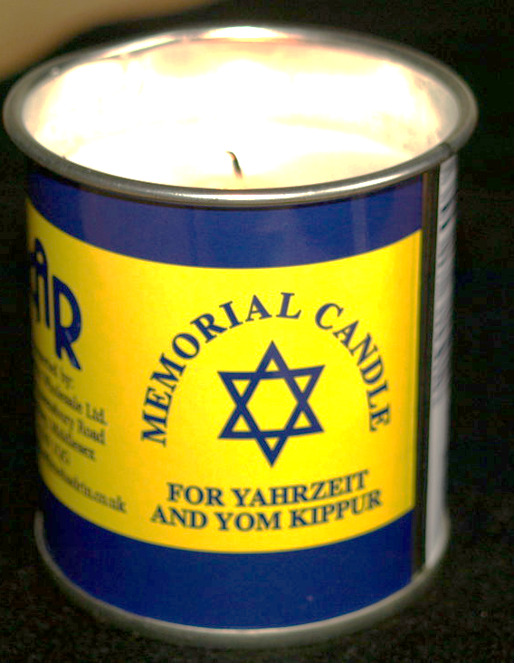
Year 10 - Advent 1 - Homework 6 Mourning Rituals
1. Use the words to fill in the timeline. Add in what the words/event means.
2. What type of candle is this and how does it link to death/the Jewish mourning rituals? _____________________________________ _____________________________________ _____________________________________ _____________________________________ _____________________________________ _____________________________________ __________________________________________________________________________________________________________ | 3. What do Jewish people not do during Sheloshim and why? _____________________________________________________________________________________________________________________________________________________________________________________________________________________________________________________________________________________________________________________________________________________________________________________________________________________________________________________________________________________________
Before death
1 year after death
Shiva, tombstone unveiling, Say the Shema, Onan, Burial, Chevra Kadisha, Sheloshim

Slide 8
Year 10 Advent 1 – extra paper for any task you cannot fit into the activity box
Activity this links to: ___________________________
Activity this links to: ___________________________
________________________________________________________________________________________________________________________________________________________________________________________________________________________________________________________________________________________________________________________________________________________________________________________________________________________________________________________________________________________________________________________________________________________________________________________________________________________________________________________________________________________________________________________________________________________________________________________________________________________________________________________________________________________________
__________________________________________________________________________________________________________________________________________________________________________________________________________________________________________________________________________________________________________________________________________________________________________________________________________________________________________________________________________________________________________________________________________________________________________________________________________________________________________________________________________________________________________________________________________________________________________________________________________________________________________________________________________________________________________________

