Slide 1
Weekly Homework Grids
YEAR 9 BOOKLET
Autumn Part 1
Name: _____________________________
Teacher: ____________________________
Room: ______________________________
Grid | Comment
1.1
1.2
1.3
1.4
1.5

Slide 2
How to complete the homework grids (Tasks 1-3)
1. Spelling Pupils will see two words: one spelled correctly, the other is a common way of misspelling it. They should circle or highlight the correct spelling. | 2. Grammar and punctuation This task will check pupils general knowledge of how to proof-read and correctly structure sentences. They might need to add missing capital letters and punctuation, or create sentences using key words. Tasks may also focus on securing grammatical terms. | 3. Vocabulary Pupils will be asked to find out the definition of a word. This word will be linked to the topic being studied in English. They can copy a definition from the dictionary or write it in their own words.
Example: School Skool | Key terms: A complex sentence has a major and minor clause or part. The minor clause won't make sense without the major clause. Although it was raining, Laura didn't put her hood up. A compound sentence is when two clauses are joined by a connective. These do make sense on their own. Laura brought her umbrella so she didn't need to wear her hood. | Example: As you can see from the example below, pupils must state the word type as well as the defintion: Education noun This means the process of receiving or giving systematic instruction, especially at a school or university, in order to learn.

Slide 3
How to complete the homework grids (Tasks 4-6)
4. Reading Comprehension Pupils will be required to read a passage from a text related to their English studies. They should read the passage then answer the question underneath it. | 5. Technique Pupils will be given a brief sentence or quote from a familiar text studied in class. The will need to work out what language technique has been used in the sentence/quote and write this in the space provided. The challenge task will require them to think about what is suggested by the technique and explain what it helps them to imagine or feel. (Please note: challenge tasks are NOT compulsory). | 6. Challenge This final homework task will require pupils to complete a random task aimed at stretching and challenging them. The tasks will be a selection of the following: Transformation – turn a piece of text into a simple image/turn an image into a description. Connections Map – make links between the given words and explain how they link. Triangle – rank order the given subject from best to worst, first to last, etc. Link to learning – identify the task that links to a previous English lesson and explain the link.
Key terms: Infer – this means to read between the lines and make sensible guesses based on the evidence in the text. Analyse – this means your child will need to work out the effect or impact of the writers' language choices. Listing – Pupils will need to select four key details from the text based on the question focus. | Example: The cat fell heavily onto the mat. What is this technique? adverb Challenge: what is the effect? The word heavily makes me imagine a very tired cat, who cannot walk any further. The fact that the cat fell, rather than sat or lay, suggests that it had no control over lowering its body, and the word heavily reinforces this lack of control.
Revising the Curriculum:
Pupils have 3 tasks that are closely linked to securing the knowledge from their Knowledge Books. Knowledge Book pages are specified to go with the task.

Slide 4
Year 9 English Weekly Homework Autumn 1.1
Spelling: prefix ‘in-’ The ‘in-’ prefix can be put in front of words to mean ‘not or without’ – equality becomes inequality. Add the prefix ‘in-’ to the below words. Beware, there are some words that you won’t be able to use it on: appropriate - accurate – legal – regular – important – decisive - direct | 2. Grammar and punctuation Add the apostrophe: The childs lunch is delicious; hes grateful to him parents for it. | 3. Vocabulary What is the meaning of this word? Marginalisation Definition ____________________________ __________________________________________________________________________ Does it have positive or negative connotations?___________________________________________________________________________________________________
4. Reading Comprehension What can you infer about the place and people from this extract? The sun was still red and large: the sky above cloudless, and light blue glaze poured over baking clay: but close over the ground a dirty grey haze hovered. As they followed the lane towards the sea they came to a place where, yesterday, a fair-sized spring had bubbled up by the roadside. Now it was dry. _________________________________________________________________________________________________________________________________________________________________________________________ | 5. Technique Holding a grudge is like holding a burning piece of coal. What is this technique? ____________ Challenge: what is the effect? ______________________________________________________________________________________________________________________________________________________________________________________________________________________________ | 6. Challenge Write a 4 sentence description of your first few weeks back to school: ____________________________________ ______________________________________________________________________________________________________________________________________________________________________________________________________________________________ _______________________________________________________________________________________________________________

Slide 5

Year 9 English Weekly Homework Autumn 1.1 Revising the curriculum
When you read Private Peaceful, you learned about the following themes: Family and Loyalty Loss Justice and Injustice Choose one of these themes and explain how it links to the story of Of Mice and Men so far. Give examples from the book to support your ideas and use your knowledge book to help you. Theme: ______________________________ This links to Of Mice and Men because... ______________________________________________________________________________________________________________________________________________________________________________________________________________________________________________________________________________________________________________________________ | When you were learning William Blake, you learned the following words. What do they mean? (Use Page 71 of your KB) | During your study of Grammar, you learned about compound sentences. Using the definition below and your knowledge book (p.3), try creating 3 of your own compound sentences.
WORD​ | Write a sentence using the word
Childhood​
Industrial​
Inequality​
Morality​
Poverty​
A compound sentence contains two main clauses (like two simple sentences). These are joined with a conjunction: and, but, so, because.
Miss Kelly was tired, so she bought a large coffee.
______________________________________________________________________________________________________________________________________________________________________________________________________________________________________________________________________________________________________________

Slide 6
Year 9 English Weekly Homework Autumn 1.2
1. Spelling What is a prefix? _______________________________________________________________________________________________________________ Circle the prefixes where they are being used: lifeless – unattended – disregard – thoughtless – inadequate – illegal | 2. Grammar and punctuation What is the function of a semi-colon? Look at the sentence below to help you explain: I have a big test tomorrow; I can't go out tonight. ________________________________________________________________________________________________________________________________ | 3. Vocabulary What is the meaning of this word? Patriarchy Type of word _______ Definition ____________________________ __________________________________________________________________________
4. Reading Comprehension Suddenly she saw the house, tucked away behind the trees almost in the shadow of the hill. It was a bare earth house in the traditional style; brown mud walls, a few glassless windows, with a knee-height wall around the yard. List four things that you learn about the house: 1____________________________________2____________________________________3____________________________________4____________________________________ | 5. Technique Life is a rollercoaster. What is this technique? ____________ Challenge: what is the effect? ______________________________________________________________________________________________________________________________________________________________________________________________________________________________ | 6. Challenge: Find an article about work/working conditions. Write the title and summarise what the article was about: Title: _________________________________ ______________________________________________________________________________________________________________________________________________________________________________________________________________________________

Slide 7

Year 9 English Weekly Homework Autumn 1.2 Revising the curriculum
When you studied texts in the Life, Labour and Loss unit, you learned the following words. Look up what they mean and se them in a sentence? (Use Page 72 of your KB) | When you studied texts in the Life, Labour and Loss unit, you learned the words from the previous task. Choose two words and explain how they link to your reading of 'Of Mice and Men' so far (page 19 and 20 of your KB). Word: ___________________________ _______________________________________________________________________________________________________________________________________________________________ Word: ___________________________ _______________________________________________________________________________________________________________________________ | During your study of Grammar, you learned about simple sentences. Using the definition below and your knowledge book (p.3), try creating 3 of your own compound sentences.
WORD​​ | Write a sentence using the word​
Exploitation | ​
Despair | ​
Control | ​
Despondent | ​
Desperation | ​
A simple sentence is a complete piece of information. It contains a subject, a verb
The pen fell on the floor.
______________________________________________________________________________________________________________________________________________________________________________________________________________________________________________________________________________________________________________

Slide 8
Year 9 English Weekly Homework Autumn 1.3
1. Spelling Correct the following misspelt words: marginilised: _________________ seemile: ____________________ metaphore: __________________ Choose two of the words to use in a sentence: __________________________________________________________________ __________________________________________________________________ | 2. Grammar and punctuation Move the subordinate clause to the start of the sentence: He cooked whilst she made the salad. __________________________________________________________________________ She was happy because he was here. __________________________________________________________________________ | 3. Vocabulary What is the meaning of this word? Inequality Type of word _______ Definition ____________________________ __________________________________________________________________________
4. Reading Comprehension He was a rich man: banker, merchant, manufacturer, and what not. A big, loud man, with a stare, and a metallic laugh. A man made out of a coarse material, which seemed to have been stretched to make so much of him. Hard Times by Dickens What do you think the phrase ‘metallic laugh’ suggests about the man and his interests? _________________________________________________________________________________________________________________________________________________________________________________________ | 5. Technique They were too far west here, too close to the Kalahari Desert, and her unease increased. What is this technique? ____________ Challenge: what is the effect? ______________________________________________________________________________________________________________________________________________________________________________________________________________________________ | 6. Challenge: Transform the technique ‘anaphora’ into an image: Define: _________________________________________________________________________________________________________________________________________________________________________________________

Slide 9

Year 9 English Weekly Homework Autumn 1.3 Revising the curriculum
When you studied Shakespeare's Histories , you learned the following words. What do they mean? (Use Page 77 of your KB) | When you studied Shakespeare's Histories, you learned the words from the previous task. Choose two words and explain how they link to a character or characters from 'Of Mice and Men' so far (page 27 of your KB). Word: ___________________________ ________________________________________________________________________________________________________________________________________________________________ Word: ___________________________ ________________________________________________________________________________________________________________________________________________________________ | During your study of Grammar, you learned about simple sentences. Using the definition below and your knowledge book (p.3), try creating 3 of your own compound sentences. Whilst it was raining, Mr Thornhill enjoyed a cup of tea in his office.​ ________________________________________________________________________________________________________________________________________________________________________________________________________________________________________________________________
WORD​​ | Write a sentence using the word​
Misogyny | ​
Hierarchy | ​
Patriarchy | ​
Expectations | ​
Authority | ​
A complex sentence contains a main clause and a subordinate clause.

Slide 10
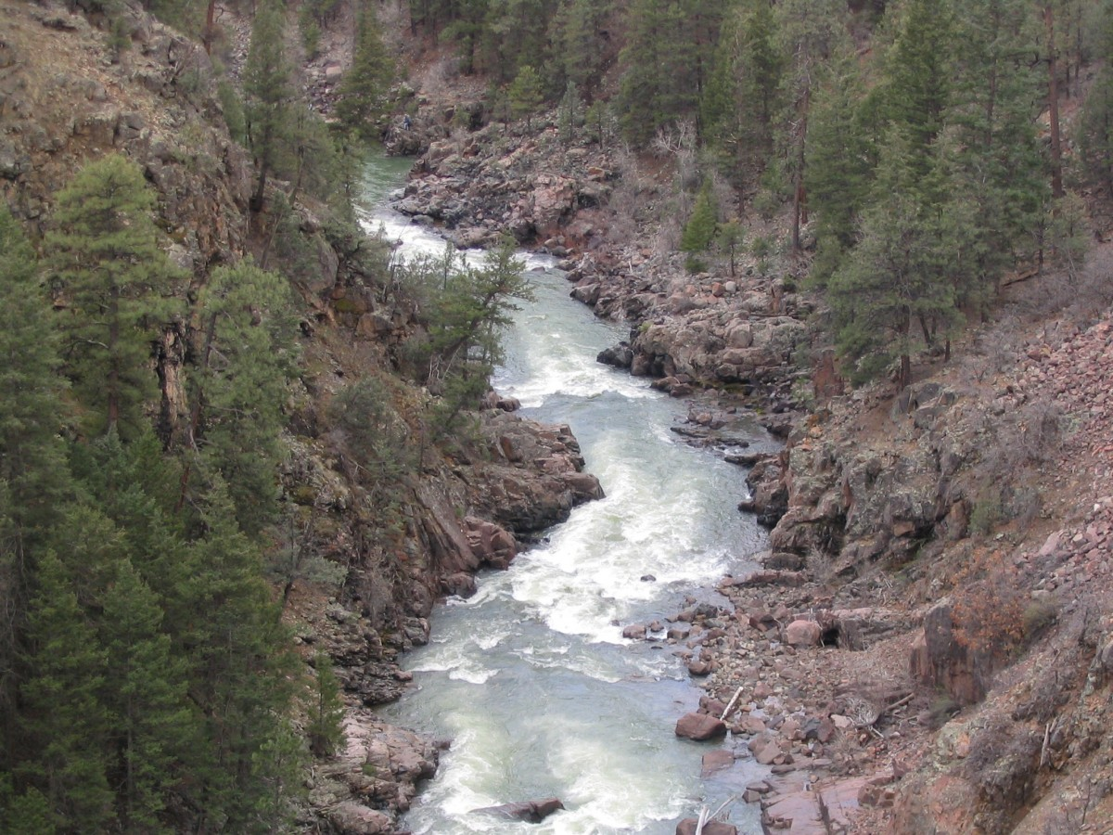
Year 9 English Weekly Homework Autumn 1.4
1. Spelling Suffixes are a letter or group of letters added to the ending of words to change their meaning or function. Circle the suffixes used in the following words: teacher – kindness – hopeless – bravely – grateful – backward | 2. Grammar and punctuation Turn the following sentences into a compound sentences: English is fun. __________________________________________________________________________ Peter thought he was late. __________________________________________________________________________ | 3. Vocabulary What is the meaning of this word? Novella Type of word _______ Definition ____________________________ __________________________________________________________________________
4. Reading Comprehension The room where I found myself was thick with dust, musty and empty of all furniture. Spiders had erected great stretchings of their web about the fireplace. It was a dark morning and the weather had stained the windows with blears of grey wash which kept the brightest part of the weak light from coming in. The far corner of the room was a blur of shadow. I had a sudden urge to have done with my task and be out of this house forever. Choose four words or phrases that suggest to you that there is something mysterious about the room. 1____________________________________2____________________________________3____________________________________4____________________________________ | 5. Technique Improve the following sentence by adding a linguistic technique: The park was busy. __________________________________________________________________________ What technique have you used? __________ Challenge: what effect did you want to create? _______________________________________________________________________________________________________________ | 6. Challenge Transform this image into a short description: __________________________________________________________________________ ______________________________________________________________________________________________________________________________________________________________________________________________________________________________ __________________________________________________________________________(You can write a full version for We Are Writers)

Slide 11
Year 9 English Weekly Homework Autumn 1.4 Revising the curriculum
When you studied the Pride Not Prejudice module in Year 8, you learned the following words. What do they mean? (Use Page 75 of your KB) | When you were reading Gothic literature in Year 8, you studied narrative structures. In your own words, summarise what each stage of a story does (page 14 of your KB) Exposition: ___________________________ _______________________________________________________________________________________________________________ Climax: ______________________________ _______________________________________________________________________________________________________________ Resolution : _________________________ _______________________________________________________________________________________________________________ | Think of your reading of Chapters 1 and 2 of ‘Of Mice and Men’ (page 18 and pages 21 and 22 of your KB). How do these chapters work as the exposition stage of a narrative? _______________________________________________________________________________________________________________ _______________________________________________________________________________________________________________ Why is the exposition important in novels? _______________________________________________________________________________________________________________ _______________________________________________________________________________________________________________
WORD​​ | Write a sentence using the word​
Morality | ​
Stereotypes | ​
Society’s norms | ​
Region | ​
Nationality | ​

Slide 12
Year 9 English Weekly Homework Autumn 1.5
1. Spelling Can you explain the meaning created by the following suffixes: -less as in lifeless: __________________ _________________________________ -ness as in hopelessness: ______________ ___________________________________ -er as in dancer: ______________________ ____________________________________ | 2. Grammar and punctuation Add the missing commas: Mrs Lee the Headteacher of Springfield Primary School was proud of her school. The students were hard-working punctual well-behaved and interested in their lessons. The classrooms were well-equipped with modern furniture new textbooks computers and interactive whiteboards. Moreover when she walked round on her daily inspection she knew that she would be welcomed into the classrooms by every teacher in the school. | 3. Vocabulary What is the meaning of this word? Misogyny Type of word _______ Definition ____________________________ __________________________________________________________________________
4. Reading Comprehension. Compare the differences between the two places described: _______________________________________________________________________________________________________________________________________________________________________________________________________________________________________________________________________________________________________________________________________________________________________________________ |  | 5. Challenge Describe your city: _______________________________________________________________________________________________________________________________________________________________________________________________________________________________________________________________________________________________________________________________________________________________________ (You can write a full version for We Are Writers)
A: The villa was small and square, standing in its tiny garden with an air of pink-faced determination. Its shutters had been faded by the sun to a delicate creamy-green, cracked and bubbled in places. The garden, surrounded by tall fuschia hedges, had the flower beds worked in complicated geometrical patterns, marked with smooth white stones.
B: It was a town of red brick, or of brick that would have been red if the smoke and ashes had allowed it; it was a town of unnatural red and black like the painted face of a savage. It was a town of machinery and tall chimneys, out of which interminable serpents of smoke trailed themselves for ever and ever, and never got uncoiled. It had a black canal in it, and a river that ran purple with ill-smelling dye, and vast piles of building full of windows where there was a rattling and a trembling all day long.

Slide 13

Year 9 English Weekly Homework Autumn 1.5 Revising the curriculum
Whilst you have been reading ‘Of Mice and Men’ you have explored a range of themes (page 19 of your KB). Can you link these themes to specific characters? _______________________________________________________________________________________________________________ _______________________________________________________________________________________________________________ _______________________________________________________________________________________________________________ _______________________________________________________________________________________________________________ | Themes are universal ideas that reappear throughout literature. Think back to texts you have read throughout Year 7 and 8. Looking at the vocabulary pages at the end of your Knowledge book. Can you think of texts from Year 7 and 8 that cover the same themes as ‘Of Mice and Men’. _______________________________________________________________________________________________________________ _______________________________________________________________________________________________________________ _______________________________________________________________________________________________________________ _______________________________________________________________________________________________________________ | During your study of grammar, you have looked at different sentence types (page 3). Look at the answer you have written for task 5 – a description of the city. Now, re-draft and expand your description by adding each sentence type. Highlight and label. ________________________________________________________________________________________________________________________________________________________________________________________________________________________________________________________________________________________________________________________________________________________________________________________________________________________________________________________________________________________________________________________________________________________________________________________________________________

